Slide 1
Gold Team – Software Architecture
Presented by Casey Boatman & Justin andras, Gold Team software architects

Slide 2
Presentation Summary
Product Concept
Access and Functionality
Basic page layout
Er diagram
Code overview
Example class diagrams

Slide 3
Product Concept – AAU Web Portal
What is it?
A website interface for Students, Professors, and Faculty at AAU
AAU stands for ‘Above Average University’ – our client
Functionality changes based on who you are
Simple, intuitive design patterns
A platform for further expansion and development

Slide 4
Access and Functionality
Users can be:
Students (Undergrad or Graduate)
Professors
Department Heads (extension of Professor)
…Or just visitors
Each has their own functionality

Slide 5

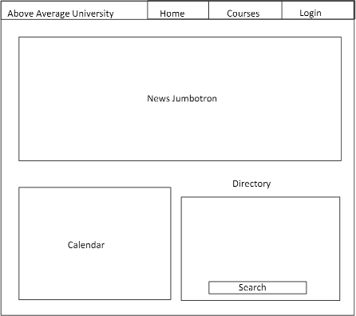
base page

Slide 6
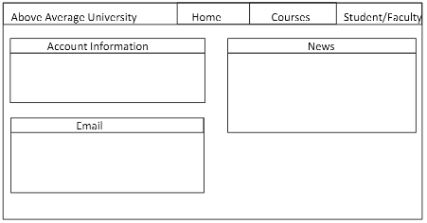
Landing page after login

Slide 7
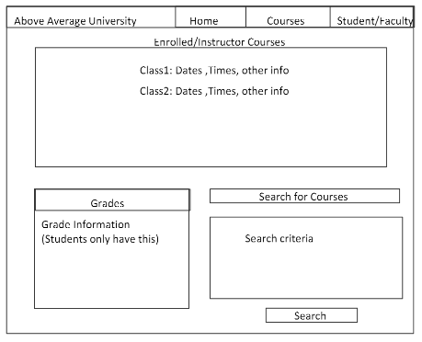
Courses page

Slide 8
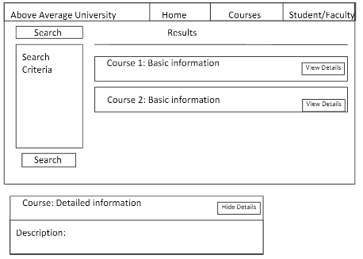
Course search page

Slide 9
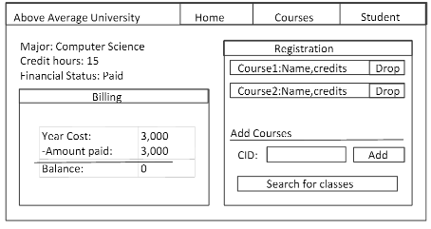
Student page

Slide 10
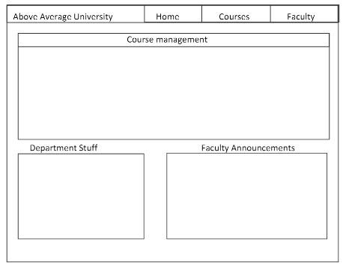
faculty page

Slide 11
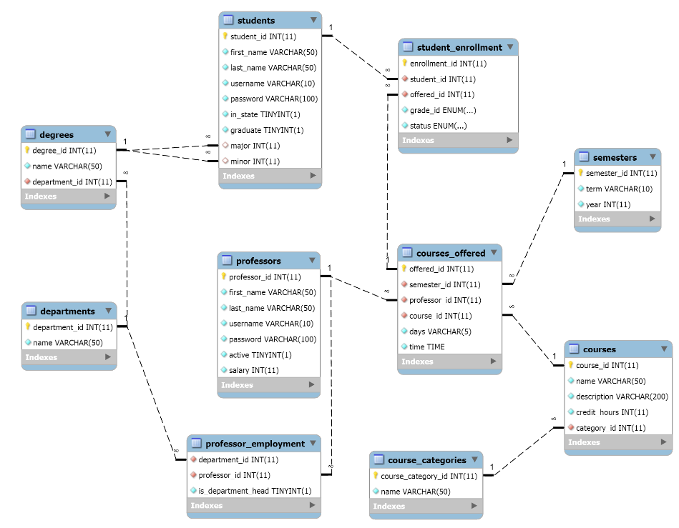
Notes:
User the mysql workbench to generate an ER diagram based off of our data

Slide 12
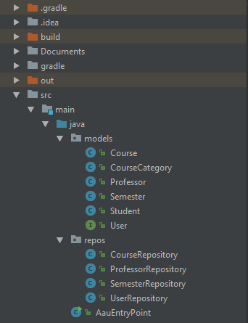
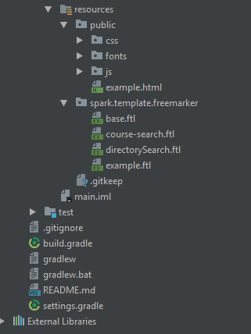
Notes:
Mention that we are using Gradle. Could have used Maven, but Gradle Gives us incremental builds (Built-in tasks, like JavaCompile) declare a set of inputs (Java source files) and a set of outputs (class files). Gradle uses this information to determine if a task is up-to-date and needs to perform any work. If none of the inputs or outputs have changed, Gradle can skip that task. Maven doesn’t do this.

Slide 13

Minimal configuration
Built for productivity
Full advantage of the jvm
Notes:
Spark Framework is a simple and lightweight. Less verbose than most applications written in other Java web frameworks. Spark focuses on being as simple and straight-forward as possible, without the need for cumbersome (XML) configuration, to enable very fast web application development in pure Java with minimal effort.

Slide 14
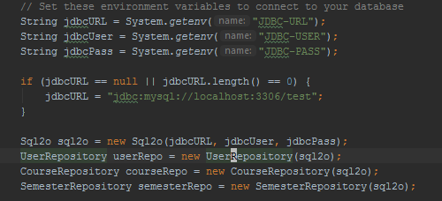

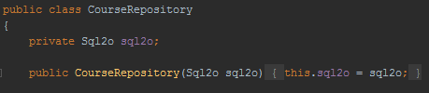

Entry Point
Repositories
Notes:
Sql2o allows us to have an easy interface for translating query results into our model classes.
-Automatic column to property mapping by name. (Case sensitive or case-insensitive, you choose.)
-Possibility to add custom column mappings if desired.
-Named parameters.
-Allows chaining of method calls
-Singleton example. The Sql20 is based in the entry point and is passed into the repositories.

Slide 15
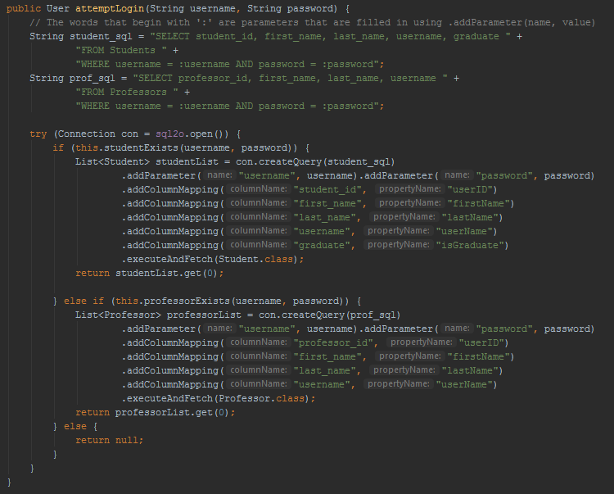
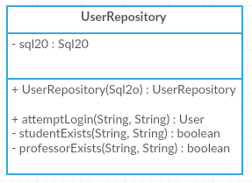
Notes:
User Repository. Maps the DB values to the appropriate property for the user object using the Sql2o object. Good example of an Abstract factory. Can give back a professor or a student. Either way, it’s a user. Here is the column mapping I was talking about.

Slide 16
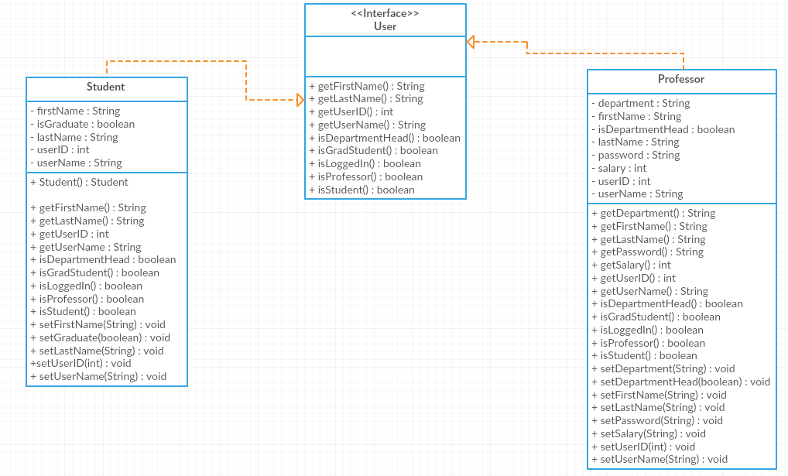
UML class diagram
Notes:
This is UML for the model classes. So User, Professor, Student, Course, etc.

Slide 17

Apache FreeMarker is a template engine: a Java library to generate text output (such as our HTML)based on templates and changing data
FreeMarker is designed to be practical for the generation of HTML Web pages, particularly by servlet-based applications following the Model View Controller pattern
We were able to separate the HTML designers from the back end programming.
Notes:
Designers could change the appearance of a page without the programmers having to change or recompile the code. This is because the application logic and the page design are separated. Although FreeMarker has some programming capabilities, it is not a full-blown programming language like PHP. Instead, Java programs prepare the data to be displayed (like issue SQL queries), and FreeMarker just generates textual pages that display the prepared data using templates.

Slide 18

library to serialize JSON so we can send data to and from the client using JavaScript
Flexible, simple and easy to use by reusing Map and List interfaces
No dependency on external libraries

Slide 19
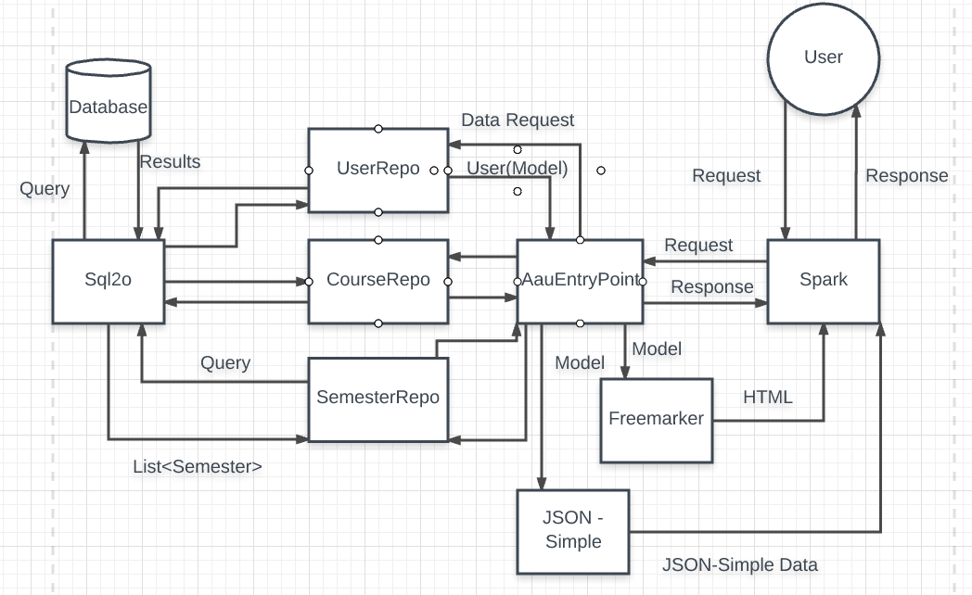

Slide 20
Comments / Questions?

