Slide 1
University Portal Tool
Above Average University

Slide 2

Project Management Presentation
Based on the
Software Project Management Plan

Slide 3
Project Summary
Purpose, Scope, Objectives
Faculty Needs
Project Deliverables
Software Deliverables
Team and Client
Assumptions and Constraints
Student Needs
Team and Client
Document Deliverables

Slide 4
Initial Project Schedule
Project Milestone | Project Artifact | Due Date
Project Start |  | February 2017
Finish Initial Documentation | SPMP, SVVP, SQAP, SCMP | February 2017
Initial Product Release | Phase 1 product, SRS | March 2017
Phase 2 Product Release | Phase 2 product | April 2017
Final Product Release | Phase 3 final product | May 2017

Slide 5
Project Organization
External Structure
AAU is the client
Prof. Ruijian Zhang is contact
Emails and Meetings

Slide 6
Organization Continued
Customer
Project Manager
Software Architect
Testing Engineer
Integration Engineer
Requirements Engineer
Internal Structure

Slide 7
Roles and Responsibilities
Project Manager
SPMP
Software Architect
SDD
Requirements Engineer
SRS
UM
Phil Parker
Casey Boatman
Ryan Peters
Justin Andres
Testing Engineer
SQAP
Integration Engineer
SCMP
SVVP
STP
Code Developer
Code Base
Josh Potrawski
Aaron Tonkovich
Whole Team
Jon Nowak
Jacob Hertl

Slide 8
Project Start-UP plan
Staffing
Resource
Hardware
Software
Other
Estimation

Slide 9
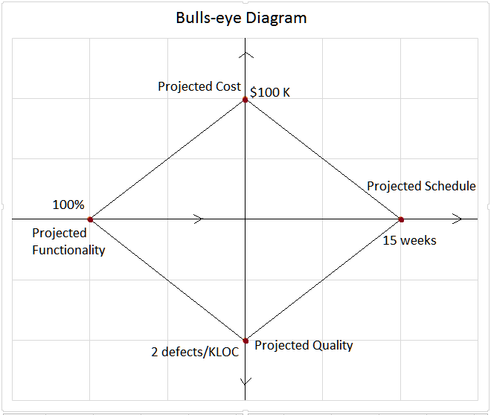

Slide 10
Work Plan
Work Activities
Schedule
Resource Allocation

Slide 11
Control Plan
Requirements
Schedule
Quality
Reporting

Slide 12
Risk Management plan
PM Responsibility
Identify, Analyze, Prioritize
Contingency
Implemented Through Team

Slide 13
Risk Management Flow Sample
No | Title | Likelihood of occurrence | Estimated Impact | Estimated Cost to Manage | Priority Rating | Retirement Plan | Responsible Persons | Completion Date
1 | Member drops class | 1 | 9 | 5 | 100 | Conquest | PM | 4/7
2 | Requirements change | 3 | 8 | 7 | 168 | Conquest | SA | 3/24
3 | SPARK creates challenges | 7 | 7 | 2 | 32 | Conquest | RE / IE | 4/29

Slide 14
Technical process model
Process Model
Methods, Tools Techniques
Infrastructure Plan
Product Acceptance Plan

Slide 15
Language Decision
Factor | Weight | C# Benefits | Java Benefits
Internet Friendly | 8 | 7 | 8
Team Familiarity | 10 | 3 | 10
Compilation Speed | 1 | 5 | 5
Runtime on Processor | 3 | 6 | 4
Core Functionality | 6 | 7 | 4
Ease of use | 8 | 6 | 5
TOTAL |  | 199 | 235

