Slide 1
Gold Team – Software Requirements Specification
Presented by Ryan Peters, Gold Team RE

Slide 2
Presentation Summary
Product Description and Overview
Product Concept
Use Case Diagram
Product Requirements and Features
Examples of Requirements
Course Search
Calendar

Slide 3
Product Concept – AAU Web Portal
What is it?
A website interface for Students, Professors, and Faculty at AAU
AAU stands for ‘Above Average University’ – our client
Functionality changes based on who you are
Simple, intuitive design patterns
A platform for further expansion and development

Slide 4
Access and Functionality
Users can be:
Students (Undergrad or Graduate)
Professors
Department Heads (extension of Professor)
…Or just visitors
Each has their own functionality

Slide 5

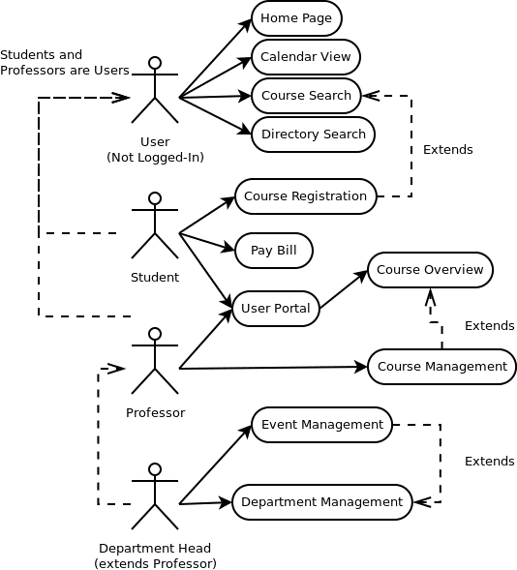
Use Case Diagram
Each use case corresponds to a “page” of functionality

Slide 6
Requirement Necessity
Essential (Product Foundation)
Home Page
Course Search
Course Registration
Directory Search
Department View
User Portal
Pay Bill
Course Overview
Department Management
Desired
Calendar View
Event Management
Optional
Course Management (incl. file uploads)
Graduate student projects

Slide 7
Requirements Organization
Requirements have three categories:
Pages
Define user-facing functionality visually
APIs
Define methods for interfacing with the back-end
What data is expected from the client/server during communication
Data Entities
Defines the data used in the above
Described in a high-level schema that is applicable for classes or tables

Slide 8
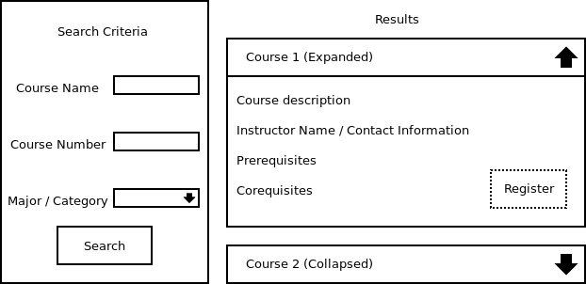
Course Search Page – Example
Search criteria appears on left
Dynamic course list appears on right using JavaScript
Courses are “accordion-style” and expand when selected
“Register” button appears if the user is a Student-type account

Slide 9
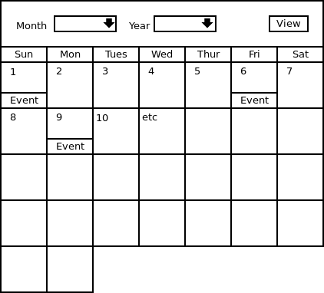
Calendar Page – Example
Month and year appear as drop-down boxes
Clicking “view” acquires server data for events for the selected month
Calendar is re-rendered with events displayed in each date box

Slide 10
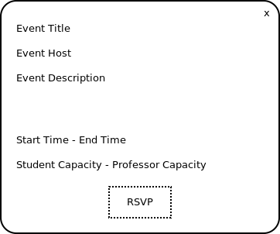
Calendar Page – Modal Dialog Example
Dialog appears over page
Background dims and dialog takes focus
RSVP button only appears if the user is a Student or Professor-type account

Slide 11
Calendar Event API Endpoint – Example
API URL: ~/api/calendar
Description: Queries all events for the month specified
Required Fields:
Selected Month
Selected Year
Returns:
List of objects detailing Calendar Events taking place in that month
Defined in Calendar Month Data Entity requirements

Slide 12
Calendar Event Data Entity – Example
Entity Fields:
Date of event
Time of event
Duration (or end-time)
Current & Max attendance (for each applicable user type)
Title & Description
Event host (Department Head)

Slide 13
Comments / Questions?
Thank you for attending!

