Slide 1

Introduction to

Slide 2
Welcome!
What is R?
A free language for statistics and data visualization
Extensive community of users and developers (especially in the sciences)
Goals for this module:
Become independent and comfortable with some of the basics of using R to analyze and visualize data
Schedule:
Day 1: bringing in data, manipulating data
Homework: practice using R with swirl
Day 2: descriptive stats in R, visualizing data

Slide 3
Pre-homework questions
Think-Pair-Share with a partner:
What questions do you have about R?
What questions do you have about RStudio?
Why is a coding language useful in modern science?
While partners are discussing an instructor will visit you to confirm that R is running properly on your computer.

Slide 4
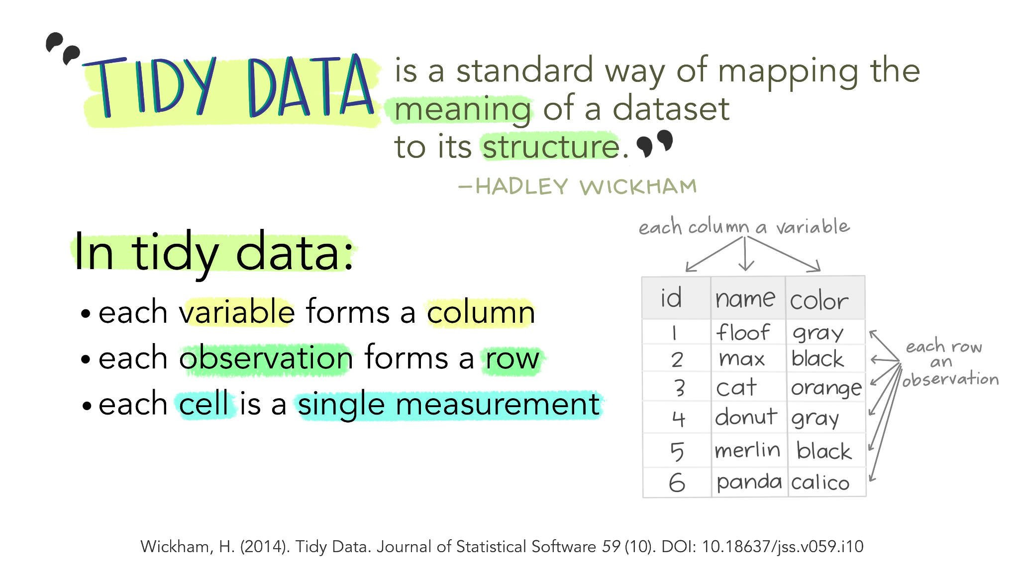
Important concepts
Reproducibility
Data organization and structure
Storage and file structure
Code organization and format
Hardware and software management

Slide 5








Day 1
Important steps for setting up an R script
Fundamentals of R
Data entry and manipulation
Homework

Slide 6
Challenge 1
In a single line of code add the values in object1 and store them in a new object named “challenge”.
Challenger answer:
challenge <- sum(object1)

Slide 7
Day 2
Homework feedback and discussion
Basic statistics in R
Communication in science
Creating figures in R
Play around with different metadata and graph types
Final Project

Slide 8
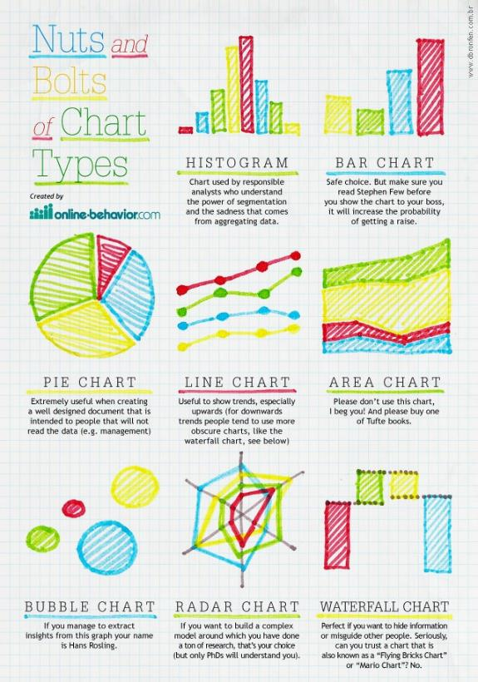
Communication in science
Figures are key to communicating data
Different types of data call for different types of figures
Reflect and share:
Can you think of a visualization of data that was helpful to you?
What features made it helpful?

Slide 9
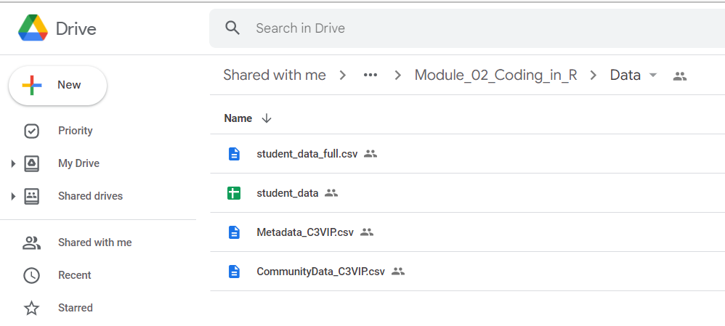
Let’s collect some data!
C3 Student folder > Module 02 > Spreadsheet name
https://docs.google.com/spreadsheets/d/1B5J000VAEiW7CV-2d-jSC-GeQKaj5OkX/edit?usp=drive_web&ouid=110211144865065713642&rtpof=true

Slide 10
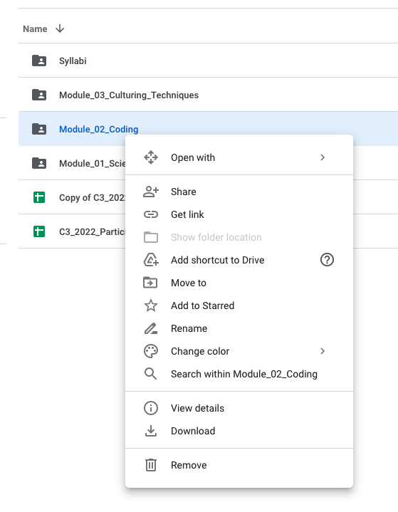
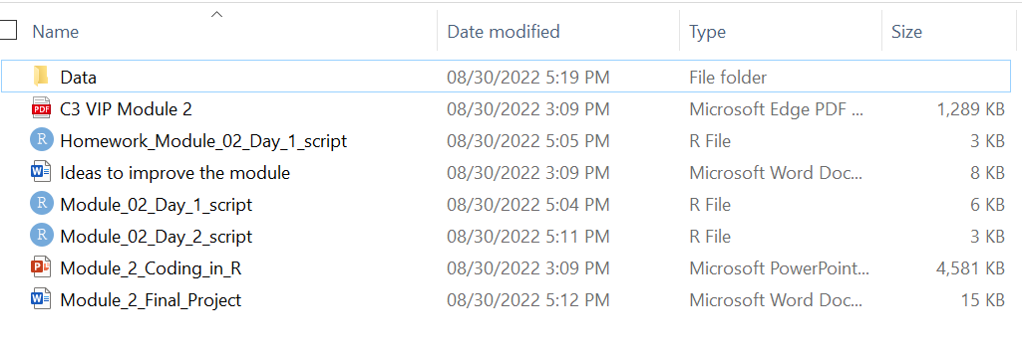
Getting started
Download entire Module_02_Coding_in_R folder from Google drive
Unzip and put on your desktop
Change data we collected to a .csv
Click on Module_02_Day_1_script to open in Rstudio

Slide 11
Homework feedback
How did swirl work for you?
Do you have any questions after using swirl?
Was this a helpful way to learn R?

Slide 12
Final Project
Assigned graph and variable
Make graph, save as SVG
Upload graph on jamboard
Write brief description
View other graphs and write a comment

Slide 13
Wrap Up – Questions about R
Reflect on what you have learned in this module
What questions do you still have about R and using R?
What applications do you see for R in science?

