Slide 1
Microbial Community Ecology using amplicon sequencing
Day 2
Goals:
Normalize a set of microbial community data
Measure and visualize alpha and beta diversity
Identify a member of your microbial community
Presentations

Slide 2
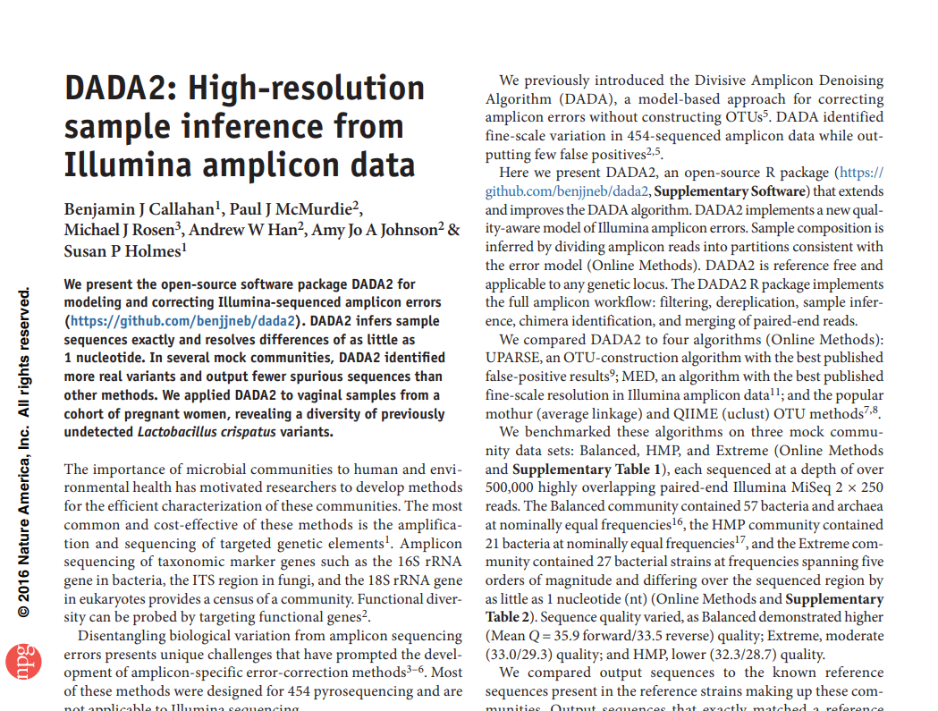

Slide 3
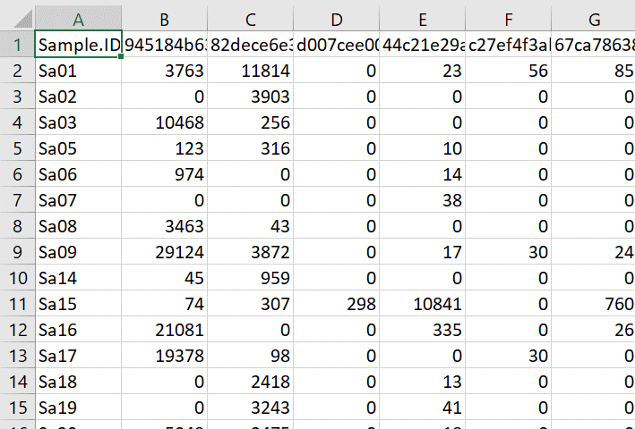
Community data structure
Data
Samples
ASVs
Richness, Abundance

Slide 4
Presentations
Draw conclusions from the work your group has done
What pitcher plant species has the most diverse communities?
Are some pitcher communities more similar to each other than others?
Is there a species that you can identify that is interesting?
Choose the conclusion that you feel strongest about and make a slide about it including a figure
Present your findings in front of the class

Slide 5
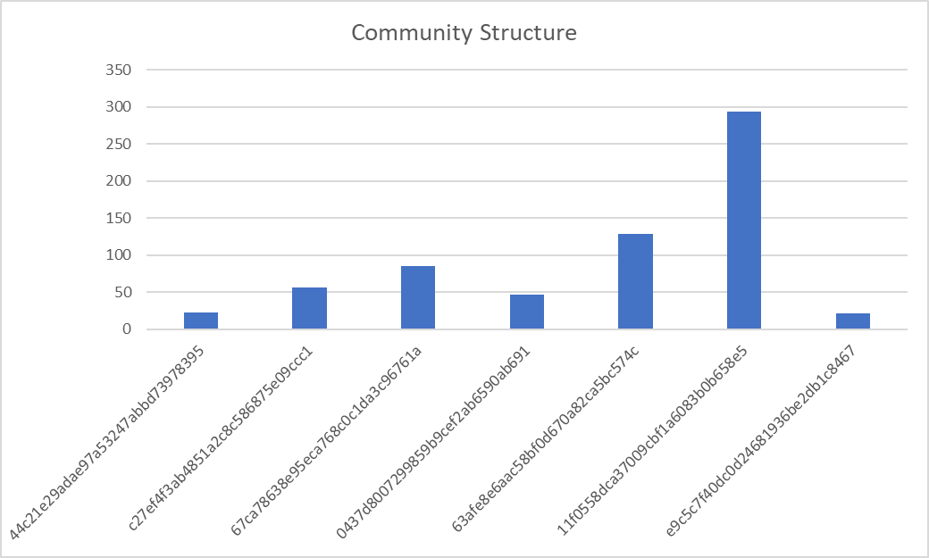
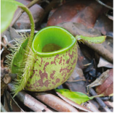
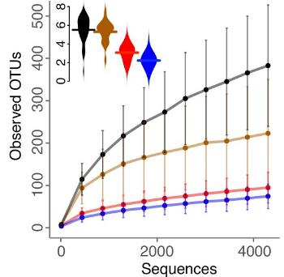
Workflow
Analysis
Create ASVs
DADA2 produces amplicon sequence variants
ASVs are unique sequences in the sample
Previous technology produced operational taxonomic units (OTUs)
These are a proxy for species and their abundance is relative
Extract Community
Normalize Data
PCR
Amplicon
sequencing

Slide 6
Normalize Data
Community 1
DNA abundance data is relative to the sample and non-comparable across samples
Normalizing data makes it comparable
Rarefying randomly samples the community equal to a specified abundance
The result is a set of communities with the same abundance distributed similarly to their original proportions
normalize
Community 2

Slide 7
Workflow
Analysis
Create ASVs
DADA2 produces amplicon sequence variants
ASVs are unique sequences in the sample
Previous technology produced operational taxonomic units (OTUs)
These are a proxy for species and their abundance is relative
Extract Community
Normalize Data
PCR
Amplicon
sequencing

Slide 8
Alpha diversity
Diversity within single communities
Multiple ways to measure
Shannon-Weaver index: uses the proportion of each species in the sample
Use a generalized linear model (GLM) to measure impact of different factors on alpha diversity
Alpha diversity

Slide 9
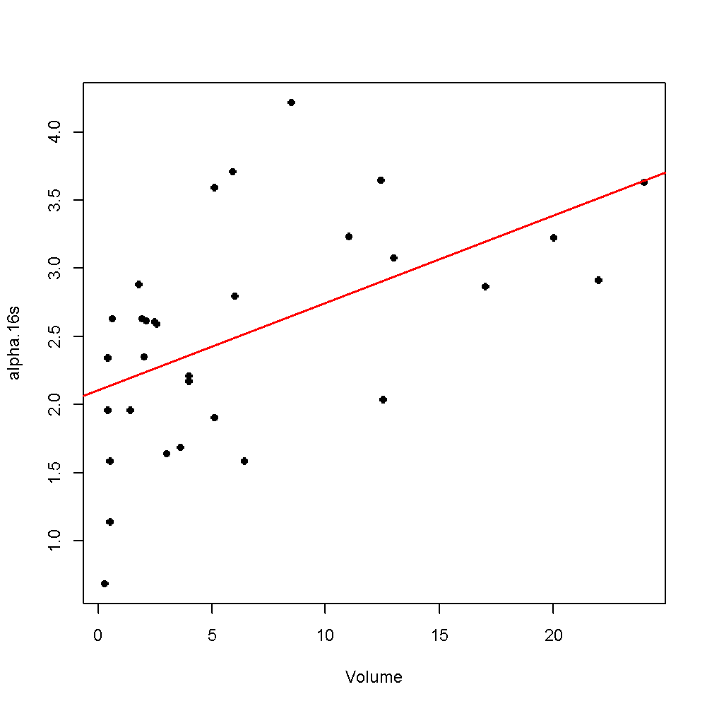
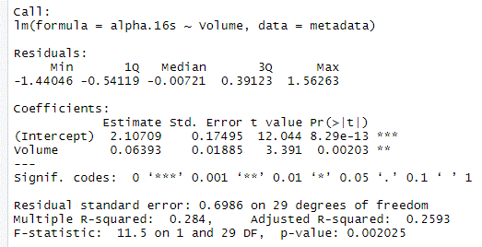
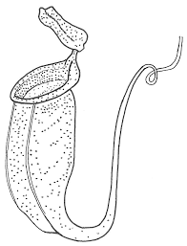
Modeling alpha diversity
Alpha diversity
factor tested
significance
Pitcher Volume

Slide 10
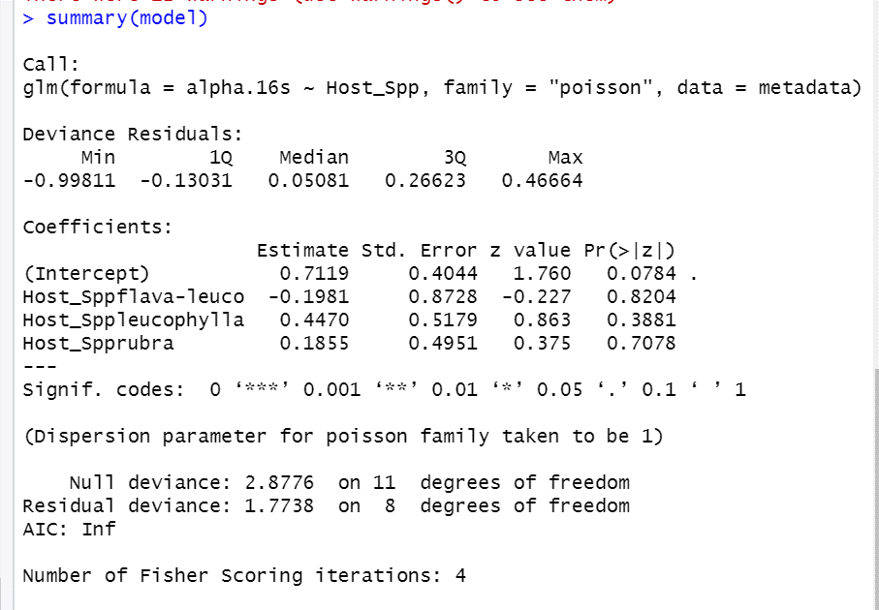
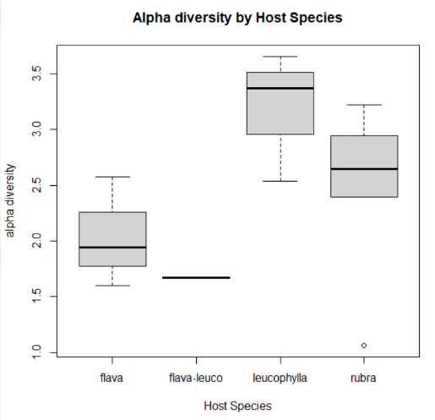
Modeling alpha diversity - categorical
factor tested
significance

Slide 11
Beta diversity
Similarity of communities based on structure
Multiple ways to measure
Bray-Curtis dissimilarity index: compares species richness and abundance
Use PERMANOVA to model impact of factors on dissimilarity
Visualize similarity of communities using nonmetric multidimensional scaling (NMDS)

Slide 12
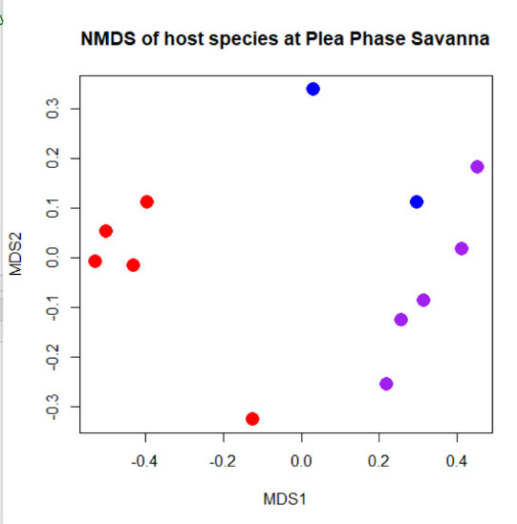
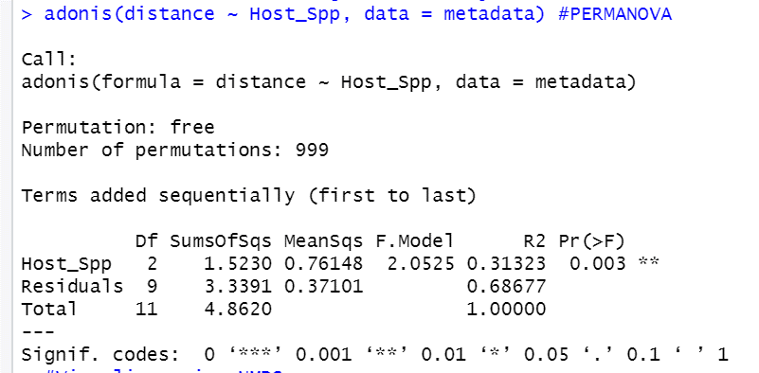
Modeling Beta Diversity
factor tested
significance
Legend
Red = flava
Blue = flava-rosea
Purple = rosea

Slide 13
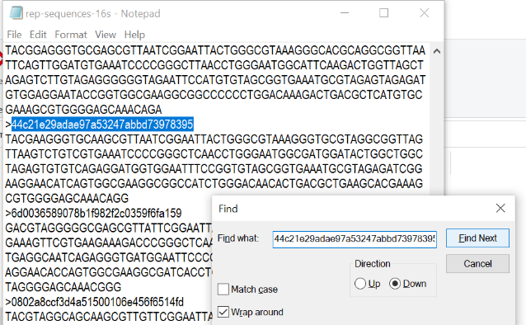
Identify a community member
ASV_counts <- colSums(data.r)
names(ASV_counts[ASV_counts == max(ASV_counts)])
[1] "44c21e29adae97a53247abbd73978395"

Slide 14
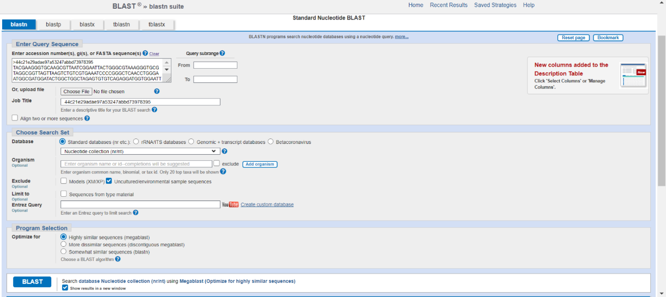
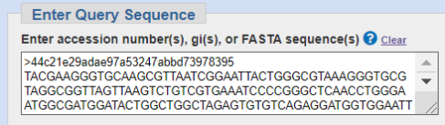
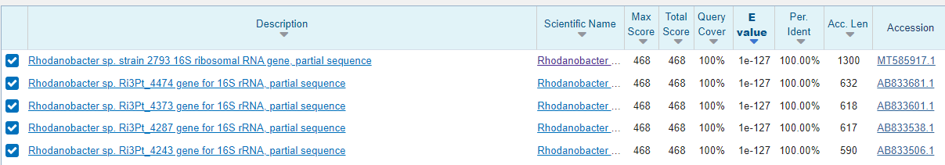
BLAST the sequence
Results

Slide 15
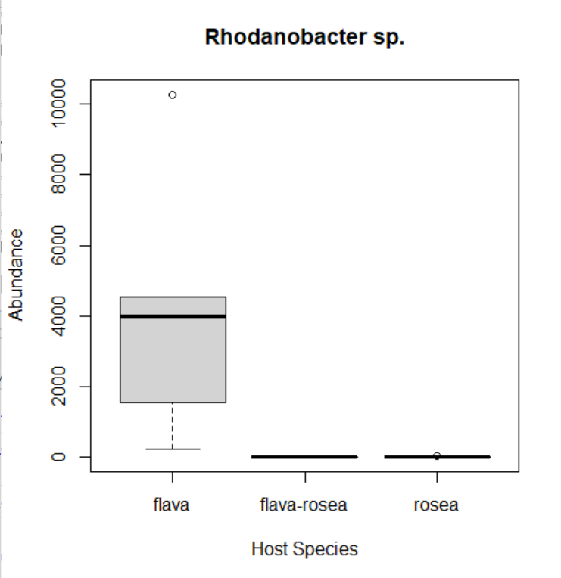
Visualize

Slide 16
Presentations
Draw conclusions from the work your group has done
What pitcher plant species has the most diverse communities?
Are some pitcher communities more similar to each other than others?
Is there a species that you can identify that is interesting?
Choose the conclusion that you feel strongest about and make a slide about it including a figure
Present your findings in front of the class

