Slide 1
Demo case solution
By
Jacob Fardrup Hennecke

Slide 2
Initial thoughts
Decisions
Monolithic design
Microservice
Detached datasource
Multi origin
Event driven design
Domain driven design
Serverless
RESTful
Sqlite
Monolithic design
Static datasource
Domain driven design
RESTful

Slide 3
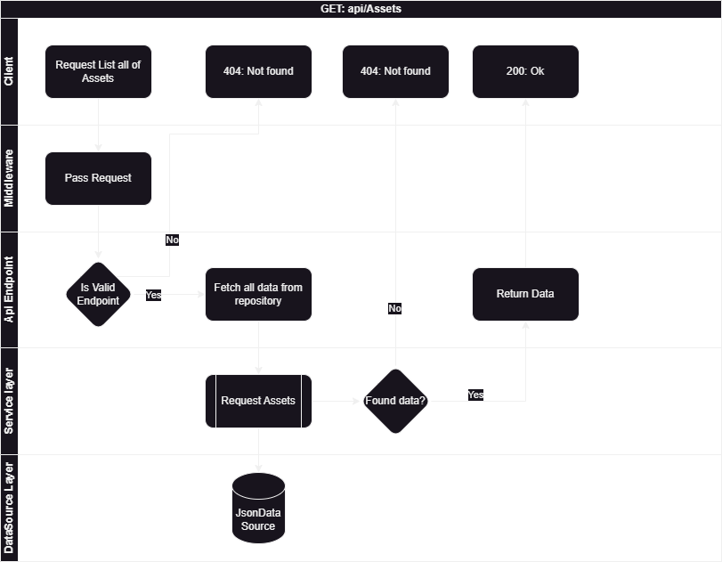
Diagram
GET: GetAllAssets
Return full list of asset stored

Slide 4
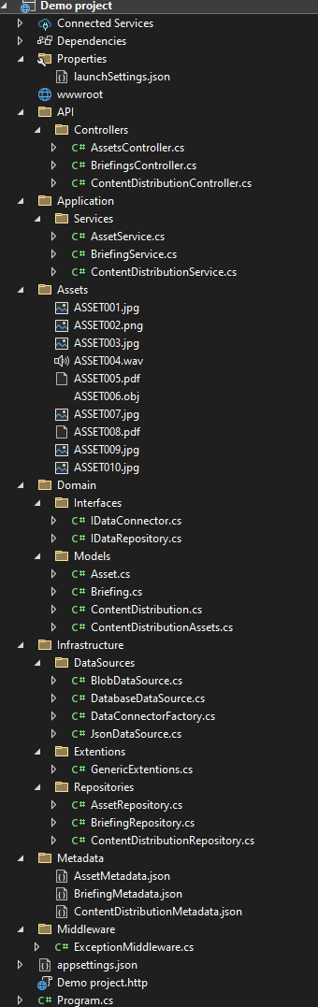
Solution Components
API
Endpoints
Assets
Application
Service level classes
Domain
Interfaces
Entity records
Infrastructure
DataSources
Repositories
Metadata
Middleware

Slide 5
What would I have done differently
Avoid the generic types for the interfaces
Correct the violations of the SOLID principles
Allow the endpoint to include files in request
Along with preview files for lists

Slide 6
Next steps...
POST input validation
Expanded Error handling + logging
Filtering, pagination and size
Authentication
Microservice(?)

