Slide 1
ML Pipeline
Pro
A connected workspace for reproducible machine learning experiments
Jacob Hermsmeyer | Nasif Ajilore | Mingma Lama
Notes:
ML Pipeline Pro brings the main steps of a machine learning project into one workspace. It helps us keep track of the data we used, the models we tried, and the results we got. Our team is Jacob Hermsmeyer, Nasif Ajilore, and Mingma Lama. I'll walk through the workflow and then show the dashboard.

Slide 2
ML work can be hard to coordinate
Datasets, code, and metrics live in separate tools
FRAGMENTED TOOLCHAIN
It becomes hard to identify a winning configuration
Notebook
Script
Database
Monitoring
Retries and tuning can duplicate work or exceed limits
Monitoring observations may be disconnected from a run
ML Pipeline Pro
One linked record of the workflow
Notes:
A machine learning project can quickly spread across notebooks, scripts, and separate tracking tools. That makes it hard to remember which data and settings produced the best result. Repeating a job can also create duplicate work, and monitoring information can lose its connection to the original model. Our goal is to keep those pieces linked in one place.

Slide 3
From a CSV to an observable model
01
02
03
04
05
06
07
Upload CSV
Prep Data
Train
Compare
Tune
Deploy
Monitor
Records link every run to its dataset version
Train multiple models on the same data
Tuning remain user-controlled
Notes:
This is the workflow from start to finish. We upload a CSV file, prepare the data, train models, and compare the results. We can then try different settings, make a selected model available for predictions, and monitor how it behaves. Each run stays linked to the dataset version it used, so comparisons are easier to follow. The user stays in control of tuning.

Slide 4
Three domain APIs, one connected workspace
Browser dashboard • HTML / CSS / JS
API gateway
Model management
Hyperparameter tuning
Performance monitoring
SUPPORTING COMPONENTS
MongoDB
Redis / Celery
Artifacts
AI provider
Prom. / Grafana
Records + references
Queued serial CPU jobs
CSV + checkpoints
LangChain tools
Metrics + panels
Notes:
The dashboard is the part the user works with. Behind it, a gateway connects to three main services: model management, tuning, and monitoring. Supporting tools save project records and files, handle longer jobs in the background, and collect information for the monitoring charts. The AI assistant connects to project tools to help users understand and manage the workflow.

Slide 5
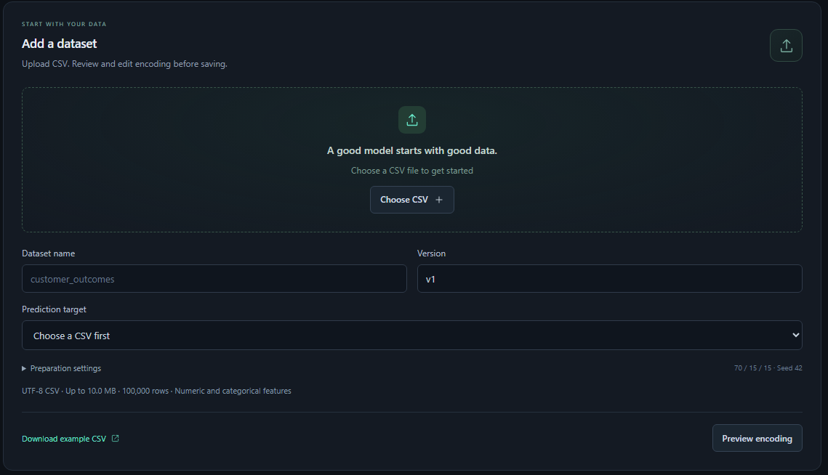
Reproducibility begins before training
Upload a raw CSV and choose the prediction target
Review encoding, missing values, and split counts
Save immutable versions with selected columns
Notes:
Before training, we upload a CSV and choose the column we want the model to predict. We review how text values and missing entries will be handled, along with how the rows are divided for training and evaluation. We can also choose which columns to keep. Saving a fixed dataset version lets us trace later results back to the same prepared data.

Slide 6
Train, evaluate, and compare classifiers
MLP and logistic regression
Compare same-version experiments by calculated metrics
Register eligible models with verified artifacts
Notes:
The project supports two model types: an MLP, which is a small neural network, and logistic regression. Both predict categories from the data. We compare experiments using the same dataset version and recorded scores, rather than guessing which model worked better. Once a model meets the requirements, we can register it, with checks that its saved model files match the recorded run.

Slide 7
Conversation is connected to saved evidence
Replies explain metrics and compare experiments
Mutating actions require confirmation
Python drafts are checked, and never auto-run
Notes:
The chat assistant can use saved project records to explain results and compare experiments. For example, we can ask how two runs differ without looking through every record ourselves. If the assistant proposes an action that changes project data, the user has to confirm it first. It can also draft Python code, but the code is checked and left for review; the workspace never runs it automatically.

Slide 8
Demo
Notes:
I'll now open the dashboard and walk through a project. I'll point out the dataset, the experiments, and how their results are connected. Then I'll show where the AI assistant fits into that workflow.

Slide 9
Limitations and future work
Only two models are supported
Data processing is basic and still expects very preprocessed/clean data
AI agent is difficult to use
Deployment is not as simple as importing a .pt file
Only supports classification
Workflow lacks polish
Notes:
There are still some clear limitations. We currently support only two models, both for classification, and the data preparation tools work best with fairly clean data. The AI assistant can be difficult to use, and deployment takes more work than just uploading a model file. The overall workflow also needs more polish. Future work would focus on easier data preparation, clearer AI guidance, simpler deployment, and support for more models and tasks.

