Slide 1

Date a scientist
Machine Learning Fundamentals
Jacob Honoré
16-04-2019

Slide 2
Table of Contents
Exploration of Dataset
Question to Answer
Augmenting the Dataset
Classification Approaches
Regression Approaches
Best K
Conclusions/Next steps

Slide 3
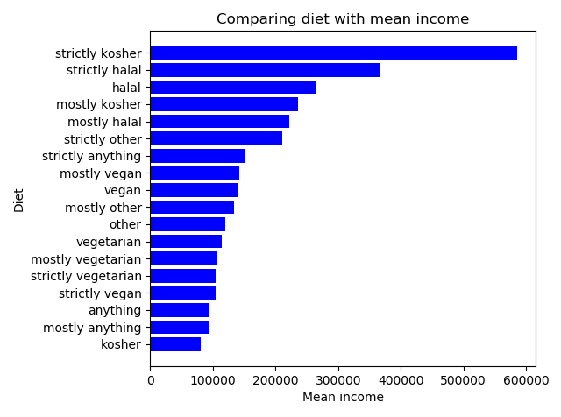
Exploration of the Dataset Comparing diet with mean income
I wanted to explore if there was some correlation between diet and mean income.
I noticed during my exploration that there were very few ”strictly kosher” etc. So it should probably be normalized more. You could do this by mapping it into kosher/halal/other/anything/vegetarian. This mapping might show completely other results as the answers are too unbalanced now.
I made this graph by firstly excluding null answers and then grouping by diet to explore the mean income of each diet type.

Slide 4
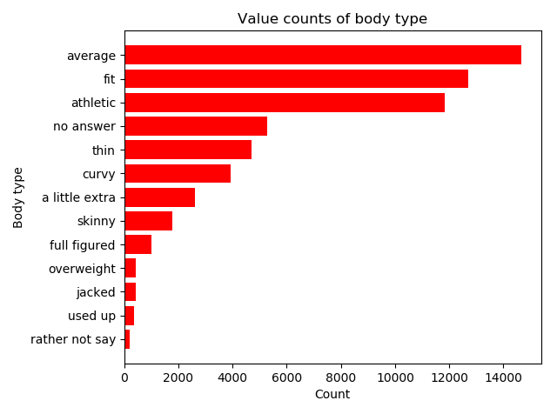
Exploration of the Dataset Value counts of body type
I wanted to explore what the body type column meant, and how many filled out data about this.
As shown, most people find themselves as average, fit or athletic. This shows that most people who are dating also keeps themselves fit. There might be a larger group of fit/average people because obese people are in the “no answer” category.
This graph has been made by firstly converting all null-answers into a new “no answer” category, then doing value count on the body types and sorting the graph to make it appear nicely.
It could be interesting to compare body type with diet.

Slide 5
Question to Answer
Out from my exploration of the dataset in the described graphs, I could not see any correlation between diet and income, by looking at the mean income of each diet type.
By looking at the different body types, I thought it would be a better idea to use this.
Can I predict a user’s diet by looking at body type and maybe other informations from their profile?

Slide 6
Augmenting the Dataset Religion mapping
User | Religion containing | Religion seriousness
0 | Laughing about it | 0
1 | Not too serious about it | 1
2 | No statement of seriousness | 2
3 | Somewhat serious about it | 3
4 | Very serious about it | 4
I thought that religion seriousness can be used for predicting the diet of the user. To get a view of how serious the user is, I categorized it by looking at what the religion cells contained. I used this to create the ”Religion seriousness” column, as shown above a user is not categorised into 5 different categories, describing how serious they are about religion.

Slide 7
Augmenting the Dataset Body type mapping
User | Body type | Body form
0 | Overweight | 0
1 | Full figured | 0
2 | Used up | 0
3 | A little extra | 0
4 | Curvy | 0
5 | Average | 1
6 | Skinny | 1
7 | Fit | 2
8 | Athletic | 2
9 | Thin | 2
10 | Jacked | 2
I thought that the body type would have impact on which diet the user is doing. The body types defined in the dataset is not very describable, so I chose to split it up in three categories, where the higher the number it is, the better the form.
The table to the left shows how the data has been mapped into the new “Body form” column.

Slide 8
Classification Approaches
Multinomial Naive Bayes Classifier
Training runtime: 0.0591s
Predicting runtime: 0.0025s
Accuracy: 48,18%
K-Neighbors Classifier
Training runtime: 0.0837s
Predicting runtime: 0.3880s
Accuracy: 48,18%
I do predictions on classification by using Naive Bayes Classifier vs. K-Neighbors Classifier. Both classifiers came up to the same accuracy, after predicting on a random training/validation set. The runtime however clearly shows that the Naive Bayes Classifier is both faster at training and predicting. It is significantly faster at predicting, which is why the preferred classifier would be Naive Bayes.
The results shows that I am on the right way, by using the select data to try to predict with classification.

Slide 9
Regression Approaches
Linear Regression
Training runtime: 0.002s
Predicting runtime: 0.0005s
Accuracy: 00,3%
K-Neighbors Regressor
Training runtime: 0.0532s
Predicting runtime: 0.2637s
Accuracy: 00,15%
The regression approaches clearly shows that regression is not the right way to answer the question. Both algorithms performs very poorly. Both alogorithms perform faster than the classification approaches.
The results shows that regression is not the right way to answer the question

Slide 10
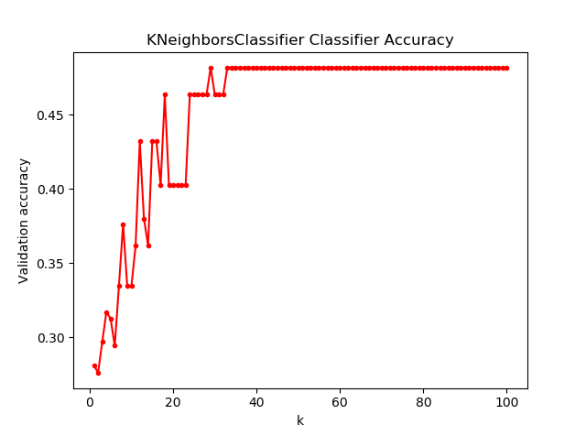
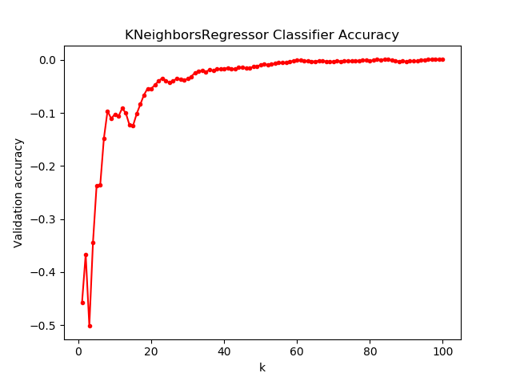
Best K
The classifier performs OK from start and gets best when K is 29.
The regressor performs poorly and are actually making predictions that are completely wrong when K is lowest, it does however become better and better but will never be good enough for actual use.

Slide 11
Conclusions/Next steps
The classification approaches are clearly best.
Naive Bayes Classifier performs faster than K-Neighbors, but they show the same accuracy.
Regression is not the right way to go for the question.
I got promising results that shows that it might be possible to predict which diet a person is having, by using other data from the dataset.
I would therefore go on with the Naive Bayes Classifier and look into which other data I could use to make it better and give better accuracy.

