Slide 1

Date a scientist
Machine Learning Fundamentals
Jacob Honoré
16-04-2019

Slide 2
Table of Contents
Exploration of Dataset
Question(s) to Answer
Augmenting the Dataset
Classification Approaches
Regression Approaches
Conclusions/Next steps

Slide 3
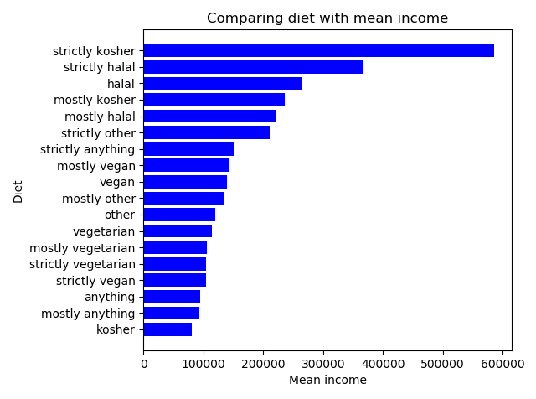
Exploration of the Dataset Comparing diet with mean income
I wanted to explore if there was some correlation between diet and mean income.
I noticed during my exploration that there were very few ”strictly kosher” etc. So it should probably be normalized more. You could do this by mapping it into kosher/halal/other/anything/vegetarian. This mapping might show completely other results as the answers are too unbalanced now.
I made this graph by firstly excluding null answers and then grouping by diet to explore the mean income of each diet type.

Slide 4
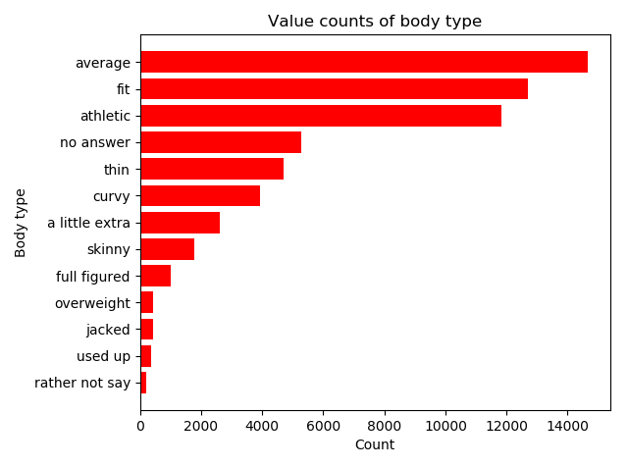
Exploration of the Dataset Value counts of body type
I wanted to explore what the body type column meant, and how many filled out data about this.
As shown, most people find themselves as average, fit or athletic. This shows that most people who are dating also keeps themselves fit. There might be a larger group of fit/average people because obese people are in the “no answer” category.
This graph has been made by firstly converting all null-answers into a new “no answer” category, then doing value count on the body types and sorting the graph to make it appear nicely.
It could be interesting to compare body type with diet.

