Slide 1

Date a scientist
Machine Learning Fundamentals
Jacob Honoré
16-04-2019

Slide 2
Table of Contents
Exploration of Dataset
Question to Answer
Augmenting the Dataset
Classification Approaches
Regression Approaches
Conclusions/Next steps

Slide 3
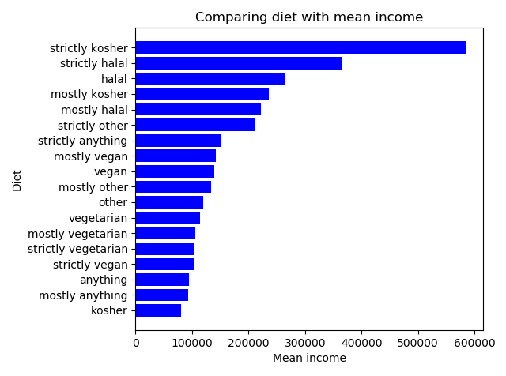
Exploration of the Dataset Comparing diet with mean income
I wanted to explore if there was some correlation between diet and mean income.
I noticed during my exploration that there were very few ”strictly kosher” etc. So it should probably be normalized more. You could do this by mapping it into kosher/halal/other/anything/vegetarian. This mapping might show completely other results as the answers are too unbalanced now.
I made this graph by firstly excluding null answers and then grouping by diet to explore the mean income of each diet type.

Slide 4
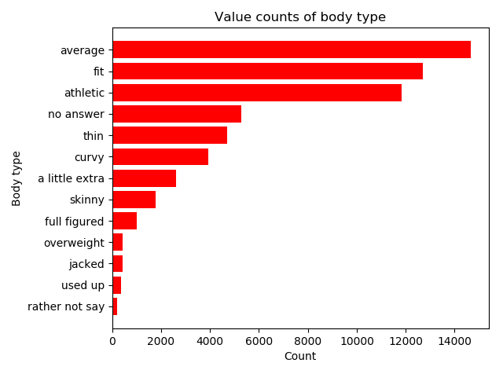
Exploration of the Dataset Value counts of body type
I wanted to explore what the body type column meant, and how many filled out data about this.
As shown, most people find themselves as average, fit or athletic. This shows that most people who are dating also keeps themselves fit. There might be a larger group of fit/average people because obese people are in the “no answer” category.
This graph has been made by firstly converting all null-answers into a new “no answer” category, then doing value count on the body types and sorting the graph to make it appear nicely.
It could be interesting to compare body type with diet.

Slide 5
Question to Answer
Out from my exploration of the dataset in the described graphs, I could not see any correlation between diet and income, by looking at the mean income of each diet type.
By looking at the different body types, I thought it would be a better idea to use this.
Can I predict a user’s diet by looking at body type and maybe other informations from their profile?

Slide 6
Augmenting the Dataset Religion mapping
User | Religion containing | Religion seriousness
0 | Laughing about it | 0
1 | Not too serious about it | 1
2 | No statement of seriousness | 2
3 | Somewhat serious about it | 3
4 | Very serious about it | 4
I thought that religion seriousness can be used for predicting the diet of the user. To get a view of how serious the user is, I categorized it by looking at what the religion cells contained. I used this to create the ”Religion seriousness” column, as shown above a user is not categorised into 5 different categories, describing how serious they are about religion.

Slide 7
Augmenting the Dataset Body type mapping
User | Body type | Body form
0 | Overweight | 0
1 | Full figured | 0
2 | Used up | 0
3 | A little extra | 0
4 | Curvy | 0
5 | Average | 1
6 | Skinny | 1
7 | Fit | 2
8 | Athletic | 2
9 | Thin | 2
10 | Jacked | 2
I thought that the body type would have impact on which diet the user is doing. The body types defined in the dataset is not very describable, so I chose to split it up in three categories, where the higher the number it is, the better the form.
The table to the left shows how the data has been mapped into the new “Body form” column.

