Slide 1
Week 2
Constraints in Relational Database Models

Slide 2
Student Objectives
Upon completion of this video, you should be able to:
List key constraints in a table
Identify referential integrity constraints that are violated by insert, delete and modify actions on given tables
Identify semantic integrity constraints that are violated, given an existing table and an update operation on a table such as modify, insert or delete

Slide 3
Types of Constraints in relational Databases
There are 3 main types of constraints:
Key constraints
Referential integrity constraints
Semantic integrity constraints

Slide 4
Key Constraints
PRIMARY KEY - Allows you to state which attribute(s) will be the primary key (the attribute(s) that ensures that no 2 tuples are identical).
A table can only have ONE primary key but the primary key can be made up of several attributes
The primary key MUST be unique
NOT NULL – Forces the user to never leave a key attribute null (empty) for a particular tuple.

Slide 5
Referential Integrity
Referential Integrity: a tuple in one relation (table) that refers to another relation (table) must refer to an existing tuple in the relation.
Formally:
Assume we have R1 and R2 with a referential integrity between the two of them. R1 has a set of attributes FK (foreign key) that references the attributes PK (primary key) R2, it must satisfy the following rules:
FK attributes must have the same domain as PK
a value of FK in a tuple t of the current state r1(R1) either occurs as a value of PK for some tuple t2 in the current state or r2(R2) is null.

Slide 6
Update Operations on Relations maintaining Integrity Rules
Department
DeptID | DeptName | *MgrEmpID | MgrStartDate
G8H | Head Office | 4 | 12/12/99
S7G | Safety Department | 3 | 11/11/98
Y5J | Research Department | 6 | 12/24/98
Employee
EmpID | LastName | FirstName | *DeptID | Sex
1 | Simpson | Bart | S7G | M
2 | Smithers | Waylan | G8H | M
4 | Burns | Monty | G8H | M
6 | Simpson | Lisa | Y5J | F
3 | Beuvieau | Patty | S7G | M
12 | Simpson | Homer | S7G | M

Slide 7
QUESTION: Determine the problems (if any exist) with the following operations to the above tables?
Insert Operation IS THIS VALID?
Insert <13, 'Gumble', 'Barney', 'S7G', 'M'> into EMPLOYEE Yes No Insert <3,'Simpson', 'Granpa', 'Y5J', 'M'> into EMPLOYEE Yes No Insert <NULL, 'Flanders', 'Ned', 'Y5J', 'M'> into EMPLOYEE Yes No Insert <18, 'Flanders', 'Todd', 'P68', 'M'> into EMPLOYEE Yes No
P
P
P
P
Department
DeptID | DeptName | *MgrEmpID | MgrStartDate
G8H | Head Office | 4 | 12/12/99
S7G | Safety Department | 3 | 11/11/98
Y5J | Research Department | 6 | 12/24/98
Employee
EmpID | LastName | FirstName | *DeptID | Gender
1 | Simpson | Bart | S7G | M
2 | Smithers | Waylan | G8H | M
4 | Burns | Monty | G8H | M
6 | Simpson | Lisa | Y5J | F
3 | Beuvieau | Patty | S7G | M
12 | Simpson | Homer | S7G | M

Slide 8
Delete Operation IS THIS VALID?
Delete employee where EmpID = 4 Yes No Delete department where DeptID = 'S7G' Yes No
P
P
Employee
EmpID | LastName | FirstName | *DeptID | Gender
1 | Simpson | Bart | S7G | M
2 | Smithers | Waylan | G8H | M
4 | Burns | Monty | G8H | M
6 | Simpson | Lisa | Y5J | F
3 | Beuvieau | Patty | S7G | M
12 | Simpson | Homer | S7G | M
Department
DeptID | DeptName | *MgrEmpID | MgrStartDate
G8H | Head Office | 4 | 12/12/99
S7G | Safety Department | 3 | 11/11/98
Y5J | Research Department | 6 | 12/24/98
QUESTION: DB2 allows 3 things to happen if you set up referential integrity between keys when you perform a delete, DB2 allows for:
Cascade
Restrict
Set Null
What do you think each of these operations do?

Slide 9
IS THIS VALID?
Yes No Yes No Yes No Yes No
Modify Operation:
Modify the gender of Employee where lastname = ‘Burns' to ‘F’ Modify Employee where lastname = 'Smithers' from DeptID = 'G8H' to DeptID = 'Y5J' Modify Employee where lastname = 'Smithers' from DeptID = 'G8H' to DeptID = 'J9J' Modify Employee where lastname = 'Smithers' from EmpID = 2 to EmpID = 12
P
P
P
P
Department
DeptID | DeptName | *MgrEmpID | MgrStartDate
G8H | Head Office | 4 | 12/12/99
S7G | Safety Department | 3 | 11/11/98
Y5J | Research Department | 6 | 12/24/98
Employee
EmpID | LastName | FirstName | *DeptID | Gender
1 | Simpson | Bart | S7G | M
2 | Smithers | Waylan | G8H | M
4 | Burns | Monty | G8H | M
6 | Simpson | Lisa | Y5J | F
3 | Beuvieau | Patty | S7G | M
12 | Simpson | Homer | S7G | M

Slide 10
Semantic Integrity Constraints
State Constraints: state the constraints that a valid state of the database must satisfy
Example: Hours worked cannot be greater than 50, Quantity Ordered must be greater than 10
Transition Constraints: define how the state of the database can change
Example: Salaries can only increase
Both of the above are enforce in relational databases through triggers and assertions

Slide 11
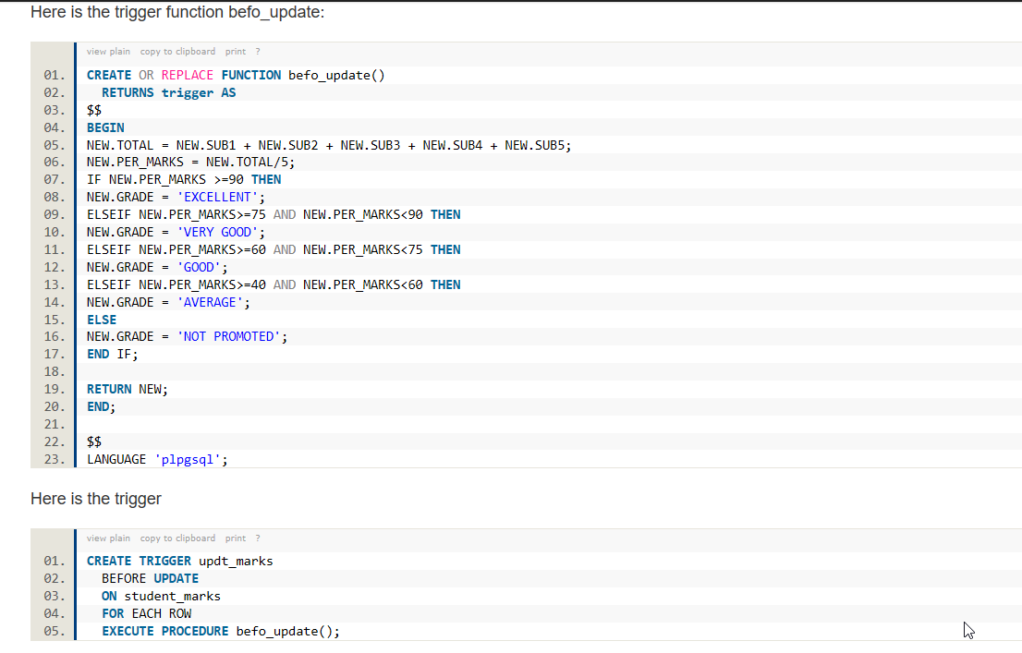
Example of a trigger
Triggers are on inserts, updates or deletes. Can you figure out what this one does?

Slide 12
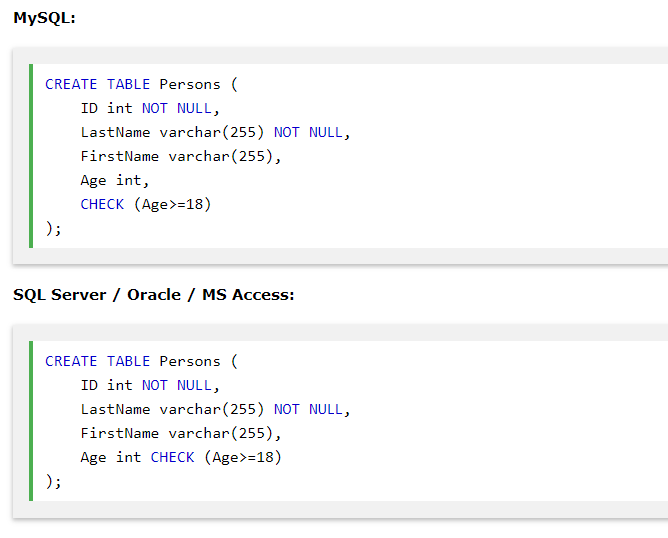
Example of a Constraint
Constraints are on inserts and updates. Can you figure out what this one does?

