Slide 1
Week 2
Taking our Case study from an ER Diagram to a Relational database

Slide 2
Student Objectives
Upon completion of this video, you should be able to:
Use the 7 rules to map ANY ER diagram to a relational database

Slide 3
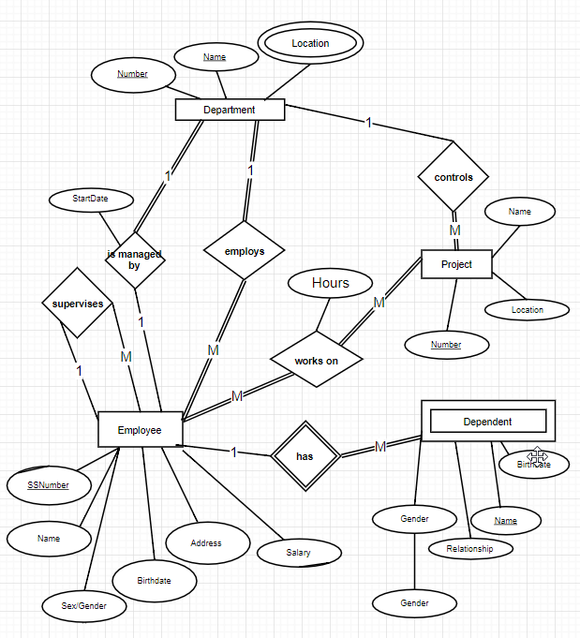
Our case study as an ER Diagram

Slide 4
Using the 7 rules and MS Access, let’s map our ER diagram to a relational Model!

