Slide 1
Week 3
The Physical Storage of A database

Slide 2
Student Objectives
Upon completion of this video, you should be able to:
Give 3 reasons why we store the database on secondary storage
List at least 4 different storage devices.
Give advantages and disadvantages of each device
Distinguish between the Primary Organization of the records and the Secondary Organization of the records.

Slide 3
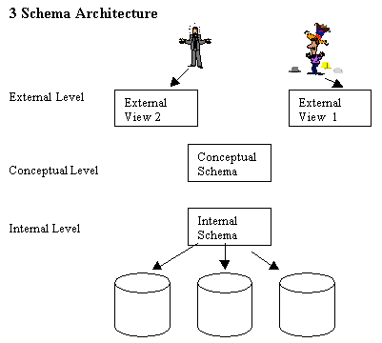
REMEMBER THE 3-Schema Architecture
In week 2, we talked about this level, this is where the relational database resides
NOW we will talk about this level, when we physically write the data onto a storage device

Slide 4
Storage Medium – physically storing the database on the computer
Primary Storage → CPU (Main Memory and faster Cache memory)
Secondary Storage
Magnetic Disks
Flash Memory (Solid State Drive SSD)
Tertiary Storage
Optical Disk (CD-ROM, DVDs) (declining because of decrease in cost and increase in capacity of magnetic disks)
Tapes

Slide 5
The Problem:
Why is a database normally stored on a hard disk rather than in faster main memory? THERE ARE THREE MAIN REASONS, what are they?
Cost
Volatility
Usually an entire database is too large to fit into main memory
Notes:
More stable
Cheaper
Main memory isn’t large enough

Slide 6
Storage of Databases
Typically on a hard drive
Advantage – Online (available at anytime)
Disadvantage – Slowish, Expensivish
Also, still need some offline storage such as tapes but quite slow → (start at minute 2) how offline storage works with tapes and autoloaders (NASA uses tapes to archive databases)
Advantage – Cheap
Disadvantage – Slow
Also flash memory (SSD)
Advantage – Fast
Disadvantage – Have to overwrite the whole block, limited number of writes
Which is better? https://www.youtube.com/watch?v=YQEjGKYXjw8&t=115s

Slide 7
Physical Database design
Picking an organization for the data on the hard disk to maximize efficiency!
Must decide on
1. THE PRIMARY FILE ORGANIZATION:
How the file records are physically placed on the disk (ordering of the primary attribute)?
How the records can be accessed?
2. SECONDARY ORGANIZATION
How can we efficiently access OTHER attributes than the primary attribute?

