Slide 1
Week 3
Example of TIME COMPLEXITY CALCULATION FOR A B+ TREE SEARCH

Slide 2
Student Objectives
Upon completion of this video, you should be able to:
Calculate the worse time for a search on a B+ tree structure for a given example.

Slide 3
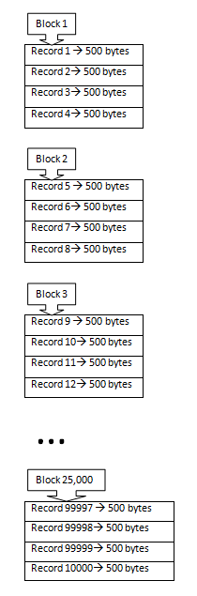
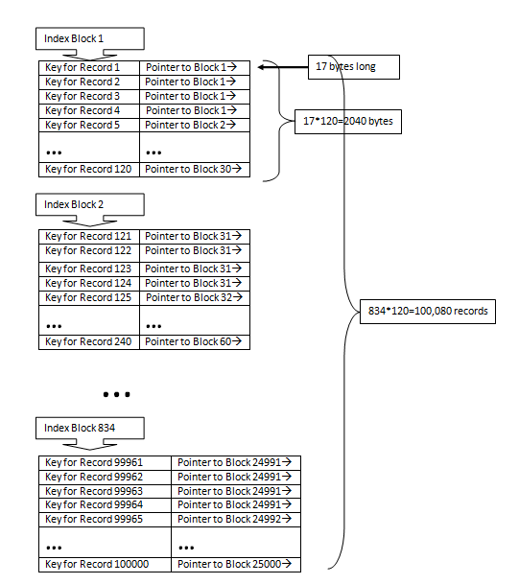
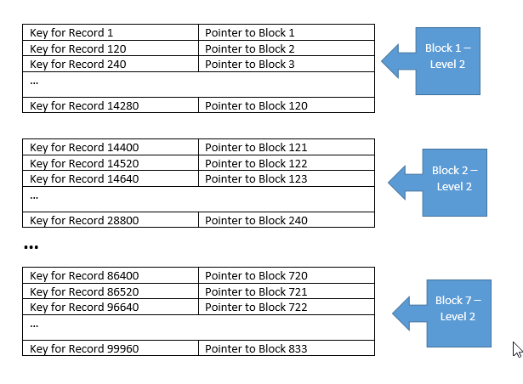
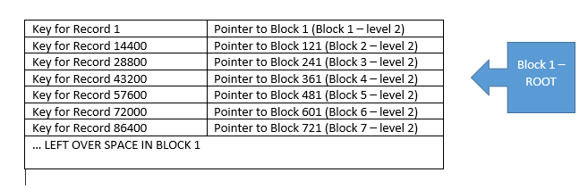
QUESTION: Find the worst case search time to find a record if you use a multilevel index for the following scenario:
r = 100,000 records stored on a disk with block size B = 2048 bytes.
Records are fixed size of R = 500 bytes.
Blocking Factor = 2048 / 500 = __________
Number of blocks needed = ____________
Ordering key field is V = 10 bytes, a block pointer P = 7 bytes, thus size of the primary record is _________ bytes per record
Blocking Factor for index = 2048 /17 =120 indices per block
# of blocks needed for index = 100000/120 = ___________
# of blocks needed for level 1 = # of blocks needed for index = ___________
# of blocks needed for level 2 = level 1/ 120 = ________________
# of blocks need for level 3 = level 2 /120 = ______________
Search is 3 levels + 1 level to get to the data block = 4 Block accesses
4
100,000/4 → 25,000
17
834
834
834/120 → 7 blocks
7/120 → 1 block
Notes:
Blocking factor 4 records per block
# blocks = 25000
17 bytes per record
120 indices per block
100000/120 = 834 → 834 blocks for the index
834 for level 3 (leaves)
834/120=7 blocks needed for level 2
1 block needed for level 3

Slide 4
Level 1: Block 1
P1 B1 P2 B2 … P6 B6 P7
Level 2: Block 1
Block 2
Block 7
…
P1 B1 … P119 B119 P120
P121 … B239 P240
P721…B833 P834
Level 3: Block 1
Block 2
…
Block 834
P1 K1 …K119 P120
P121 …K239 P240
P99880 …K99999 P100000
Disk containing 100000 records

