Slide 1
Week 3
USING MULTILEVEL INDICES FOR EVEN MORE SPEED!

Slide 2
Student Objectives
Upon completion of this video, you should be able to:
Differentiate between a single level index and a multi-level index.
Recognize what data structure a multilevel index resembles
Distinguish between a B – Tree and B+ Tree
Given an order for a tree, draw the node
Given a node, determine the order of the tree
Given a tree, figure out the depth of the tree (number of levels in the multileveled index)
Given a B+ Tree and a key value, show how to traverse the tree to find that value.

Slide 3
OH NO…EVEN OUR INDEX FILE IS HUGE!
QUESTION: What could we do if the index file that points to our records is also too big to fit into memory? How could we speed up the search on the index file?
ANSWER: what if we made another index ON our index file!
Just one index file is a single level index
If we have an index on our index (and so on), we have a multileveled index.

Slide 4
Multi Level Index
The index itself is ordered, so maybe we could create an index on the index!
Original file is called the first level index
Index to index is called the second level index
We could repeat, create a third, fourth, … until the top level index fits on ONE block
Can do this for a any type of index (primary, clustering, secondary) as long as the first level index is more than 1 block

Slide 5
Looks kinda like this:
Key for Record 1 and Block Pointer to location of key index in level 2 | …
Index Level 3
Index Level 2
Key for Record 1 and Block Pointer | … | Key for Record n and Block Pointer
Index Level 1
Key for Record 1 and Block Pointer | … | Key for Record n and Block Pointer
Data
Record 1 | Record 2 | Record 3 | … | Record n-1 | Record n

Slide 6

QUESTION: All you CS people, what does the structure look like (something you have already learned about in CS2210)?
Key for Record 1 and Block Pointer …
Key for Record 1 and Block Pointer …
Key for Record 1 and Block Pointer …
Key for Record 1 and Block Pointer | … | Key for Record n and Block Pointer
Key for Record 1 and Block Pointer | … | Key for Record n and Block Pointer
Key for Record 1 and Block Pointer | … | Key for Record n and Block Pointer
Key for Record 1 and Block Pointer | … | Key for Record n and Block Pointer
Record 1 | Record 2 | Record 3 | … | Record n-1 | Record n
Key for Record 1 and Block Pointer | … | Key for Record n and Block Pointer
Key for Record 1 and Block Pointer | … | Key for Record n and Block Pointer
Record 1 | Record 2 | Record 3 | … | Record n-1 | Record n
Record 1 | Record 2 | Record 3 | … | Record n-1 | Record n

Slide 7
Tree
Each level of our tree will be an index to the next level (the next index)
A tree is really an index to an index to an index, where the high level index is the root and the lowest level, the leaves, is the final index pointing to the data on the disk.
Problem: as new records are added to the data file and old records are deleted, we need to keep our index file correct and still pointing to the correct records. How do we insert and delete in our index levels when the file/records are updated?

Slide 8
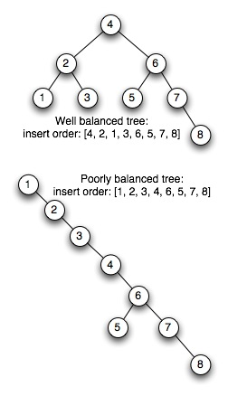
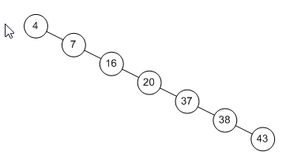
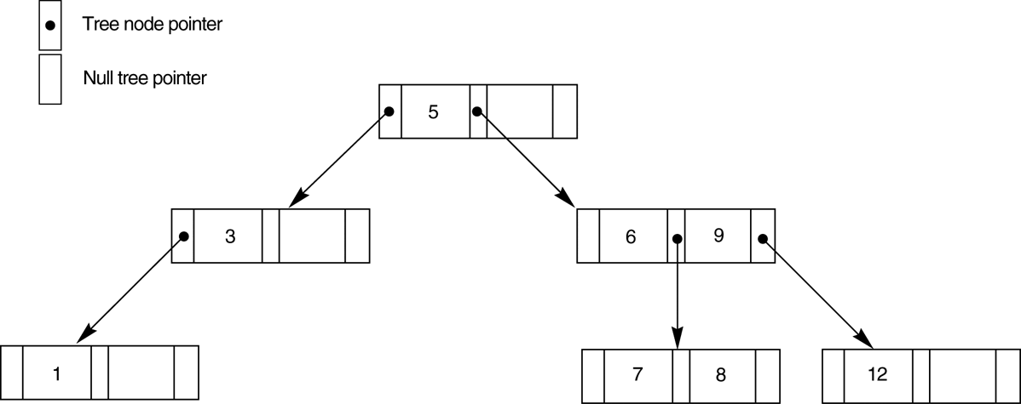
Problem
Can become unbalanced!
NOTE: This balanced tree is NOT a B+ tree because every node is NOT in the leaves

Slide 9
Balanced Trees
More versatile than hashing: allows for retrieval based on exact key match, pattern matching, range of values and part key specification
More versatile than ISAM because the B+-Tree grows as the relation grows
Retrieval more efficient too
B+- Trees are a type of Multilevel Index!

Slide 10
Searching on a sorted file using a binary search (single level index) typically requires approximately log₂P page accesses for an index with p pages. A multilevel index overcomes this problem by reducing the search range by treating the index file as the data file and builds an index for the index file and then builds another index file for that index file by splitting the index.
DBMS uses a tree data structure to hold data and indexes. The tree consists of a root node that can have child nodes. Each of these child nodes can have their own child nodes. A node with no children is called a leaf node
The depth of the tree is the maximum number of levels between the root node and a leaf node. If the depth is the same from the parent node to each leaf node then the tree is called a balance tree or B- Tree.

Slide 11
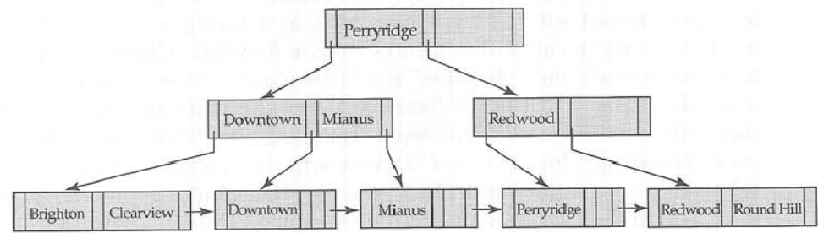
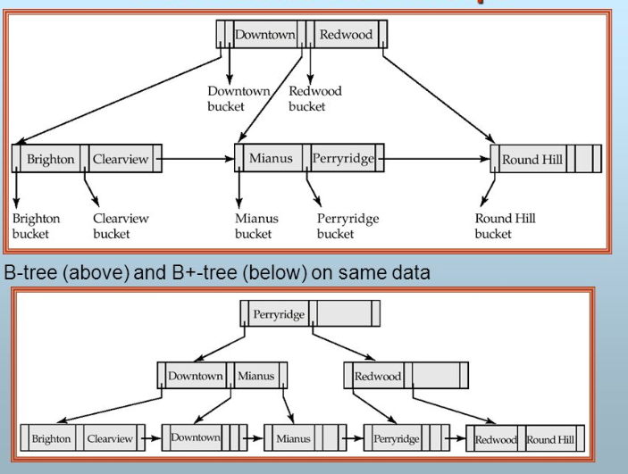
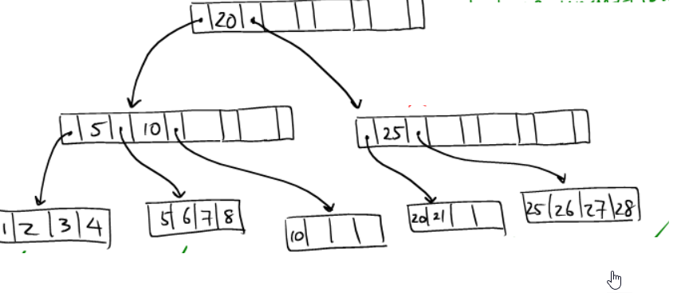
The degree (order) of the tree is the maximum number of children allowed per parent. Larger degrees create broader, shallower trees
A B+-Tree is a variation of a B-Tree. The only difference is that in a B-Tree, every value of the search field appears once at some level in the tree, along with a data pointer. In a B+-Tree, data pointers are stored only at the leaf nodes of the tree; hence, the structure of leaf nodes differs from the structure of internal nodes
Drawbacks: Keeping the tree balanced (i.e. the same depth) is time consuming as records are inserted and deleted

Slide 12
Rules for B+-Trees
If the root is not a leaf node, it must have at least 2 children
For a tree of order n, each node (except root and leaf) must have between n/2 and n pointers and children. If n/2 is not an integer, round the result set up
For a tree of order n, the number of key values in a leaf node must be between (n-1)/2 and (n-1) pointers and children. If (n-1)/2 is not an integer, round up the result
The number of key values contained in a non-leaf node is 1 less than the number of pointers
The tree must always be balanced: i.e. every path from the root node to a leaf must have the same length
Leaf nodes are linked in order of key values

Slide 13

Internal Nodes
Order p
Each internal node is of the form <P1, K1, P2, K2, ..., Pq-1, Kq-1, Pq>, where q<=p and each Pi is a tree pointer.
Within each internal node K1<K2<...<Kq-1
For all search field values X in the subtree pointed at by Pi, we have Ki-1 < X <= Ki for 1 <i<q, X<=Ki for i =1, and Ki-1 < X for i=q
Each internal node has at most p tree pointers
Each internal node, except the root has at least [(p/2)] tree pointers. The root node at least 2 tree pointer if it is internal node
An internal node with q pointers, q <= p, has q-1 search field values.

Slide 14
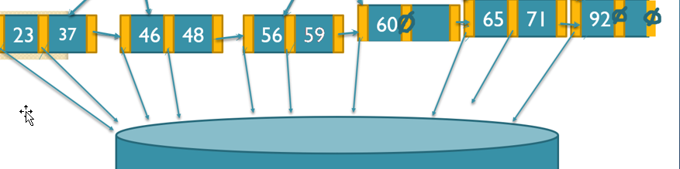
Leaf nodes
Each leaf node is of the form: <<K1, Pr1>, <K2,Pr2>,...,<Kq-1,Prq-1>, Pnext>
Pnext points to the next leaf node of the B+ tree
Within each leaf node, K1<K2<....<Kq-1, q<=p
Each Pri is a data pointer (points to the disk) that points to the record whose search field value is Ki or to a file block containing the record
Each leaf node has at least [(p/2)] values.
All leaf nodes are at the same level.

Slide 15
Always figure out what your nodes look like First based on your order
Order 3
Order 2
Order 5
Order 8
We will MAINLY DO ORDER 3!

Slide 16
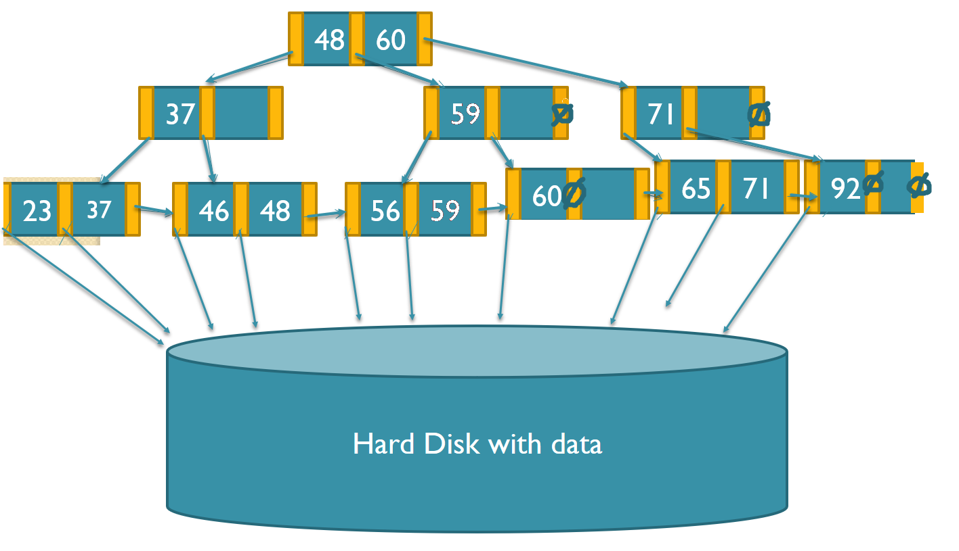
Traversing (looking for something iN) a B+ Tree
Let’s look for the item with a key of 65
Now let’s look for an item with a key of 48
Now let’s find all the items between 46 and 65

