Slide 1
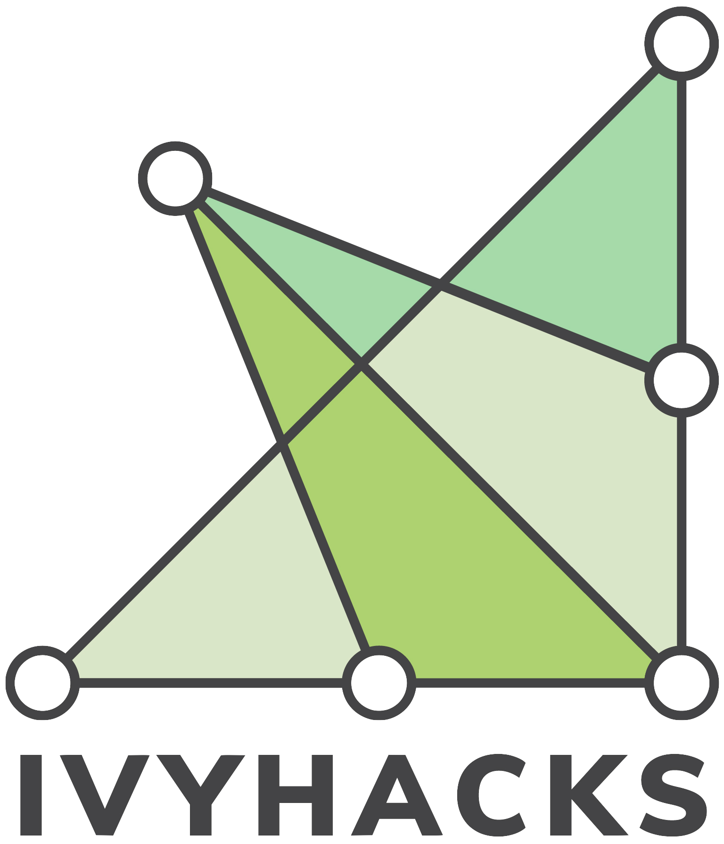
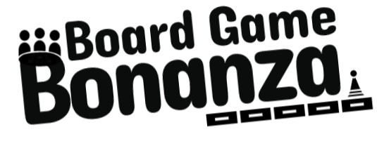
Understanding online board games
An overview of current experiences of board games turned digital.

Slide 2
01
02
03
04
The Problem
What’s up with virtual board games?
User Questions
Who are our users? and what does the experience look like for them?
Analysis
What are the implications of this?
Results
Prototype Website

Slide 3
The Problem
Our world is more Digital. Almost 4.57 billion people were active internet users as of July 2020.¹ So much has changed to support that - and while turning digital has its benefits, people still crave the physicality of the tabletop board game.²
Notes:
1 = Clement, J. (2020, July 24). Digital users worldwide 2020. Retrieved from https://www.statista.com/statistics/617136/digital-population-worldwide/#:~:text=Almost 4.57 billion people were,in terms of internet users.
2 = Jolin, D. (2016, September 25). The rise and rise of tabletop gaming. Retrieved from https://www.theguardian.com/technology/2016/sep/25/board-games-back-tabletop-gaming-boom-pandemic-flash-point

Slide 4
User Research
Target Outcome
What are people’s experience with playing board games online?
The Results
The basics:
Monopoly is the most popular game played
People play between 1-2 hours, and rarely don't finish the games they start in one sitting
Most frequently 4 people play together.
People enjoy playing games that they have the flexibility to choose how long to play, and have the flexibility to be creative with the game (aka making their own rules)
Notes:
1 = Clement, J. (2020, July 24). Digital users worldwide 2020. Retrieved from https://www.statista.com/statistics/617136/digital-population-worldwide/#:~:text=Almost 4.57 billion people were,in terms of internet users.
2 = Jolin, D. (2016, September 25). The rise and rise of tabletop gaming. Retrieved from https://www.theguardian.com/technology/2016/sep/25/board-games-back-tabletop-gaming-boom-pandemic-flash-point

Slide 5
User Research
Target Outcome
What are people’s experience with playing board games online?
The Results
Online behaviour
The pandemic, in its height did change behaviour surrounding games: some played more, some less but heavily depending on the people played with, and the availability of games online
Interviewees see board games as a very good way to not be online, away from devices
They are more fun in person because it's easier to have multiple conversations at the same time.
Participant 3: Wants to play Catan but “it’s covid times right now, so I can’t really do that, I mean, gotta be in the same room”
Notes:
1 = Clement, J. (2020, July 24). Digital users worldwide 2020. Retrieved from https://www.statista.com/statistics/617136/digital-population-worldwide/#:~:text=Almost 4.57 billion people were,in terms of internet users.
2 = Jolin, D. (2016, September 25). The rise and rise of tabletop gaming. Retrieved from https://www.theguardian.com/technology/2016/sep/25/board-games-back-tabletop-gaming-boom-pandemic-flash-point

Slide 6
User Research
Target Outcome
What are people’s experience with playing board games online?
The Results
Board games on discord
Participant Two: “It’s just boys talking online - I literally don’t know what it's actually for. Utterly oblivious.”
Benefits include: you get a lot without paying for anything, very intuitive once familiar, many clubs and friends online, no ads.
People play on the platforms they are already on (eg imessage games)
Pitfalls: learning curve is tough, hard to manage a server.
Notes:
1 = Clement, J. (2020, July 24). Digital users worldwide 2020. Retrieved from https://www.statista.com/statistics/617136/digital-population-worldwide/#:~:text=Almost 4.57 billion people were,in terms of internet users.
2 = Jolin, D. (2016, September 25). The rise and rise of tabletop gaming. Retrieved from https://www.theguardian.com/technology/2016/sep/25/board-games-back-tabletop-gaming-boom-pandemic-flash-point

Slide 7
User Research
Target Outcome
What are people’s experience with playing board games online?
The Results
“I tried to get my friends, who played d&d to use like a bot to help me, like, manage stuff. Yeah. And it took them more than like 30 seconds to figure out how to use it. So then they decided not to use it. Yeah. So like, it better be like something that you can pick up and use almost immediately “
Stressing Intuitive Interaction. Need ease and simplicity.
Notes:
1 = Clement, J. (2020, July 24). Digital users worldwide 2020. Retrieved from https://www.statista.com/statistics/617136/digital-population-worldwide/#:~:text=Almost 4.57 billion people were,in terms of internet users.
2 = Jolin, D. (2016, September 25). The rise and rise of tabletop gaming. Retrieved from https://www.theguardian.com/technology/2016/sep/25/board-games-back-tabletop-gaming-boom-pandemic-flash-point

Slide 8
User Research
Target Outcome
What are people’s experience with playing board games online?
Next steps
Target the population already on discord; they are comfortable, know the platform, and already have friends online
Highest focus on flexibility of the bot: they provide a system, but give people the ability to do what they want
set process of communication: people are prompted how to play. Photo sharing is intuitive and does not have high data costs like video sharing, and the ability to look back and reflect on past moves.
***Costs involved = slow and potentially tedious.
Build in mind of expansion to 4 people games, up to 2 hours that are mainly played in one sitting.
Notes:
1 = Clement, J. (2020, July 24). Digital users worldwide 2020. Retrieved from https://www.statista.com/statistics/617136/digital-population-worldwide/#:~:text=Almost 4.57 billion people were,in terms of internet users.
2 = Jolin, D. (2016, September 25). The rise and rise of tabletop gaming. Retrieved from https://www.theguardian.com/technology/2016/sep/25/board-games-back-tabletop-gaming-boom-pandemic-flash-point

Slide 9
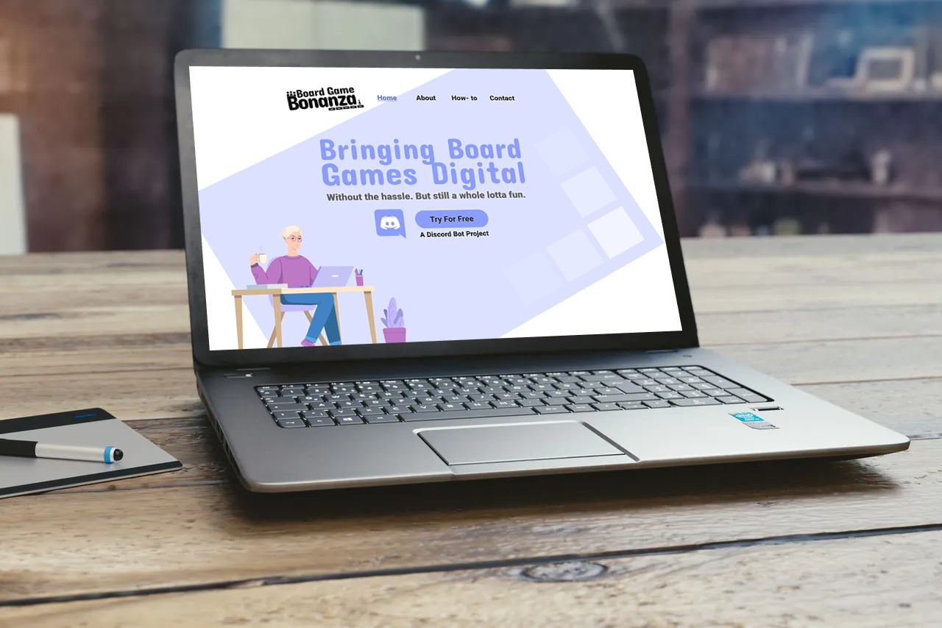
The Prototype
Notes:
1 = Clement, J. (2020, July 24). Digital users worldwide 2020. Retrieved from https://www.statista.com/statistics/617136/digital-population-worldwide/#:~:text=Almost 4.57 billion people were,in terms of internet users.
2 = Jolin, D. (2016, September 25). The rise and rise of tabletop gaming. Retrieved from https://www.theguardian.com/technology/2016/sep/25/board-games-back-tabletop-gaming-boom-pandemic-flash-point

Slide 10
The Prototype
This design:
This design stresses integration with discord, a selling point for the product because it is already a well used platform for digital games
both logo and background mimic games, with the illustration (courtesy of freepik) helps communicate the online nature of the product
The focus of the website is showing how flexible, and intuitive the bot is - the website is very minimalistic to reflect this, and brings attention to the call to action of adding the bot to a users discord.
Notes:
1 = Clement, J. (2020, July 24). Digital users worldwide 2020. Retrieved from https://www.statista.com/statistics/617136/digital-population-worldwide/#:~:text=Almost 4.57 billion people were,in terms of internet users.
2 = Jolin, D. (2016, September 25). The rise and rise of tabletop gaming. Retrieved from https://www.theguardian.com/technology/2016/sep/25/board-games-back-tabletop-gaming-boom-pandemic-flash-point

Slide 11
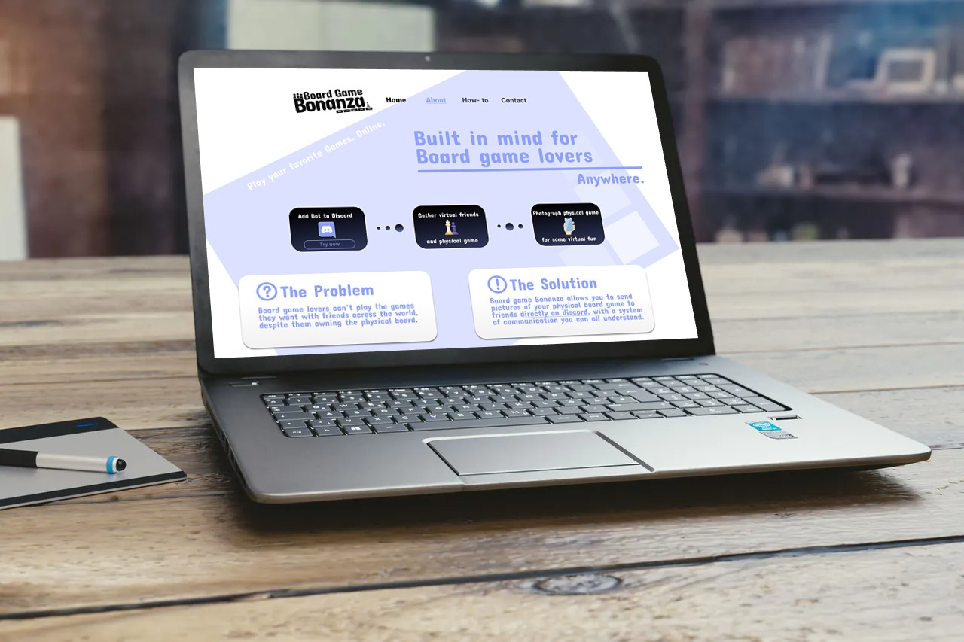
The Prototype
(continued)
Notes:
1 = Clement, J. (2020, July 24). Digital users worldwide 2020. Retrieved from https://www.statista.com/statistics/617136/digital-population-worldwide/#:~:text=Almost 4.57 billion people were,in terms of internet users.
2 = Jolin, D. (2016, September 25). The rise and rise of tabletop gaming. Retrieved from https://www.theguardian.com/technology/2016/sep/25/board-games-back-tabletop-gaming-boom-pandemic-flash-point

Slide 12
The Prototype
This design:
There are only four pages of the website; landing, about, how-to and contact.
our goal is to have people on the website for as little time as possible.
We want them out, playing the game.
however, we know that it's important to include the essentials: what problem we are solving (about), a thorough guide of how to interact with the bot (how to), and someone to contact if issues arise (contact).
Notes:
1 = Clement, J. (2020, July 24). Digital users worldwide 2020. Retrieved from https://www.statista.com/statistics/617136/digital-population-worldwide/#:~:text=Almost 4.57 billion people were,in terms of internet users.
2 = Jolin, D. (2016, September 25). The rise and rise of tabletop gaming. Retrieved from https://www.theguardian.com/technology/2016/sep/25/board-games-back-tabletop-gaming-boom-pandemic-flash-point

Slide 13
What’s next?
Target Outcome
What are people’s experience with playing board games online?
We took the time to understand the market, created the bot with functionality for one game (Goblet Goblet), and started a website prototype.
To scale up, we would:
Create a fully functioning website prototype and move into development
Add more functional games, such as those identified in preliminary user research
Conduct more product testing with the discord bot to identify lapses in language, and more intuitive commands.
Notes:
1 = Clement, J. (2020, July 24). Digital users worldwide 2020. Retrieved from https://www.statista.com/statistics/617136/digital-population-worldwide/#:~:text=Almost 4.57 billion people were,in terms of internet users.
2 = Jolin, D. (2016, September 25). The rise and rise of tabletop gaming. Retrieved from https://www.theguardian.com/technology/2016/sep/25/board-games-back-tabletop-gaming-boom-pandemic-flash-point

