Slide 1
Make the VirtualBox

Slide 2
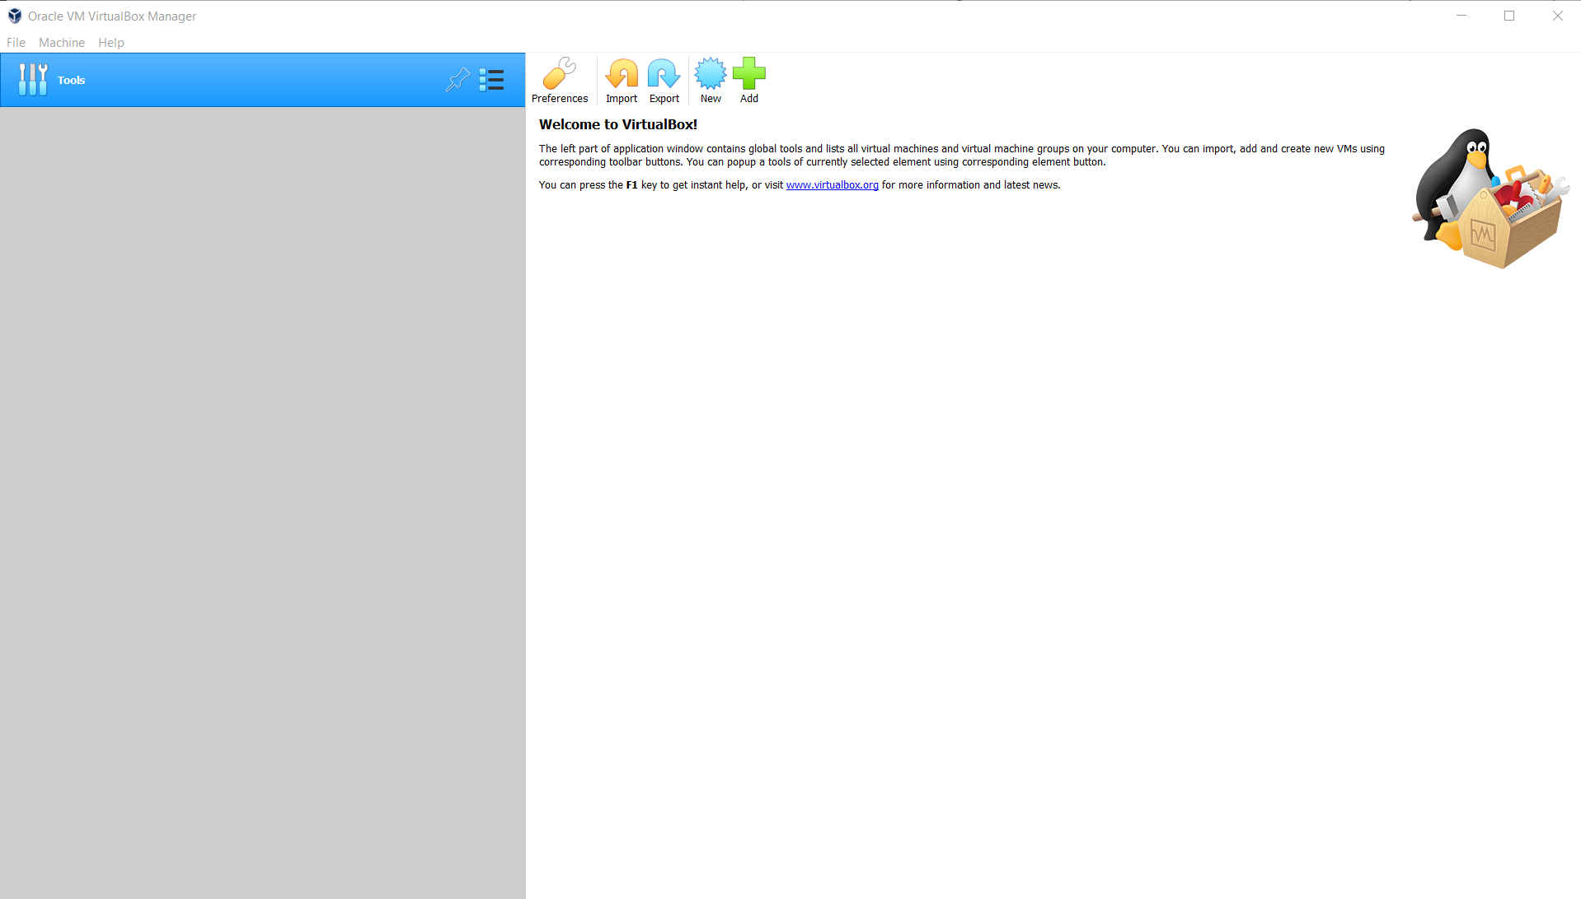
Open Saysme

Slide 3
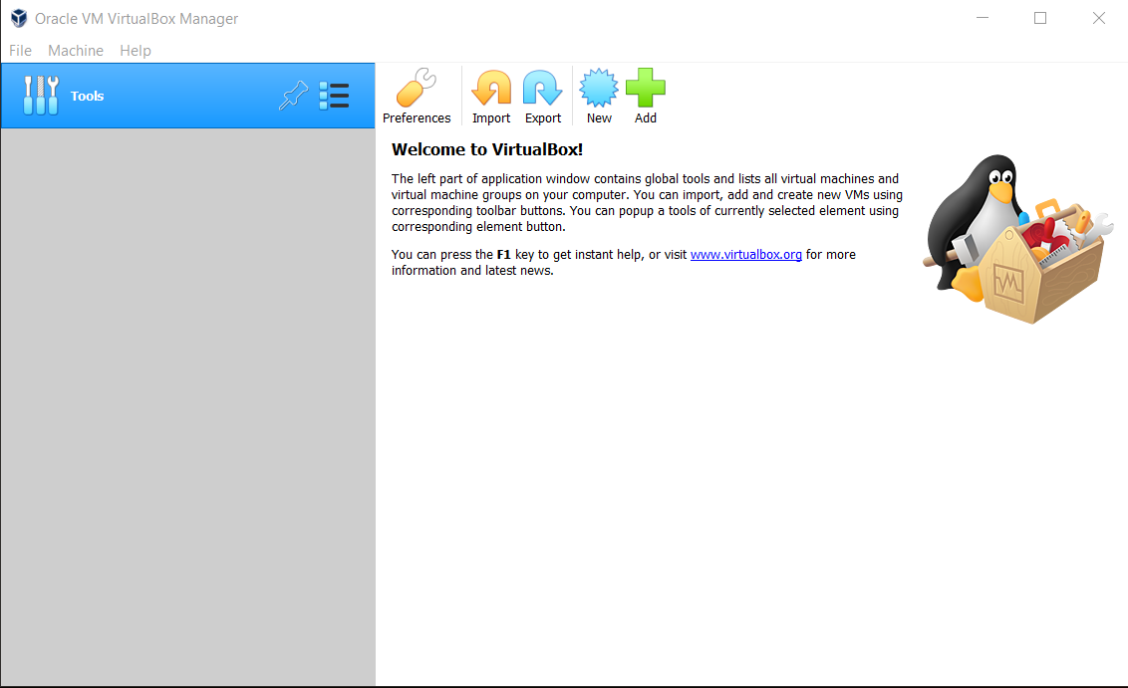
Add an empty Box
First things first, we need a box to put Ubuntu in, that is our VirtualBox!
Click Here

Slide 4
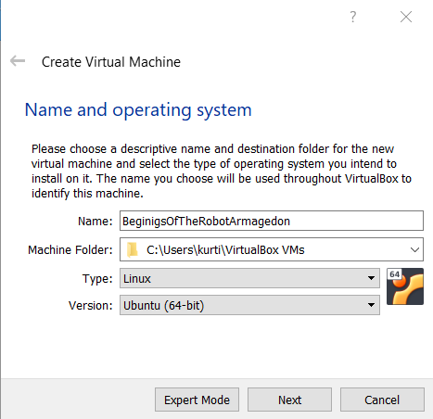
Create Virtual Machine
Here comes some steps
1-Name our VirtualBox
2-Make sure our ‘Type’ is Linux (that is what Ubuntu is)
3-We like Ubuntu Linux, that is what we downloaded!
Next!

Slide 5
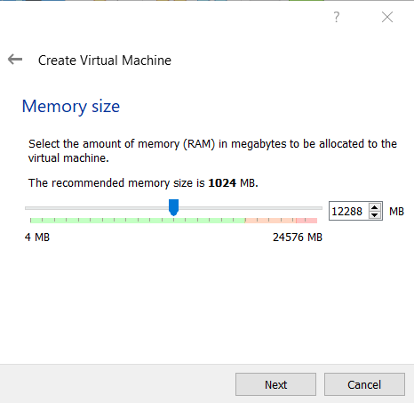
The Memory
When building VirtualBoxes we usually use about half of the available memory.
Note: the memory isn’t split in even 1000 MB increments, it is not the best idea to force this either as 1GB or memory is not 1000 MB but 1024

Slide 6
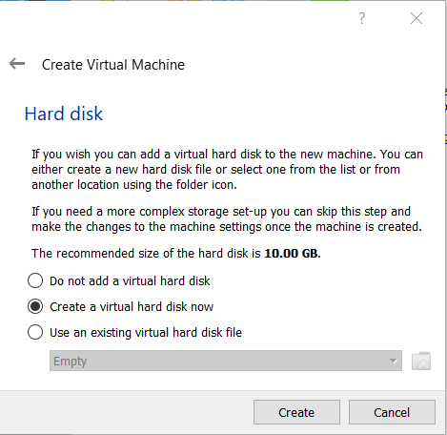
The Storage
Yes, we need a Hard disk, we have to store our world ending Robot Thinkers somewhere.

Slide 7
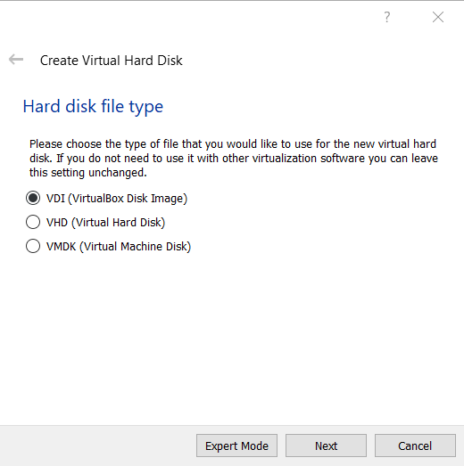
Are we an Apple or an Orange
The defaults will work as we want our VirtualBox software to play nice with us and our to be Ubuntu computer.

Slide 8
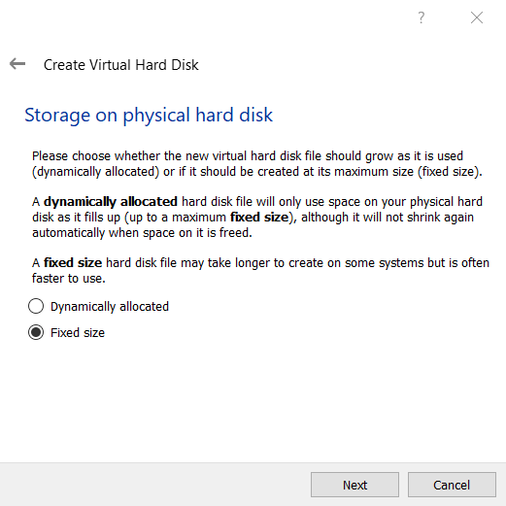
Space or Performance
Here is where choices got a bit complicated.
Dynamically Allocated starts our VirtualBox only as big as what's on it, and will grow as we add until we hit our max.
This is optimal for space limited hosts
Lower performance
Fixed size starts our VirtualBox the size of the set maximum
This is optimal for performance
Bad for space

Slide 9
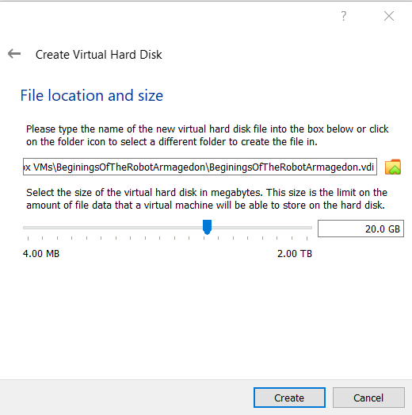
The Size
Now we set what that max size is
We will be adding some hefty software later so having a good sized VirtualBox is nice

Slide 10
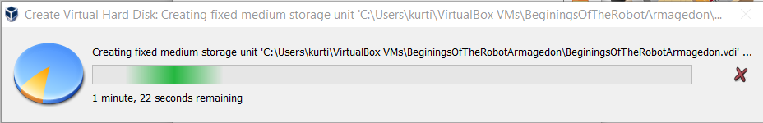
Everything has a loading bar somewhere

Slide 11
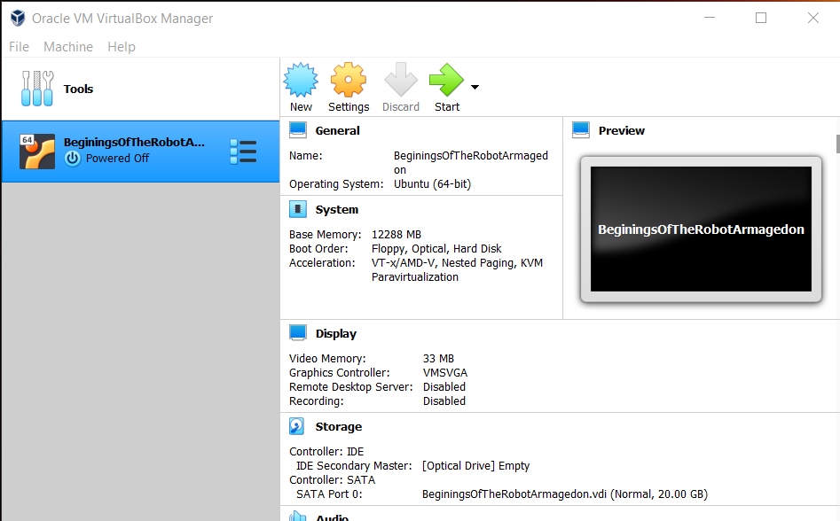
Its just an empty Box
Now that our box is fully made it is time to add Ubuntu
With our VirtualBox selected Click Settings

Slide 12
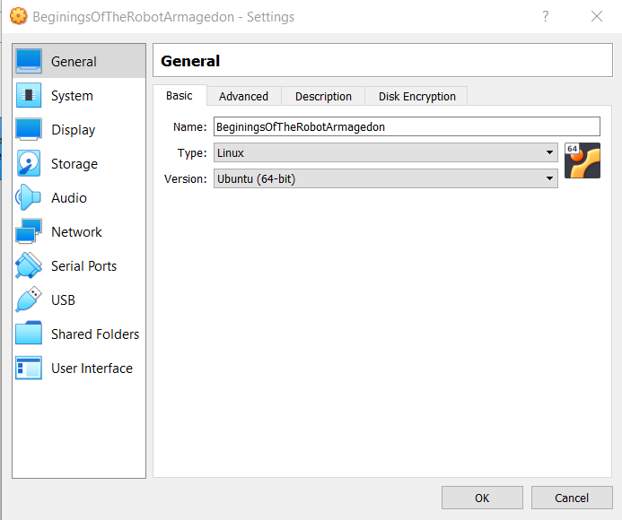
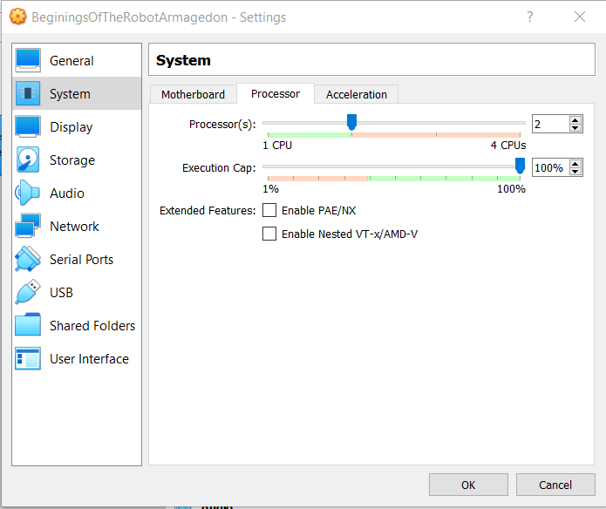
It’s just too slow otherwise
Before we add Ubuntu we will increase our processor core count, this will speed up our VirtualBox massively.
The processor core allocation is located under System
Then the Processor Tab
We cannot add all the cores because or host computer needs some to operate as well.

Slide 13
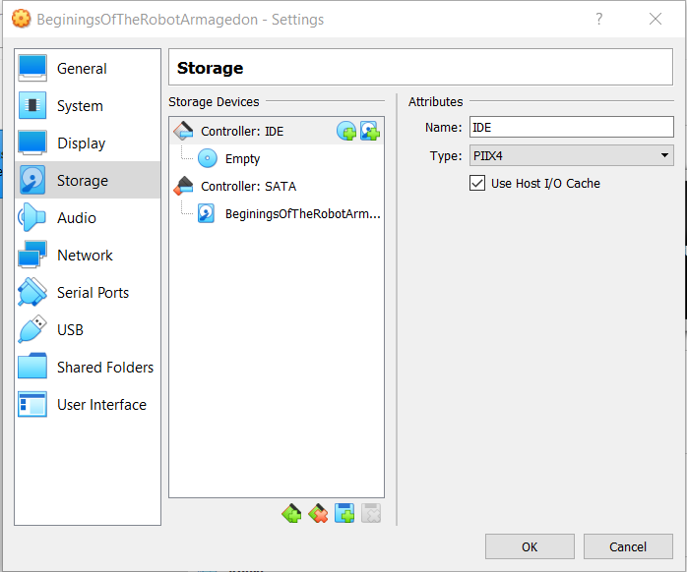
Now to add Ubuntu
We will add the Ubuntu Operating System within Storage
Within Storage Select the add optical drive

Slide 14
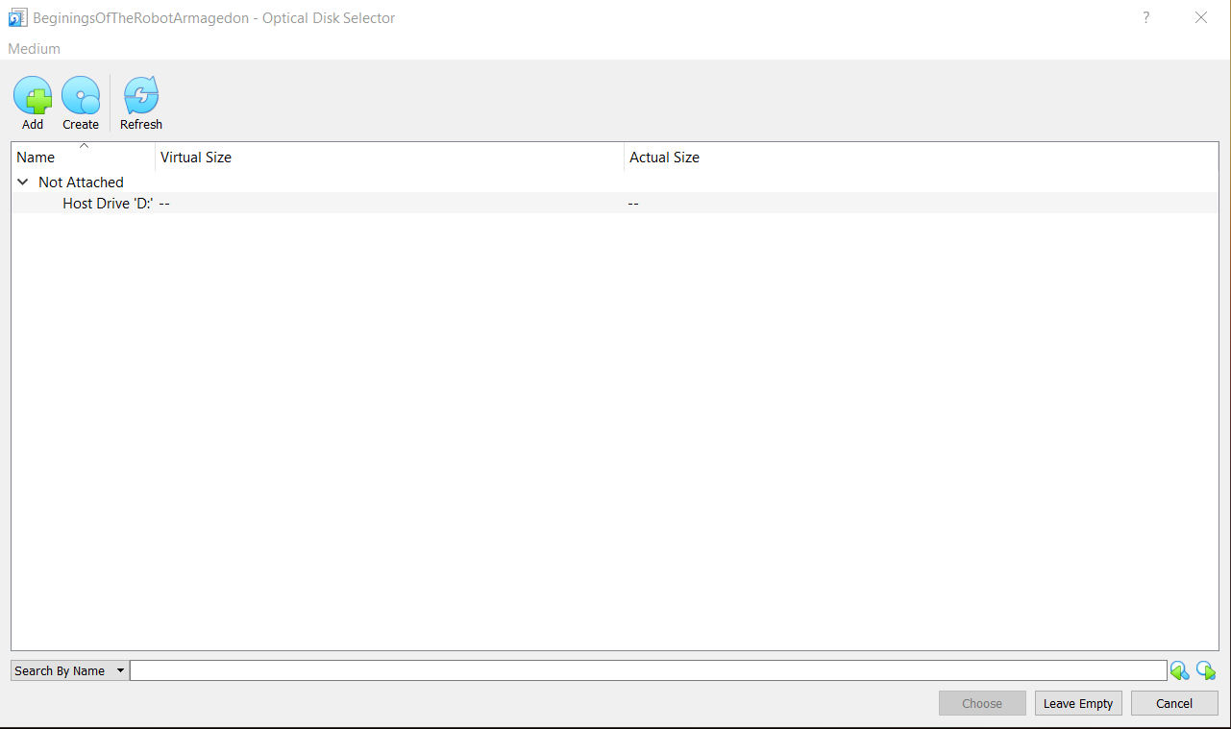
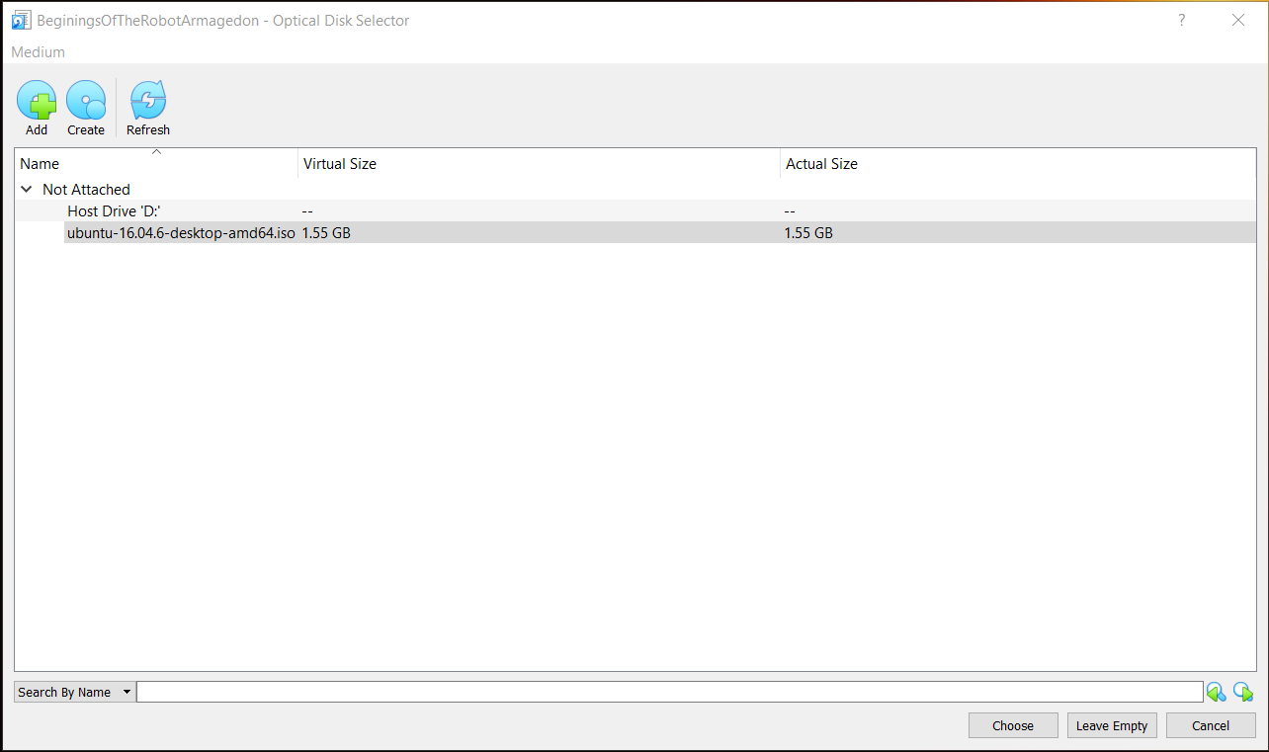
Add Ubuntu
Now we select Add
Find our .iso image
And add it to the VirtualBox storage
Ubuntu I Choose You!

Slide 15
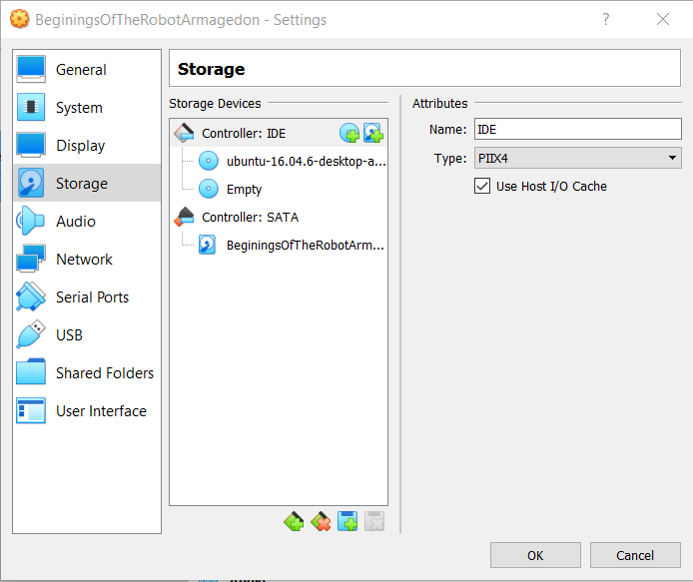
All done here
Click OK to exit, nothing else for us to do here

Slide 16
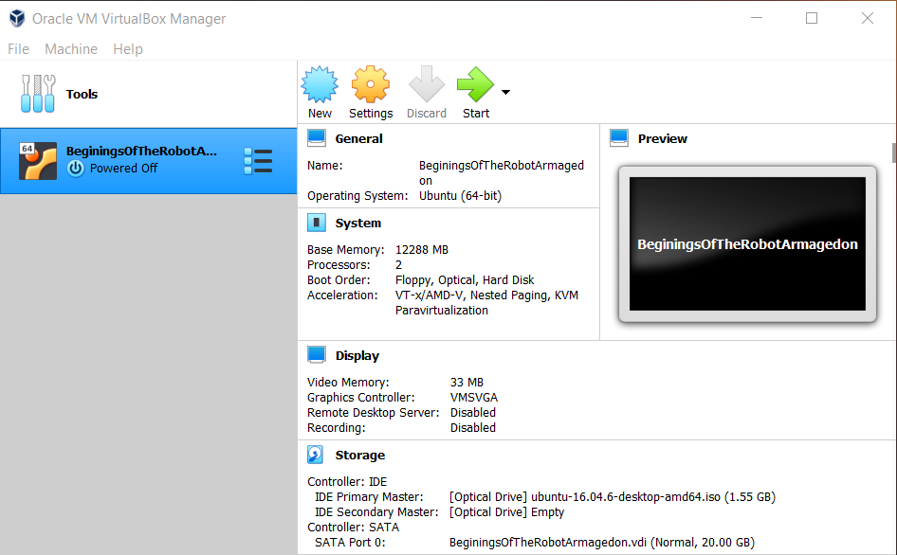
Go Baby Go!
Lets start her up.

Slide 17
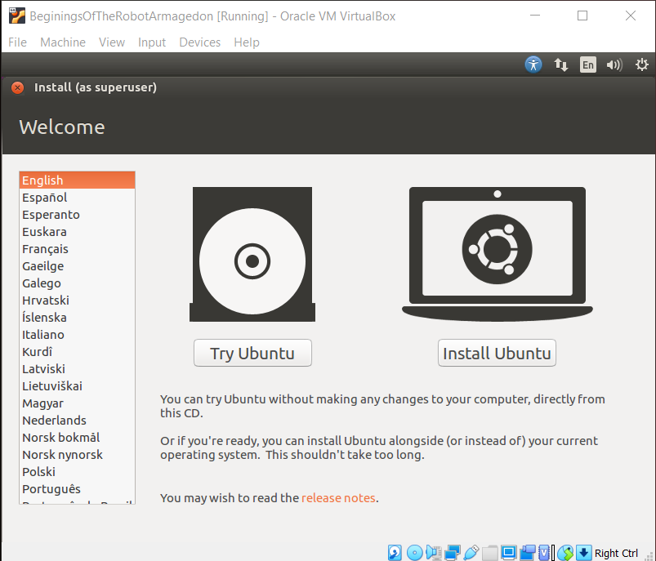
Time to install Ubuntu
We’re not trying nothing, headfirst in the deep end all the way

Slide 18
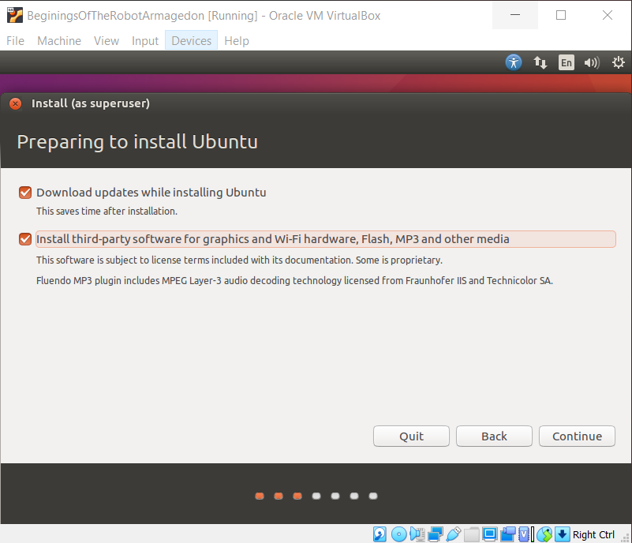
We have already been at this a while
Save time? Hell yay
Not necessary for either of these but if you use cool stuff in or with your host it is recomended

Slide 19
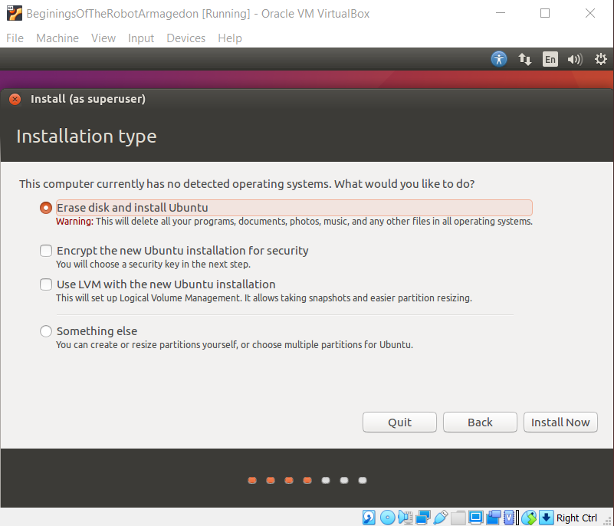
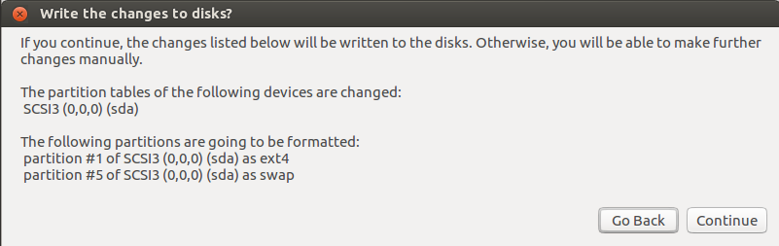
It’s all cool
Nothing to see here anyway
Install and continue away

Slide 20
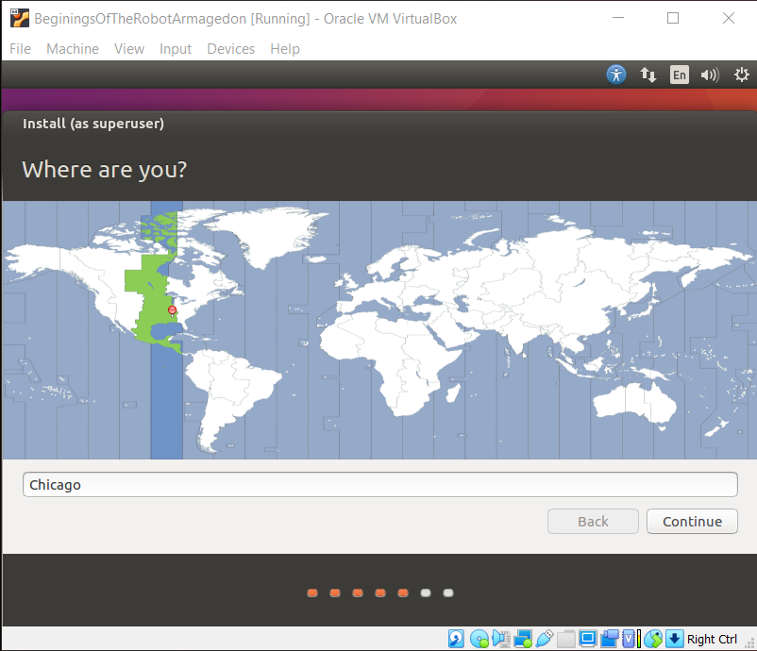
That’s not nice
Just when we though it was going to install
Where we at?

Slide 21
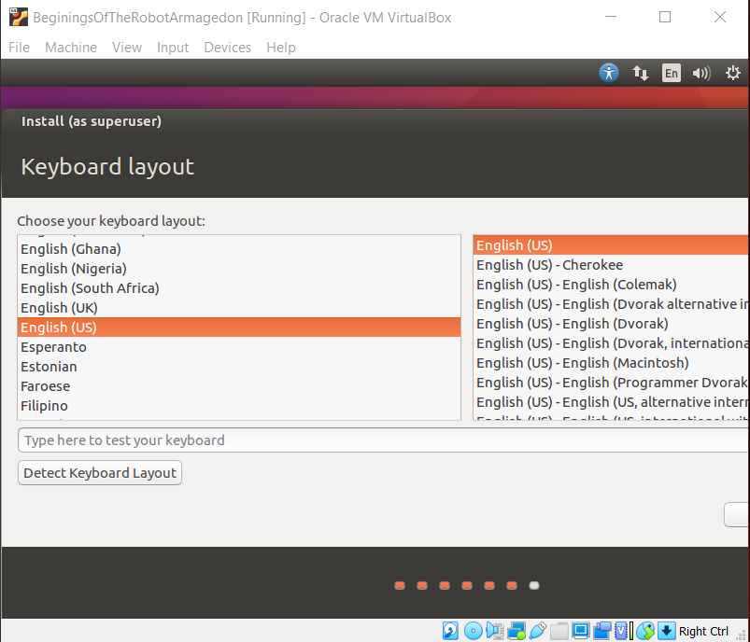
Any fun toys?
Got a cool funky keyboard?
English(US) is the basic QWERTY keyboard

Slide 22
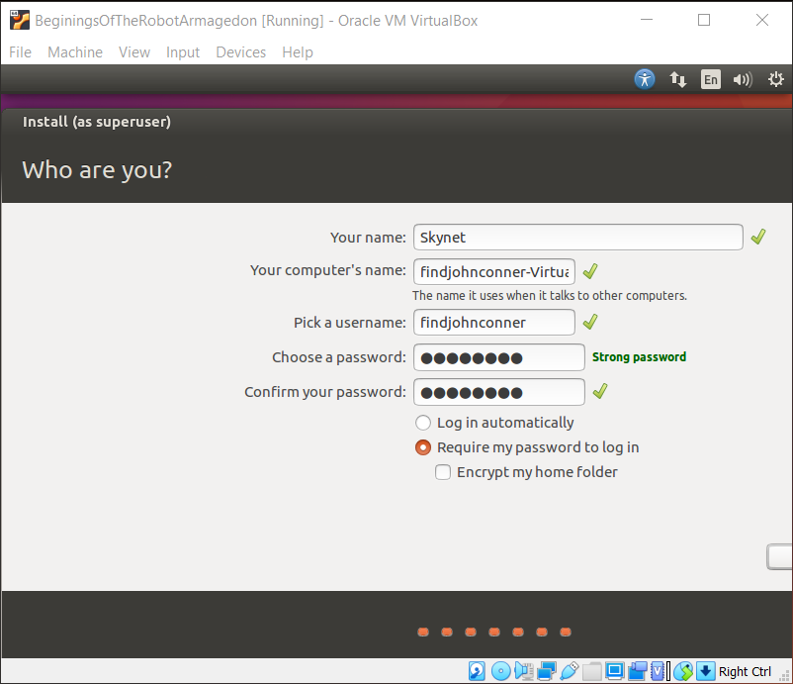
Lets make our login
Note:
As you can see my buttons got cut off T-T
To fix select the last password section then press tab until the button barely shown on the bottom is highlighted, press tab one more time press return/enter
We will permanently fix this after instillation

Slide 23
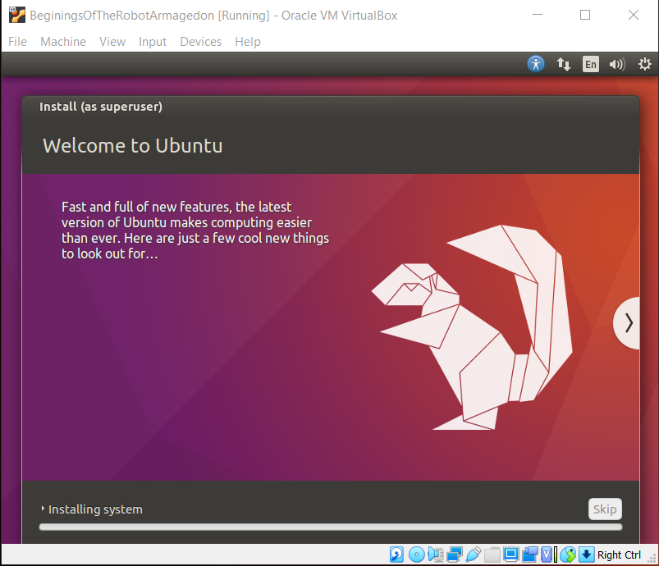
And Off We Go!
This may take a minute

Slide 24
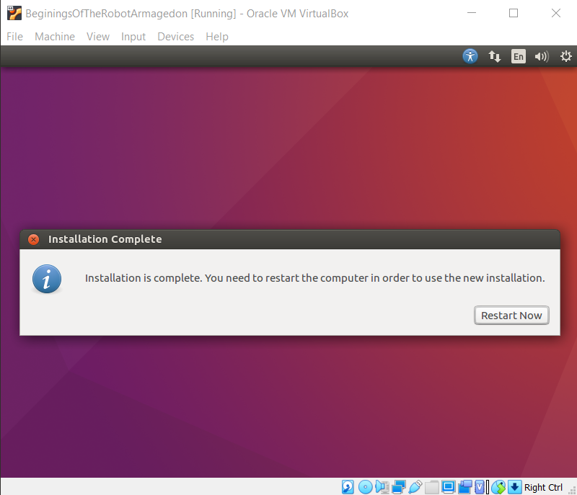
Restart
Finally done with the installation
Just got to fix that glitch, don’t wanting it to show up in the matrix

Slide 25
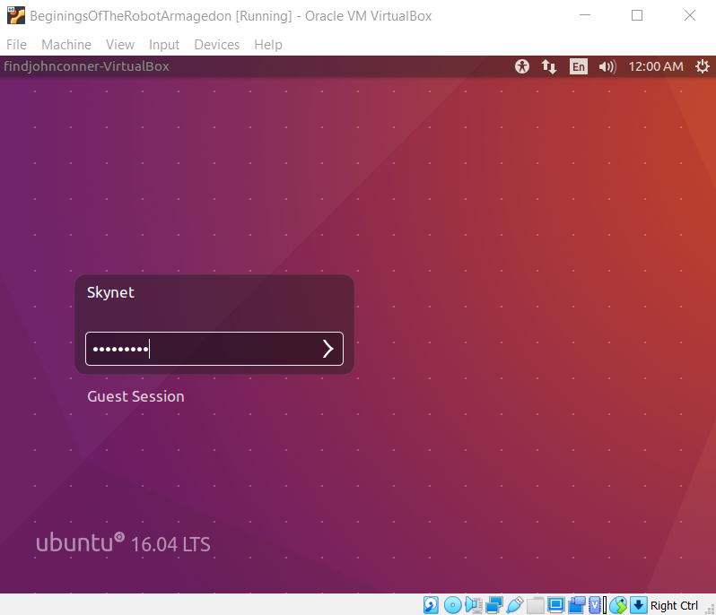
Login to mini-mi computer
Login using the username and password you set up with

Slide 26
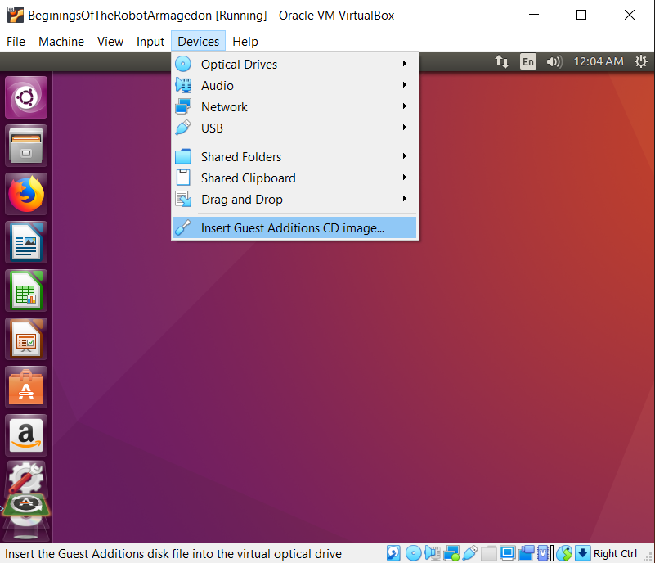
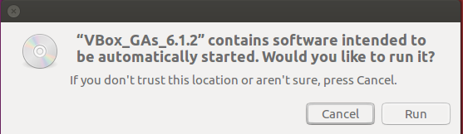
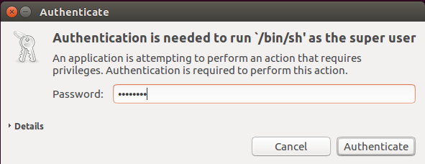
Fix the matrix
To fix our bug
Under Devices select
Insert Guest Additions CD image…
Run and enter password

Slide 27
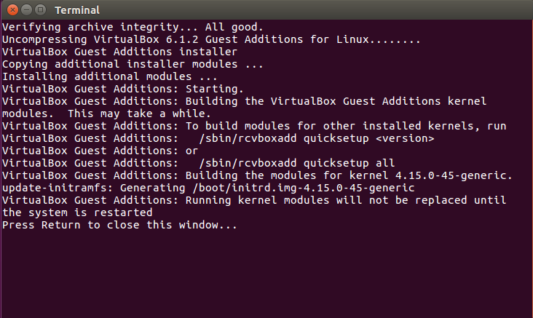
All Done Yay!
With this Ubuntue VirtualBox is up and running

Slide 28
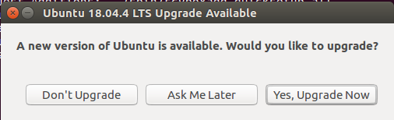
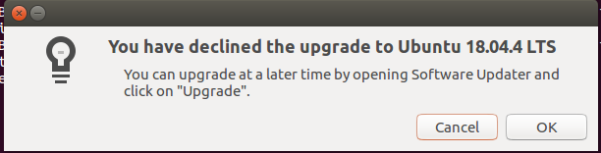
Don’t Update
We downloaded 16.04 because we want 16.04 so no need to update

