Slide 1



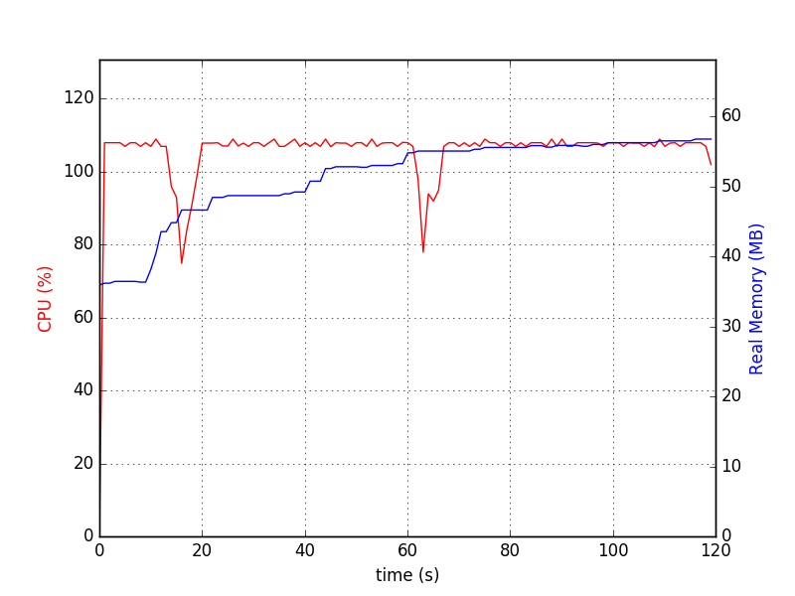
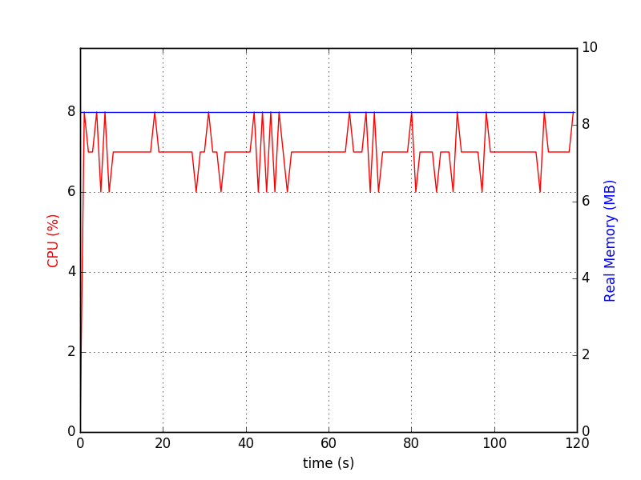
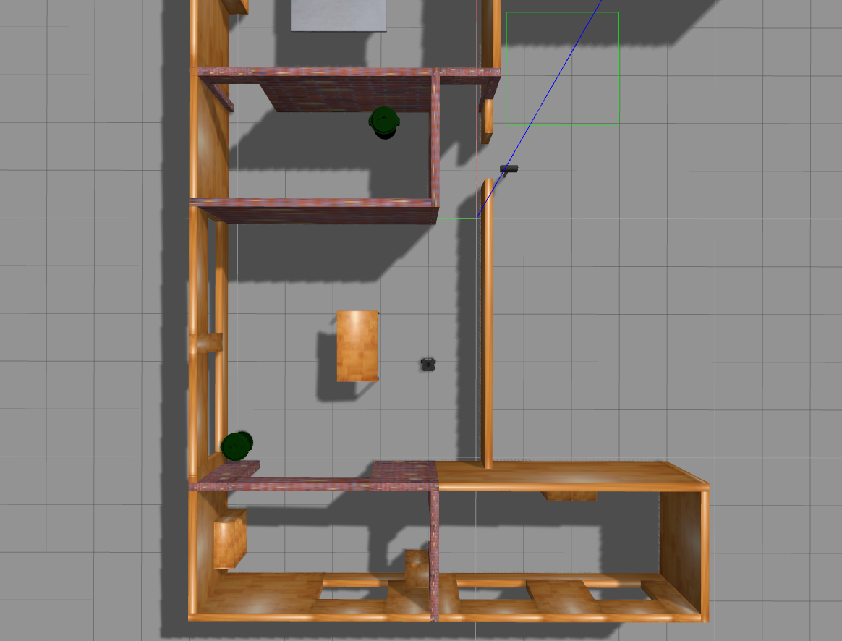
Simultaneous Localization and Mapping Analysis Southwestern Oklahoma State University
Documentation. (n.d.). Retrieved from ROS Wiki: wiki.ros.org
Documentation. (n.d.). Retrieved from ROS Wiki: wiki.ros.org
Jacob Miller | Kurtis Clark | Dr. Jeremy Evert | Department of Computer Science and Engineering Technology
Definitions
Objectives
Data
ROS – Robot Operating System. An open source suite of programs designed to be implemented in various robot platforms
SLAM – Simultaneous Localization and Mapping. The estimation of an unknown map and an agent’s location inside it
Turtlebot – Entry level robotics platform, utilizing open source software
Simulate virtual robot for test and analysis
Analyze SLAM solutions using ROS
Assemble a functional Turtlebot
Emphasize projects related to current research trajectories for NASA, and general robotics applications
SLAM resource usage
Methods
Gazebo resource usage
Settled on parameters to compare: memory and cpu
Utilized bash scripts to automate initialization and resource collection
Analyzed and plotted data
Simulation Example
Project Future
Iterate on data collection method
Deploy in different environments:
Ensures data gathered data isn't tampered by original testing environment
Gives a chance to test tutorials being written as part of project
Address I/O concerns
References
Quigley, M., Conley, K., Gerkey, B., Faust, J., Foote, T., Leibs, J., ... & Ng, A. Y. (2009, May). ROS: an open-source Robot Operating System. In ICRA workshop on open source software (Vol. 3, No. 3.2, p. 5).
Durrant-Whyte, H., & Bailey, T. (2006). Simultaneous localization and mapping: part I. IEEE robotics & automation magazine, 13(2), 99-110.
ROS Documentation. (n.d.). Retrieved from ROS Wiki: wiki.ros.org
This material is based upon work supported by the National Aeronautics and Space Administration under Grant No.NNX15AK02H issued through NASA Education.

