Slide 1
ROS: Robot Operating System
ROS is the medium by which SLAM operates and uses the sensors of the robot.

Slide 2

The Virtual Machine
ROS and SLAM run on a Linux operating system called Ubuntu.
Unless we want to completely wipe out the existing OS on our computer it would be a good idea to use a virtual machine instead.
A virtual machine is like a small computer within a computer, so that the small computer won't affect the outer computer.
We will be using Oracle VM VirtualBox.
VirtualBox can be found at: https://www.virtualbox.org/
To install VirtualBox: VirtualBox Install

Slide 3

Ubuntu 16.04
Now that a virtual machine software has been downloaded, we can install Ubuntu.
Yet we can't just install any version of Ubuntu.
ROS and SLAM run on Ubuntu version 16.04, other versions can cause errors in the software.
Ubuntu 16.04 can be fount at: http://releases.ubuntu.com/xenial/
The image we want is the desktop image, 64-bit (AMD64) desktop image. [or 32-bit if that is what you’re running]

Slide 4
Making the virtual machine
Now that we have both a Virtual Machine maker and an image for an operating system it is time to make the VirtualBox.
Make The VirtualBox

Slide 5
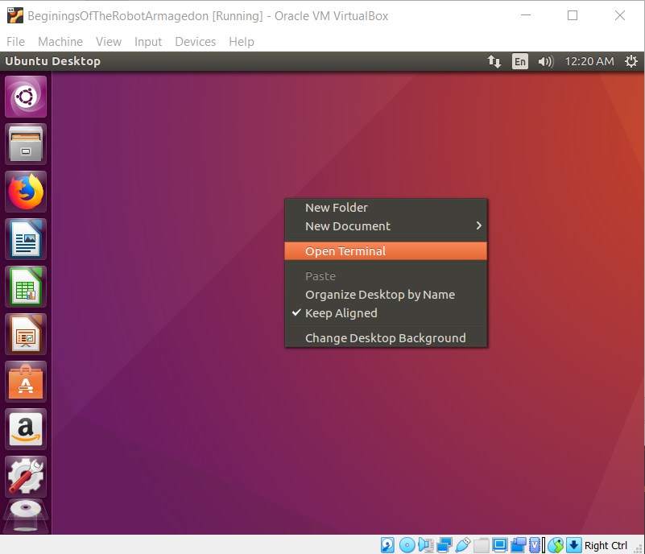
Time to get started
We will now begin working in the terminal
An easy way to open the terminal is to right click the screen and select: open terminal
Or ctrl+alt+t

Slide 6
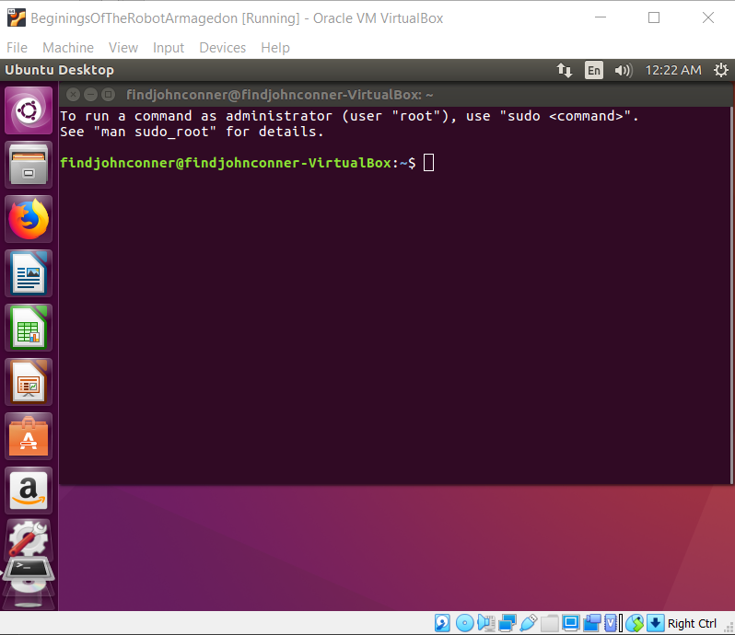
Here is our workspace for a while

Slide 7
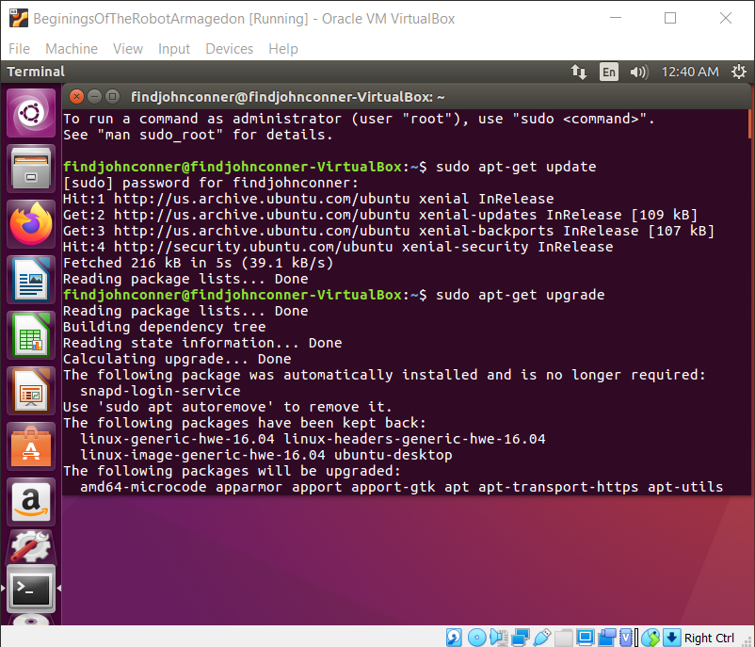
Check for updates
First 2 lines are to check for and update our system
this isn’t an upgrade to a new Ubuntu version, this makes sure all the software and security systems are up to date
$ sudo apt-get update
$ sudo apt-get upgrade

Slide 8
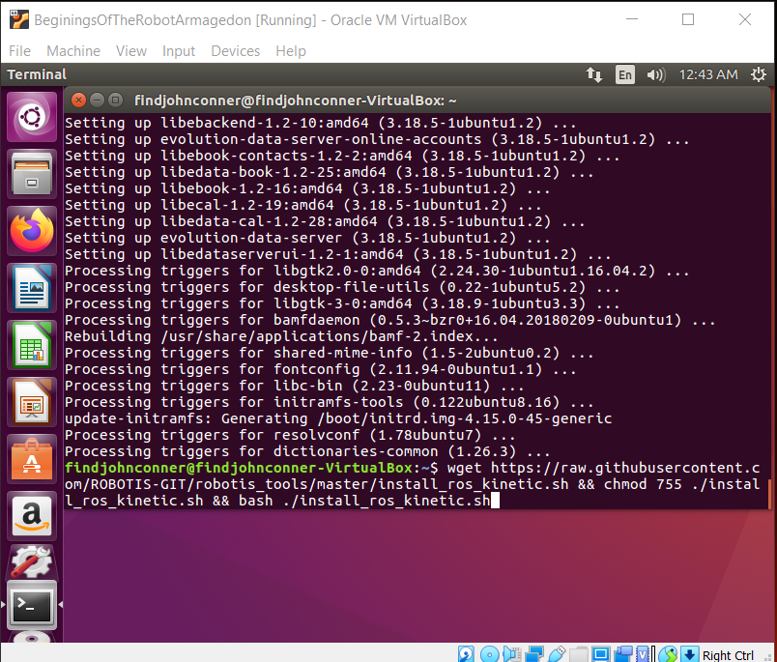
Now to get ROS
Thanks to the lovely people at robotis there is a single line of code that will automatically download ROS for us. Yay!
$ wget https://raw.githubusercontent.com/ROBOTIS-GIT/robotis_tools/master/install_ros_kinetic.sh && chmod 755 ./install_ros_kinetic.sh && bash ./install_ros_kinetic.sh

Slide 9
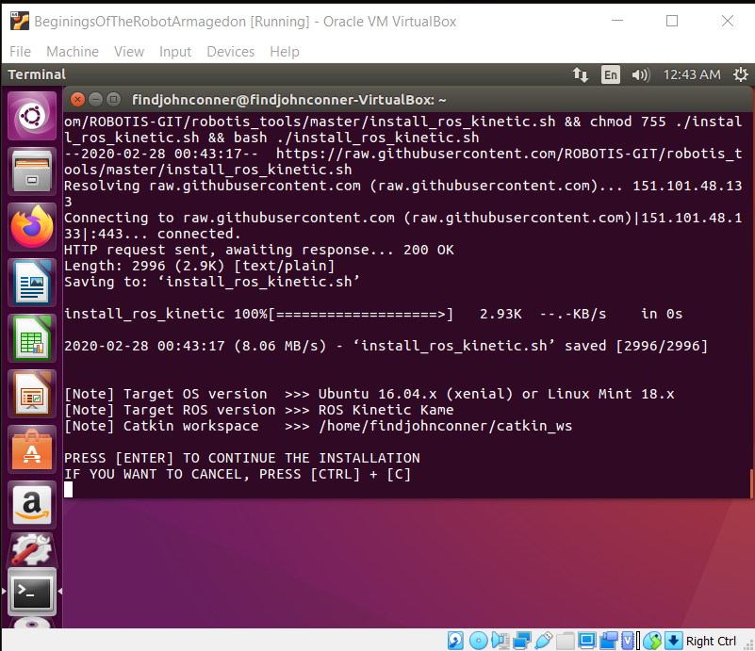
Get ROS
Press return/enter
And the download begins
This may take a while

Slide 10
Make sure we have the dependencies Here is a big line
$sudo apt-get install ros-kinetic-joy ros-kinetic-teleop-twist-joy ros-kinetic-teleop-twist-keyboard ros-kinetic-laser-proc ros-kinetic-rgbd-launch ros-kinetic-depthimage-to-laserscan ros-kinetic-rosserial-arduino ros-kinetic-rosserial-python ros-kinetic-rosserial-server ros-kinetic-rosserial-client ros-kinetic-rosserial-msgs ros-kinetic-amcl ros-kinetic-map-server ros-kinetic-move-base ros-kinetic-urdf ros-kinetic-xacro ros-kinetic-compressed-image-transport ros-kinetic-rqt-image-view ros-kinetic-gmapping ros-kinetic-navigation ros-kinetic-interactive-markers

Slide 11
Last step for ROS
$ cd ~/catkin_ws/src/
$ git clone https://github.com/ROBOTIS-GIT/turtlebot3_msgs.git
$ git clone https://github.com/ROBOTIS-GIT/turtlebot3.git
$ cd ~/catkin_ws && catkin_make

Slide 12
Braiiiins
ROS=Robot Operating System
ROS is the brains of a robot
Not so much the physical equivalent but more of the robots ability to think

Slide 13
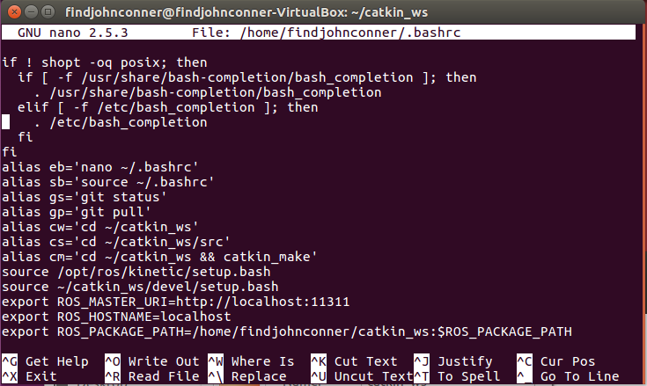
Common Errors
A common error I ran into was that my the commands I was running couldn’t find the dependencies they relied on.
To fix this:
$ nano ~/.bashrc
At the bottom add export ROS_PACKAGE_PATH=/home/findjohnconner/catkin_ws:$ROS_PACKAGE_PATH
Ctrl x
Y then Enter/return
This is your username

Slide 14
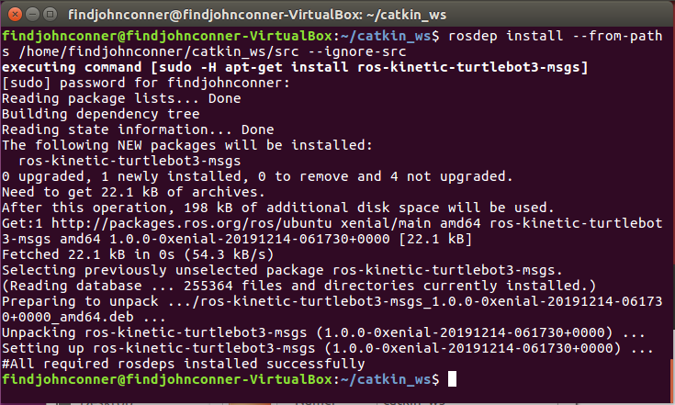
Common Errors
Another error is missing dependencies
Because we are getting a lot of our stuff from GitHub we are not actually installing many of the dependencies
To remedy this all we need to do is run
$ rosdep install --from-paths /home/findjohnconner/catkin_ws/src --ignore-src

Slide 15
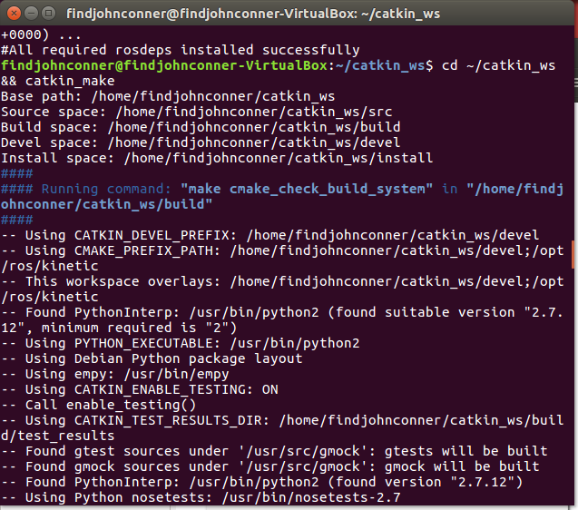
World Builder
Now that we have our robot brains we need a world for it to explore
We get this with gazebo
$ cd ~/catkin_ws/src/
$ git clone https://github.com/ROBOTIS-GIT/turtlebot3_simulations.git
$ cd ~/catkin_ws && catkin_make

Slide 16
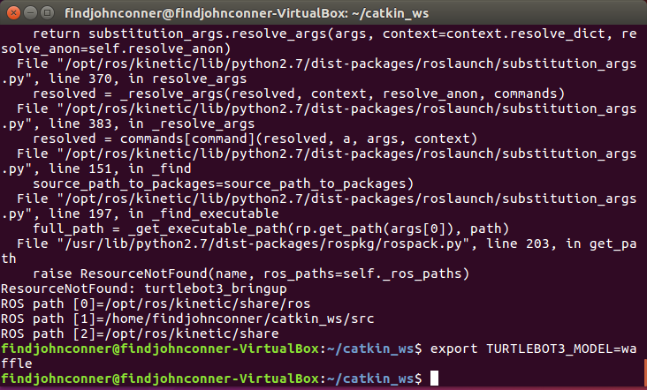
Start the robo
Now we got to tell ROS what kind o’robo we will be using
$ export TURTLEBOT3_MODEL=waffle
Or “burger”

Slide 17
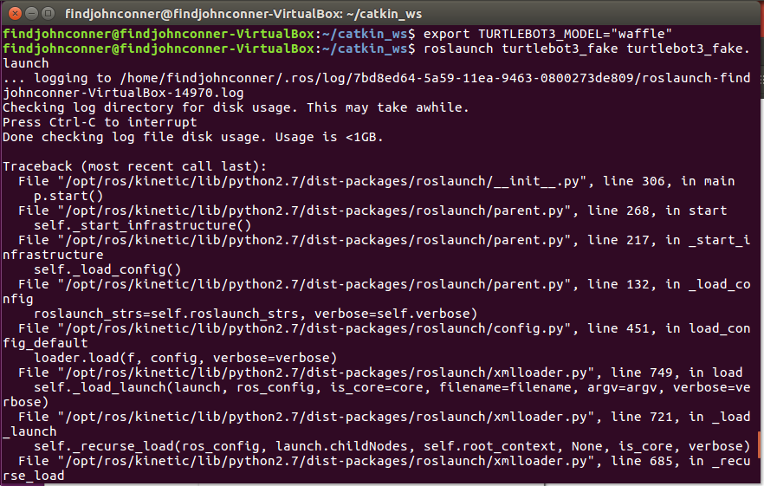
Launch the world
Now to launch our robot
$ roslaunch turtlebot3_fake turtlebot3_fake.launch
This opens up our world and drops our robo inside

Slide 18
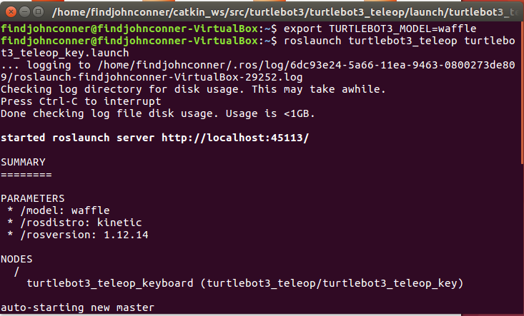
Take control
Now to control our robo
First open a new terminal right click screen or ctrl + t
Now we need to tell what robo $ export TURTLEBOT3_MODEL=waffle
And to control our robo
$ roslaunch turtlebot3_teleop turtlebot3_teleop_key.launch
This window needs to be open to control the robo

Slide 19
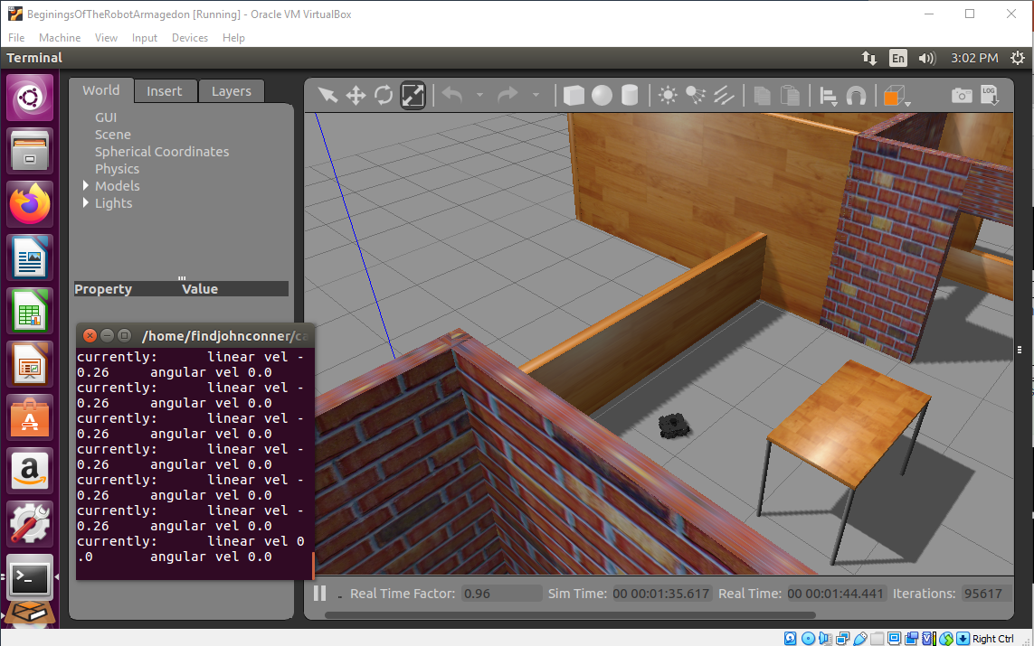
Other worlds
Instead of running fake.launch we can use gazebo and run inside worlds with stuff!
Run these instead then run teleop
$ export TURTLEBOT3_MODEL=waffle
$ roslaunch turtlebot3_gazebo turtlebot3_house.launch

Slide 20

More Worlds
To see more world types as well as much more detailed info about the turtlebot and ROS go here:
http://emanual.robotis.com/docs/en/platform/turtlebot3/simulation/#turtlebot3-simulation-using-fake-node

Slide 21
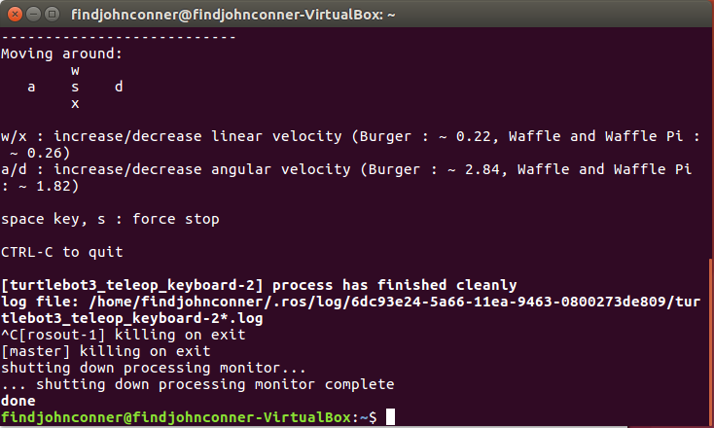
To end our fun
To close down our robo sim we close the application
Then inside out terminal we use ctrl+c
Now we can close and shut down

Slide 22
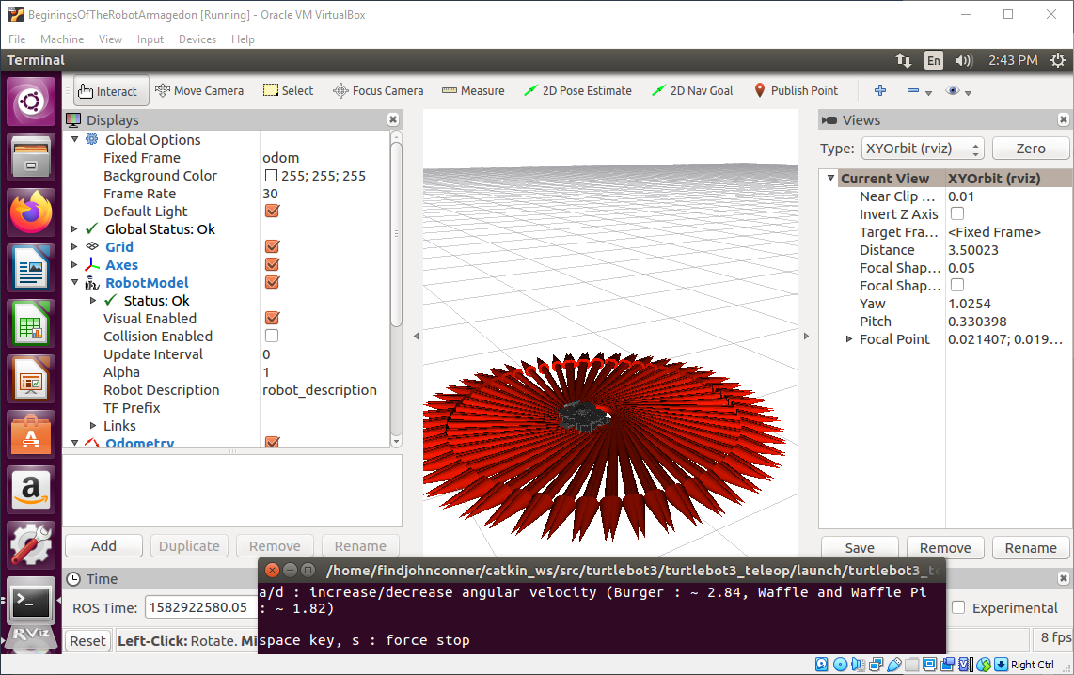
For next time
Now that all the software is installed, all we have to do to run our simulations again is to start over from Start the robo.

