Slide 1



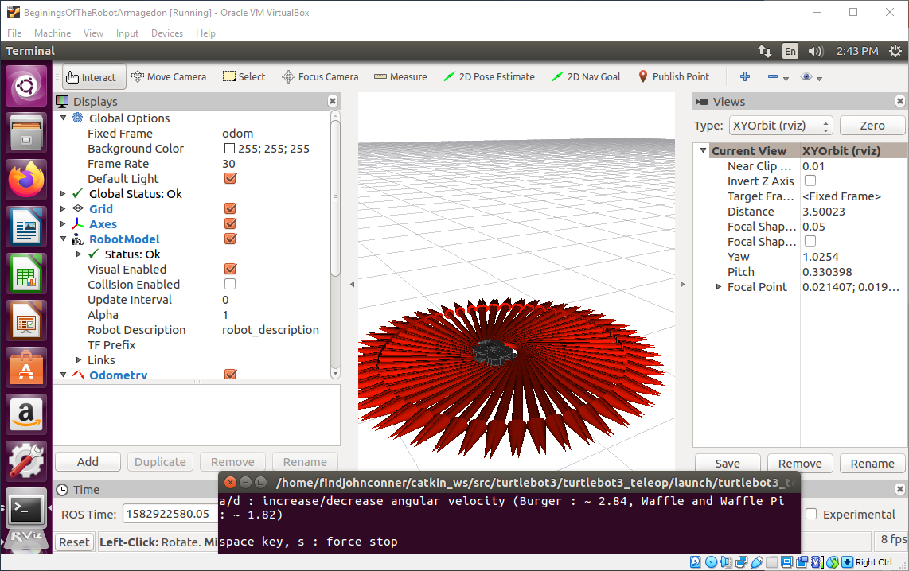
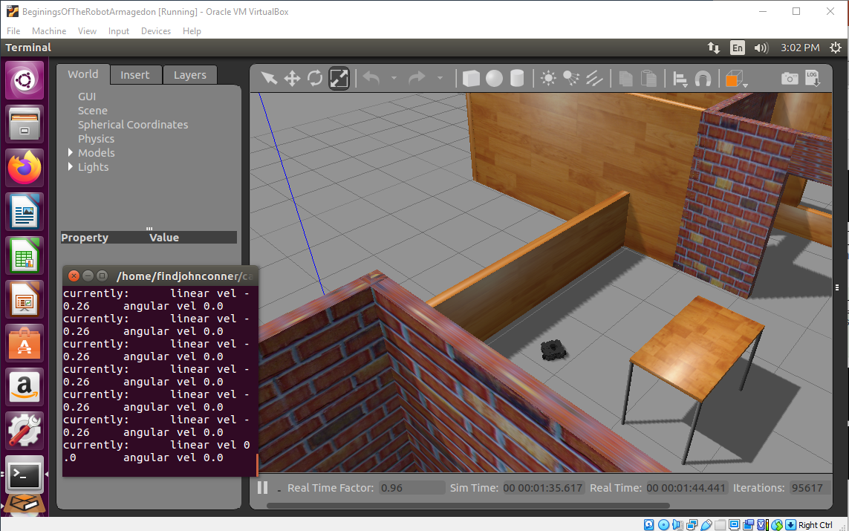
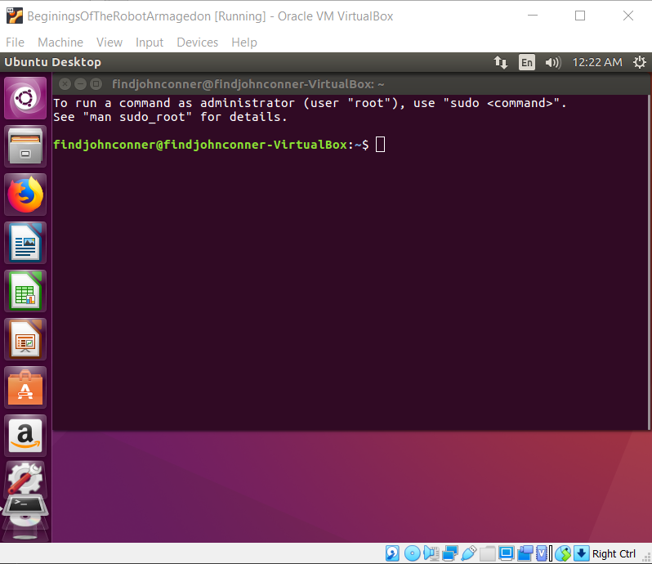
Robot Simulation Analysis Southwestern Oklahoma State University
Documentation. (n.d.). Retrieved from ROS Wiki: wiki.ros.org
Documentation. (n.d.). Retrieved from ROS Wiki: wiki.ros.org
Kurtis Clark | Jacob Miller | Dr. Jeremy Evert | Department of Computer Science and Engineering Technology
Definitions
Objectives
The End Product
ROS – Robot Operating System. An open source suite of programs designed to be implemented in various robot platforms
SLAM – Simultaneous Localization and Mapping. The estimation of an unknown map and an agent’s location inside it
Turtlebot – Entry level robotics platform, utilizing open source software
Build a tutorial targeted to Middle School and High School Students to get ROS running on a Virtual Machine
Make ROS and it’s simulations approachable to middle school and high school students.
Project Future
Expand on the Simulation control tutorials, smoothing out the learning curve for the ROS simulations
Make a tutorial teaching about SLAM and how to use and manipulate SLAM
Implement in real life with iRobot Create (Roomba)
The Virtual Machine VirtualBox
References
Methods
ROS Documentation. (n.d.). Retrieved from ROS Wiki: wiki.ros.org
Turtlebot3 Documentation. (n.d.). Retrieved from Robotis: emanual.robotis.com/
Troubleshooting Documentation. (n.d.). Retrieved from community forums: answers.ros.org
Created robot simulation: Gazebo
Created Virtual Machine: VirtualBox with Ubuntu 16.04
This material is based upon work supported by the National Aeronautics and Space Administration under Grant No.NNX15AK02H issued through NASA Education.

