Slide 1
To Install VirtualBox

Slide 2
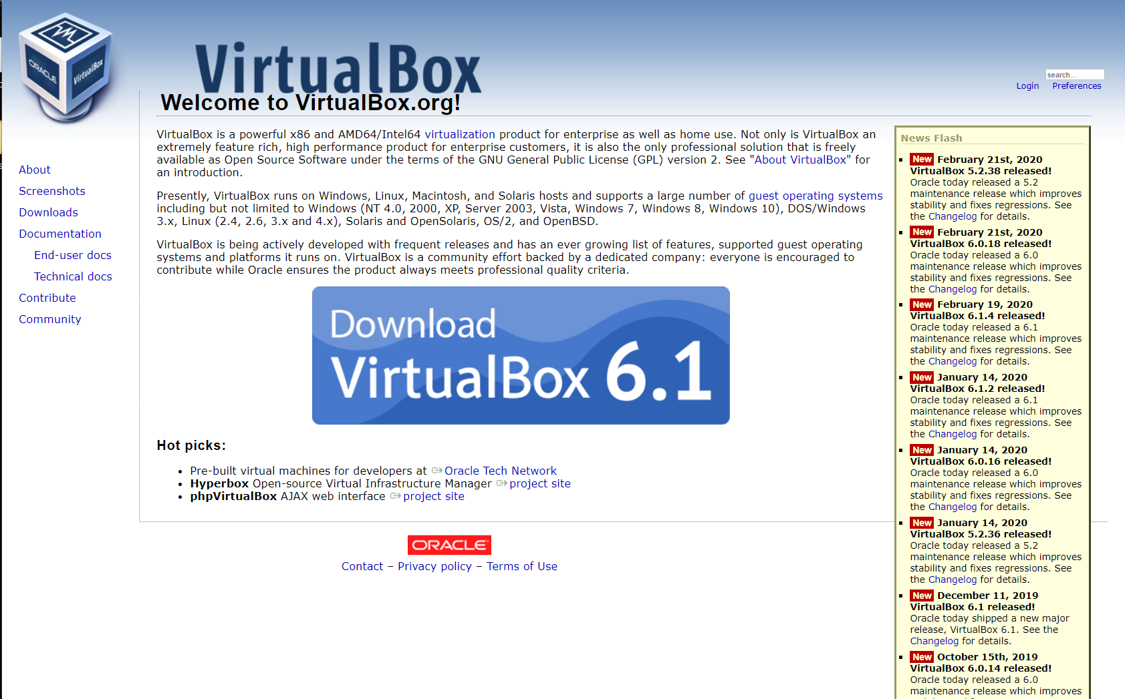
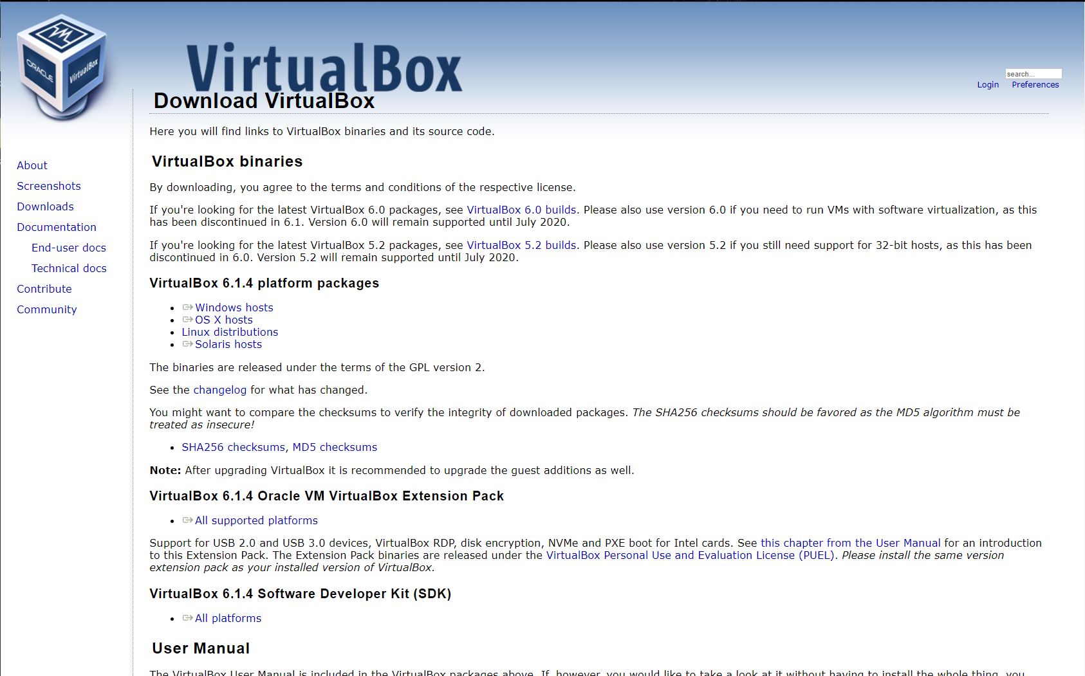
To install VirtualBox:
On the second screen we select which operating system we are using.
Once selected the installer can be saved and the download will begin.
Now to just install.

Slide 3
VirtualBox Main Website:
https://www.virtualbox.org
Press Download to go to next page

Slide 4
Here we select the operating system we will run VirtualBox on
Once selected the installer will download
Select your Operating System

Slide 5
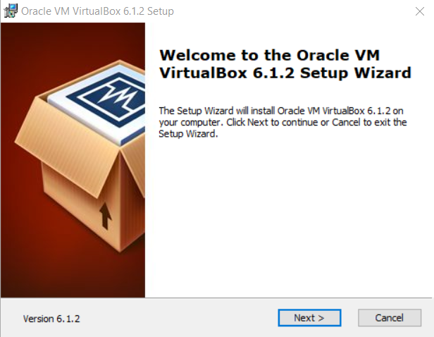

Now we navigate to the installer and double click the application
Upon activating the installer, the first screen we see is the welcome page
Click

Slide 6
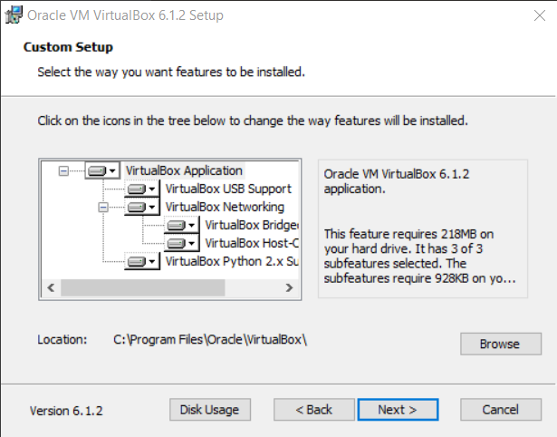

Then is the custom setup.
Thankfully for what we are doing we don’t need to change anything
So, click

Slide 7
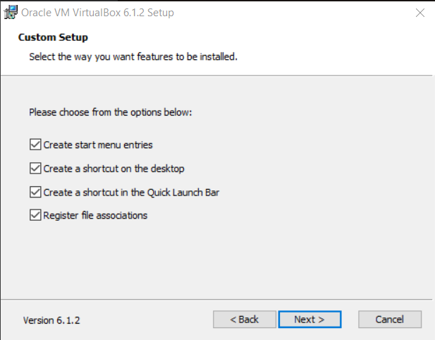

This part of custom setup is up to preference
Click

Slide 8
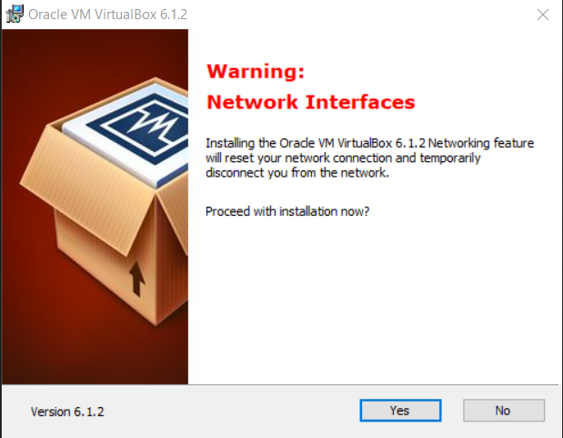

So that your new VirtualBox can connect to the internet without interfering with the host machine, the installer needs to deactivate the network connection and change the network settings.
Kind of like turning off the power when working on a power outlet.
Click
YOU WILL LOSE THE INTERNET DURING INSTALATION
IT WILL COME BACK

Slide 9
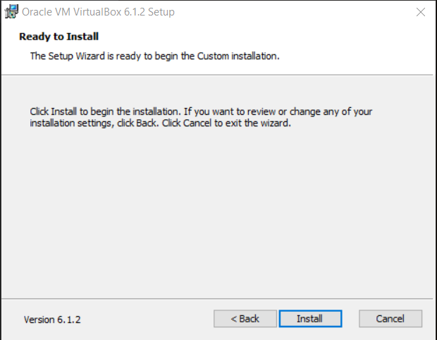

Time to install
Click
Go Baby Go!

Slide 10
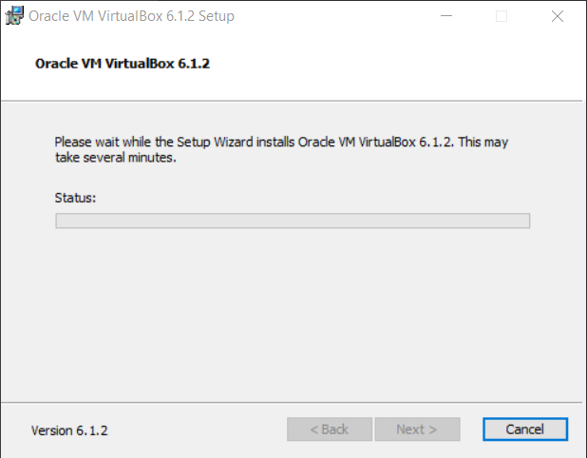
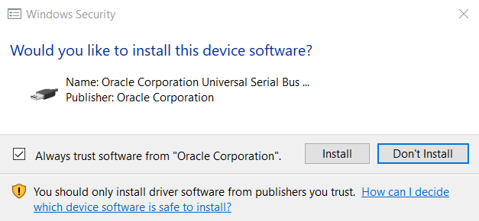
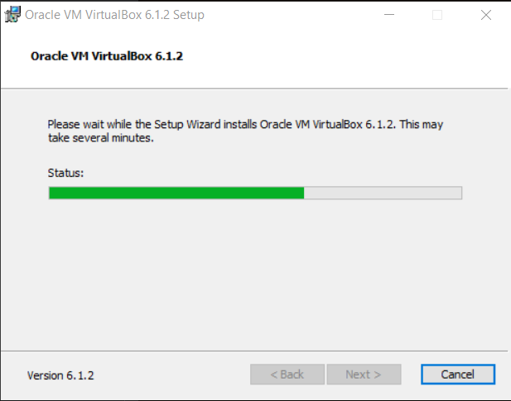

At this point a security window may come up.
The installer is trying to change your computer.
This is because we are telling it to, so click ‘yes’
Yes, Windows Security, we did ask Oracle to install their software.
It is not necessary to have
But without it this dialogue will appear several more times.

Slide 11
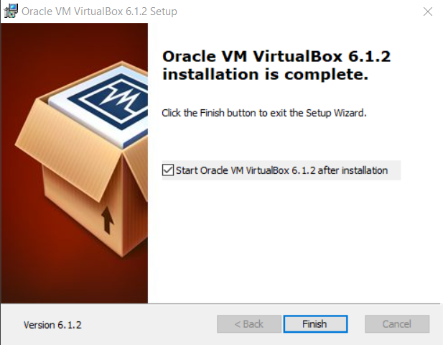
Yay! We’re done!

