Slide 1
Into:
SLAM: Simultaneous localization and mapping
SLAM is the thought process that robots use to navigate the world around them.
The robot uses SLAM to look for and remember where things are around itself.
Then uses that information to figure out where it is in relation to those things.
ROS: Robot Operating System
ROS is the medium by which SLAM operates and uses the sensors of the robot.

Slide 2

Step 1: The Virtual Machine
ROS and SLAM run on a Linux operating system called Ubuntu.
Unless we want to completely wipe out the existing OS on our computer it would be a good idea to use a virtual machine instead.
A virtual machine is like a small computer within a computer, so that the small computer won't affect the outer computer.
We will be using Oracle VM VirtualBox.
VirtualBox can be found at: https://www.virtualbox.org/
To install VirtualBox: VirtualBox Install

Slide 3

Step 2: Ubuntu 16.04
Now that a virtual machine software has been downloaded, we can install Ubuntu.
Yet we can't just install any version of Ubuntu.
ROS and SLAM run on Ubuntu version 16.04, other versions can cause errors in the software.
Ubuntu 16.04 can be fount at: http://releases.ubuntu.com/xenial/
The image we want is the desktop image, 64-bit (AMD64) desktop image. [or 32-bit if that is what you’re running]

Slide 4
Step 3: Making the virtual machine
Now that we have both a Virtual Machine maker and an image for an operating system it is time to make the VirtualBox.
Make The VirtualBox

Slide 5
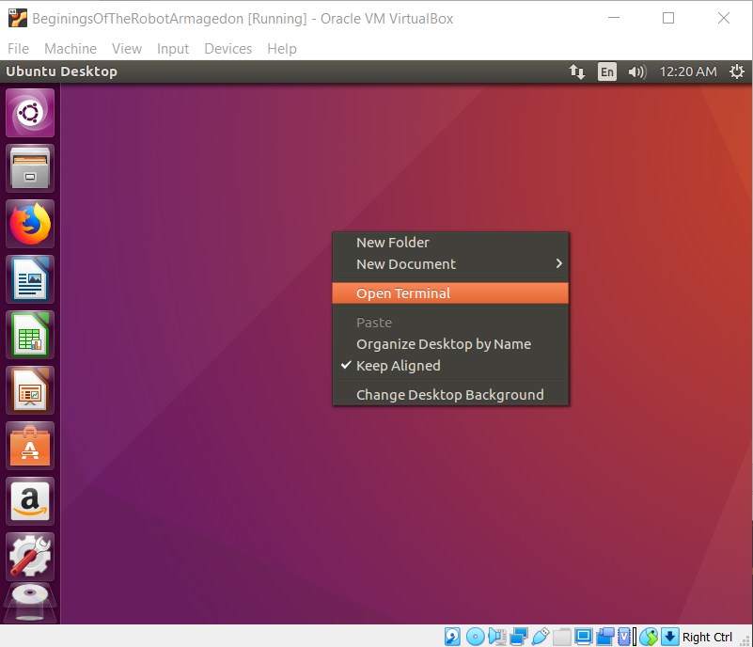
Time to get started
We will now begin working in the terminal
An easy way to open the terminal is to right click the screen and select: open terminal

Slide 6
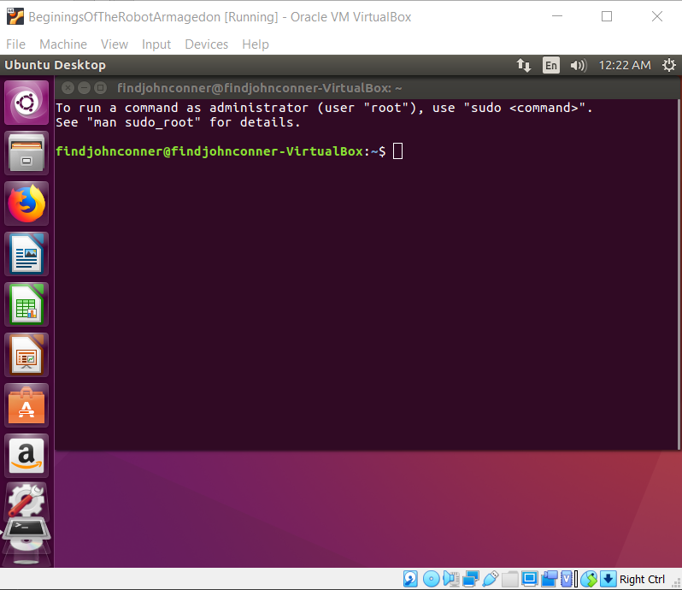
Here is our workspace for a while

Slide 7
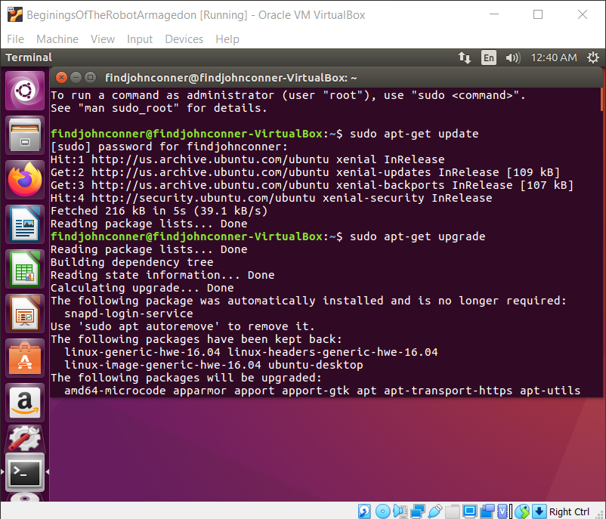
Check for updates
First 2 lines are to check for and update our system
this isn’t an upgrade to a new Ubuntu version, this makes sure all the software and security systems are up to date
$ sudo apt-get update
$ sudo apt-get upgrade

Slide 8
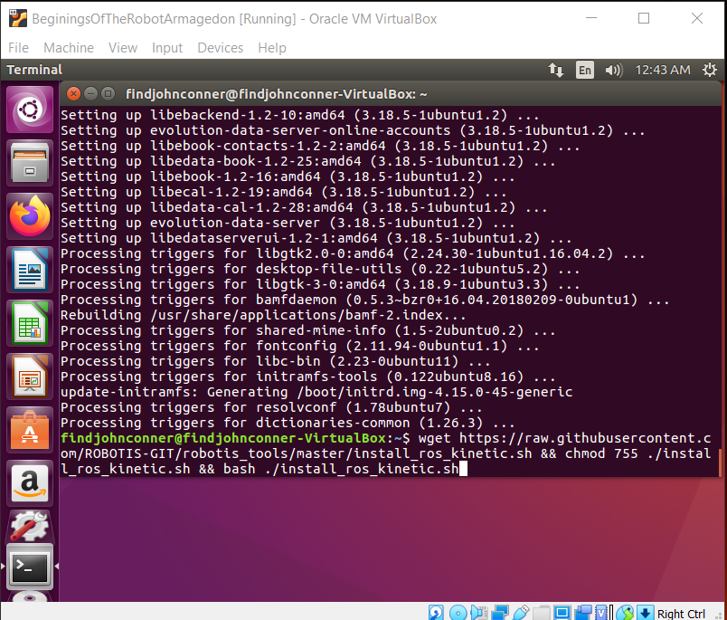
Now to get ROS
Thanks to the lovely people at robotis there is a single line of code that will automatically download ROS for us. Yay!
$ wget https://raw.githubusercontent.com/ROBOTIS-GIT/robotis_tools/master/install_ros_kinetic.sh && chmod 755 ./install_ros_kinetic.sh && bash ./install_ros_kinetic.sh

Slide 9
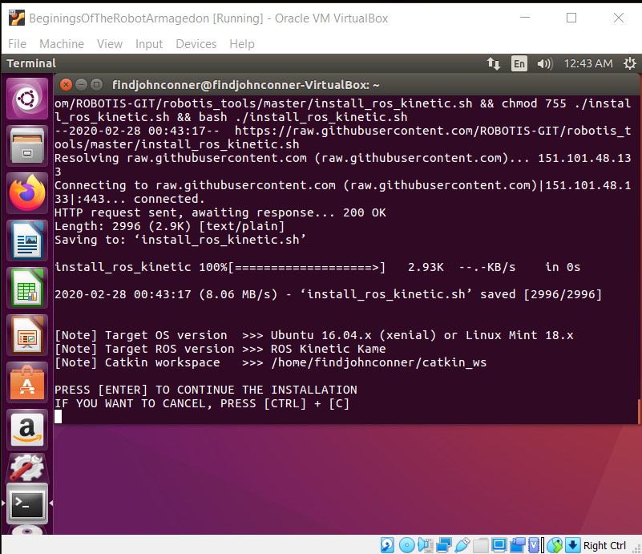
Get ROS
Press return/enter
And the download begins
This may take a while

Slide 10
Braiiiins
ROS=Robot Operating System
ROS is the brains of a robot
Not so much the physical equivalent but more of the robots ability to think

Slide 11
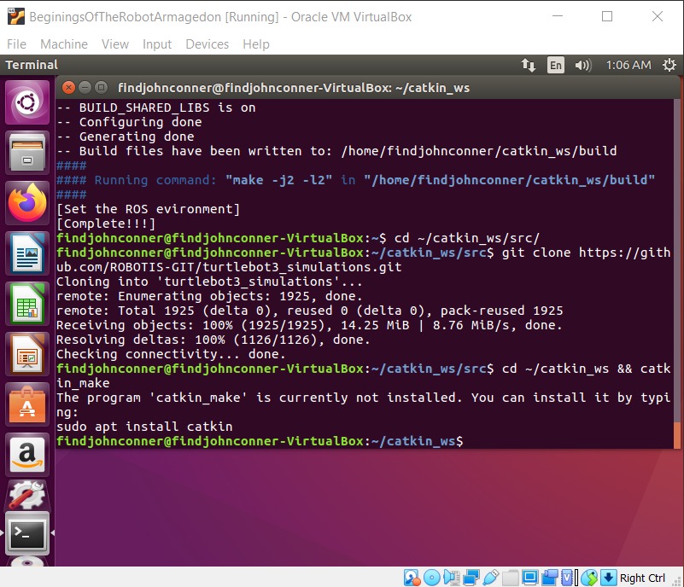
World Builder
Now that we have our robot brains we need a world for it to explore
We get this with gazebo
$ cd ~/catkin_ws/src/
$ git clone https://github.com/ROBOTIS-GIT/turtlebot3_simulations.git
$ cd ~/catkin_ws && catkin_make

Slide 12
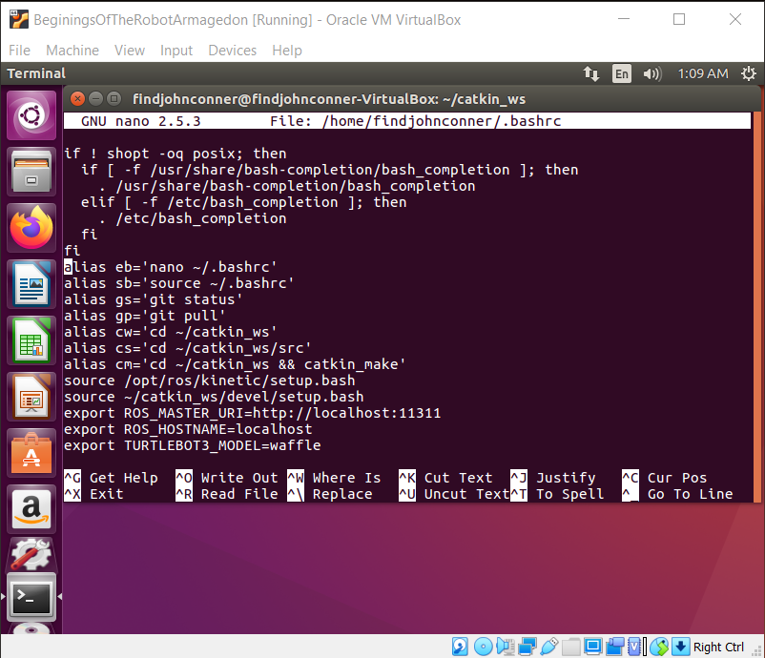
Bit more to do
Now that we have gazebo, we need to do a bit of configuration editing
nano ~/.bashrc
add to bottom of file export TURTLEBOT3_MODEL=waffle
Ctrl x
Y, enter/return to save

Slide 13
Missing depenencies
To get some packages needed to launch lets install some packages
$ sudo apt install python-catkin-pkg
$ sudo apt install catkin
$ sudo apt install python-roslib

Slide 14
Launch the robo
Now to launch our robot
$ roslaunch turtlebot3_fake turtlebot3_fake.launch

Slide 15
