Slide 1


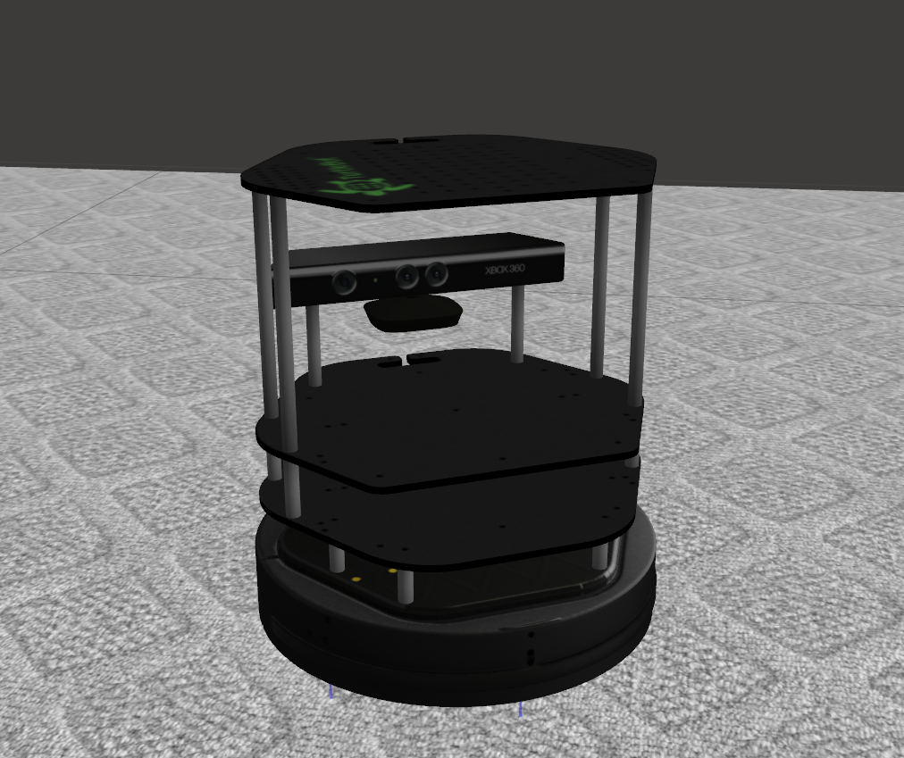
Robot Simulation Analysis Southwestern Oklahoma State University
Documentation. (n.d.). Retrieved from ROS Wiki: wiki.ros.org
Documentation. (n.d.). Retrieved from ROS Wiki: wiki.ros.org
Jacob Miller | Dr. Jeremy Evert | Department of Computer Science and Engineering Technology
Definitions
Objectives
Visualization
ROS – Robot Operating System. An open source suite of programs designed to be implemented in various robot platforms
SLAM – Simultaneous Localization and Mapping. The estimation of an unknown map and an agent’s location inside it
Turtlebot – Entry level robotics platform, utilizing open source software
Simulate virtual robot for test and analysis
Analyze SLAM solutions using ROS
Assemble a functional Turtlebot
Emphasize projects related to current research trajectories for NASA, and general robotics applications
Gazebo simulation of Turtlebot in crafted environment
Visualization of SLAM in ROS using RVIZ
Project Future
Use already completed work to create a functional, physical robot
Utilize Researchers previous experience in image segmentation to accomplish:
Have robot SLAM autonomously
Analyze and compare SLAM approaches
Have robot seek out a particular object in volume
Turtlebot Example
References
Methods
Quigley, M., Conley, K., Gerkey, B., Faust, J., Foote, T., Leibs, J., ... & Ng, A. Y. (2009, May). ROS: an open-source Robot Operating System. In ICRA workshop on open source software (Vol. 3, No. 3.2, p. 5).
Durrant-Whyte, H., & Bailey, T. (2006). Simultaneous localization and mapping: part I. IEEE robotics & automation magazine, 13(2), 99-110.
ROS Documentation. (n.d.). Retrieved from ROS Wiki: wiki.ros.org
Created robot simulation: Gazebo
Implemented SLAM
Capable of autonomous navigation and simple objectives
This material is based upon work supported by the National Aeronautics and Space Administration under Grant No.NNX15AK02H issued through NASA Education.

