Slide 1

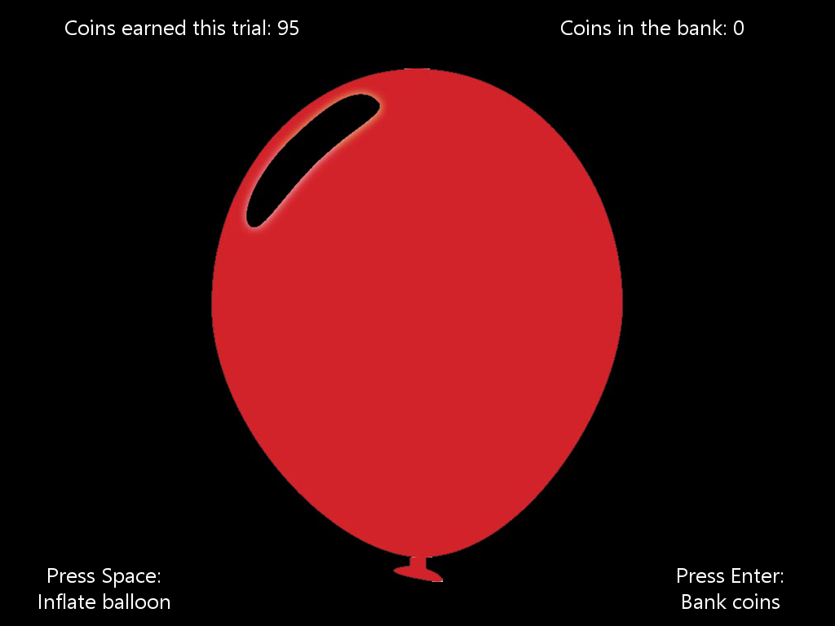
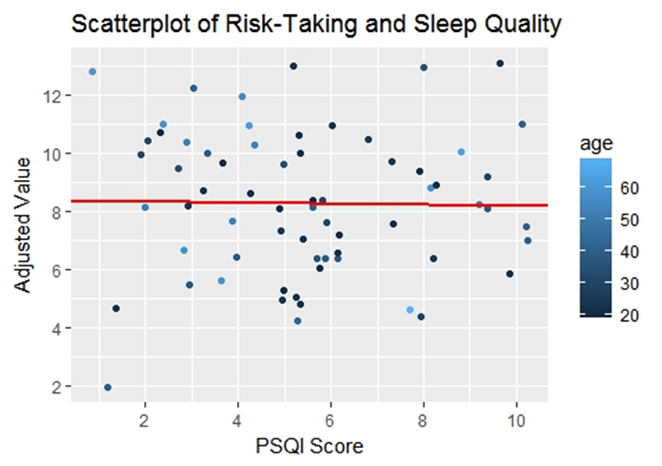
Sleep Quality & Risk-Taking in a General Population
Jacob Leiser
Supervised by Dr Emanuele De Luca and Dr Maria Gardani
Introduction
Aims
Poor sleep quality impacts elements of decision-making like risk-taking.
The relationship between these factors is important given roles such as junior doctors where shift patterns can be irregular and high-risk decisions are part of the job.
Most research in this area focusses on adolescents and poor sleepers.
So this study aims to investigate the relationship between sleep quality and risk-taking in a sample with a wide rang of age and sleep quality.
Method
Participants (n=66, 37 females, 29 males, ages 20-69, M=34.8) completed the Pittsburgh Sleep Quality Index (PSQI) as well as measures of insomnia, anxiety, depression and current sleepiness.
80 trials of the Balloon Analogue Risk Task (proxy measure of risk-taking) were then carried out (as shown on right).
The task requires participants to earn coins by inflating balloons, with an increasing chance of the balloon popping with each inflation .
Results
Correlation Matrix of Questionnaire and Experiment Data
No significant correlation was found between PSQI and risk score (Adjusted Value): r(64) = -0.02, p=0.904.
Participants were then split into good and bad sleepers as per PSQI scoring (≤5 and >5, respectively).
A 2-sample t-test found no significant difference between the risk score means for the two groups: t(64) = 0.34, p = .732.
Conclusions
Non-significant results due to limited range of sleep quality in the sample. Possible PSQI scores range from 0-21 and sample scores were 1-10 (M=5.4).
The sample effectively covered good to average sleepers with no correlation found between sleep quality and risk-taking in this range.
However, experiment code is in Python and analysis in R so can be repeated online in order to recruit a better sample to test hypothesis.

