Slide 1
TEA
Team Name: T
By Jacob London, Yongyuan Zhang, Ziyan Lin, Hmayak Apetyan, Hyung Jin Kim

Slide 2
TEA
TEA (Tiny Encryption Algorithm)
64-bit Feistel cipher
Utilizes a 128-bit key
X number of rounds
64 rounds recommended
Public domain encryption algorithm

Slide 3
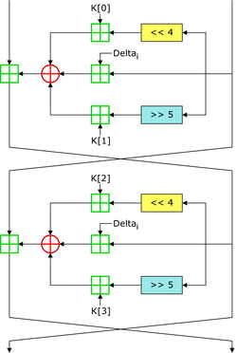
TEA Example (2 rounds)

Slide 4
TEA Implementation
The design of the algorithm is not overly complex
Utilizing concepts learned in class
Goal
Write data to encrypt onto FPGA through UART
Display data through VGA
Show the 64-bit input
Show the 128-bit key
Show the enciphered or deciphered data
Switch control
Switch encipher and decipher mode
Input the number of rounds through the switches

Slide 5
Work Distribution
Encipher
Jacob London
Decipher
Hyung Jin Kim
VGA
Yongyuan Zhang and Ziyan Lin
UART
Hmayak Apetyan

Slide 6
Resources
https://en.wikipedia.org/wiki/XTEA
https://en.wikipedia.org/wiki/Tiny_Encryption_Algorithm
https://en.wikipedia.org/wiki/Feistel_cipher
https://en.wikipedia.org/wiki/Block_cipher

