Slide 1
Plan
Nye koncepter
ego-netværk
constraint – bridging (Burt)
burt vs igraph
assortative mixing (assortativity)

Slide 2
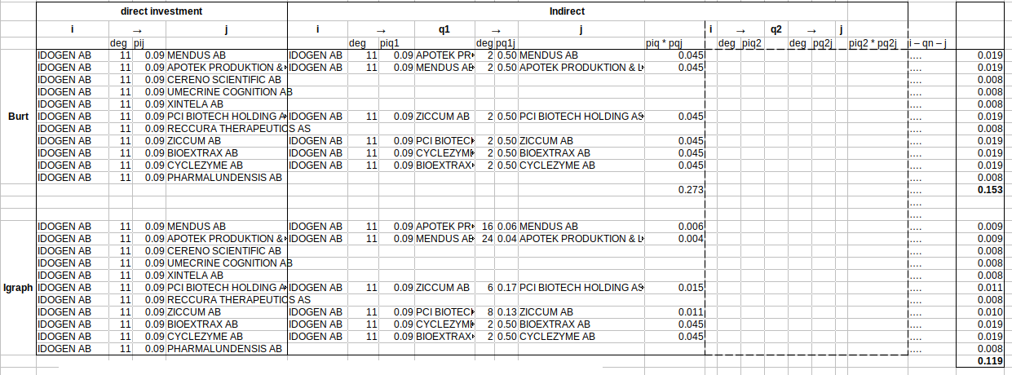
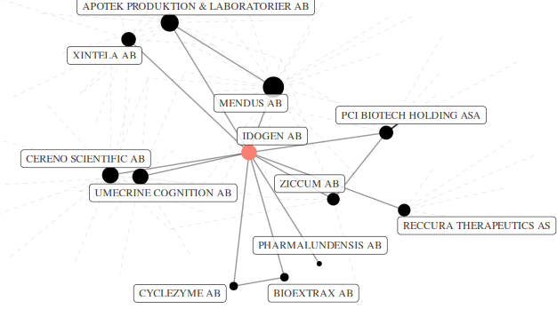

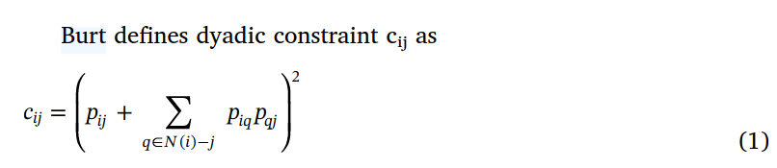
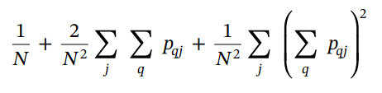
?
c-size
c-density
c-hierarchy

