Slide 1

PrezGo -presentation assistant-
Marketable device for the purpose of attention grabbing and presentator friendly techniques for the speaker to use in presentations
HackMIT 2016 Project
Robert Henning Catherine Zeng Mayukha Vadari Jacob Miske

Slide 2
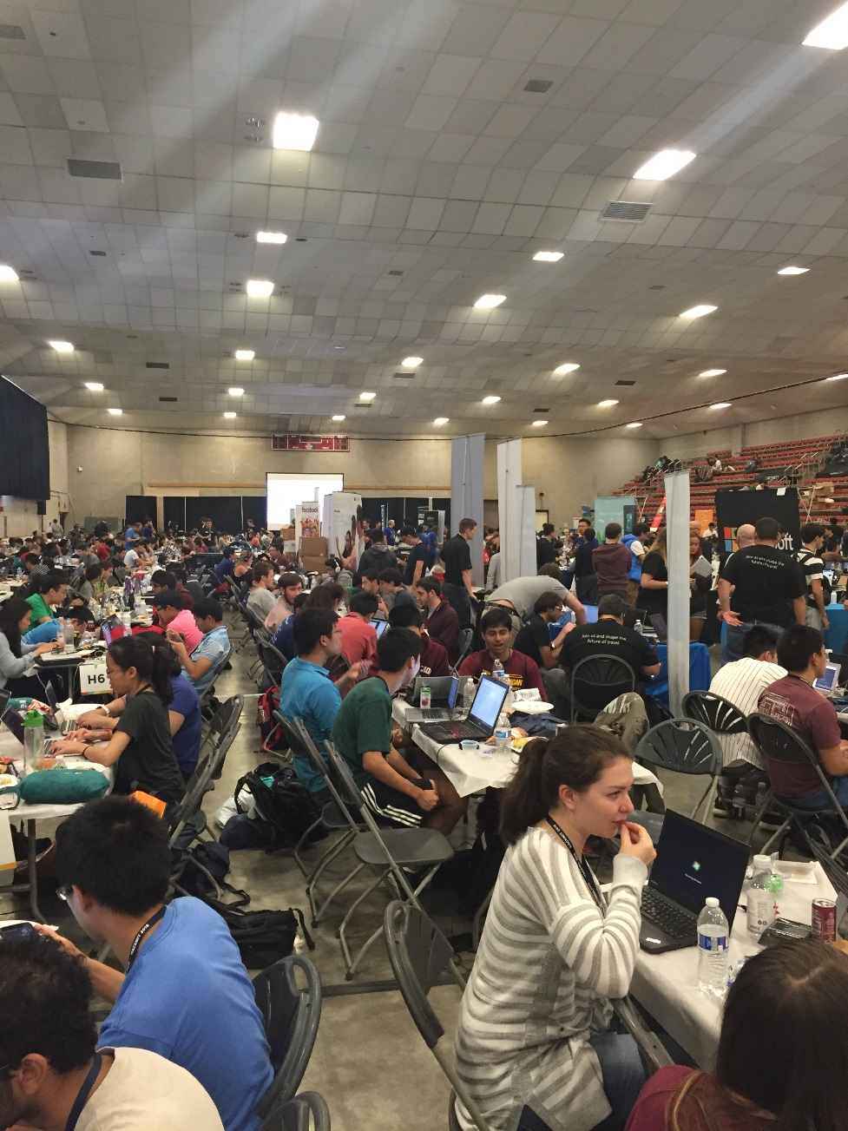
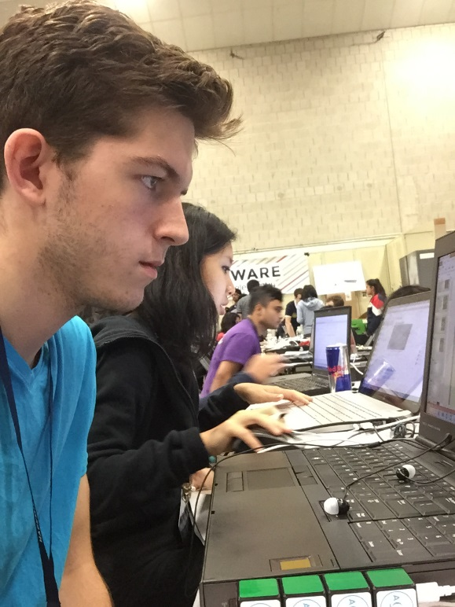
Freshman Hackathon
Our team is made up from four memebers of the class of 2020 at the Massachusetts Institute of Technology. From students with intended majors across the spectrum of course numbers. Our team considered making tools to improve productivity such as chrome extensions that limit and motivate certain activity by the student. We took over table H3 for the day of 9/17/16 in the Johnson Ice Rink.

Slide 3
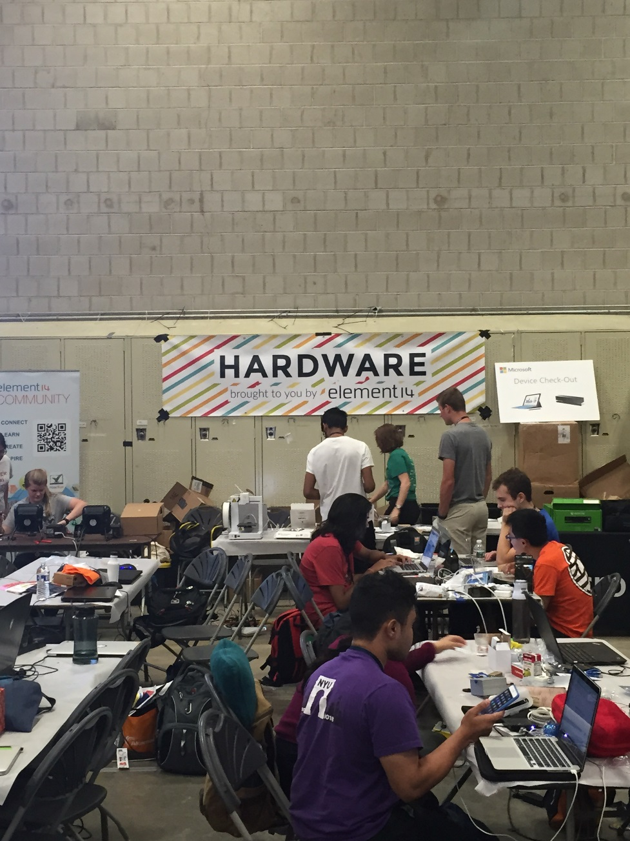
Hardware
We are using a variety of components in conjunction with a Arduino micro. Mainly, two microphones located on different ends of the breadboard will listen and respond to sudden changes in sound density. Snaps and claps will trigger the Arduino to send input after a delay period checks to see how many claps are heard.

Slide 4
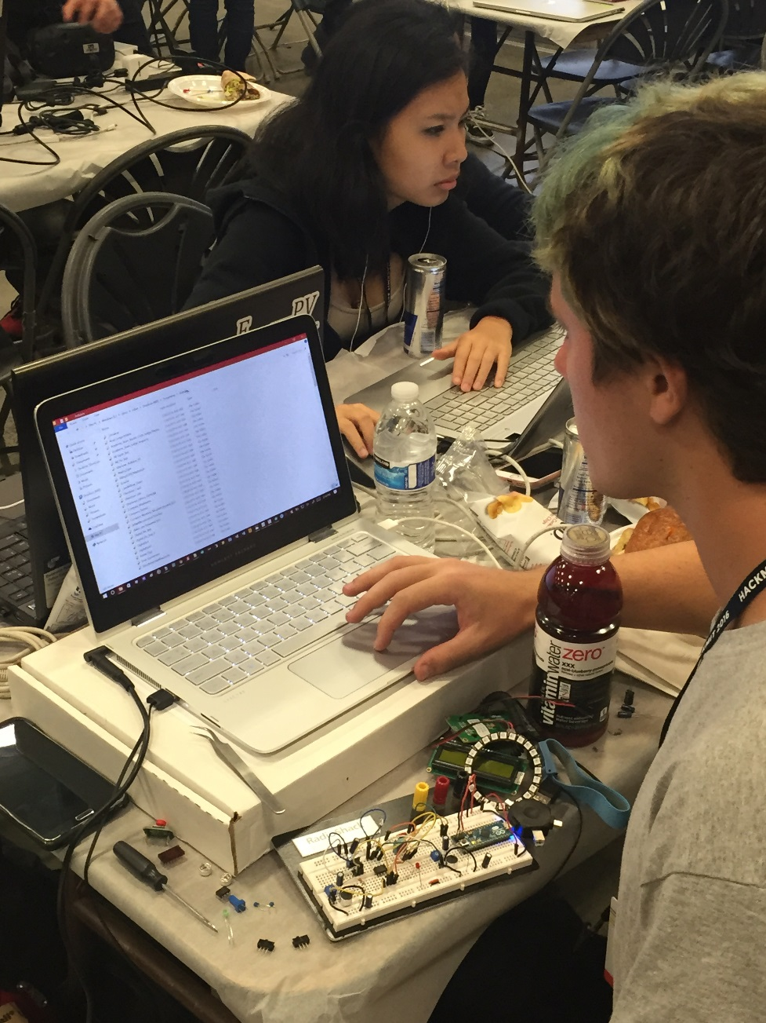
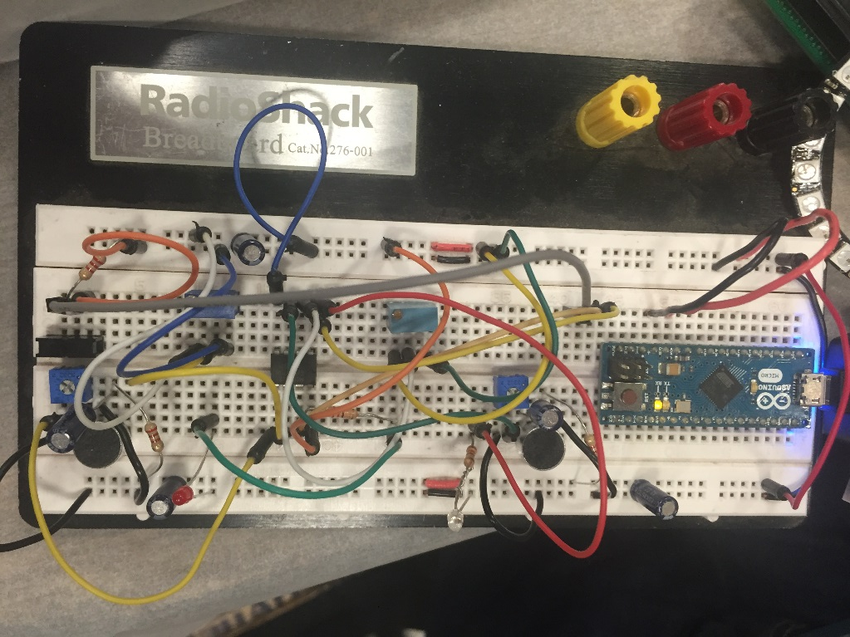
Setting up the breadboard
Cost of the breadboard and components necessary to produce the device in mass production with bulk bought resources is about $12. The microphones are located roughly 4 inches apart and can be adjusted for sensitivity. Two microphones are used to make the input directional. Saboteurs in the audience cannot trigger the clapper unless it is orientated in the wrong direction.

Slide 5
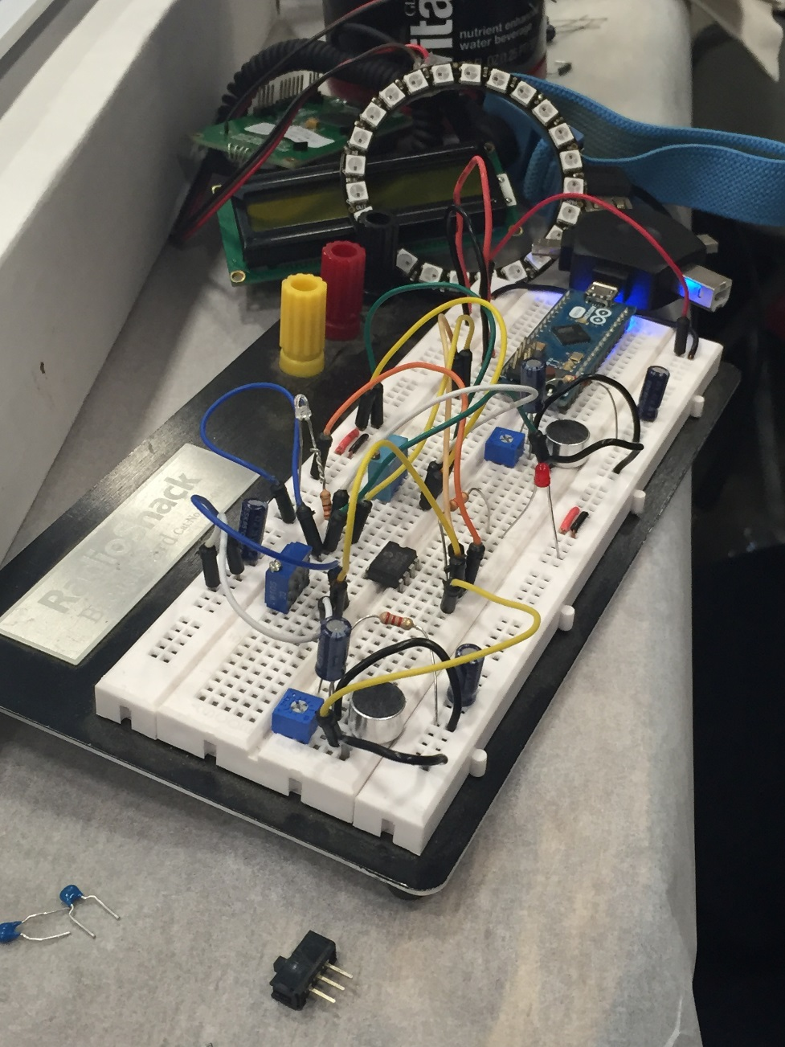
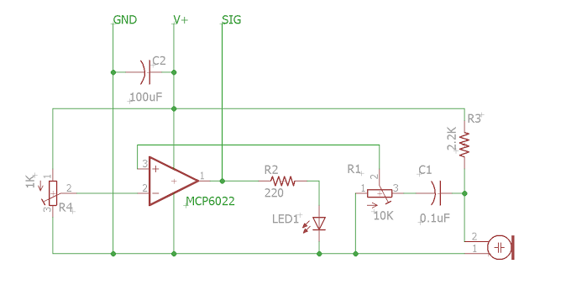
Multiple Inputs
A series of delay commands are very important to the general project. Delays exist for purpose of multiple claps to determine different functions. Errors, such as a single microphone reading or a clap coming from the audience, are remedied by running set-up code that only accepts inputs that follow through the directional microphone.

Slide 6
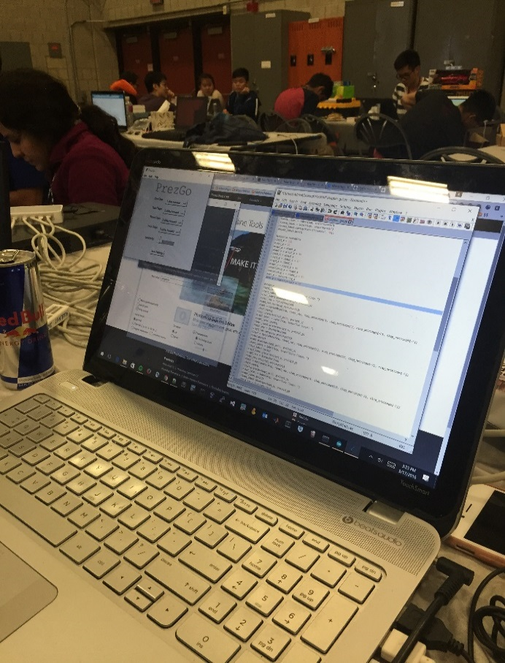
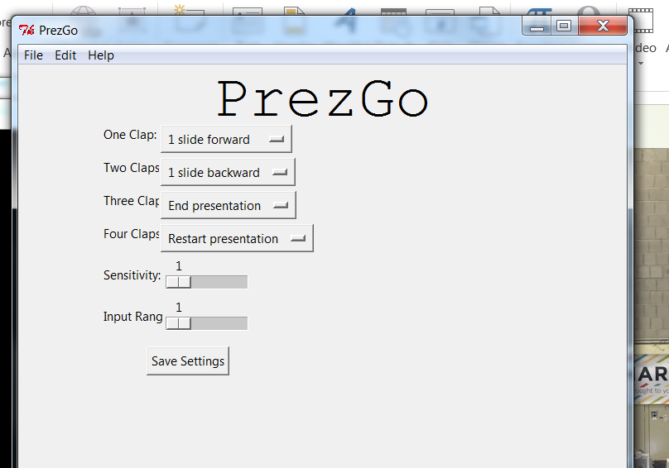
clapper_gui.py
A straightforward settings tool is implemented through python to be run in parallel to the Arduino driver that controls the clapper. This clapper doesn’t just turn the lights on and off.

Slide 7
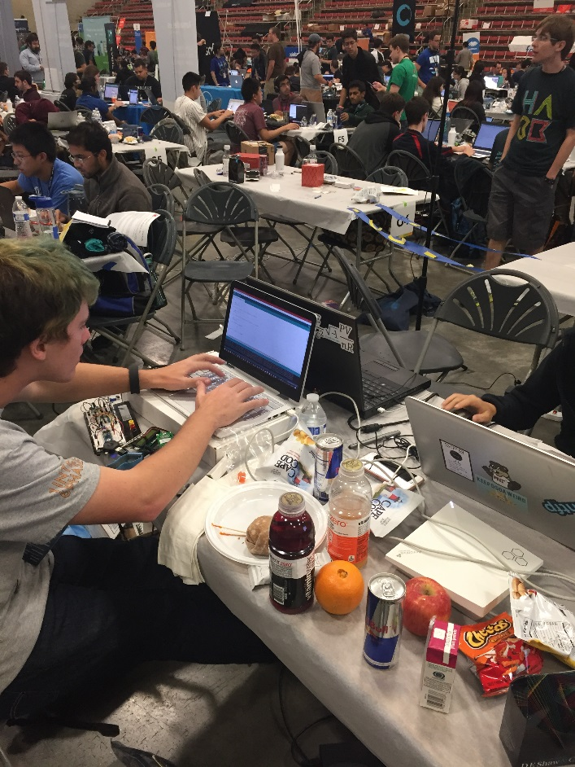
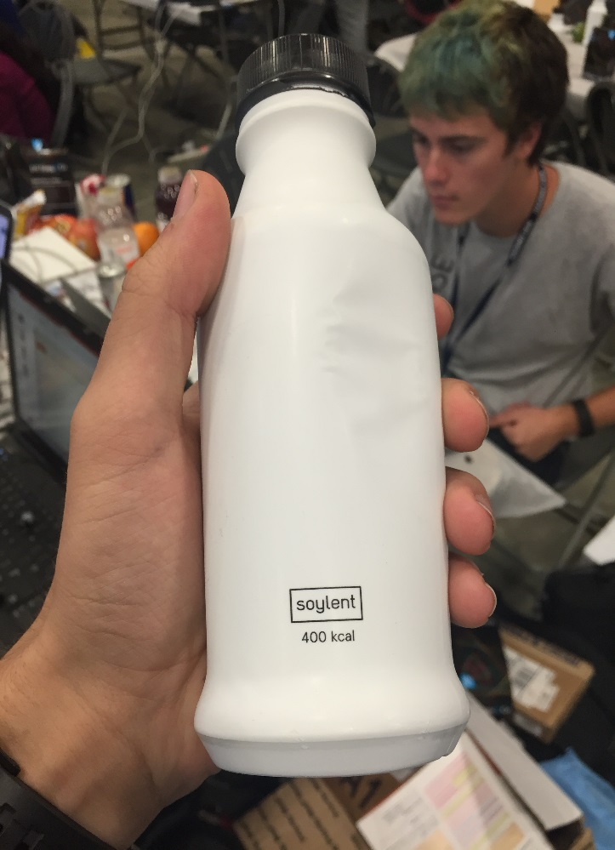
Arduino on USB
Fig 1, shown right: Coding into Arduino IDE
The power source for the Arduino will be the laptop in which it is run. The goal of marketable product would be a device that simply hooks into any USB device slot, installs it’s own drivers for the python script, and may be immediately used to conduct a presentation.
Fig 2, shown left: Our Power Source

Slide 8
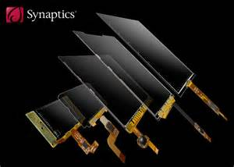
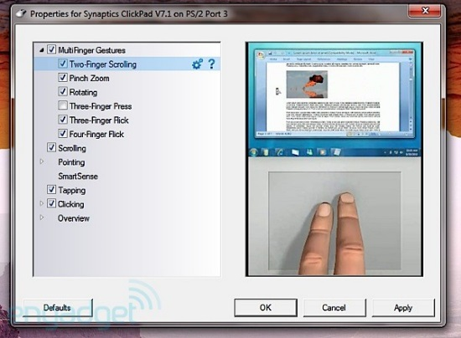

Synaptics Touch
Some of the simplest functions a presentation may need are covered by the one, two, three clap system. However the person giving the presentation may want to load up slides with a high density of text and images. In this case, the speaker may want to zoom in on parts, pan, or switch slides without returning to their computer.

Slide 9
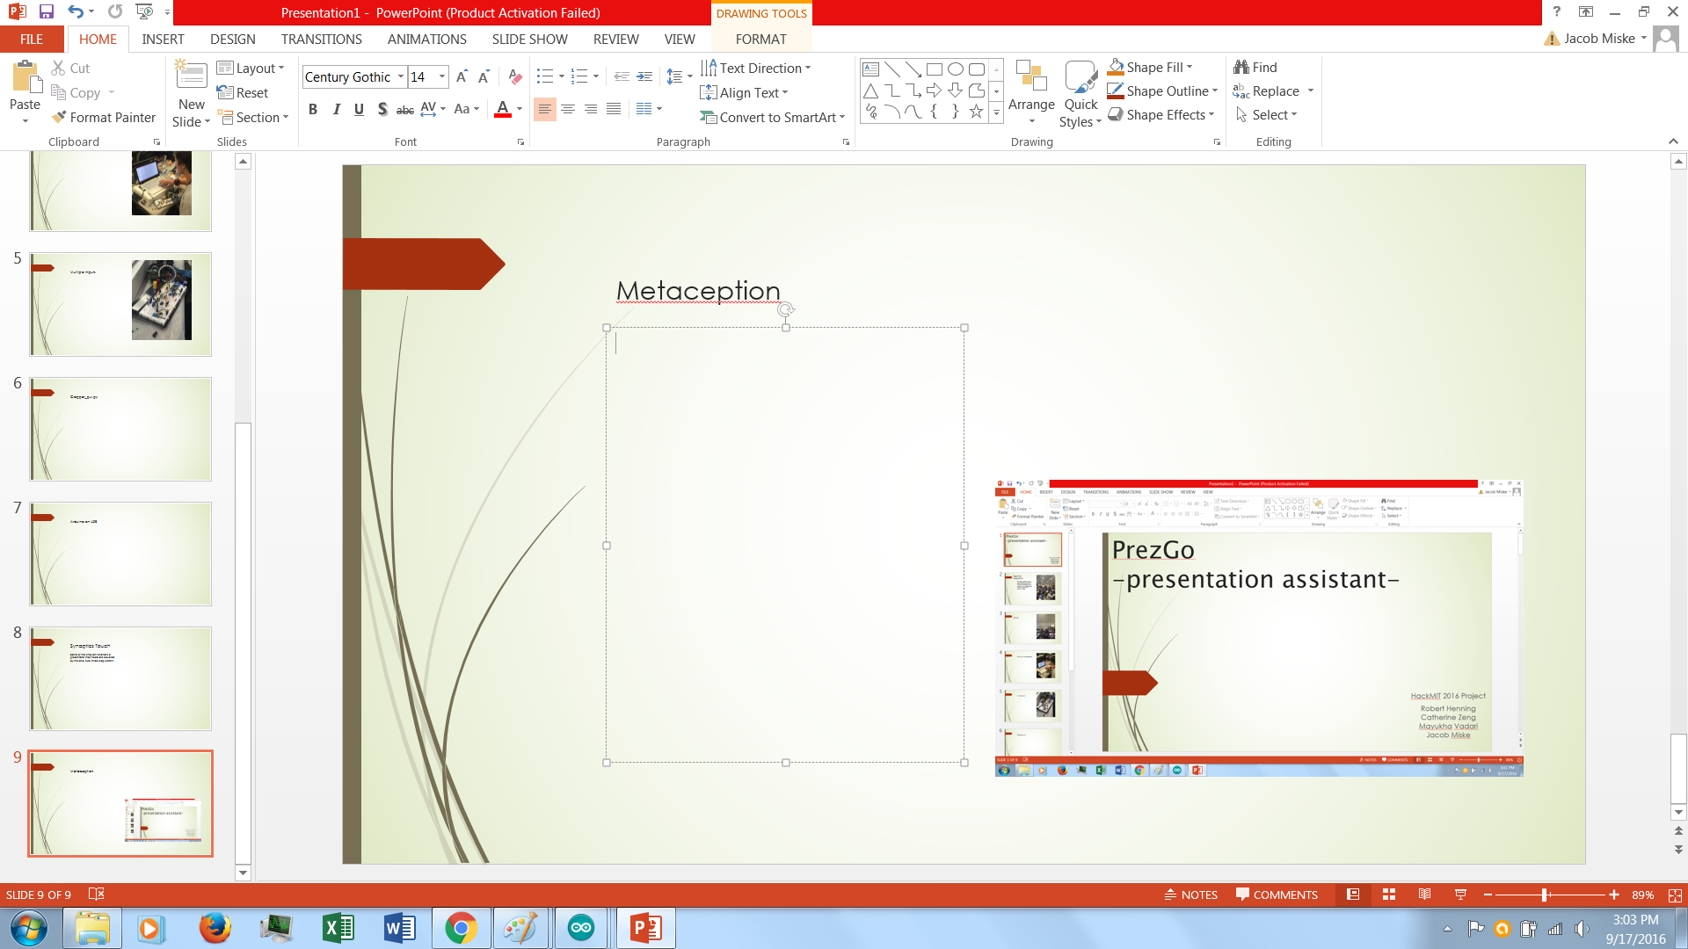
Metaception
This has been a presentation about a presentation tool used to make presentator’s presentations better presentations.
Roles:
Robert Henning – Hardware/Programming
Catherine Zeng – Design/Programming
Mayukha Vadari – Programming/Python
Jacob Miske – Hardware/Presentation

