Slide 1
Spark DAG – Directed Acyclic Graph

Slide 2
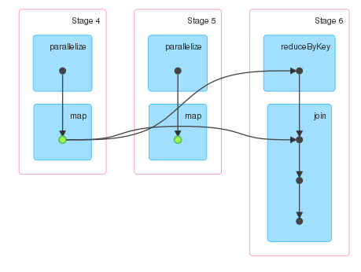
Directed Acyclic Graph
A visual Representation of
the transformations and actions
performed on an RDD.
Shows the Logical Flow
of Operations

Slide 3
How DAG works:
When a Spark Job is executed, the Driver Program identifies any actions and transformations.
The Scheduler then creates a graph that is split according to stages.
Each stage is comprised of tasks done on each partition of an RDD.
A new stage is created when we do a Wide Transformation

Slide 4
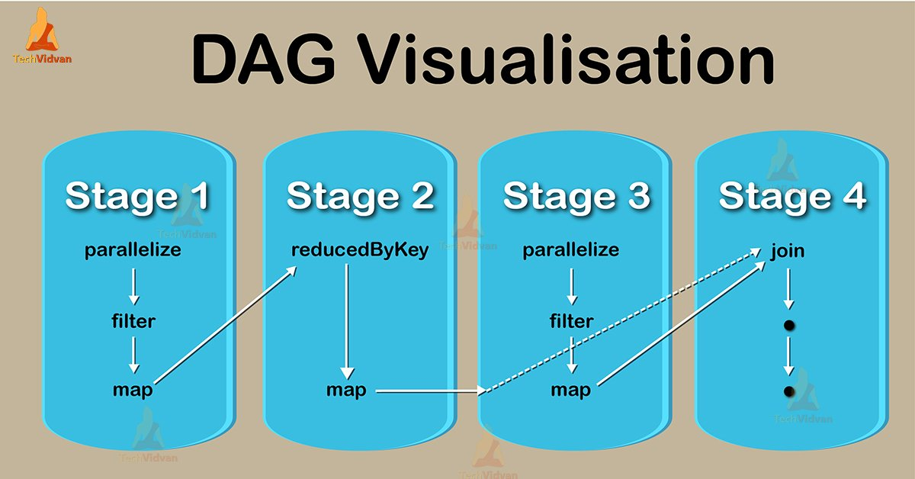
Sample DAG

Slide 5
Visual Representation
Each edge represents an RDD operation, and each vertex (corner) is an RDD.

Slide 6
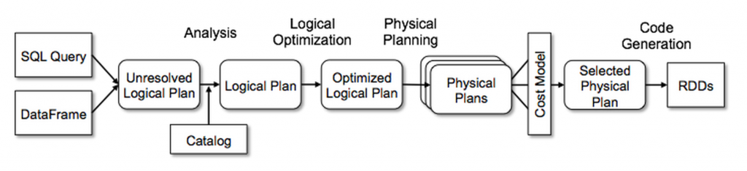
Execution Plans
DAG also creates what is known as an Execution Plan.

Slide 7
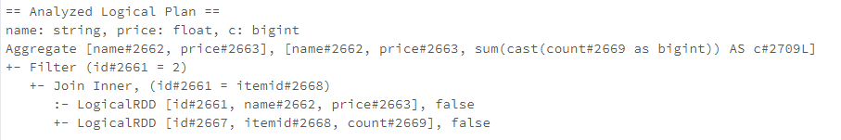
Logical vs Physical Plan
Logical Plan is created when we perform an SQL Query
The Catalyst Optimizer observes the steps of the Query and organizes them to help make the query more efficient. This is the Logical Plan.

Slide 8
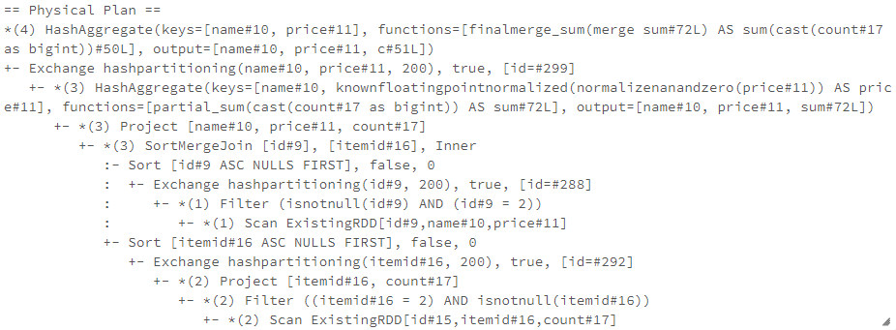
Physical Plan
From the optimized Logical Plan, the Catalyst Optimizer generates several Physical Plans.
A Physical Plan details how the tasks will be performed on the cluster.

Slide 9
How to view an Execution Plan
Sample:
x = sql(‘SELECT Items.name, Items.price, sum(Orders.count) FROM Items, Orders WHERE Items.Id = Orders.ItemId GROUP BY Items.name)
x.explain(mode=‘extended’)

Slide 10
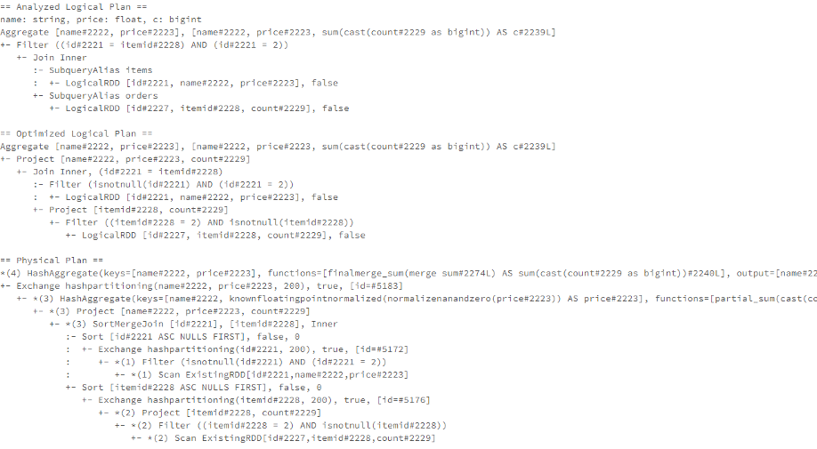

Slide 11
Why we need DAG
Keeps track of RDD operations to run jobs in minimum time.
Determines the preferred location to run each task.
Helps maintain fault tolerance for RDDs.

