Slide 1
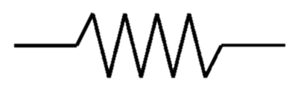
x_{eq}
x
v = 0
k
m

Slide 2
y
F_{G}
x
F_{N}

Slide 3
x_{eq}
x
k
m
m

Slide 4
y
F_{G}
x
F_{k}
F_{N}

Slide 5
x_{eq}
x
k
m
m

Slide 6
x = +x_{max}, v = 0, a = -a_{max}
m
Maximum spring extension
x = 0, v = v_{max}, a = 0
Spring equilibrium position
x = -x_{max}, v = 0 , a = +a_{max}
Maximum spring compression

Slide 7

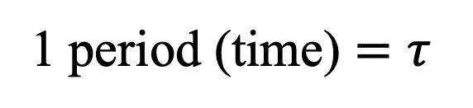
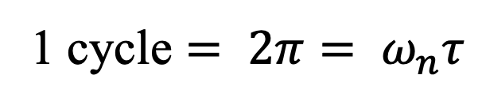

x(t)
1 cycle $= 2π= ω_{n}τ$
$$φ$$
1 period (time) $=τ$
C
Slope at
t = 0 is v₀
x₀
$$ω_{n}t$$
C

Slide 8
x_{eq}
x
k
m
k

Slide 9
k
m
x

Slide 10


k
m
$$\frac{L}{2}$$
$$\frac{L}{2}$$

Slide 11

Unstretched spring position
c
k
$$Δ$$
m
x
Equilibrium position

Slide 12
F_{k}
F_{G}

Slide 13
Unstretched spring position
c
k
Equilibrium position
x₀
m
v₀

Slide 14
F_{c}
F_{k}
F_{G}

Slide 15

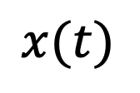
$$x(t)$$
Undamped response
$$t$$

Slide 16

$$x(t)$$
Overdamped response
$$t$$

Slide 17
$$x(t)$$
Critically-damped response
$$t$$

Slide 18
$$x(t)$$
Underdamped response
$$t$$

Slide 19
$$x(t)$$
$$t$$

Slide 20









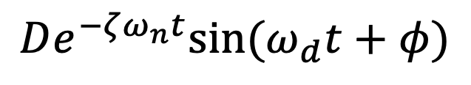

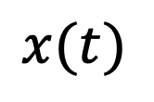


$$x(t)$$
Underdamped response
$$De^{−ζω_{n}t}$$
D
$$x_{1}$$
$$τ_{d}$$
$$x_{2}$$
$$x_{3}$$
$$x_{4}$$
$$t_{1}$$
$$t_{2}$$
$$t_{3}$$
$$t_{4}$$
$$t$$
D
$$De^{−ζω_{n}t}sin⁡(ω_{d}t+φ)$$
$$−De^{−ζω_{n}t}$$

Slide 21
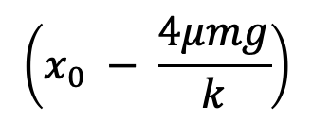


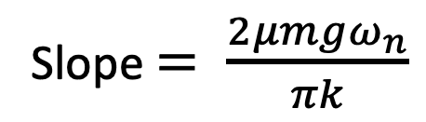
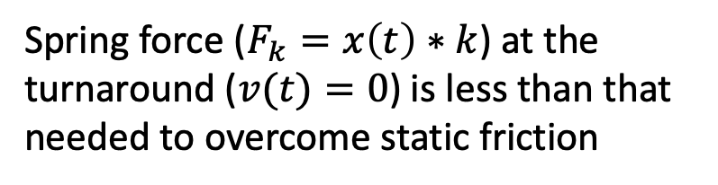

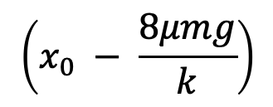

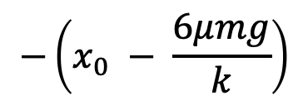
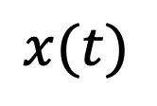
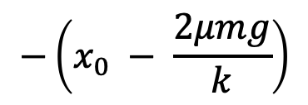
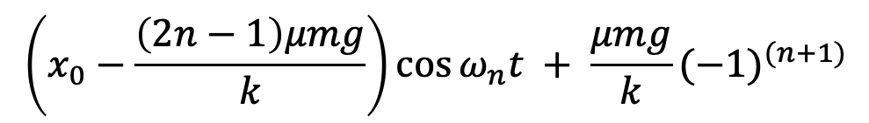
$$\left(x_{0} − \frac{4μmg}{k}\right)$$
Friction damping response
$$x0$$
$$τ_{n}$$
Spring force ($F_{k}=x\left(t\right)∗k$) at the turnaround ($v(t)=0$) is less than that needed to overcome static friction
$$x(t)$$
$$\left(x_{0} − \frac{8μmg}{k}\right)$$
$$0$$
$$t$$
Slope $= \frac{2μmgω_{n}}{πk}$
$$−\left(x_{0} − \frac{6μmg}{k}\right)$$
$$−\left(x_{0} − \frac{2μmg}{k}\right)$$
$$\left(x_{0}−\frac{\left(2n−1\right)μmg}{k}\right)\cos{ω_{n}t + \frac{μmg}{k}{(−1)}^{(n+1)}}$$

Slide 23
x_{eq}
x
c
m
F
k

Slide 24
x_{eq}
x
m
F
k

Slide 25
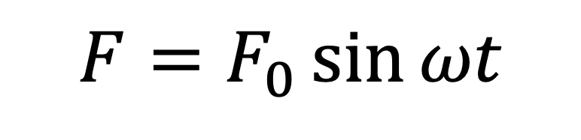
x_{eq}
x
k
m
$$F=F_{0}\sin{ωt}$$

Slide 27

x_{C}
Complementary Solution
$$ω_{n}$$
x_{C}

Slide 28

x_{P}
Particular Solution
x_{P}
$$ω_{0}$$

Slide 29
x_{G}
x_{G} = x_{C} + x_{P}
General Solution

Slide 30
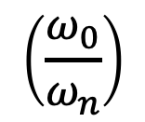
MF
$$\left(\frac{ω_{0}}{ω_{n}}\right)$$
Notes:
0

Slide 31

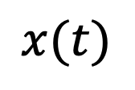
$$x(t)$$
$$t$$

Slide 32
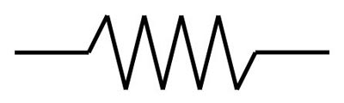
F(t)
m
k
k
k

Slide 33
⍵

Slide 34
⍵

Slide 35

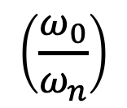




MF
$$\frac{c}{c_{c}}=0$$
$$\frac{c}{c_{c}}=0.1$$
$$\frac{c}{c_{c}}=0.25$$
$$\frac{c}{c_{c}}=0.5$$
$$\frac{c}{c_{c}}=1$$
$$\left(\frac{ω_{0}}{ω_{n}}\right)$$

Slide 36
x_{eq}
x
k
m

Slide 37
x_{eq}
x
c
m
k

