Slide 1
LECTURE 1

Slide 2
D
E
B
C
A

Slide 5
y'
y
r_{B/A}
B
A
x'
r_{A}
Translating reference frame (coordinate system)
r_{B}
O
x
Fixed reference frame (coordinate system)

Slide 6


B
A
$$ω_{BC}, α_{BC}$$
$$θ$$
C

Slide 7
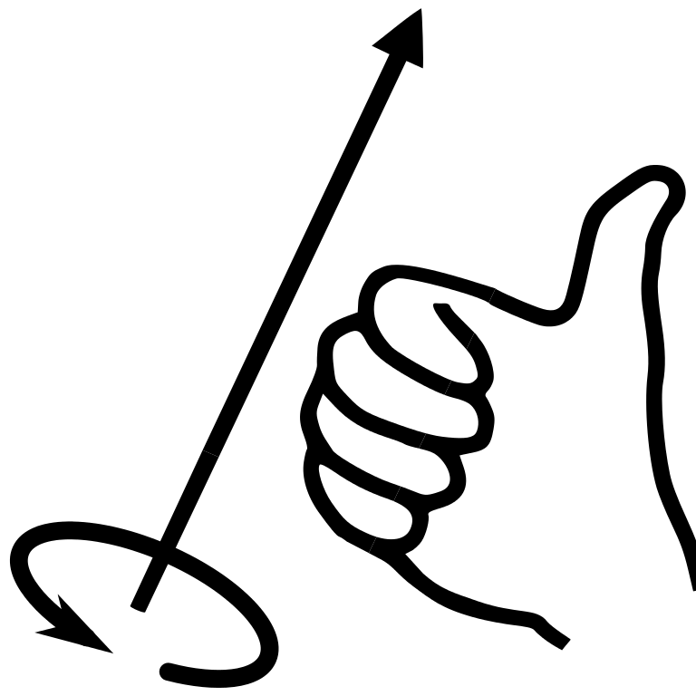
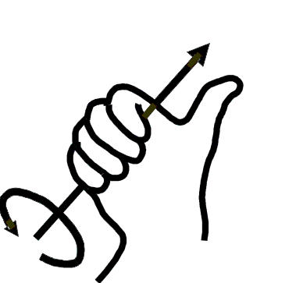



$$dθ, ω,α$$
ADD RH RULE HAND
O
r
P
$$θ$$
$$dθ$$

Slide 8
$$dθ, ω,α$$
O
r
P
$$θ$$
$$dθ$$

Slide 9

B
$$α_{A}$$
A
0.05 m
0.15 m

Slide 10

$$α_{A}$$
A
B
0.05 m
0.15 m

Slide 11
LECTURE 2

Slide 12

Y
y
A
B
x
X

Slide 13
y'
y'
A
dr_{A}
x'
A
x'
r_{B/A}
r_{B/A}
B'
dr_{B/A}
dr_{A}
B
B
dr_{B}
Rotation
Translation

Slide 14

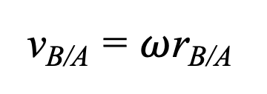
v_{A}
A
A
$$ω$$
v_{B/A}
v_{B/A} = $ω$r_{B/A}
v_{B =} v_{A +} v_{B/A}
+
r_{B/A}
=
v_{A}
B
v_{A}
B
Rotation about the base point A
Translation

Slide 15

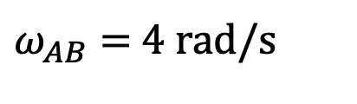

125 mm
C
$$45o$$
B
$ω_{AB}$ = 4 rad/s
300 mm
$$θ$$
A

Slide 16
12-7

Slide 17
ω
A
v_{A}

Slide 18
y
ω
A
v_{A}
x

Slide 19
B
ω
A
v_{A}

Slide 20
B
ω
A
v_{A}

Slide 21

B
B
IC
$$≡$$
at this instant ONLY
IC
ω
ω
A
A
v_{A}
v_{A}

Slide 22

B
300 mm
$$45o$$
A

Slide 23

Centrode
IC₀
v_{IC} = 0
IC₁
Motion of ICZV with time
$$ω$$
IC₂
IC₃
r_{A/IC}
v_{A}
IC₄
A
IC₅
…

Slide 24

A
$$ω_{AB}$$
0.2 m
B
v_{B} = 2 m/s

Slide 25




IC
r_{B/IC}
r_{C/IC}
r_{A/IC}
$$v_{B}=ωr_{B/IC}$$
B
$$ω$$
$$v_{C}=ωr_{C/IC}$$
C
A
$$v_{A}=ωr_{A/IC}$$

Slide 26
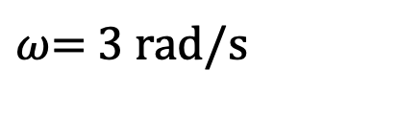
B
G
A
0.75 ft
0.5 ft
$ω$= 3 rad/s

Slide 27



6 in.
B
A
$$30o$$
8 in.
$$45o$$
C
$$ω_{CD}$$
D
4 in.

Slide 28


A
$$30o$$
0.2 m
B
$$45o$$
C
0.1 m
$$ω_{BC}$$

Slide 29


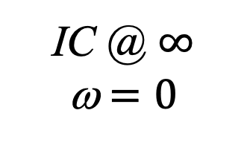
Case 1
Case 2
Case 3
v_{B}
v_{B}
v_{B}
B
B
B
IC
A
A
v_{A}
A
v_{A}
v_{A}
IC
IC @ $∞$
ω $=0$
ω $≠0$
ω $≠0$

Slide 30
LECTURE 4

Slide 31


Path of point A
a_{A}
a_{A}
$$ω,α$$
A
A
A
a_{B/A}
r_{B/A}
$$ω, α$$
a_{B}
=
+
a_{A}
(a_{B/A})_{n}
(a_{B/A})_{t}
B
B
B
Path of point B
General plane motion
Rotation about the base point A
Translation

Slide 32

y
x
$$α$$
$$ω$$
B
G
A

Slide 33


y
B
1 m
x
1 m
$$θ_{B}=45o$$
$$θ_{A}=45o$$
C
A

Slide 34
LECTURE 5

Slide 35



y'
$$dθ$$
$$dθ$$
dj'
x'
di'
j'
i''
j''
i'
i = 1
j = 1
$$Ω$$

Slide 36


E
B
C
1 m
$$30o$$
D
y
$$30o$$
x'
y'
1 m
A
x

Slide 37
LECTURE 7

Slide 38


v_{A}
A
$$ω,α$$
$$θ$$
y
r
B

