Slide 1
l
Group 6
MARKET RESEARCH & BUSINESS ANALYTICS
Global Events, Commodities
& Currency Markets
Market Trends, Investment Risk & Global Economic Insights
Prepared by Group 6 | MSc Data Science | University of Europe for Applied Sciences | July 2026

Slide 2
AGENDA
Four Themes, Twenty Minutes
A
B
C
D
Global Events
Commodity Deep-Dive
Currency Markets
Risk & Recommendations
Timeline of shocks (1960–2026) and which markets they moved most
Oil, gold & silver mechanics, correlations, crisis behaviour, forecasts
USD dominance, CNY/RMB's rise, sanctions & alternative settlement
Sensitivity ranking, exposure notes, and three practical actions
Global Events, Commodities & Currency Markets
2

Slide 3
A1 · MAJOR GLOBAL EVENTS
Three Events That Redefined the Markets
1973
2008
2022
OPEC Oil Embargo
Global Financial Crisis
Russia–Ukraine War
Arab oil producers cut exports to the US and allies; Brent-equivalent crude roughly quadrupled, ending the era of cheap post-war oil.
Lehman Brothers' collapse triggered a synchronized crash across oil, equities and credit, followed by a gold- and silver-led safe-haven rally.
Invasion and sanctions disrupted energy supply chains, pushing Brent toward $120+ and accelerating a shift toward alternative payment settlement.
Global Events, Commodities & Currency Markets
3

Slide 4
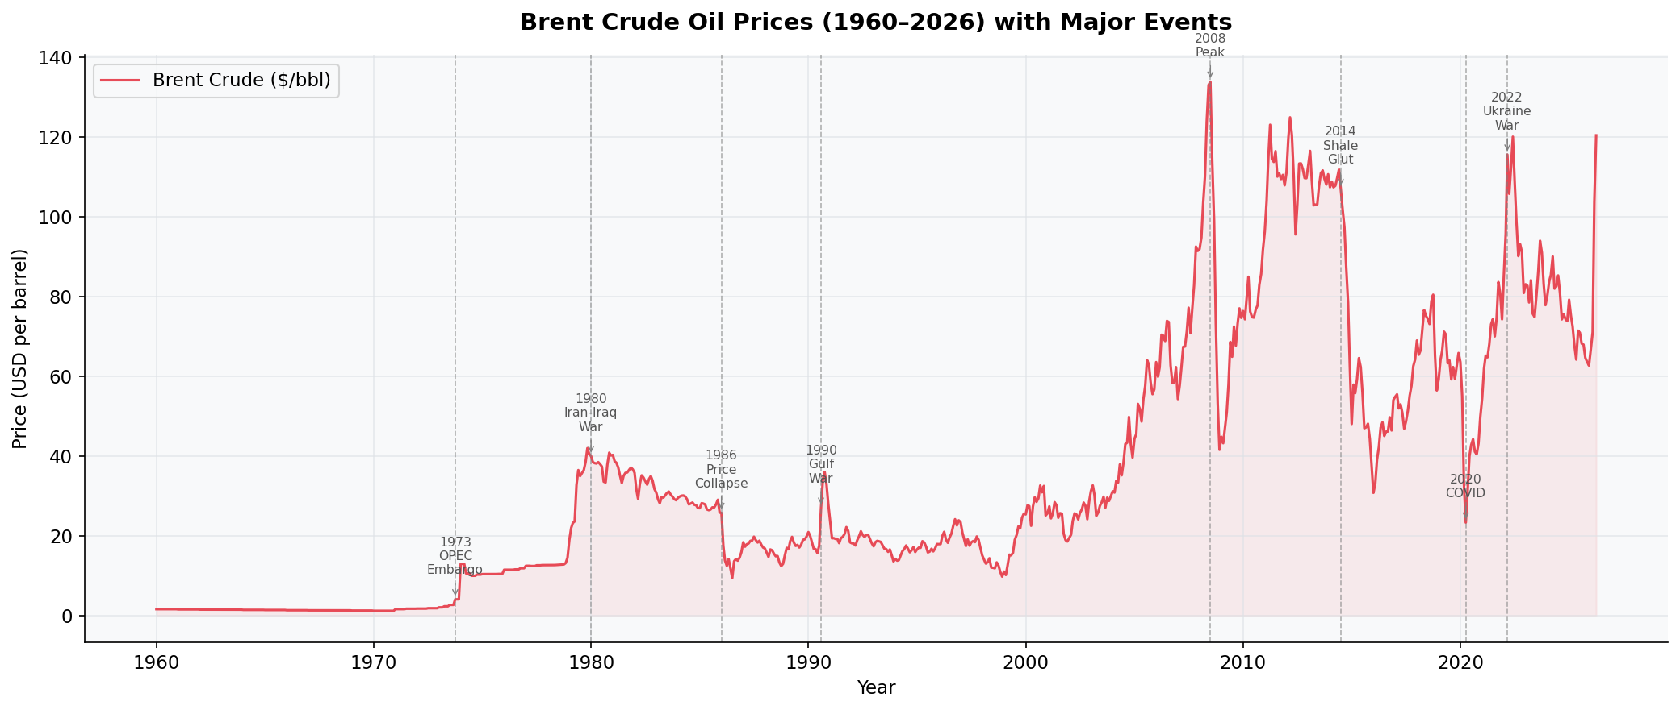
A2 · EVENT TIMELINE 1960–2026
18 Events Across Six Decades
Oil-driven shocks: 1973 OPEC Embargo, 1980 Iran–Iraq War, 1990 Gulf War, 2014 Shale Glut, 2022 Ukraine War
Monetary shocks: 1971 Nixon Shock (end of gold convertibility), 1980 Hunt Brothers silver squeeze
Financial crises: 2008 GFC, 2020 COVID-19 demand collapse
Recent: 2021 silver "meme squeeze", 2024 gold all-time high, 2026 renewed volatility
Brent Crude with major event markers, 1960–2026
Global Events, Commodities & Currency Markets
4

Slide 5
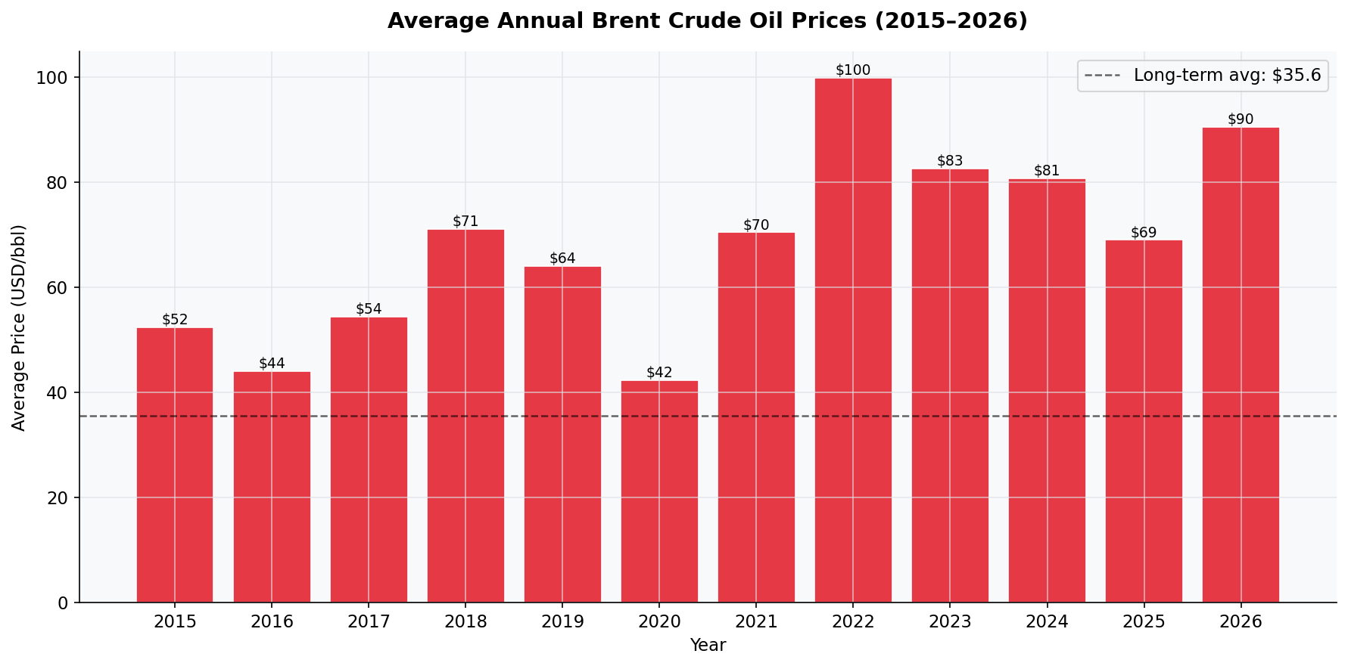
A3 · MOST OIL-CONNECTED EVENT
OPEC 1973 vs. Ukraine 2022
1973 OPEC Embargo
Structural break: price roughly quadrupled and never returned to pre-1973 levels — a permanent regime shift.
2022 Ukraine War
Sharpest recent supply-side shock: Brent jumped toward $120+/bbl as sanctions rerouted global energy flows.
Verdict: 1973 wins on structural, permanent impact; 2022 wins on speed and magnitude of the price spike.
Average annual Brent price, 2015–2026 (long-term avg $35.6/bbl)
Global Events, Commodities & Currency Markets
5

Slide 6
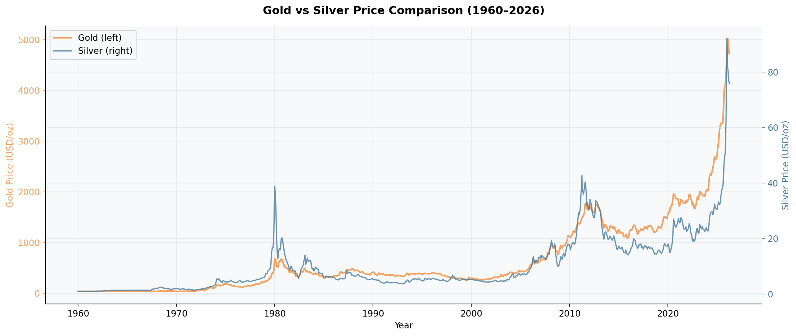
A4 · MOST GOLD/SILVER-CONNECTED EVENT
Nixon Shock 1971 vs. Hunt Brothers 1980
1971 Nixon Shock
Ended dollar-gold convertibility, freeing gold to trade as a market-priced asset — the foundational event for every gold rally since.
1980 Hunt Brothers Squeeze
Attempted cornering of the silver market drove prices near $40/oz before a dramatic collapse — silver's most extreme volatility event.
Verdict: Nixon Shock is the deeper structural driver for gold; Hunt Brothers is the sharpest silver-specific shock.
Gold (left axis) vs Silver (right axis), 1960–2026
Global Events, Commodities & Currency Markets
6

Slide 7
B5 · OIL SUPPLY SHOCKS
How Supply Shocks Move Brent Crude
1. Direct supply withdrawal
Embargoes, war damage, or OPEC quota cuts physically remove barrels from the market, tightening balances immediately.
2. Risk premium / fear pricing
Traders price in the probability of further disruption, pushing prices above what current flows alone justify.
3. Spare-capacity constraints
When OPEC+ spare capacity is thin, even small outages cause outsized price moves.
4. Demand-side offsets
High prices eventually destroy demand and pull in substitutes (shale, renewables), which is why spikes historically mean-revert.
2022 (Ukraine) and 2008 (pre-GFC) both cleared $95–100/bbl
Global Events, Commodities & Currency Markets
7

Slide 8
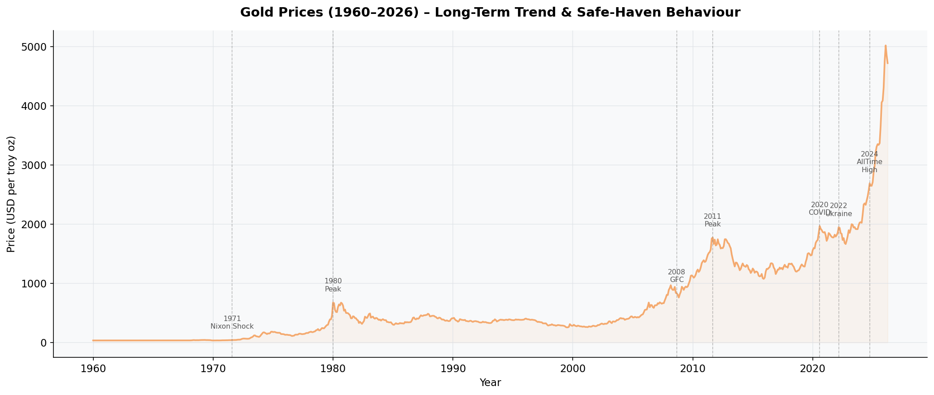
B6 · GOLD IN GEOPOLITICAL UNCERTAINTY
Why Gold Is the Default Safe Haven
No counterparty risk
Gold is nobody's liability, so it can't default when banks, governments or currencies are under stress.
Inflation hedge
Fixed physical supply preserves purchasing power as fiat currencies are debased.
Central-bank demand
Reserve diversification away from single-currency exposure has been a persistent buyer of last resort.
Flight-to-quality flows
Institutional capital rotates into gold during equity/credit stress, visible at every 2008, 2020 and 2022 marker.
Gold price with event markers, 1960–2026 — new all-time high in 2024
Global Events, Commodities & Currency Markets
8

Slide 9
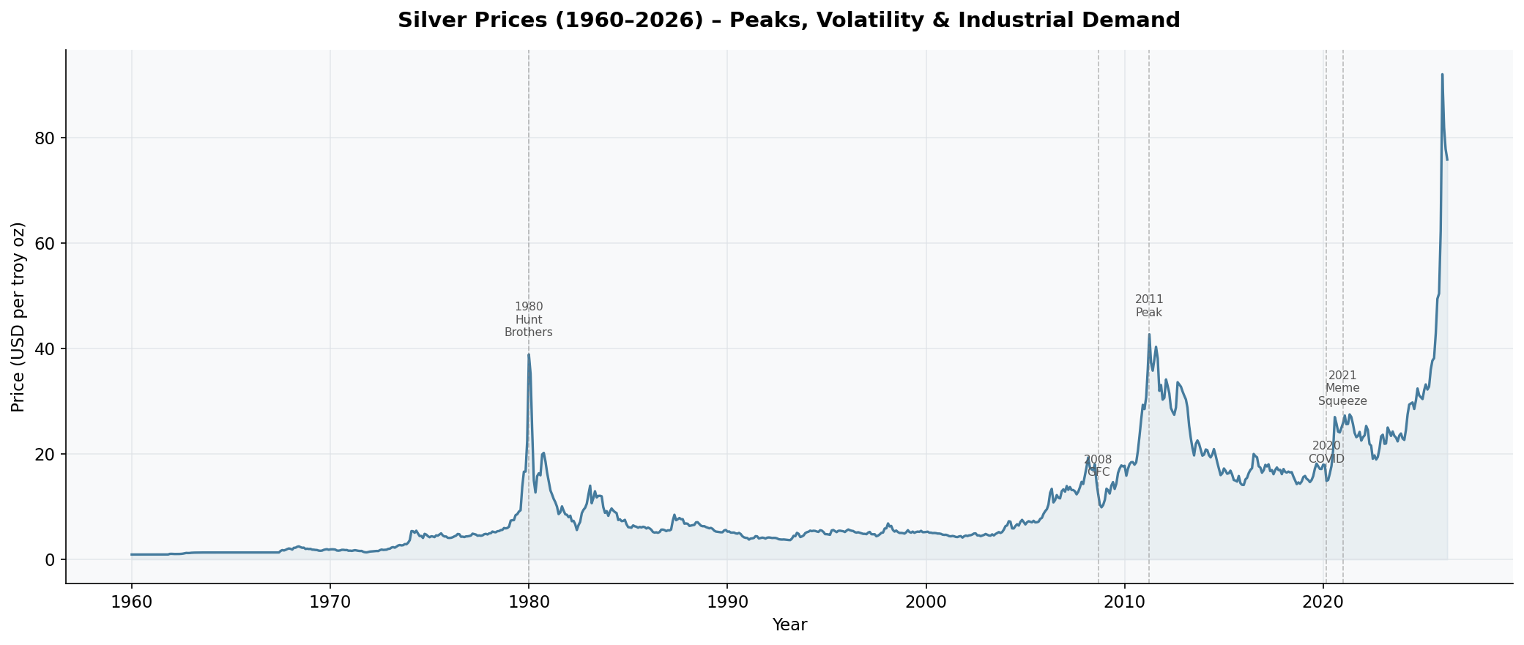
B7 · SILVER'S SPLIT PERSONALITY
Precious Metal Meets Industrial Commodity
Precious-metal side
Tracks gold closely (correlation 0.958) as investors treat it as a cheaper store-of-value proxy.
Industrial side
~half of demand comes from electronics, solar panels and industrial uses, tying silver to global growth cycles.
Result: amplified volatility
Smaller, thinner market plus dual demand drivers means silver overshoots gold in both directions — 1980 and 2011 peaks, sharper 2008 and 2020 crashes.
Silver price with event markers — note the sharper spikes and drawdowns vs. gold
Global Events, Commodities & Currency Markets
9

Slide 10
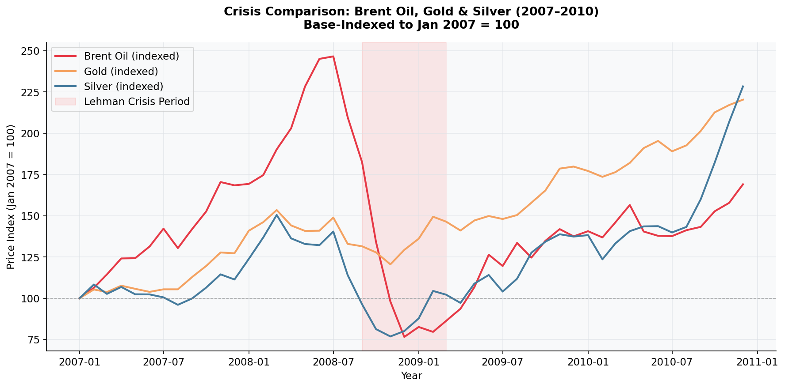
B8 · CRISIS COMPARISON — 2008 GFC
Same Crisis, Three Different Paths
Brent Oil
Ran hardest into the peak (~247) then collapsed fastest, bottoming near 76 during the Lehman window — a pure demand-shock reaction.
Gold
Dipped only briefly, then climbed almost without interruption to ~220 by 2010 — the clearest safe-haven signature.
Silver
Fell hardest of the three in the crisis window, then rebounded most explosively, ending highest at ~230 — its dual identity in one chart.
Brent, Gold & Silver indexed to Jan 2007 = 100
Global Events, Commodities & Currency Markets
10

Slide 11
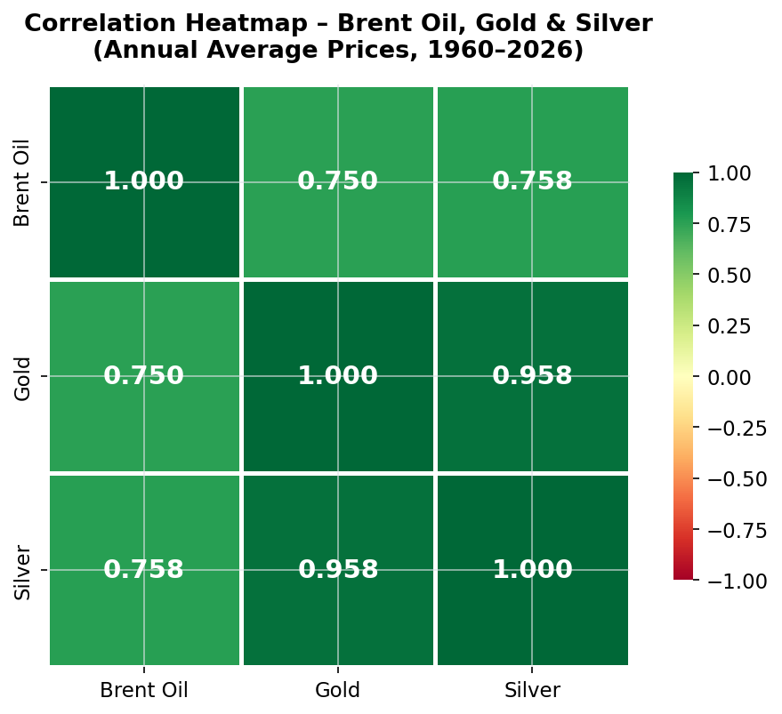
B2 / B3 · CORRELATION ANALYSIS
How Tightly Do These Markets Move Together?
0.958
Gold – Silver correlation (near-perfect)
0.758
Brent Oil – Silver correlation (moderate-strong)
0.750
Brent Oil – Gold correlation (moderate-strong)
Global Events, Commodities & Currency Markets
Pearson correlation, annual average prices, 1960–2026
11

Slide 12
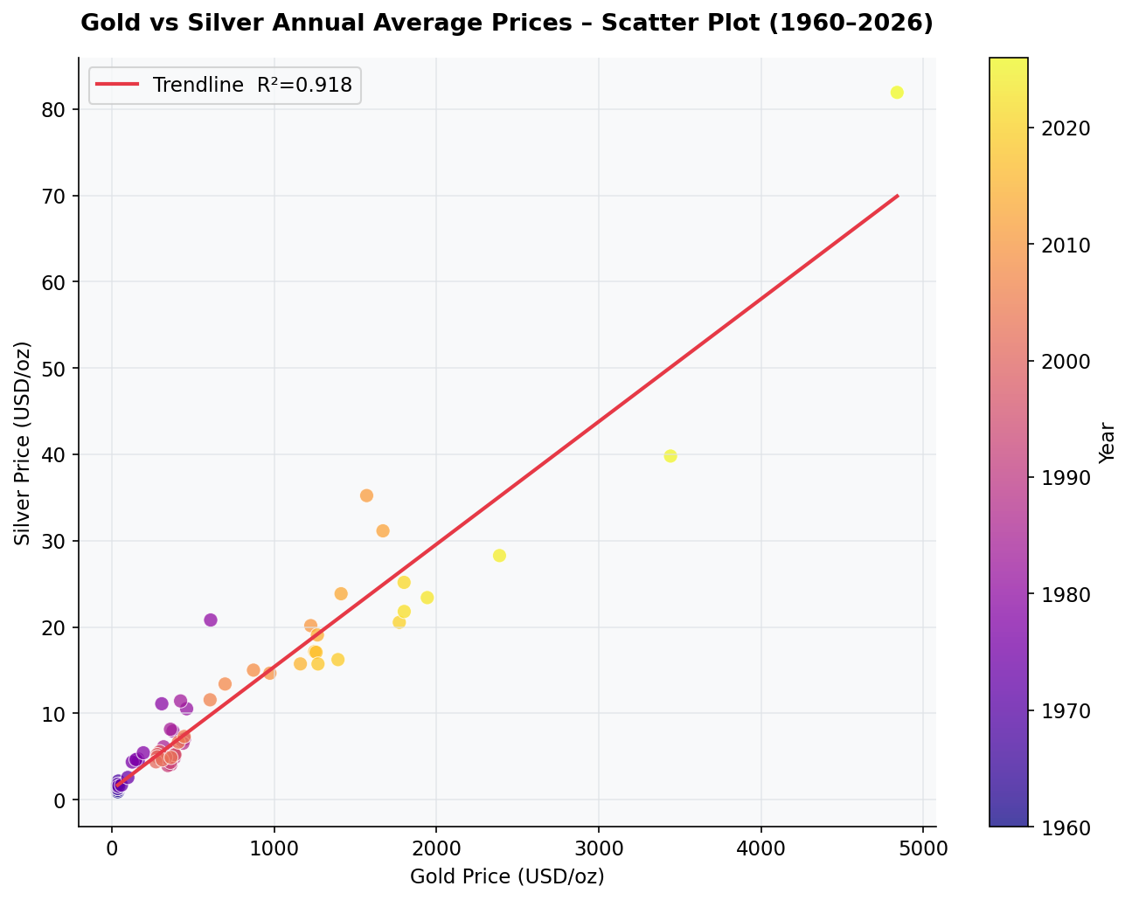
B4 · BONUS ANALYSIS
Gold vs. Silver: A Near-Linear Relationship
R² = 0.918
Over 90% of the annual variation in silver prices is explained by gold prices alone.
Recent years (yellow points) cluster furthest from the origin — both metals are trading at structurally higher levels than any prior decade.
The relationship holds across 65+ years and multiple monetary regimes, reinforcing that both are priced off the same core drivers: real interest rates, the dollar, and safe-haven demand.
Annual average prices, 1960–2026, colored by year
Global Events, Commodities & Currency Markets
12

Slide 13
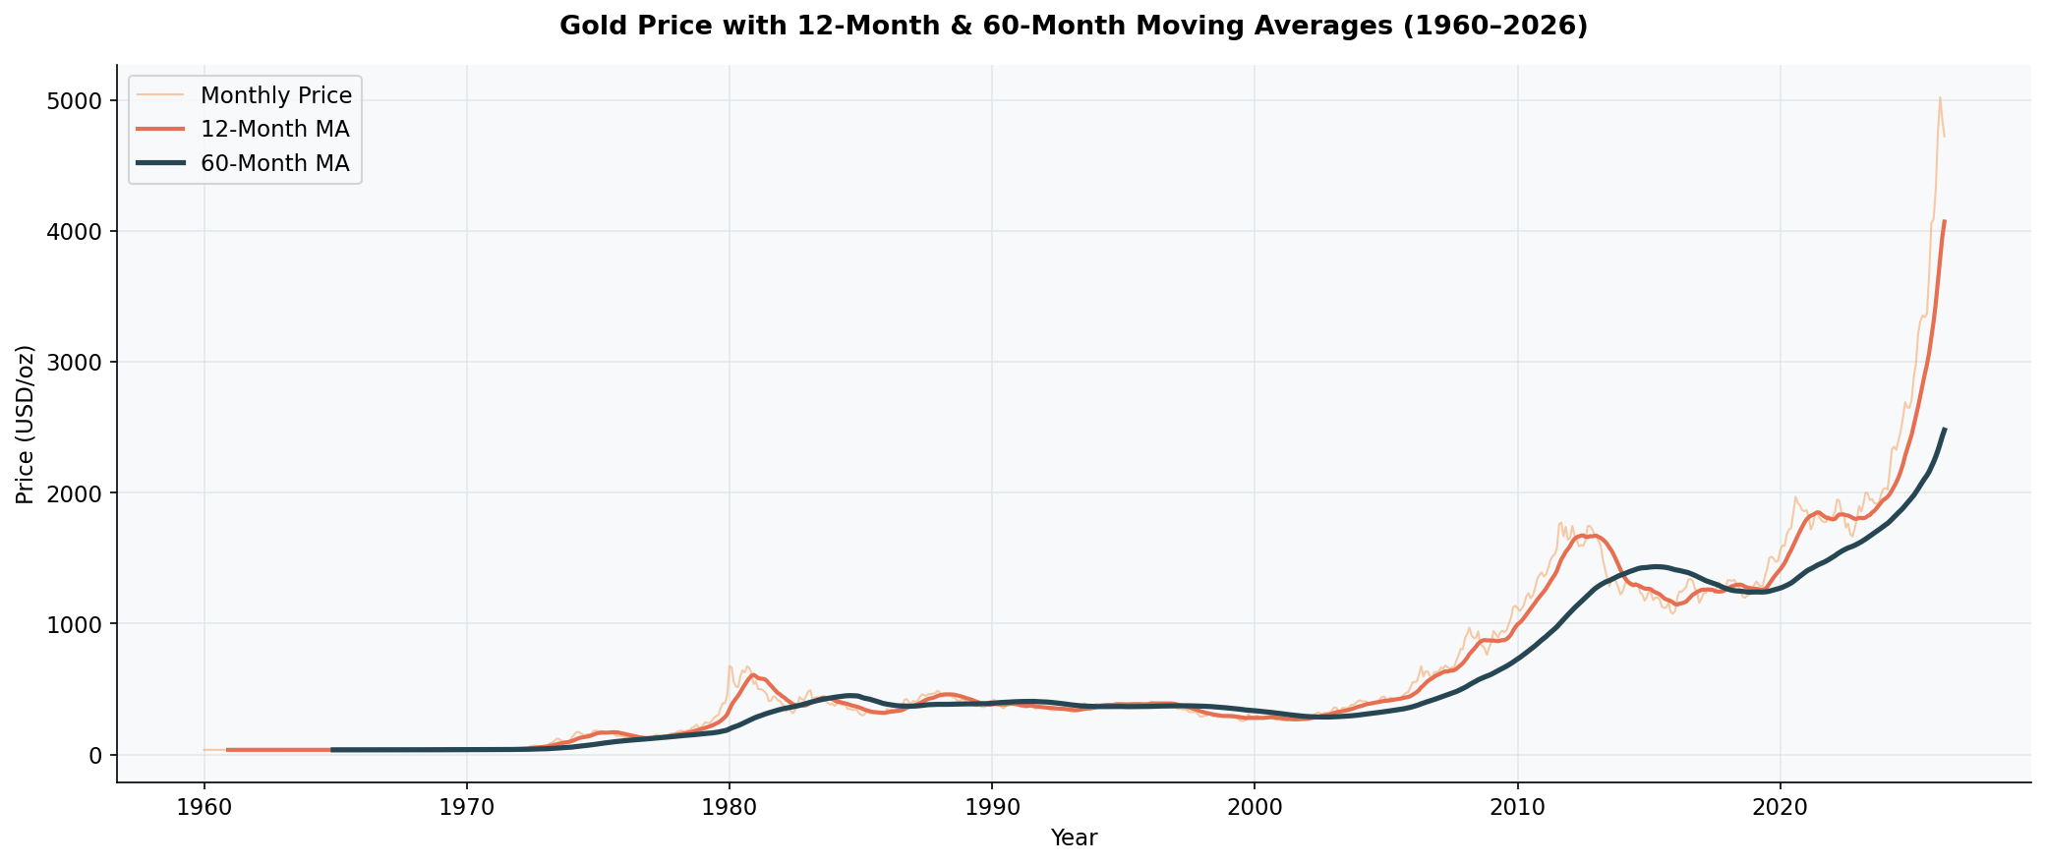
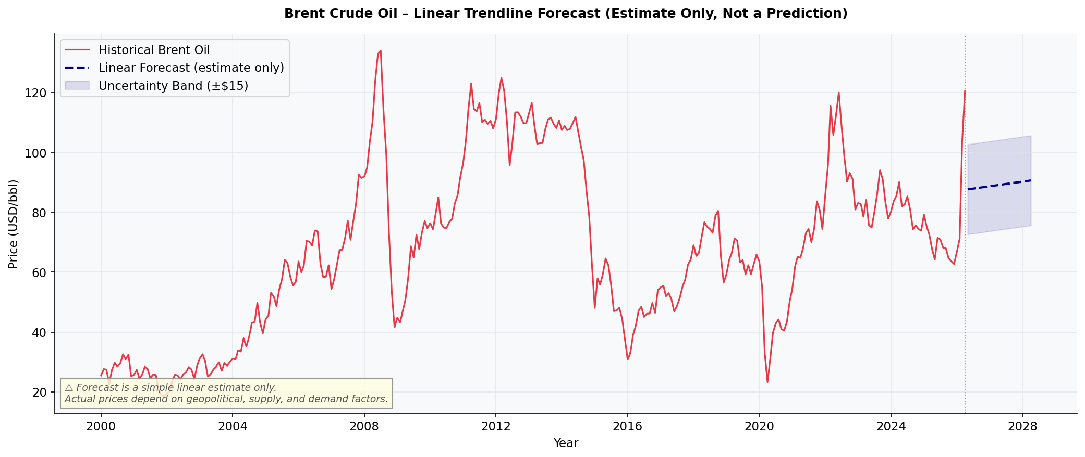
B5 / B6 · BONUS ANALYTICS
Smoothing the Trend, Estimating What's Next
Gold: 12-month vs 60-month moving average
Brent: simple linear trendline (estimate only, not a prediction)
Global Events, Commodities & Currency Markets
13

Slide 14
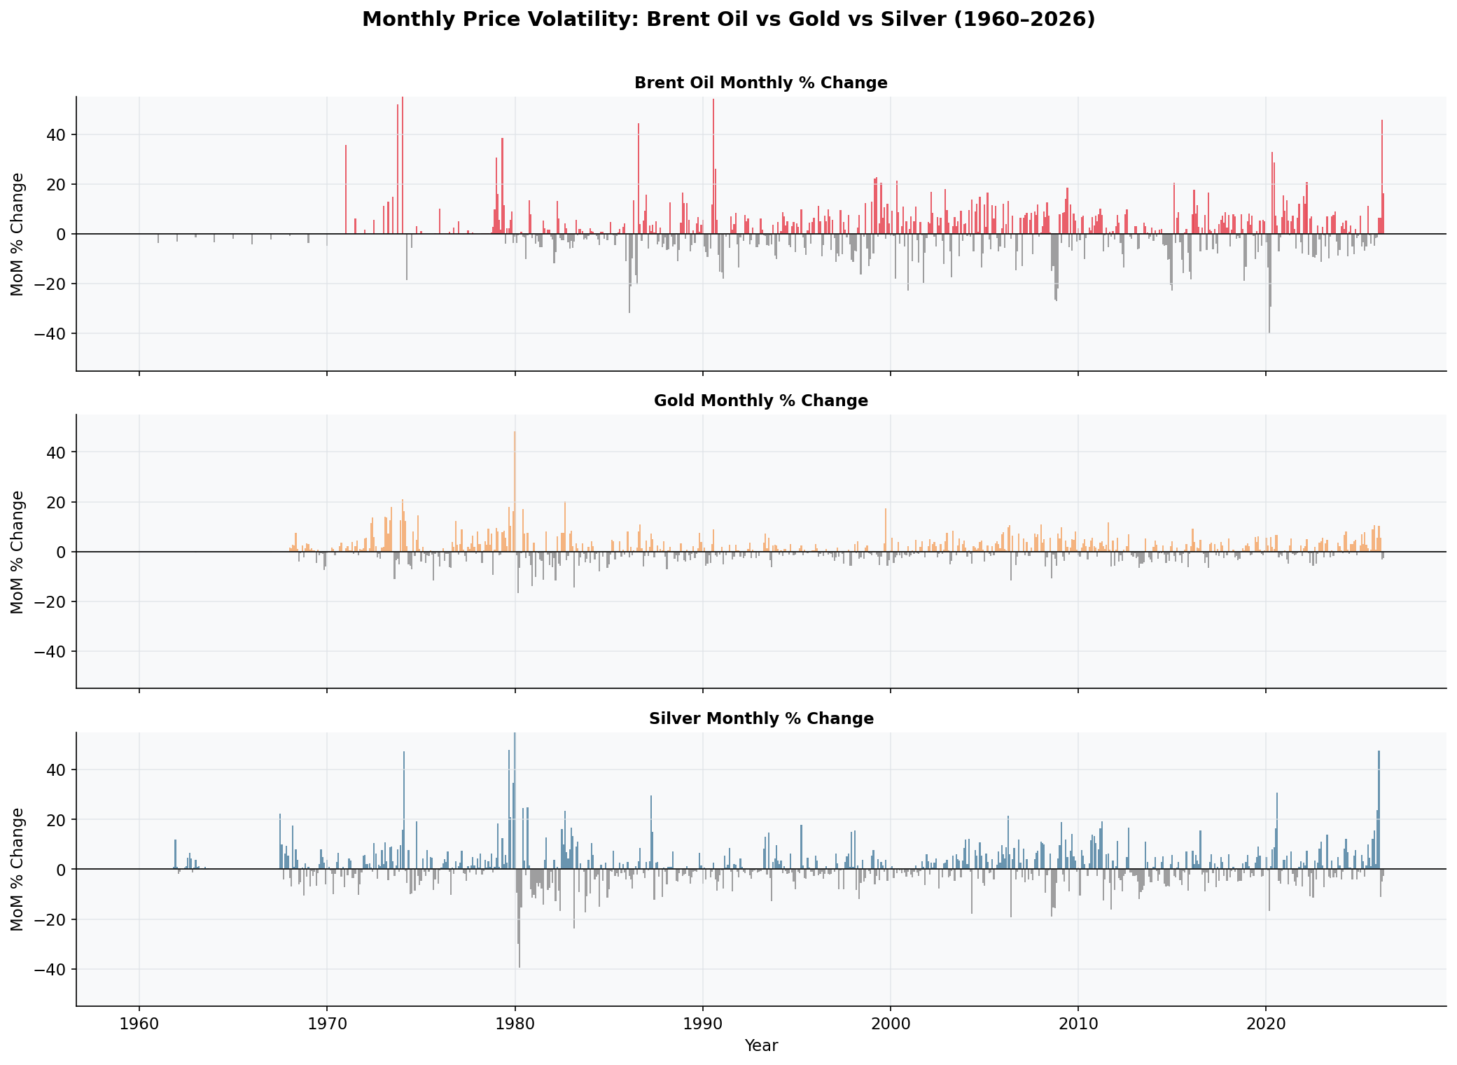
VOLATILITY ANALYSIS
Which Market Swings the Hardest?
Silver: widest swings
Monthly moves regularly exceed ±40%, most visible around 1980 and the current 2026 run-up.
Oil: frequent, moderate spikes
±20–40% single-month moves cluster tightly around every major event marker.
Gold: steadiest of the three
Rarely exceeds ±20% monthly outside 1980 — consistent with its safe-haven role.
Monthly % change, Brent Oil vs Gold vs Silver, 1960–2026
Global Events, Commodities & Currency Markets
14

Slide 15
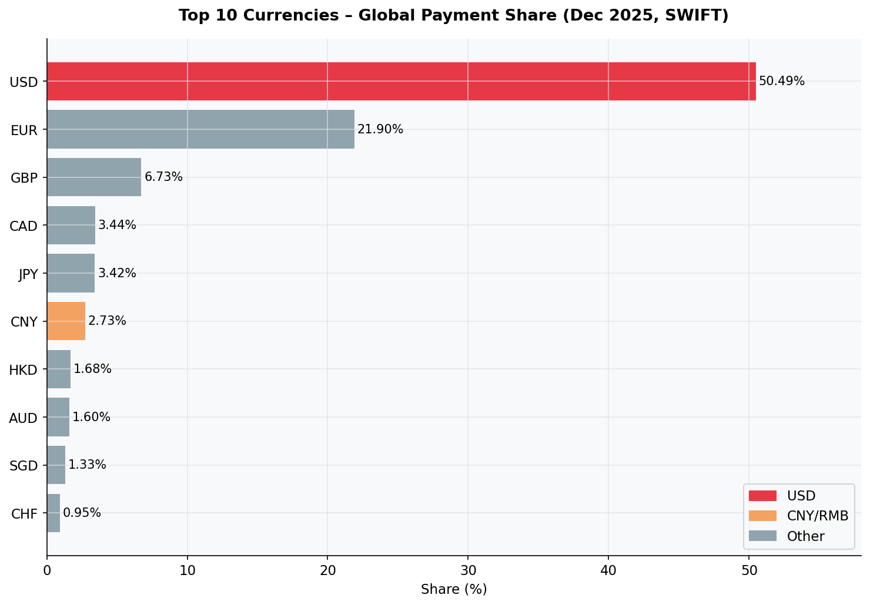
C9 · USD IN GLOBAL PAYMENTS
The Dollar Still Leads by a Wide Margin
50.49%
USD share of global SWIFT payments — more than double the euro.
21.90%
EUR, a distant second.
The next seven currencies (GBP, CAD, JPY, CNY, HKD, AUD, SGD, CHF) combined don't match the euro's share alone — payments remain heavily concentrated.
Top 10 currencies by SWIFT payment share, Dec 2025
Global Events, Commodities & Currency Markets
15

Slide 16
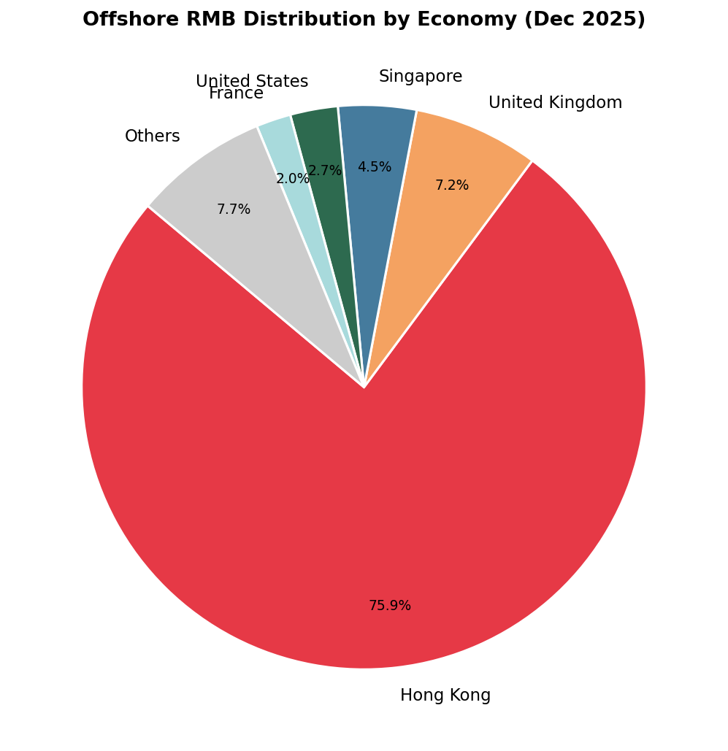
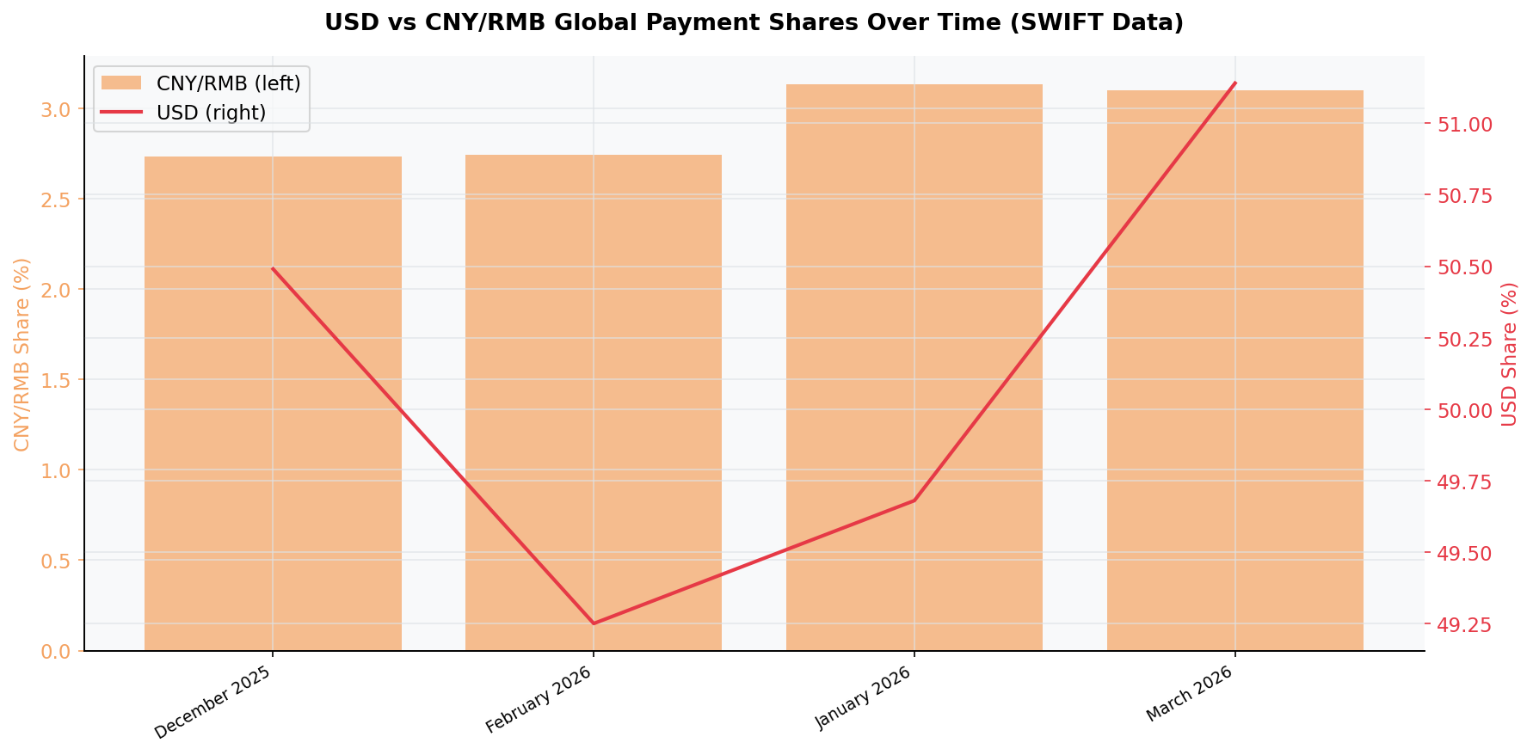
C10 / C12 · CNY/RMB'S ROLE
The Renminbi Is Growing — From a Small Base
Offshore RMB distribution by economy, Dec 2025
CNY/RMB vs USD payment share, Dec 2025–Mar 2026
Global Events, Commodities & Currency Markets
16

Slide 17
C11 · SANCTIONS & ALTERNATIVE SETTLEMENT
Sanctions Are Accelerating a Search for Alternatives
SWIFT exclusion as a weapon
BRICS Pay & bilateral settlement
Cutting banks off from SWIFT (e.g. post-2022 Russia sanctions) freezes their ability to settle in USD/EUR, creating strong incentive to route around the system.
BRICS nations are building payment rails and local-currency swap lines to settle trade without touching the dollar system.
CNY as the leading alternative
Structural limits
China's push for RMB internationalization — offshore clearing hubs, trade-finance invoicing — is the most advanced substitute, though still a small share of total flows.
Capital controls, thin RMB bond markets and limited convertibility mean no alternative currently offers USD's depth, liquidity or trust.
Global Events, Commodities & Currency Markets
17

Slide 18
D13–D16 · RISK & RECOMMENDATIONS
Sensitivity, Exposure & What To Do About It
D13 — Most Event-Sensitive Market
D14 — Oil-Exposed Company Risk
Brent Crude reacts fastest and hardest to geopolitical shocks — every marked event on the timeline produced an immediate, visible price move.
Input-cost volatility can swing ±30-50% within a single year (2020 vs 2022); hedging programs and flexible pricing contracts materially reduce earnings risk.
D15 — USD / Gold / CNY Asset Holder
D16 — Three Recommendations
USD remains the deepest, most liquid store of value; gold offers uncorrelated crisis protection; CNY exposure carries upside from internationalization but limited liquidity today.
1. Hedge oil exposure with futures/options ahead of known geopolitical risk windows.
2. Hold 5–10% gold as portfolio insurance, not a return driver.
3. Monitor CNY internationalization as an early signal, but don't over-rotate yet.
Global Events, Commodities & Currency Markets
19

Slide 19
CONCLUSION
The Bottom Line
1
Events move oil first and hardest
2
Gold and silver confirm each other
Brent reacts fastest to geopolitical shocks; 1973 set the structural floor, 2022 delivered the sharpest recent spike.
0.958 correlation and R²=0.918 — gold anchors the safe-haven trade, silver amplifies it in both directions.
3
The dollar's dominance is still intact
4
Diversification beats prediction
USD holds 50.49% of global payments; CNY is rising but remains a single-digit share story for now.
Forecasts carry wide uncertainty bands — hedging oil exposure and holding gold as insurance manage risk better than timing calls.
Across six decades and three currencies of stress, the same pattern holds: oil prices geopolitical risk, gold and silver price monetary trust, and the dollar still prices everything else.
Global Events, Commodities & Currency Markets
20

Slide 20
Thank You
Questions & Discussion
Full analysis: Market_Research_Report.docx | Data: Commodity_Analysis.xlsx

