Slide 1


Harry’s Data Exercise
Jacob Shughrue

Slide 2

Project Overview Steps Taken
1
Excel → Initial data exploration and manipulation
Imported .csv and saved as data_excel_export.xlsx
Created 15 columns (incl. 5 flags) to allow for filtering and analysis
Power BI → Data visualization
Imported data_excel_export.xlsx
Some additional manipulation/creation of measures (via DAX)
Created fully interactive dashboard of findings
Python → Automation of data manipulation
Created a script to replace the manual steps taken in Excel
After becoming familiar with the data, I wrote a script that could be run 100+ times a day
This automates the data pipeline eliminating the need for Excel
Output results to data_python_export.csv
2
3
2

Slide 3
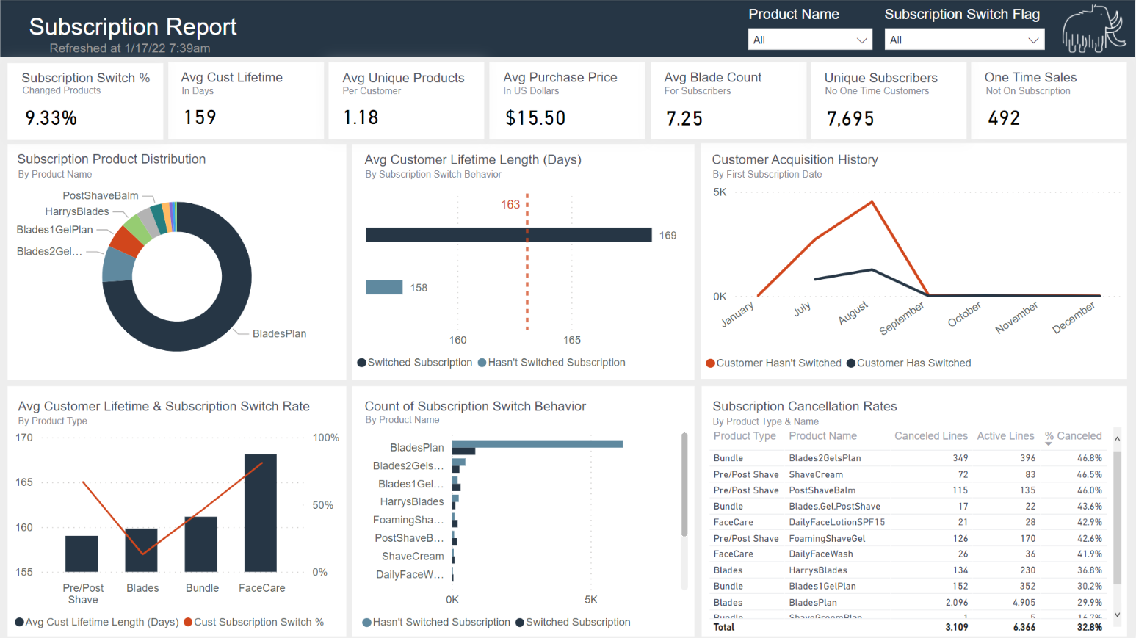

Slide 4
Dashboard Findings Explained
Of the total dataset, 7,369 rows (74%) detail customers who have subscribed to receive blades - of that, 6,184 have never tried another product
For blade subscribers there is an average of 1.17 unique products in a customer lifetime
This leads to data that is largely skewed (bottom middle chart)
This arranges the overall dataset to have a low % of customers that “switch subscriptions”
The product switch likelihood is higher for pre/post shave or facial care products (see bottom left chart indicated by the orange % line)
Customers that are open to testing products other than blades in turn have a higher switch %
Blades have the lowest cancellation history around 30% (see bottom right chart)
Pre/post shave and facial care products have average cancellation percentages above 40% (see bottom right chart)
Some customers may have been willing to try new products but didn’t stick with them
4

Slide 5
Dashboard Findings Explained
The data shows that customers who switched subscriptions have a marginally higher average customer lifetime (see top middle chart)
~7%, or 11 days longer in the several months of data
Looking strictly at customers with retention over 160 days, the number of customers who have switched products does increase, at least marginally, to just above a 10% subscription switch rate
While only a small portion of customers terminated their subscriptions in the data, customers with an end type of “admin” had worse retention than that of the website
The subscription switch % for an “admin” is 8.6% compared to 35.9% of the website
The customer average lifetime also drops down to 92 days when a subscription is terminated via an “admin”
Normally human interaction would be a good opportunity for encouraging other products but these findings show the opposite
5

Slide 6
Assumptions & Opportunities
Assumptions
Lines that started and ended on the same day were one-time purchases
These were filtered out of the dashboard via the one-time purchase flag
Subscription end type of “admin” means a customer service rep was answering the phone
Opportunities
Dashboard can be refreshed on a nightly basis
Additional pages could be created to answer specific questions on a more granular level
Larger data time frame
Would allow for a long-term regression/correlation analysis
(e.g., if starter set kit has long term retention of its 3 products years later)
Implementation of a date slicer to allow the end user to select a specific year
would allow for year over year % growth calcs to see what metrics are improving/declining
6

