Slide 1

FAKE NEWS DETECTOR STOP THE SPREAD OF MISINFORMATION WITH FACT-CHECKING DECEMBER 3, 2019
news_Buster ©
Alex Kwan
Aaron Tan
Elise Lagacé
Gurtej Bhasin
Jacob Bulir

Slide 2

OBJECTIVE & SCOPE
Issues with Fake News:
Plummeting stock price
Destroyed reputation
Unreasonable customer expectations/weak engagement
How can you be protected?!
The Solution – “Fake News Detection” Algorithm
Combined with your current content-management algorithms
Significant reduction in fake news content
Build trust with customers – build a long lasting reputation!

Slide 3
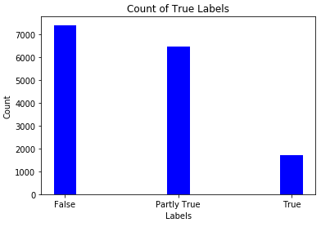
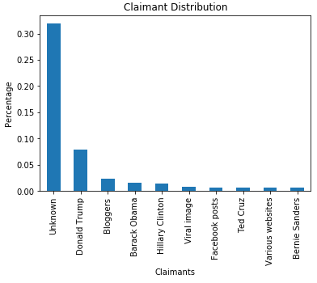
DATA VISUALIZATION
Truth Rating Distribution
Raw Claimants

Slide 4
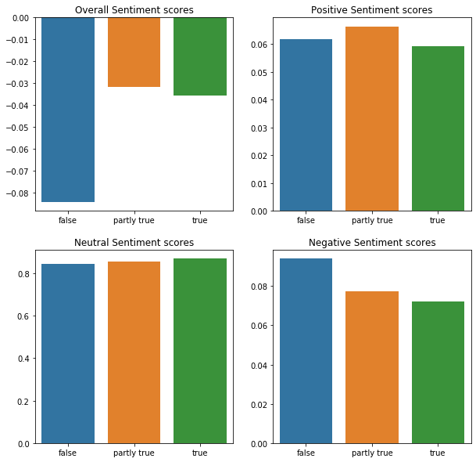
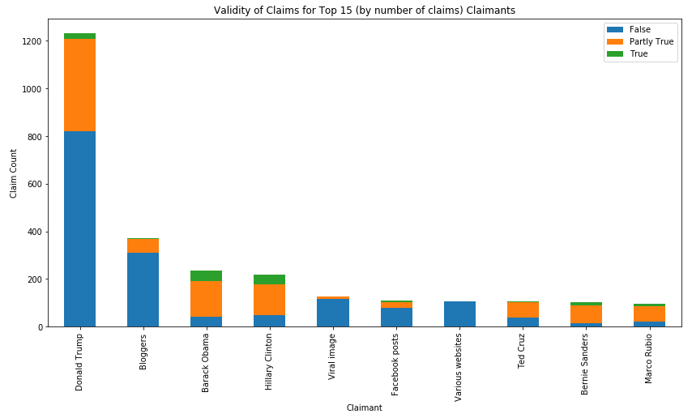
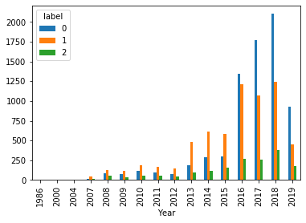

DATA VISUALIZATION
Sentiment Analysis
Claimants
Dates Trends

Slide 5

METHODOLOGY
Data Cleaning
Missing Values
Text cleaning & word embedding
Visualize
Key trends between claim features and truth rating
Feature Engineering
Sentiment Analysis
Feature Selection
Encoding features
Date & Claimant Features
Part of Speech Features
Similarity score between claims and related article text
Feature Importance
Drop un-important features
Algorithm
Ensemble model to determine most frequent prediction
Gridsearch for hyperparameter tuning
Evaluation of results
Features Created:
Claimant group (individuals vs organization)
Claimant gender (male/female)
Year, month, days of the week
Sentiment scores (neutral, positive, negative, overall)
Similarity scores between claim and articles
Parts of Speech

Slide 6

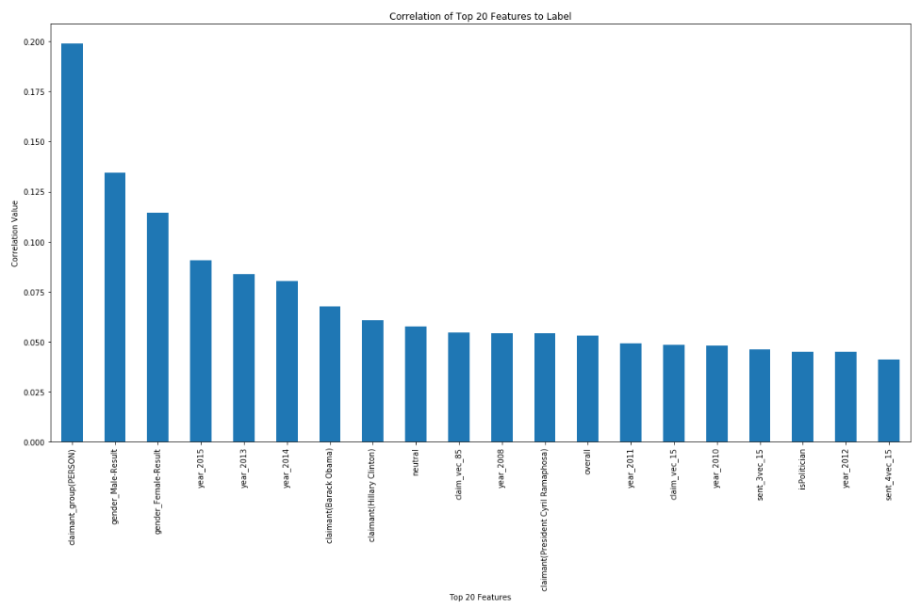
FINAL FEATURES
Correlation for the top 20 features
Top Features
Claimant as Individuals
Claimant Gender
Years
Specific Claimants
Sentiment scores
Correlation Value
Top 20 features

Slide 7

THE ENSEMBLE METHOD
Models
Benefits
Logistic Regression
K-NN
Decision Trees
SVM
Combine results from multiple models
Advantage from multiple methods and mitigate pitfalls from one single model
Improved prediction!

Slide 8
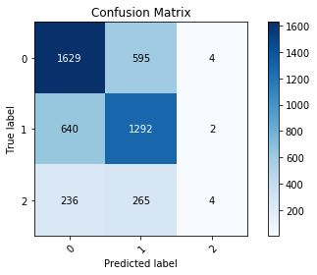
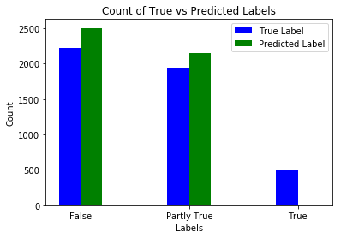
THE ALGORITHM
Performance
Outputs
Performance Metric | Algorithm Score
Accuracy | 63%
Precision | 70%
Recall | 47%
f1 Score | 45%
Run time (cost) | 85min (Data Cleaning); 400 min (Model Implementation)

Slide 9

CONCLUSION & INSIGHTS
Improved content management:
at least 63% reduction in fake news content
Higher rate of others sharing/recommending your platform
Growing and robust reputation and market value!

Slide 10

FURTHER WORK
Optimize to improve precision
Additional hyperparameter tuning for each model
Additional Feature Engineering
Populate unknown claimants
Deep Learning
We look forward to discussing further developments and optimizing this algorithm further to suit your needs.

Slide 11
Questions?

Slide 12
DATA CUP

