Slide 1
Inside the Cost Report
Tips and Suggestions on Improving Your Team’s Cost Report for Next Year

Slide 2

The Concept of the Competition
For the purpose of this competition, the students are to assume that a manufacturing firm has engaged them to produce a prototype car for evaluation as a production item.
The cost event objective is two-fold
  One – to teach the participants that cost and a budget are significant factors and must be taken into account in any engineering exercise
  Two – to learn and understand the manufacturing techniques and processes of some of the components
This means:
  The pricing reflected in the book should show the methods used to build this prototype vehicle. If another method will be used to create a production level of the vehicle, notate that information in the book as well, so that process decisions can be analyzed.
  You will be producing 4 cars a day for an unspecified period of time, so volume pricing or wholesale cost is not possible.
  The vehicle should cost no more than $25,000 retail. (NOTE: at $25,000 the points for the vehicle’s cost are zero.)
  Costs are not based on special pricing, discounts or donated items available to the schools – Items should be costed using retail values.

Slide 3

Postmark Deadline
The only way that negative points are possible in the Cost event is by either turning in a book late or the ultimate – not turning in a book at all.
  Books must be post marked by no later than midnite on the deadline date
  Ten points is deducted every day that the book is post marked after the deadline date (-10 points), up to a maximum of 8 days or -80 points for being late. You can still turn in a book after that but no more than 80 points can be charged for being late. If at all possible, you must turn in a cost report prior to the event.
  If no book at all is turned in the penalty is -100 points for the report score. Points can still be earned for process discussion and price score on the day of the event (the maximum possible points available in this case would be -50 points) (-100 plus +50 for price score and random discussion score and visual inspection) – this option is not highly recommended but is better than receiving a negative 100.

Slide 4


The Written Report
The report should include the following:
  A cover or binder with the team’s name and correct vehicle number on it. The binder should not come apart with use. (Pack it well during shipping as this is when the book takes the most punishment)
  A cover letter (preferably bound with in the book) It should be addressed to a specific person preferrably the cost judges or whomever the report is directed to and include the intent of the book as well as the cost of the vehicle reported. It should be signed by a team captain or member of the team as any business letter should be.
  A table of contents – with page numbers rather than section numbers – the less flipping around in the book that you make the judges do the less cumbersome the book is to work with
  Include an introduction of the book itself, or an overview of some of the decisions made in the development of the costs or manufacturing processes used. Although not required, a plant layout or line layouts would be helpful as well to help you to understand where waste may be eliminated in the manufacturing process and facilitate manning decisions. The exchange rate used should also be included in the introduction so that the judges know what factors to use in their review of the book

Slide 5

The Written Report
Brake
System
Brakes
The report should include the following:
  A cost summary – this is a breakdown of what each section of the vehicle sub-totals to and what the entire vehicle’s total is. It may be helpful at this point to graphic show what portion of the whole each section or commodity makes up. It is also important that the numbers reflected in the cost summary are the same numbers shown in the bill of material for each section and the totals agree
  Tabs for each section or commodity of the book – these should have words on them not numbers, again if the judges have to refer back to the table of contents each time that they need to find a section of the book, you are making them work too hard
Engine
And
Drivetrain
Wheels
Frame &
Body
Brake
System
Instruments
& Wiring
Suspensions
& Shocks
Misc, Fit &
Finish
Steering
System

Slide 6

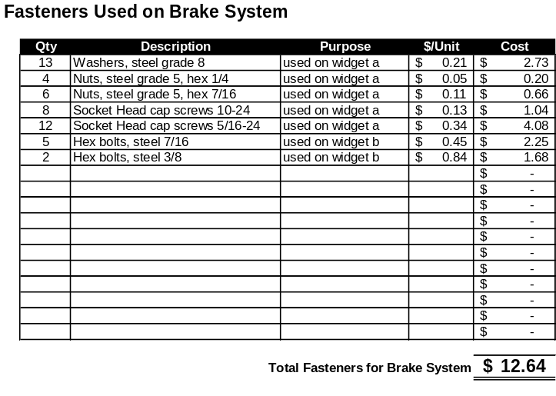
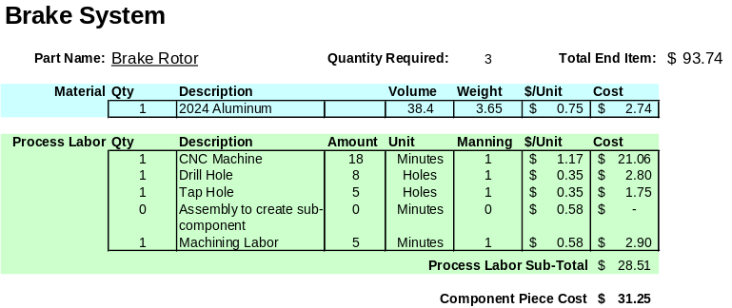
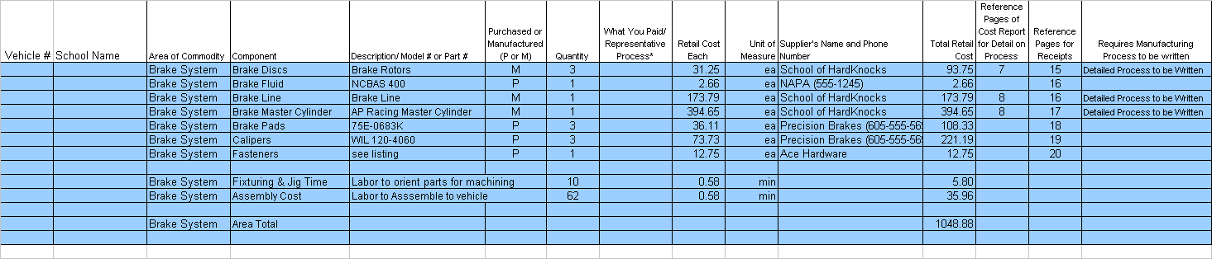
Section by Section
Brake
System
(Up to 10 pages
of detail process
descriptions per
section or commodity)
Drawings, Prints or Graphics
Receipts (retail) and
Catalog Pages
(with highlighted items)
Please cross-reference these
Items with the BOM
and/or Process Breakdowns
Listing and cost of fasteners
Used in this commodity section
Process Descriptions for Manufactured Parts
Brakes
Widget ‘A’
Brake System – BOM

Slide 7

Section by Section
What we expect in each commodity section:
  The section should be organized in a fashion that is logical and consistent. Print should be no smaller than 10 point and use only one side of the paper.
  Each page should be numbered consecutively – don’t renumber pages for each section – there should only be one page 1, etc.
  Each section should include a printed copy of the Bill of Material for that commodity only. This should appear first in each commodity section. We will provide you with the electronic spreadsheet format for this BOM.
Brake System – BOM

Slide 8
Section by Section
What we expect in each commodity section:
  After the bill of material, list out the parts that were manufactured by your team and give the process for each part. This is the section that each of the judges looks at to determine the feasibility of your process and your understanding of the methodologies chosen, so be as specific as you can – if the part is welded for instance, tell how long the weld is and how much time was spent jigging the part, manning, and list out the associated costs - don’t just say “weld” and give a dollar figure.
  If you would use a different process when building a production level of the part you may wish to note that in this section as well and explain the reasons for methodology change, etc.
  These pages are limited to 10 per commodity – the limit does not include the BOM, random process discussion, drawings, prints, receipts or fastener page
  Make sure that the costs you report for the manufactured items tie back to the Bill of Material
  Make sure the math is correct and all calculations and formulas work correctly.
  Foolish math errors make up a goodly portion of the penalties given out. Especially errors like “Qty = 4” and not multiplying the base price times four.
(Up to 10 pages of detail process descriptions per
section or commodity)
Process Descriptions for Manufactured Parts

Slide 9


Section by Section
What we expect in each commodity section:
  Include as many drawings, diagrams and photographs that you feel are needed to clarify the process used.
Drawings, Prints or Graphics
Widget ‘A’

Slide 10

Section by Section
What we expect in each commodity section:
  Include receipts for the purchased items and the materials used to manufacture the fabricated items. Remember the cost of the vehicle is retail, so if you get special pricing from a supplier or vendor, make sure that you also get what the cost would be in retail terms to report in the cost report. Discounted prices are there to help you be able to build the vehicle but the retail price will give the correct picture of what the prototype actually would cost the manufacturing firm looking to buy your prototype
  You needn’t give the judges a box of receipts but make copies of them or scan them in so they fit conveniently on the report page. Remember not to make them so small that they can not be read easily
  Cross-reference the line items in the BOM and Process descriptions with the receipts and drawings so that the judges know to which part they are related

Slide 11
The Electronic BOM
The electronic Bill of Material or EBOM should only be a listing of the end items used on your vehicle
The format will be provided for you electronically in an Excel spreadsheet and when completed by your school, should be included with your book on a diskette (either 3.5” or cd).
Do not change column headings, add columns or change description names
If you must add columns to the spreadsheet for exchange or other items – add them after the standard columns – these added columns will not be used by the cost judges
If your team uses parts that can not be classified using the standard list of items, you may add lines to that particular section or commodity – but it is highly recommended that you stick to the items provided for consistency and ease of use by the judges
The format will follow the listed items found in Appendix A-3
There will be a line item in each section for fasteners – this should a reflect a total only – a sheet listing the individual fasteners and where used should be included after the receipts in each commodity section
There will also be a line item for the labor to assemble the sub-components to the vehicle. In some sections (like frame and body) – there will also be a line entry to account for the jig time needed for welding the frame together or the time required to position parts for machining or CNCing – this should alleviate a number of penalties since a large number of teams often miss this item
The end item costs for manufactured parts should tie to the process sheets that follow the BOM page(s)
The section should be totaled and the totals should also tie to the cost summary page at the beginning of the book

Slide 12

Addendums
Addendums will only be accepted at registration or in the case of teams that register late on the day of the static events, once registered the addendum should be brought directly to the cost tent for immediate processing
The addendum should be only a single page and should use the format found in the rules at Appendix A -2
Be sure to show the old total of the commodity and then the new total – call out the difference in the third column
The changes for each commodity should be explained in simple terms in the lines below
Bracketed numbers are subtractions – un-bracketed numbers in this third column are additions to the reported cost

Slide 13
At the Event
When it is time for your team to appear at the cost event bring your vehicle to the assigned queue where you will be welcomed by one of the cost event bay stewards
The steward will take you to the sign-in desk and help you to get started with our judging process
There you will make your random draw of the two commodities that you will need to discuss in the manufacturing discussion – a sticker will be put on your judging card so our bay steward will know which judges you will need to see to discuss the random items
There will be a judge that will listen to how you would process each of the commodities
Another judge will listen to how the team processed the vehicle overall – think about waste elimination and the Principles of Lean Manufacturing
You will be assigned point for each of these items by the judges – this random discussion is worth 20 pts
"Pick a card . . ."

Slide 14




At the Event
The steward will also inform you if your team had any significant adjustments to your original reported cost – remember the judges have been pouring over your cost reports for 6 weeks and will have found any errors in process, overlooked labor time, discrepancies on receipts, etc.
The judges who gave the penalties will be happy to discuss them with you
Attitude is very important here – a combative or argumentative approach is not the way to go – The judges have over 375 combined years of experience in their fields, they are there to help you to learn about manufacturing processes and methods and help you make the decisions necessary to future successful products
At this time the judges will also look over the vehicle to assure that the items and processes listed in the cost report are in fact the ones used on the vehicle that has been brought to the cost event – the judges may or may not ask you any questions on these parts – they will for the most part be checking their private notations regarding your vehicle to complete this evaluation

Slide 15


At the Event
Penalties and points will be adjusted accordingly and at the discretion of the judges
The same judges evaluate all 140 cost reports and the vehicles that they represent so the scoring is consistent across each entire commodity
Once your appointment is completed, the bay steward will give you a sheet with your points tallied on it. This sheet and the points on it reflect a “moment in time” prior to the visual portion of the competition. The printing was done the day before the event, prior to the receipt of any cost addendums and before any visual adjustments were made. It can only give you an idea of the points you could be getting
22.63+26.22+15.72+18.00 = ???

Slide 16
At the Event
Cost scores could go up or down depending on the minimum vehicle and any adjustments made to its scoring as well – if more penalties are levied against the lowest vehicle, the overall set of point scores will go up. If penalties are explained and removed from the lowest vehicle, the overall set of point scores will decrease
Scores will be posted the following morning
$10,500
Price Score decreases
Another car
could become
#1
$9,800
Price Score 30 pts.
$9,300
Price Score 30 pts.
$25,000
0 points
21
53
5
7
62
113

Slide 17


Things to Remember --
Cover or Binder with School name and car #
Cover Letter
Table of Contents with Page Numbers
Introduction
Cost Summary with Totals
Electronic Bill of Material (EBOM) on disk or CD
School of
HardKnocks
Car # 144
In Each Commodity Section
Receipts (retail) and
Catalog Pages
(with highlighted items)
Please cross-reference these
items with the BOM
and/or Process Breakdowns
Bill of Material for Specific Commodity
Process Sheets for Manufactured Parts
(10 page limit)
Process Descriptions for Manufactured Parts
Drawings, Prints, Photographs and Graphics
widget 'A'
Receipts, Catalog Pages (Highlighted)
Brake System - BOM
Fasteners Page
And don't forget . . .
Send it to us by the
Postmark Deadline
(Up to 10 pages
of detail process
descriptions per
section or commodity)
Repeat for each of the commodities
Introduction
Brake System
Frame &
Body
Instruments
& Wiring
Misc, Fit &
Finish
Suspensions
& Shocks
Steering
System
Wheels
Engine
And
Drivetrain
Engine and Drivetrain
Brake
System
Drawings, Prints, Photographs and/or Graphics
Table of Contents
Frame and Body
Cost Summary
Instruments and Wiring
Miscellaneous, Fit and Finish
Listing and cost of fasteners
Used in this commodity section
Steering System
Suspensions and Shocks
Wheels and Tires

Slide 18

Hope this brief overview of our expectations assists you in your preparations of next year’s epic.
Best wishes on your team’s success!
The Cost Judges

