Slide 1
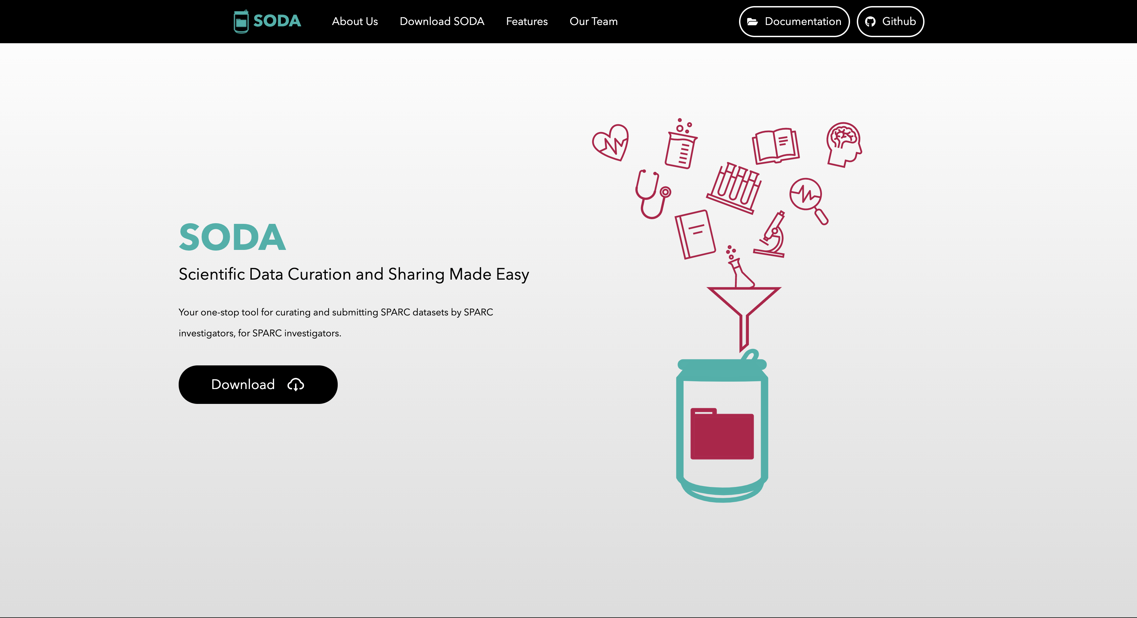
About SODA
SODA for SPARC
Learn more
Download SODA for SPARC
This would just scroll down to the “About us” section
This would scroll down to the “SODA for SPARC” section

Slide 2


