Slide 1

Office fidelity / 中文排版

Slide 2
Editable text

Slide 3

Editable text
Bold 中文 and regular Latin share a baseline. Inline const retry = 3 must remain readable.
First item / 第一项
A second item with enough text to wrap onto another line without a second bullet or overlapping
paragraphs.
Missing-font fallback: 缺字回退仍然可编辑。

Slide 4
Table metrics

Slide 5
Table metrics
Contract | English and Chinese | Status
Cancellation | 晚到响应不能重新写入文件 | Verified
Recovery | Keep externally edited content and retain the recoverable preimage. | Verified
Bounds | Long cell text wraps inside the cell with padding on every side. 这段中文不能覆盖相邻单元格。 | Review
Merged header / 合并标题
Left 左 | Right 右

Slide 6
Layer order

Slide 7
Layer order
Background layer / 背层
Foreground layer / 前层

Slide 8
Diagram fallback

Slide 9
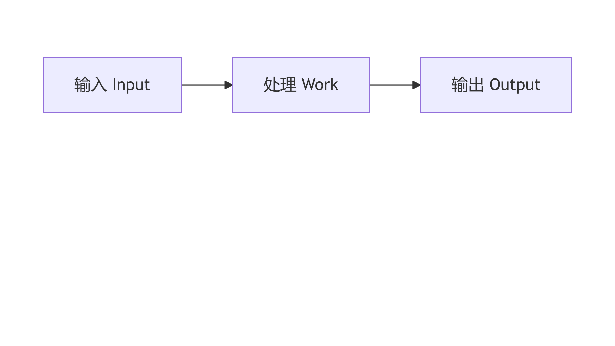
Diagram fallback
Mermaid geometry remains an explicit image fallback. Surrounding text stays editable.

Slide 10
End

