Slide 1

Genetic Algorithm
Based on natural evolution
Population of individuals with size n
Individuals have a genetic representation (gene)
Individuals can be evaluated to receive a score that represents their fitness
Individuals with a higher fitness have a higher chance to be selected for reproduction
Genes from two individuals can be combined and adjusted (crossover, mutation)

Slide 2
Genetic Algorithm: Genetic Representation
Appearance, Behaviour, Physical qualities
Designing a good genetic representation this is expressive and evolvable is not trivial
Common:
Binary array
Binary tree
Natural language
Parse tree
Directed graph
Alphabet:
abcdefghijklmnopqrstuvwxyz. -
Population
aefeqawded-
befdjfi ezp
…
n

Slide 3
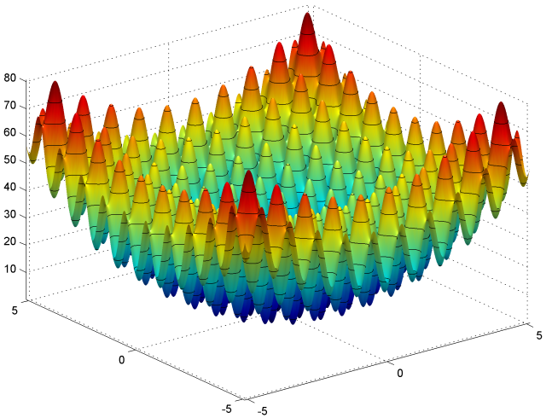
Genetic Algorithm: Evaluation
Evaluate the quality of an individual
Solicitates a search through the hypothesis/solution/parameter space
Alphabet
abcdefghijklmnopqrstuvwxyz. -
Population
aefeqawded-
befdjfi ezp
…
n
Target
h | e | l | l | o |  | w | o | r | l | d
a | e | f | e | q | a | w | d | e | d | - | 2 | .1818
b | e | f | d | j | f | i |  | e | z | p | 3 | .2727

Slide 4
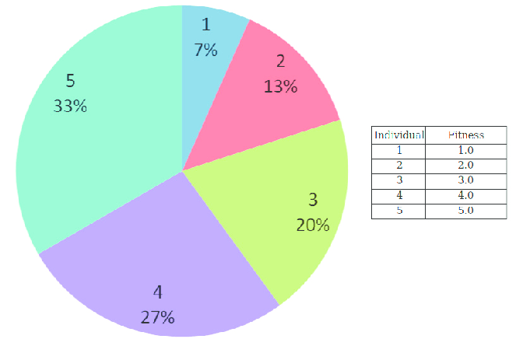
Genetic Algorithm: Selection
Roulette Wheel Selection
Tournament Selection
Tournament size k
Select k individuals via a uniform distribution (random)
Take best individual in tournament

Slide 5
Genetic Algorithm: Crossover & Mutation
Crossover
Mutation
A way to combine the genes of the two parent individuals into a/two new gene for a/two new individuals
Conveys the information in the two parent genes to a new hopefully improved individual
Adjust a gene to contain new random information
Enlarges the information captured in the gene pool. Gives the chance to introduce new information.
b | e | f | d | j | f | i |  | e | z | p
a | e | f | e | q | a | w | d | e | d | -
b | e | f | d | j | a | w | d | e | d | -
b | e | f | d | j |  | w | d | e | d | -

Slide 6
Genetic Algorithm: Summary
Process
Variables
Initialise population
While evolving:
Evaluate
Selection
Reproduction
Stopping condition?
Set amount of generations
Fitness threshold
Population size n
Mutation probability p_{m}
Crossover probability p_{c}
Selection method
tournament size k (TS)

Slide 7
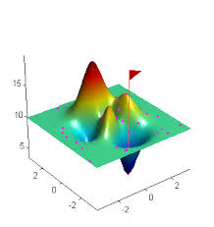
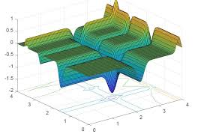
Genetic Algorithm: Notes
Smoothness of evaluation function
Optimality of solution
Elitism
Keep best x individuals alive between generations
Food for thought:
Genes with different sizes
Constant / variable population size
Parameter tuning

Slide 8
Practical Setup
Python 3 (3.8.5 was used)
Visual Studio Code
Clone Repository https://github.com/SimonCraenen/GeneticAlgorithmPython.git
Create Virtual Python Environment
python –m venv .venv
Install packages
pip install numpy
pip install kivy[base] --pre --extra-index-url https://kivy.org/downloads/simple/

Slide 9
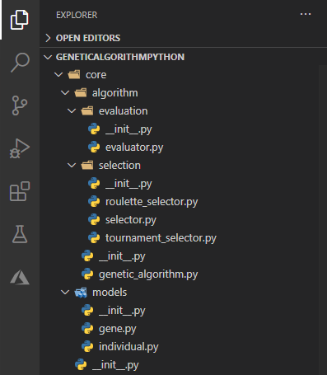
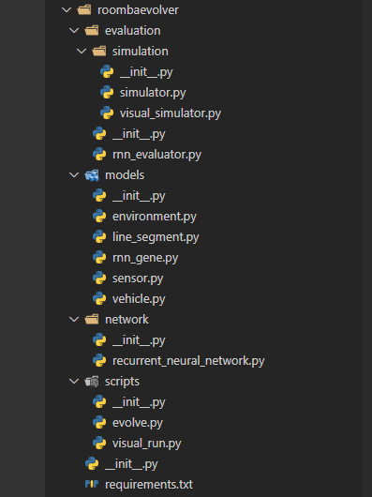
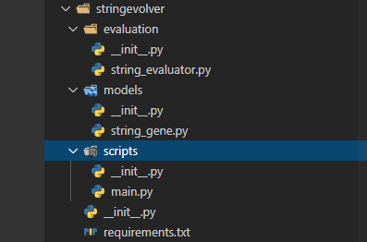
Practical Setup: Code Overview

Slide 10
Practical Setup: Code Overview
core/algorithm/genetic_algorithm.py
Saving
Main loop
core/algorithm/selectoin/selector.py
core/evaluation/evaluator.py

Slide 11
Practical Setup: Code Overview String Evolver
core/evaluation/evaluator.py
evaluation/string_evaluator.py
evaluate
models/string_gene.py
mutate
crossover
scripts/main.py

Slide 12
Practical Setup: Code Overview Roomba Evolver
evaluation/simulation/rnn_evaluator.py
evaluate
models/rnn_gene.py
mutate
crossover
scripts/evolve.py
scripts/visual_run.py

Slide 13
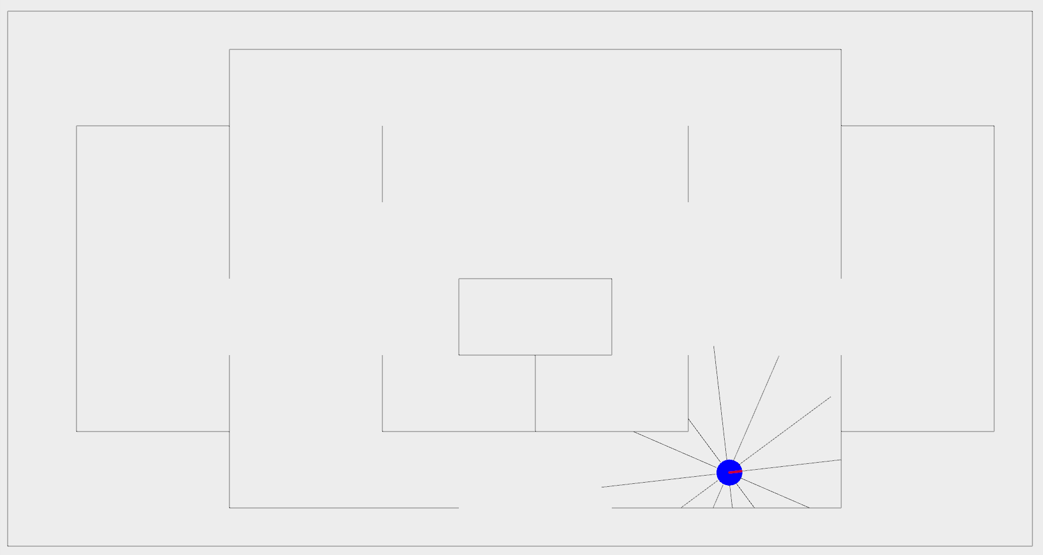
Practical: Goal

Slide 14
Practical: Individuals
Gene: Recurrent Neural Network Weights
Fixed Network Structure
Bias Node
Sensor Values
Previous Outputs
1
s₁
o₁
s_{n}
o₂
inputs
x =
outputs
inputs
outputs
n=10; inputs=13; outputs=2

