Slide 1
finding the shortest synchronizing word in a WFA
Presentation by: Mitchell Jacobs

Slide 2
What’s a WFA?
First let’s start with DFAs

Slide 3
Deterministic finite automaton
Deterministic – Returning the same output when provided the same input state.
Finite – Bounded range
Automaton - a machine that performs a function according to a predetermined set of coded instructions.
Putting it all together
A finite-state machine that preforms a function by running through a state sequence uniquely determined by the input.

Slide 4
Weighted Deterministic finite automaton
Inputs to DFAs can be any sequence of defined symbols, i.e [a-zA-Z].
Weighted Deterministic Finite Automaton assign weight to each symbol.
WFAs are equivalent to DFAs when each symbol is assigned the same weight.
If you are paying attention, you might be wondering how WFAs know the weight of each symbol.
There are other ways to inform WFAs of symbol weight, i.e Dictionaries, but for this algorithm we are simply giving the WFA a weight function.

Slide 5
A Quick exercise

Slide 6
γ = Input
Alphabet = {α,β}
γ₀ = “αβααβαβ”
γ₀ = {S₀, S₁, S₂, S₂, S₂, S₁, S₀, S₀} = True
γ₁ = “βααβαββα”
γ₁ = {S₀, S₀, S₁, S₀, S₀, S₁, S₂, S₁ ,S₀} = True
γ₂ = “αβαββα”
γ₂ = {S₀, S₁, S₂, S₂, S₁, S₂, S₂} = False
β
α
β
α
γ
S₀
S₁
S₂
α
β

Slide 7
γ = Input
Alphabet = {α,β}
γ₀ = “αβααβαβ”
γ₀ = {S₀, S₁, S₂, S₂, S₂, S₁, S₀, S₀} = True
β
α
β
α
γ
S₀
S₁
S₂
α
β

Slide 8
γ₁ = “βααβαββα”
γ₁ = {S₀, S₀, S₁, S₀, S₀, S₁, S₂, S₁ ,S₀} = True
β
α
β
α
γ
S₀
S₁
S₂
α
β

Slide 9
γ₂ = “αβαββα”
γ₂ = {S₀, S₁, S₂, S₂, S₁, S₂, S₂} = False
β
α
β
α
γ
S₀
S₁
S₂
α
β

Slide 10
Synchronizing words
As seen in the previous example, series of symbols can return two values:
If we return to the starting state – True
If we don’t return to the starting state – False
A series of symbols [words] that returns True is considered synchronizing.
Also as seen in the previous example, synchronizing words can be of variable length

Slide 11
Weighted synchronizing words
Adding weights to symbols allows us to determine the weight of a given synchronizing word.
So now we are able to state the goal of the algorithm
The goal of the algorithm is to find the shortest and “lightest” synchronizing word.

Slide 12
Algorithm
Analysis of the algorithm

Slide 13
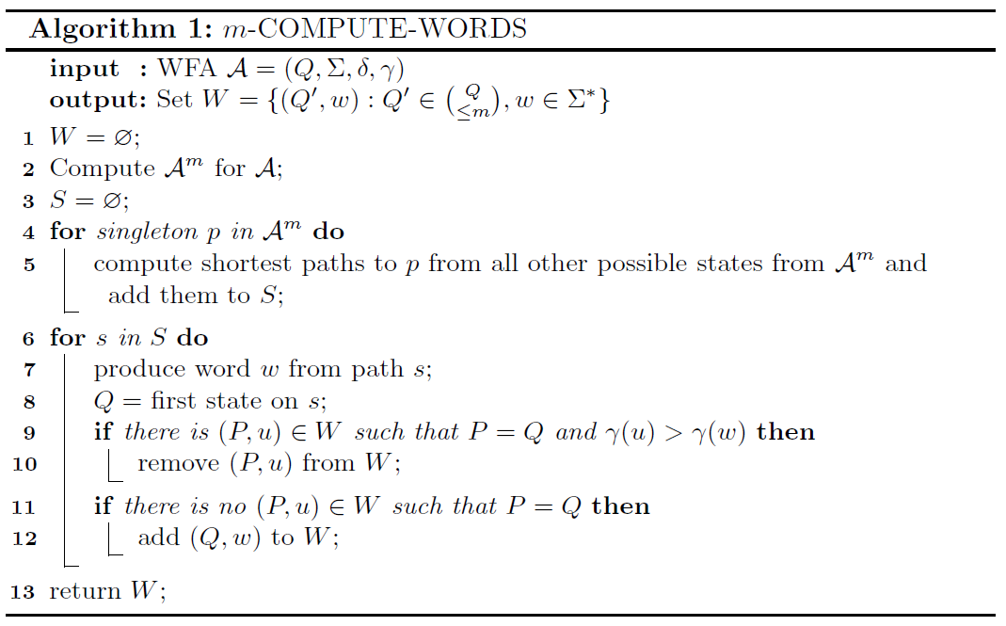
Compute words
Compute words takes a WFA A and maximum subsets m as input and returns W.
Q is a finite set of states.
Σ is a finite alphabet.
δ is the transition function: Q x Σ → Q
γ is the weight function: Σ → N
W is a set containing the shortest synchronizing words for Q’, where Q’ is up to m subsets of Q.
This algorithm is used to generate a set of short synchronizing words to weigh for any power automaton of A.

Slide 14
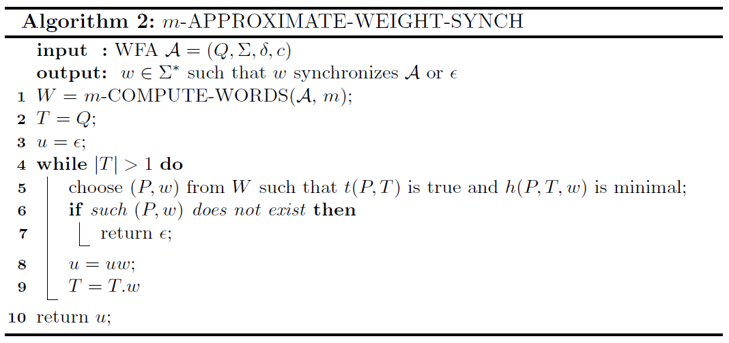
Approximate weight of synchronizing words
Approximate weight synch takes a WFA A and maximum subsets m as input and returns W.
W is a set containing the shortest synchronizing words reaching state m.
This algorithm is used to generate a set of short synchronizing words to weigh from any given WFA and starting state in the WFA.

