Slide 1
approximating the shortest synchronizing word in a WFA
Presentation by: Mitchell Jacobs

Slide 2
What’s a WFA?
First let’s start with DFAs

Slide 3
Deterministic finite automaton
Deterministic – Returning the same output when provided the same input state.
Finite – Bounded range
Automaton - a machine that performs a function according to a predetermined set of coded instructions.
Putting it all together
A finite-state machine that preforms a function by running through a state sequence uniquely determined by the input.

Slide 4
Weighted Deterministic finite automaton
Inputs to DFAs can be any sequence of defined symbols, i.e [a-zA-Z].
Weighted Deterministic Finite Automaton assign weight to each symbol.
WFAs are equivalent to DFAs when each symbol is assigned the same weight.

Slide 5
Applications of finite automata
Finite automata are used in many applications
Text processing
Compilers
Hardware design
Network protocols
Automata theory is present in many fields
Computer Science (duh)
Linguistics
Philosophy
Biology
Electrical Engineering

Slide 6
A Quick exercise

Slide 7
γ = Input
Alphabet = {α,β}
γ₀ = “βαββα”
γ₀ = {S₀, S₁, S₂, S₃, S₀} = True
β
α
α
γ
S₀
S₁
α
β
α
S₃
S₂
β
β

Slide 8
γ₁ = “βααβαβββα”
γ₁ = {S₀, S₁, S₁, S₂, S₁, S₂, S₃ ,S₃ ,S₀} = True
β
α
α
γ
S₀
S₁
α
β
α
S₃
S₂
β
β

Slide 9
γ₂ = “βαβαβα”
γ₂ = {S₀, S₁, S₂, S₁, S₂, S₁} = False
β
α
α
γ
S₀
S₁
α
β
α
S₃
S₂
β
β

Slide 10
Synchronizing words
As seen in the previous example, series of symbols can return two values:
If we return to the starting state – True
If we don’t return to the starting state – False
A series of symbols [words] that reaches an end state is considered synchronizing.
For our example, the end state is the starting state.
Also as seen in the previous example, synchronizing words can be of variable length.

Slide 11
Weighted synchronizing words
Adding weights to symbols allows us to determine the weight of a given synchronizing word.
So now we are able to state the goal of the algorithm
The goal of the algorithm is to approximate the shortest and “lightest” synchronizing word.

Slide 12
Algorithm
Analysis of the algorithm

Slide 13
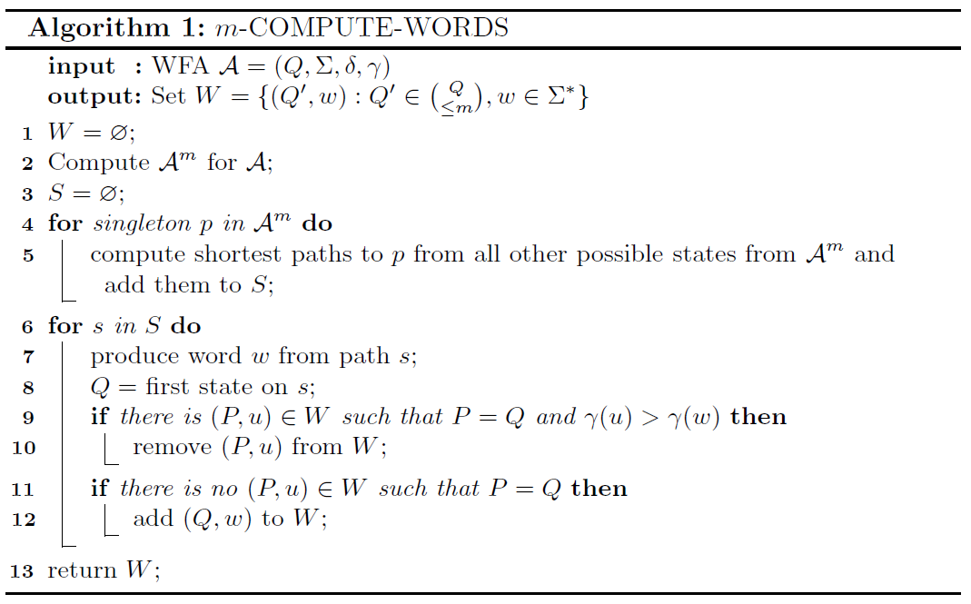
Compute words
Compute words takes a WFA A and maximum subsets m as input and returns W.
Q is a finite set of states.
Σ is a finite alphabet.
δ is the transition function: Q x Σ → Q
γ is the weight function: Σ → N
W is a set containing the shortest synchronizing words for Q’, where Q’ is up to m subsets of Q.
This algorithm is used to generate a set of weighted short synchronizing words for any power automaton of A.

Slide 14
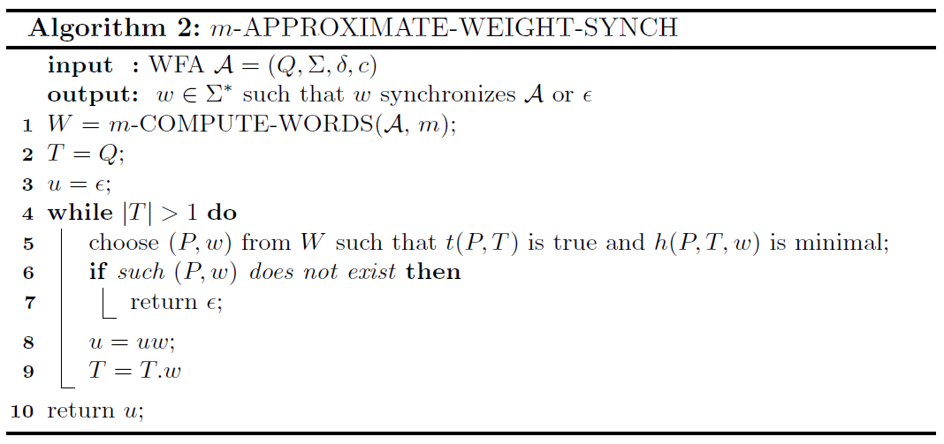
Approximate weight of synchronizing words
Approximate weight synch takes a WFA A and maximum subsets m as input and returns u.
u is the approximate shortest and “lightest” synchronizing word or NULL if there is no synchronizing word.
This algorithm uses the previous compute words algorithm to generate words, then evaluates each word with t and h, returning the word which satisfies t and minimizes h .

Slide 15
Heuristics
Definitions for h and t

Slide 16

Heuristics
As stated in the title of the second algorithm, we are approximating the best synchronizing word.
We are trying to balance the length of the word and the weight of the word
Each h and t uses a different approach to approximate the best synchronizing word.
Heuristic 1: P is the set of all the shortest
t₁(P,T) ≡ $(P ⊆T ∧ \left|P\right|>1)$ words for each cardinality of T.
h₁(P,T,w) ≡ $\frac{γ(w)}{\left|P\right|−\left|P.w\right|}$ T is the set of all remaining states.
Examples- P: ((0, “”) , (1, ” β”), (2, “βα”)) T: (2,3)

Slide 17

Additional heuristics
Heuristic 2:
t₂(P,T) ≡ $(P ⊆T ∧ \left|P\right|>1)$
h₂(T,w) ≡ $\frac{γ(w)}{\left|T\right|−\left|T.w\right|}$
This approach uses the same t from H₁ but uses T instead of P for h.
h₂ prioritizes words that reduce the remaining states needed to be calculated over words with less weight.

Slide 18

Additional heuristics
Heuristic 3:
t₃(P,T,m) ≡ $(P ⊆T ∧ \left|P\right|=min⁡(m,\left|T\right|))$
h₃(w) ≡ $γ(w)$
This approach is modeled off Eppsiten’s breadth-first heuristic algorithm for DFAs which checks all paths up to depth m for each state.
t₃ checks if P is a subset of T and if P is equal to m which is number of “branches” we can path down.
h₃ simply returns the weight of the word.

Slide 19

Additional heuristics
Heuristic 4:
t₄(P,T) ≡ $(P ⊆T ∧ \left|P\right|>1)$
h₄(P,T,w) ≡ $\frac{γ(w)}{{(\left|T\right|−\left|T.w\right|)}^{2}}$
This approach uses the same t and h from H₂ but squares the denominator.
H₁₋₃ might not choose paths which use heavier symbols in the first iteration which could lead to inefficient paths.
h₄ highly prioritizes words that reduce the remaining paths needed to be calculated over words with less weight.

Slide 20
My additions
https://github.com/Jacobsma/CS477-Project

Slide 21
New Additions
Heuristics
Implementing new heuristics to possibly find better synchronizing words.
Modifying current heuristics to possibly improve their results
Automata
Testing the algorithm on more automata
Comparing results from each automata
Optimization
Optimizing the current algorithms implementation
Refactoring the current algorithm implementation
Timing
Timing the computation time for each heuristic
Comparing heuristic timing

