Slide 1
approximating the shortest synchronizing word in a WFA
Presentation by: Mitchell Jacobs

Slide 2
Refresher
A quick refresher on what automata are

Slide 3
Deterministic finite automata
Deterministic finite automata are finite-state machines that preform a function by running through a state sequence uniquely determined by the input.
The input to a DFA is a regular language. Regular languages are defined by the Pumping theorem.

Slide 4
Pumping theorem
Pumping Theorem: If L is a regular language, then:
∃k ≥ 1 (∀ strings w ∈ L, where |w| ≥ k (∃ x, y, z (w = xyz,
|xy| ≤ k,
y ≠ ε, and
∀q ≥ 0 (xy^{q}z ∈ L)))).
Basically, a language is regular if you can “pump” a string in the middle and the output is unchanged.
L is a regular language containing all the strings that start with a, followed by one to inifinite b’s, ending in an a.
aba ∈ L and abbbbba ∈ L

Slide 5
Nondeterministic finite automata
Nondeterministic finite automata are equivalent to deterministic finite automata, but they allow for ε transitions.
ε transitions are transitions from one state to another that don’t consume any of the input.
These transitions make the output of the automata nondeterministic, as you can not determine whether the automata will take the ε transition.

Slide 6
Nondeterministic finite automata cont.
Every nondeterministic finite automata can be converted to a deterministic finite automata, but why does this matter?
Nondeterministic finite automata can be more easily conceptualized and constructed, allowing us to tackle more complex problems.

Slide 7
Weighted finite automata
Inputs to DFAs can be any regular language.
Weighted Finite Automaton assign weight to each symbol in the language.
WFAs are equivalent to DFAs when each symbol is assigned the same weight.

Slide 8
Synchronizing words
Synchronizing words can return two values:
If we reach the end state → True
If we don’t reach the end state → False
A series of symbols [word] that reaches an end state is considered synchronizing.
The end state can be any state of an automata.
Adding weights to symbols allows us to determine the weight of a given synchronizing word.

Slide 9
Why use automata

Slide 10
Applications of finite automata
Text processing
Lexical analysis
Compilers
Hardware design
Network protocols (TCP)

Slide 11
Who even uses automata?
Computer Science
Linguistics
Philosophy
Biology
Electrical Engineering

Slide 12
Algorithms
Analysis and implementations of the algorithms

Slide 13
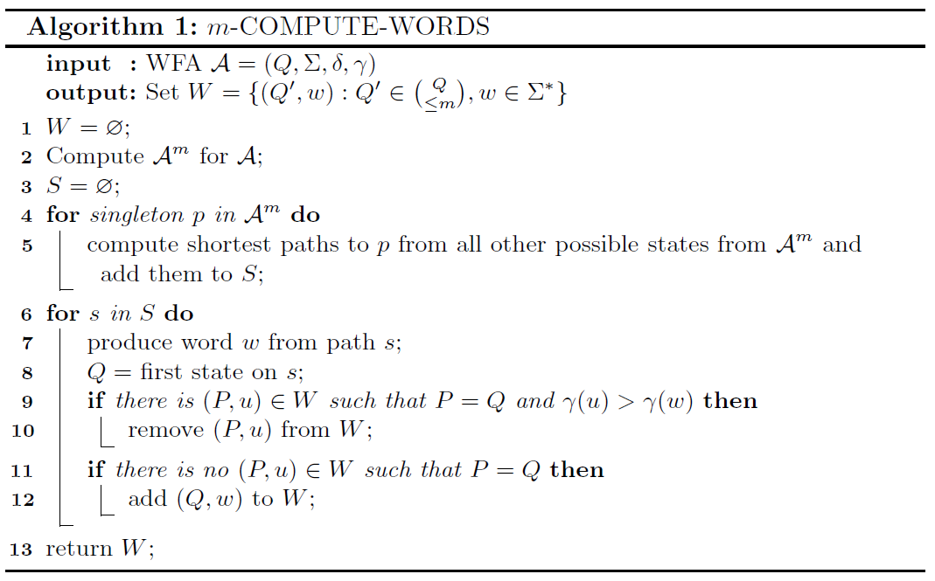
Compute words
Compute words takes a WFA A and maximum subsets m as input and returns W.
Q is a finite set of states.
Σ is a finite alphabet.
δ is the transition function: Q x Σ → Q
γ is the weight function: Σ → N
W is a set containing the shortest synchronizing words for Q’, where Q’ is up to m subsets of Q.
This algorithm is used to generate a set of weighted short synchronizing words for any power automaton of A.

Slide 14
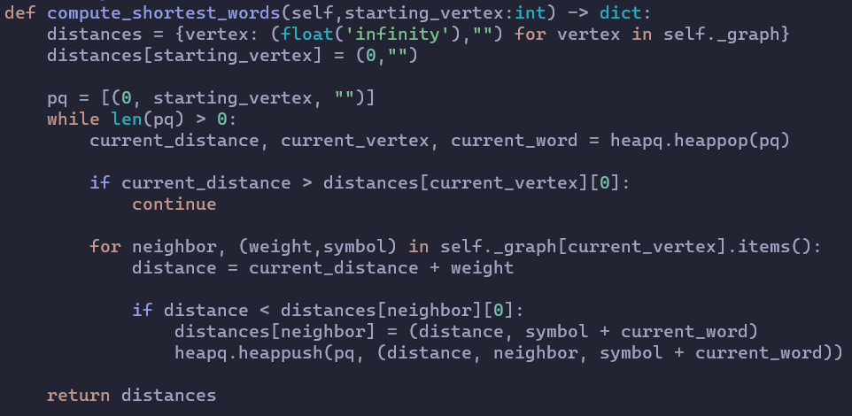
Compute words Implementation
Compute words takes a WFA A and a starting state m as input and returns W.
Graph is a set of all the paths from each state to every other state.
Pq is a heap containing the current shortest synchronizing words in Graph.
Distances is a set containing the shortest synchronizing words in Graph.
This algorithm generates the set of the shortest synchronizing words from any starting state in automaton of WFA A.

Slide 15
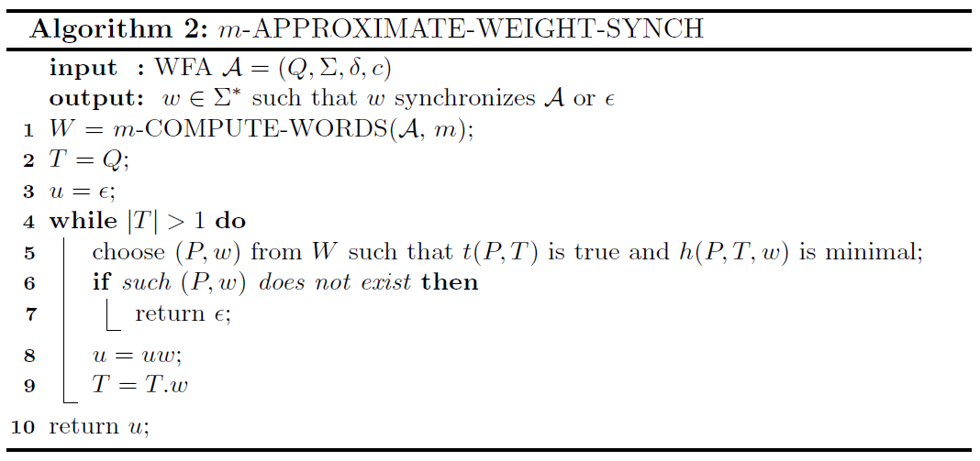
Approximate weight of synchronizing words
Approximate weight synch takes a WFA A and maximum subsets m as input and returns u.
u is the approximate shortest and “lightest” synchronizing word or NULL if there is no synchronizing word.
This algorithm uses the previous compute words algorithm to generate words, then evaluates each word with t and h, returning the word which satisfies t and minimizes h .

Slide 16
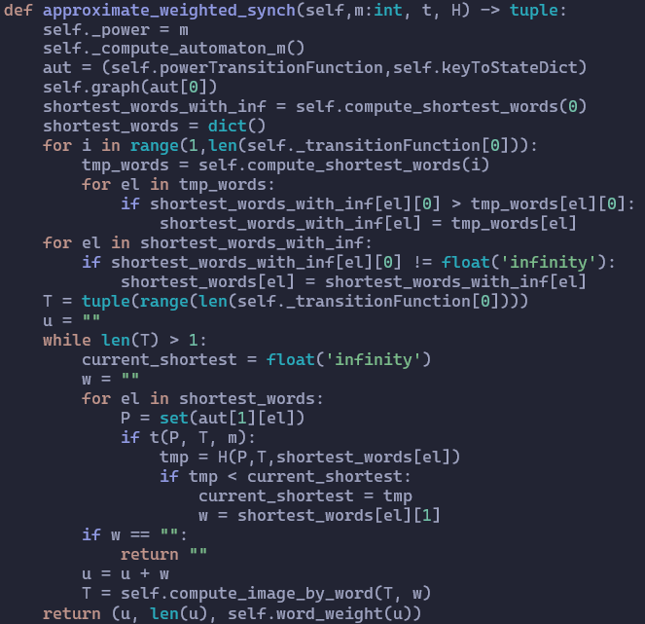
Approximate weight of synchronizing words implementation
Approximate weight synch takes a WFA A, maximum subsets m, t, and heuristic h as input and returns u.
u is the approximate shortest and “lightest” synchronizing word or an empty string if there is no synchronizing word.
T is the set of all the states in A.
This algorithm uses the previous compute words algorithm to generate words, then evaluates each word with t and h, returning the word which satisfies t and minimizes h .

Slide 17
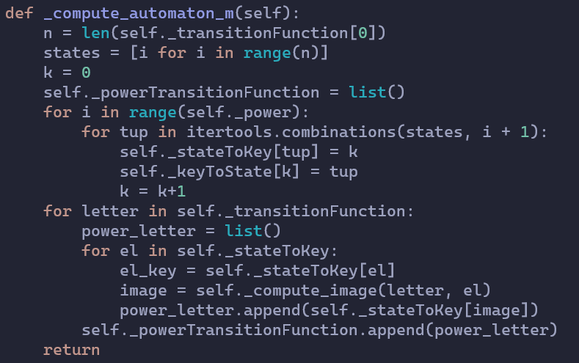
Compute automaton implementation
Compute automaton takes subsets m input.
m is the number of subsets that compute automaton creates.
States are all the states in A.
stateToKey is a dictionary mapping the state representations of the transition function to their respective key representations.
keyToState is a dictionary mapping the key representations of the transition function to their respective state representations.
This algorithm computes the mth power set of the automaton along with dictionaries mapping the state and key representations of the transition function.

Slide 18
Heuristics
Definitions for h and t

Slide 19
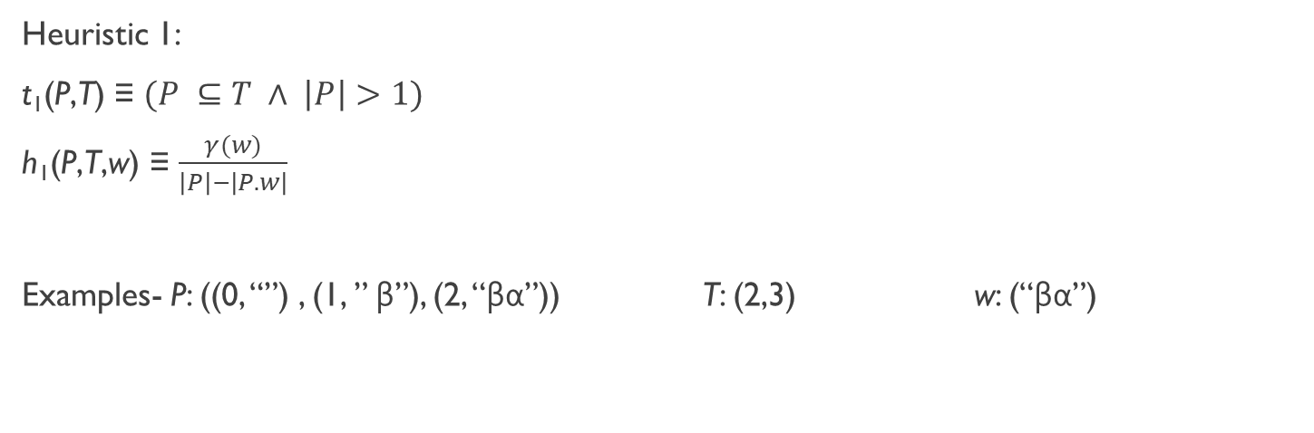
Heuristics
Heuristic 1:
t₁(P,T) ≡ $(P ⊆T ∧ \left|P\right|>1)$
h₁(P,T,w) ≡ $\frac{γ(w)}{\left|P\right|−\left|P.w\right|}$
Examples- P: ((0, “”) , (1, ” β”), (2, “βα”)) T: (2,3) w: (“βα”)
P is a path to another state in T.
T is the set of all remaining states.
w is the current word.

Slide 20
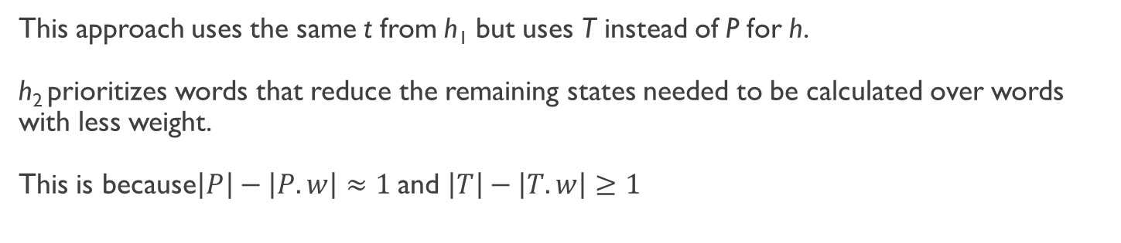

Heuristics cont.
Heuristic 2:
t₂(P,T) ≡ $(P ⊆T ∧ \left|P\right|>1)$
h₂(T,w) ≡ $\frac{γ(w)}{\left|T\right|−\left|T.w\right|}$
This approach uses the same t from h₁ but uses T instead of P for h.
h₂ prioritizes words that reduce the remaining states needed to be calculated over words with less weight.
This is because$\left|P\right|−\left|P.w\right|≈1$ and $\left|T\right|−\left|T.w\right|≥1$

Slide 21

Heuristics cont.
Heuristic 3:
t₃(P,T,m) ≡ $(P ⊆T ∧ \left|P\right|=min⁡(m,\left|T\right|))$
h₃(w) ≡ $γ(w)$
This approach is modeled off Eppsiten’s breadth-first heuristic algorithm for DFAs which checks all paths up to depth m for each state.
t₃ checks if P is a subset of T and if P is equal to m which is the number of “branches” we can path down.
h₃ simply returns the weight of the word.

Slide 22

Heuristics cont.
Heuristic 4:
t₄(P,T) ≡ $(P ⊆T ∧ \left|P\right|>1)$
h₄(P,T,w) ≡ $\frac{γ(w)}{{(\left|T\right|−\left|T.w\right|)}^{2}}$
This approach uses the same t and h from h₂ but squares the denominator.
h₁₋₃ might not choose paths which use heavier symbols in the first iteration which could lead to inefficient paths.
h₄ highly prioritizes words that reduce the remaining paths needed to be calculated over words with less weight.

Slide 23
My additions
https://github.com/Jacobsma/CS477-Project

Slide 24
New Additions
Automata testing
Added functionality to test automata from a file or from standard input
Allowed for using custom heuristics in automata testing
Automata generation
Added functionality to generate automata for testing
Optimization
Optimized the previous algorithm’s implementation
Refactored the previous algorithm’s implementation using an OOP approach
Implemented multithreading
Timing
Timed the computation time for each heuristic type
Timed the computation time for finding the shortest word
Timed total computation time

Slide 25
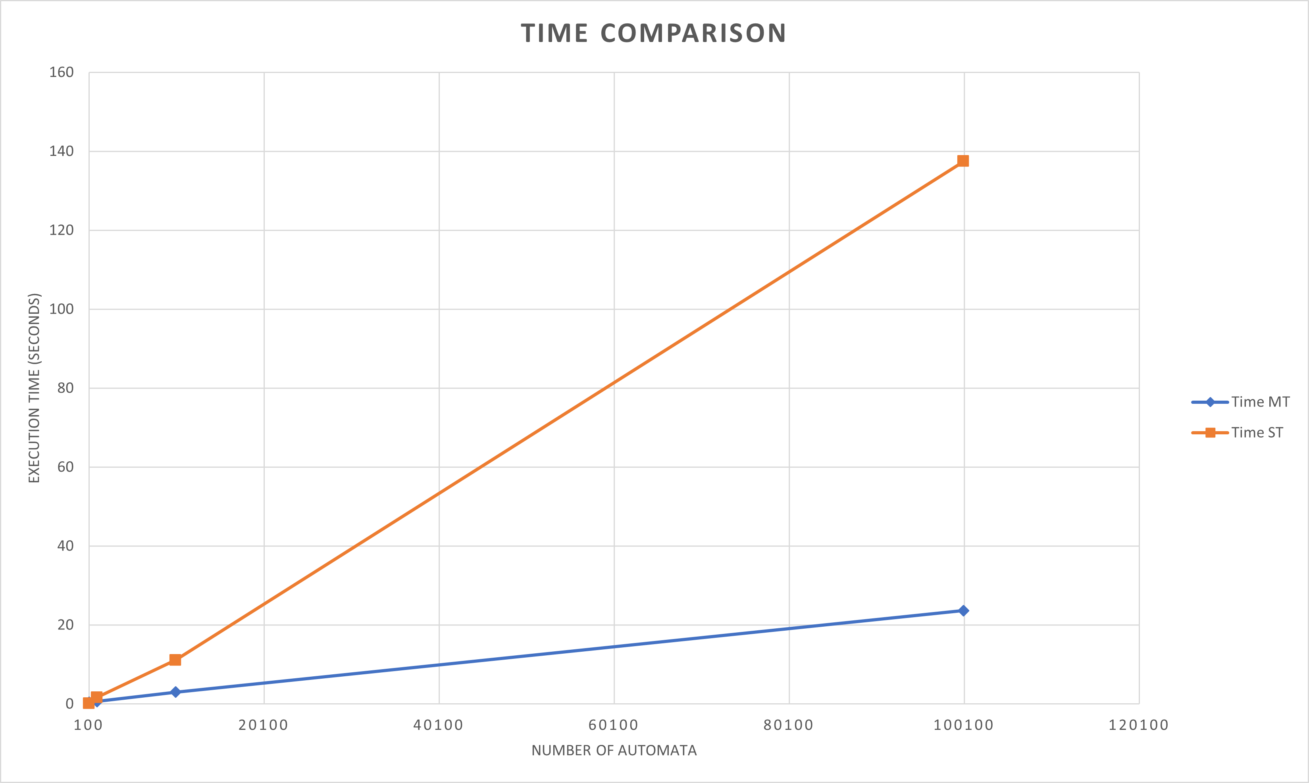
Optimization
Due to poor performance in the initial OOP refactoring, I implemented multithreading and received tremendous performance improvements.
MT is the multithreaded performance
ST is the singlethreaded performance

Slide 26
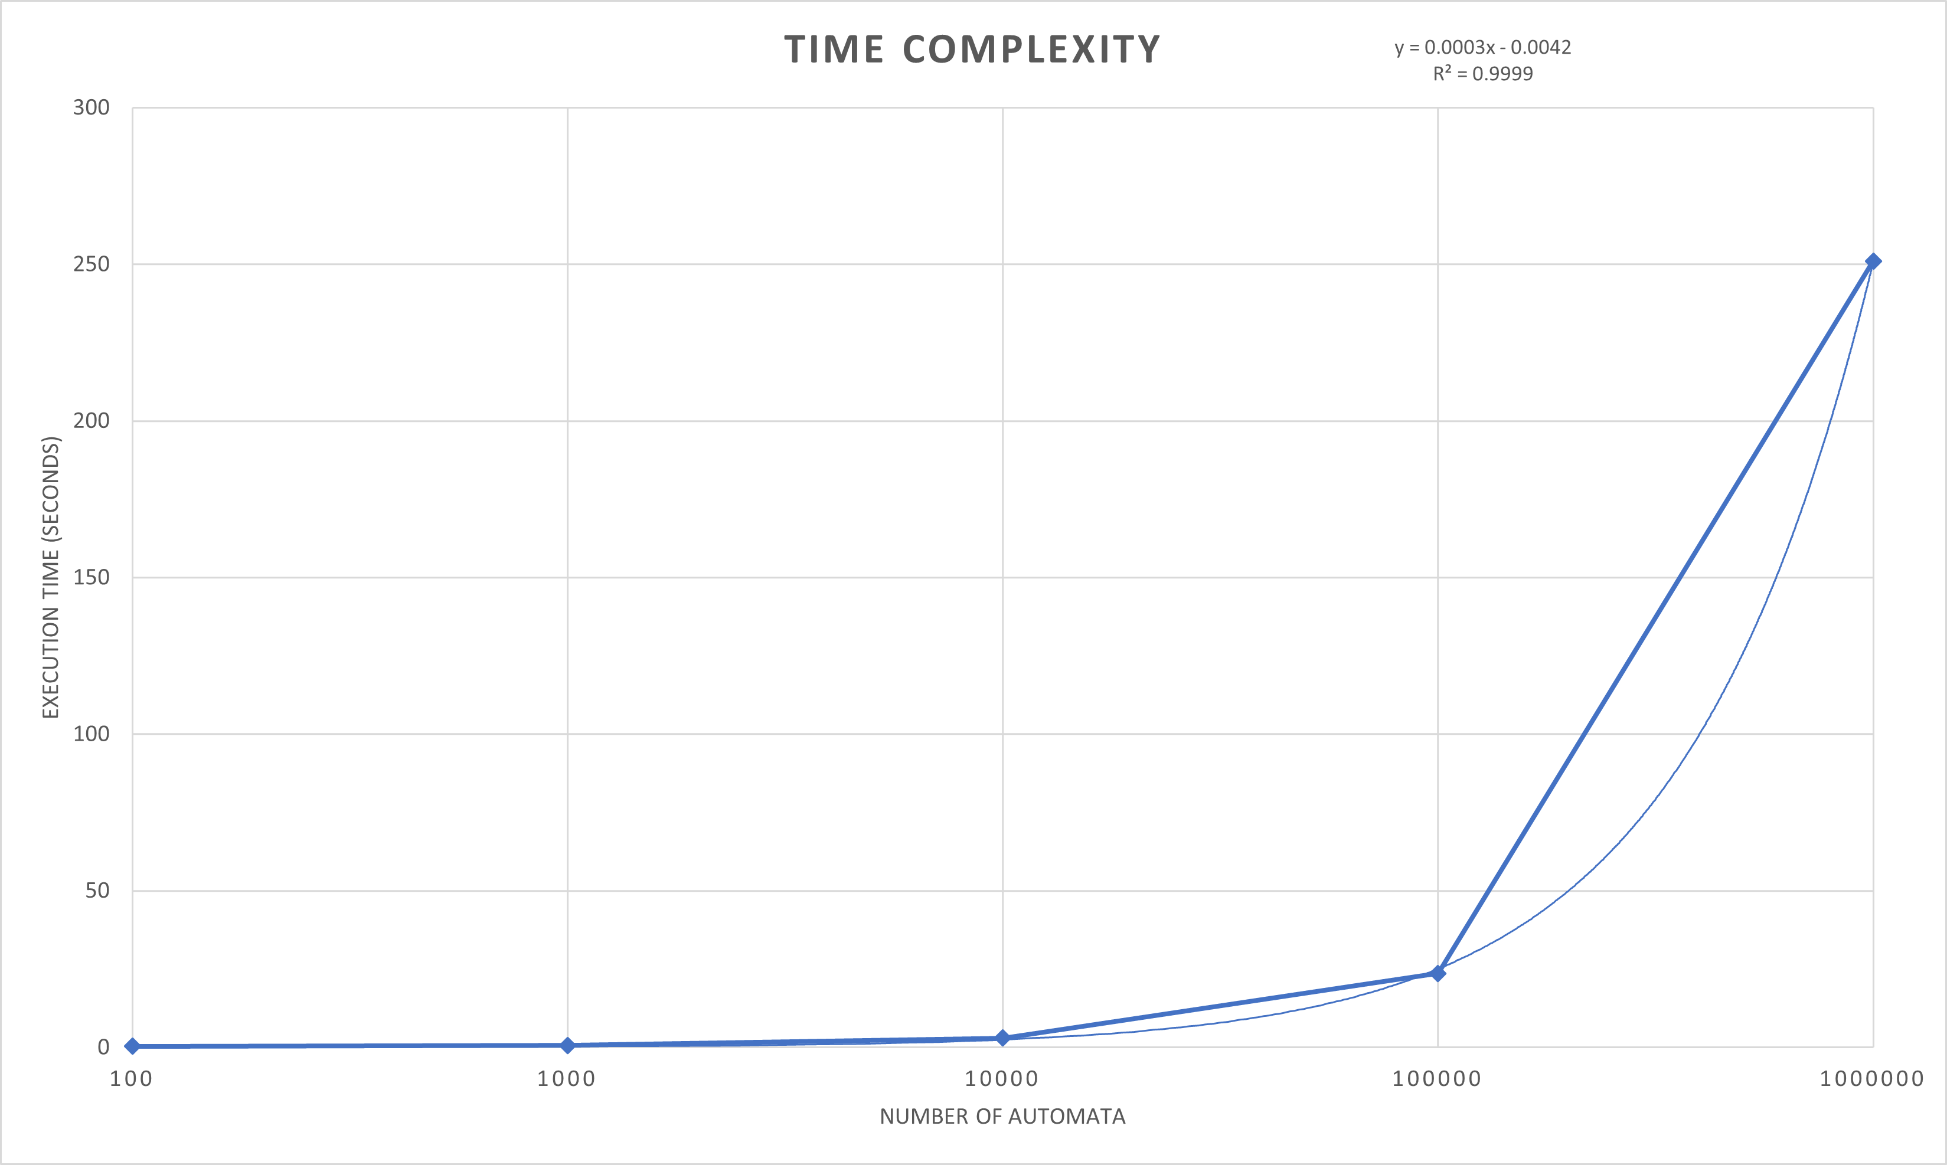
Time complexity
This logarithmic graph shows the time complexity of the Automata script.
The R² value highly suggests that the algorithm is O(N) complexity.

Slide 27
What this project can be used for
This project can be used to quickly and efficiently test any weighted deterministic finite automata using a range of predetermined heuristics or by custom made heuristics.
The automata tested by this project can be used for natural language processing and Markov models. Both of which are used extensively in Machine Learning.

Slide 28
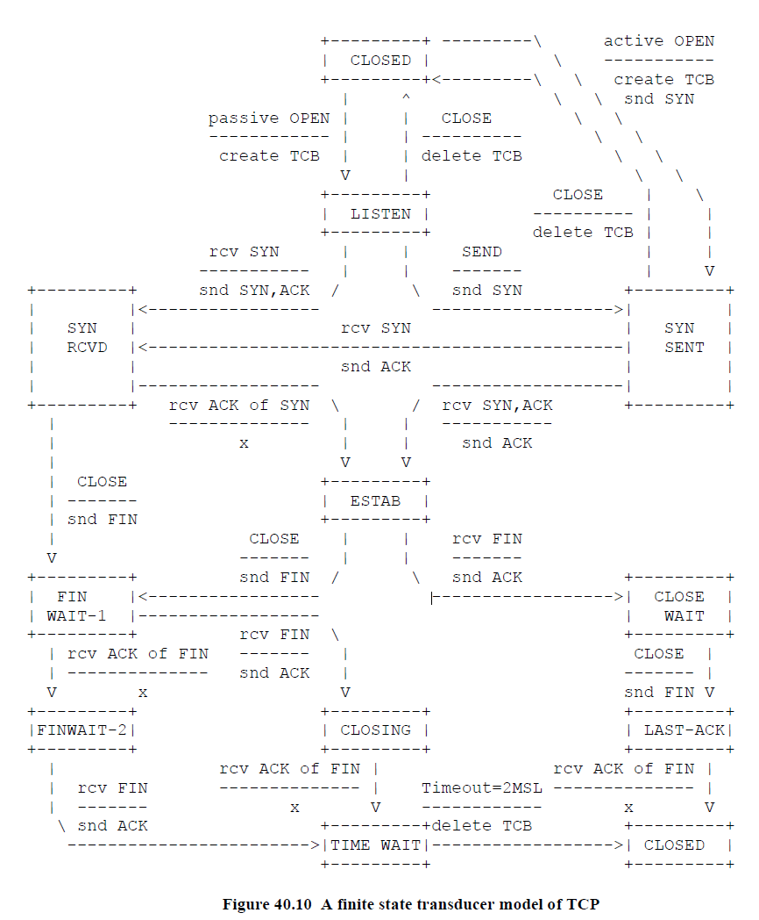
TCP
The TCP network protocol can be represented as a finite automaton.
Elaine, R. (2007). Networks. Automata, Computability and Complexity:
Theory and Applications (pp. 699-701). Pearson.

Slide 29
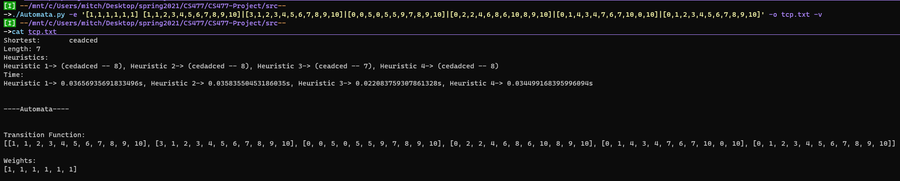
Path of least resistance through TCP
Path is CLOSE→RECVACK→POPEN→RECV→CLOSE→RECV→RECVACK
Weights = [POPEN,AOPEN,CLOSE,RECV,RECVACK,TIMEOUT]

Slide 30
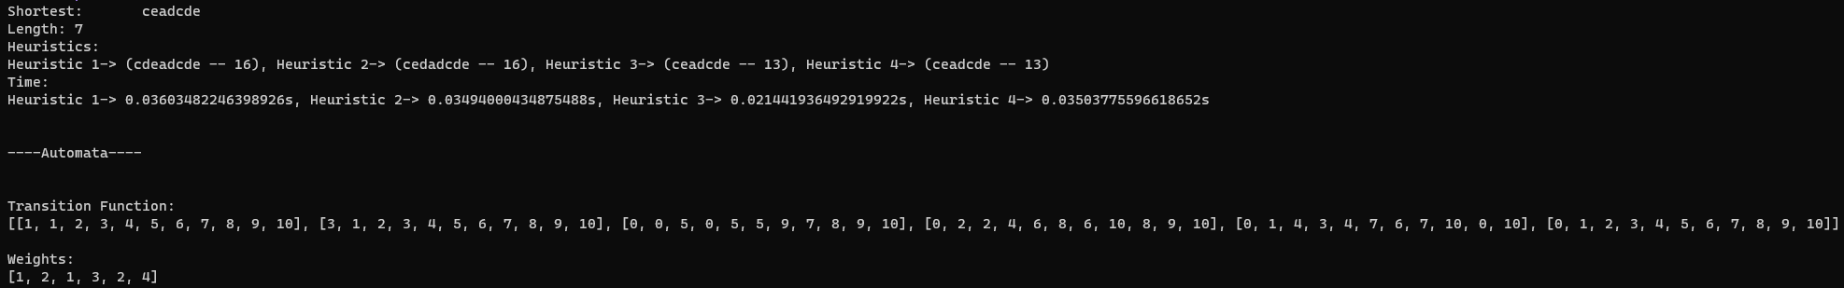
Path of least resistance through TCP
Path is CLOSE→RECVACK→POPEN→RECV→CLOSE→RECVACK→RECV
Weights = [POPEN=1,AOPEN=2,CLOSE=1,RECV=3,RECVACK=2,TIMEOUT=4]

Slide 31
References
Ruszil, J. (2021). Approximation algorithm for finding short synchronizing words in weighted automata. arXiv preprint arXiv:2103.16185.
Elaine, R. (2007). Automata, Computability and Complexity: Theory and Applications. Pearson.
David Eppstein. 1990. Reset sequences for monotonic automata. SIAM J. Comput. 19, 3 (June 1990), 500–510. DOI:https://doi.org/10.1137/0219033

