Slide 1
Servlets
By: Keith Jacobson

Slide 2
What is Servlet?
It is an object that receives a request and then generates a response based on what is received.
They imbed HTML into Java code, it is used to create web application.
Java Server Page files help to deliver server side customized content on a webpage through servlets.
A software developer may use a servlet to add dynamic content to a web server using the Java platform.

Slide 3
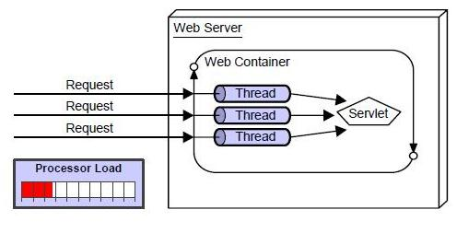
Advantage of Servlet
better performance: because it creates a thread for each request not process.
Portability: because it uses java language.
Robust: Servlets are managed by JVM so we don't need to worry about memory leak, garbage collection etc.
Secure: because it uses java language..

Slide 4
