Slide 1
HTTPURLConnection
By: Keith Jacobson

Slide 2
What is it?
This is an HTTP-centric class, and many of its methods are useful only when you are working with HTTP URLs.
You use it to communicate with an URL.
You can use getOutputStream or getInputStream, so essentially you are connecting with a HTTP URL.
Transparient Response compression (gzip)
Response cache

Slide 3
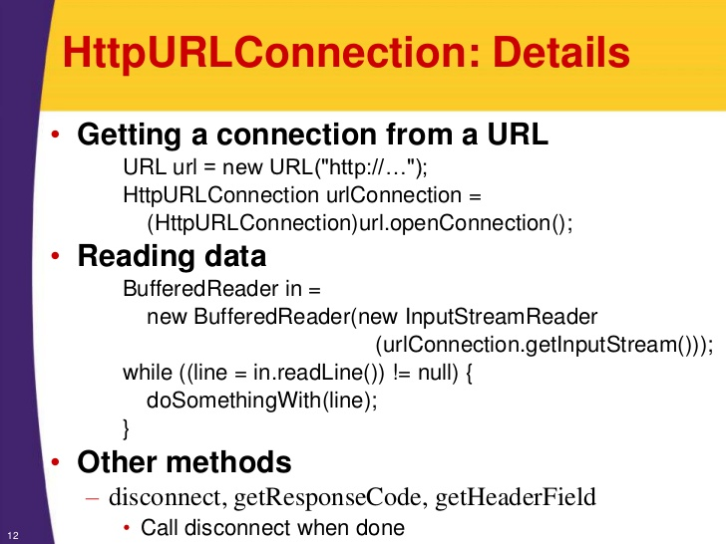
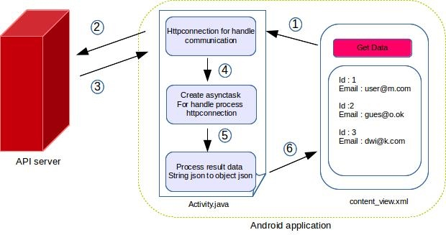
More Info Through Diagrams:

