Slide 1
Hibernate
By: Keith Jacobson

Slide 2
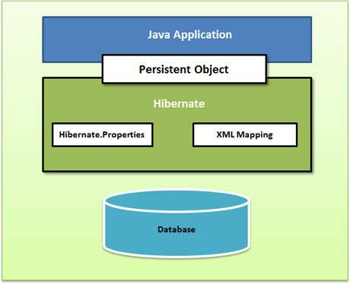
What is Hibernate?
It sits between your Java objects and a database server and takes care of mapping Java classes to database tables, data querying, and retrieval too.

Slide 3
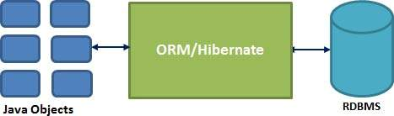
Continued.
It does not require an application server to work.
IF there is a change in the database or any of its tables, then you only need to change the XML file properties.
Minimized Database access.

