Slide 1
Java Collections
By: Keith Jacobson

Slide 2
Collections:
They can be called containers – is simply a single object holding other objects.
They are similar to an Array in that they hold data from different containers, however they are different in that they are dynamic or change to fit what is placed in them.
Collections are used: to store, to retrieve, to manipulate, and to communicate aggregated data.

Slide 3
Interfaces:
These are abstract data types that represent collections.
They allow collections to manipulated independent of the details of their representation.
In object-oriented programming, such as java, they usually form a hierarchy. (Diagram shown later.)

Slide 4
Implementations:
These make concrete implementations of collection interfaces.
Essentially they are re-usable data structures.

Slide 5
Algorithms:
These are the methods that perform useful computations, sometimes they need to be imported.
The do things such as searching and sorting on objects that use collection interfaces.
They are polymorphic: meaning that the same method can be used on many different implementations of the appropriate collection interface.
Very re-usable functionality.

Slide 6
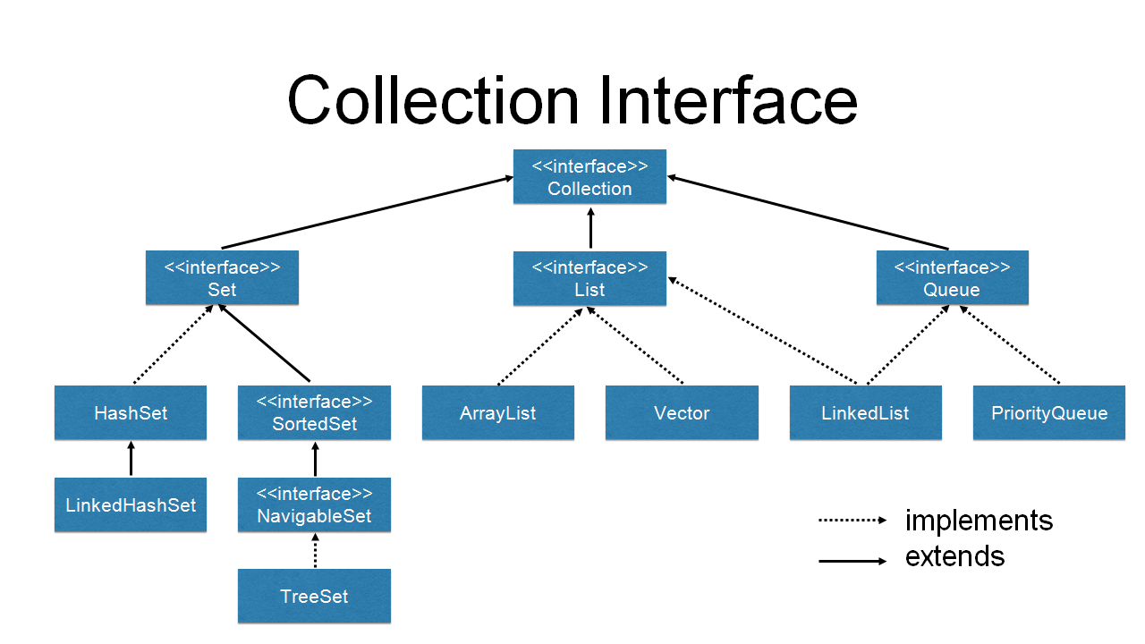
Hierarchy of Classes and Interfaces Extending or Implementing the Collection Interface:
SOURCE: https://dzone.com/articles/an-introduction-to-the-java-collections-framework

