Slide 1
Threads, Executors, and Runnables
By: Keith Jacobson

Slide 2
What are Threads?
It is the program’s path to execution.
You usually need more than one thread to accomplish a programs desired effect.
For example if you had a program would draw pictures, it would not be ableto because it is dedication its thread to receiving input from the user, you would need execution from more than one thread to accomplish this, hence multi-threading.

Slide 3
How to Create a Thread?
Two ways:
Implementing Interface.
Extending a Class.
Interfaces provide the groundwork of a class. They are used to design the requirements for a set of classes to implement.
Extending a class is a way to inherit methods and variables from a parent class.

Slide 4
What are the Executors?
The Executor framework is an abstraction layer over the actual implementation of java multithreading.
It is the first concurrent utility framework in java and used for standardizing invocation, scheduling, execution and control of asynchronous tasks in parallel threads.
The execution rules are defined during the creation of the constructor. → And then the executor runs the concurrent threads following the rules set earlier.

Slide 5
What are Runnables?
A Runnable is basically a type of class (Runnable is an Interface) that can be put into a thread, describing what the thread is supposed to do.
If you make a new Thread with runnable as it's parameter, it will call the run method in a new Thread.
A Runnable process block is a simple class that implements a run() method. Within the run() method is the actual task that needs to be executed by a running thread. By implementing a class with the Runnable interface, we ensure that the class holds a run() method.

Slide 6
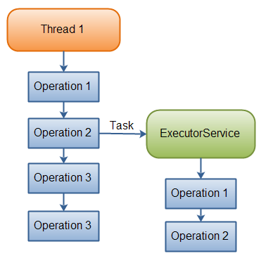
How Threads and Executors Work:

