Slide 1
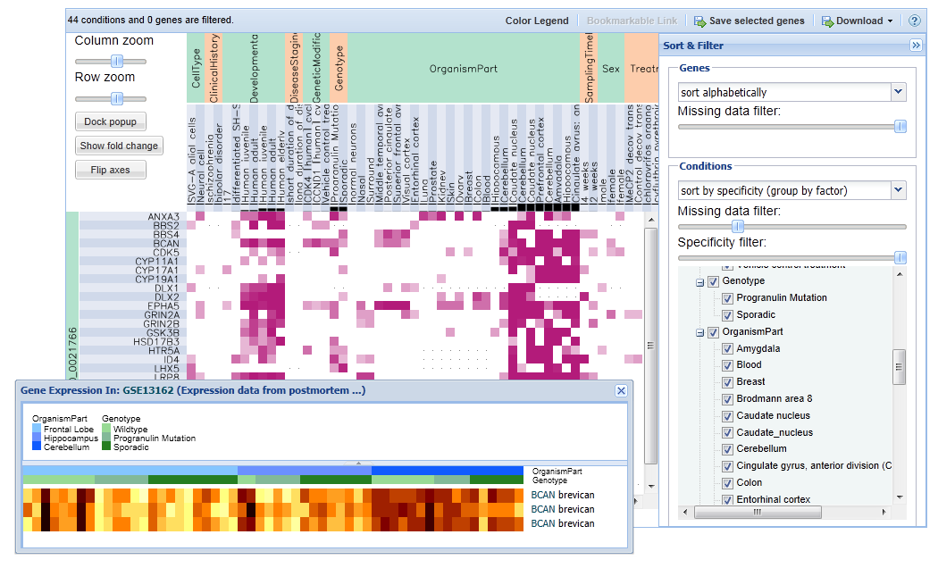
Select genes and experiments by
+ clicking on them. Use this button to save your selections.
Ctrl
Differential Expression Specificity
These bar or pie charts show the number of probes differentially expressed out of the total number of probes expressed in an experiment.
Of the charts highlighted, the ones on the right show lower specificity.
Sort and filter your genes and conditions by criteria including:
The amount of data the row or column is missing (indicated by a grey dot in the cell)
How specific the differential expression is in an experiment (indicated by the specificity charts in the column labels)
Condition values
Click on any cell to visualize expression patterns as heatmaps or line plots.

