Slide 1
Smart Glove for Fist Dance
Shiyi Tang, Yan Zhu, Bohan Diao

Slide 2
Introduction: Fist Dance
Shake hands for first four beats​
Any actions for next four beats​
Rock paper scissor for next two beats​
Point to a direction for next two beats​
If "win rock paper scissor" & "both point to the same direction" :​
Victory!!!​
Else​
Repeat

Slide 3
Introduction: basic idea
Game participant: 1 person, 1 computer
The person will wear a custom built data glove with flex sensors and IMU​
The ML model will make a prediction about the person’s gestures.​
The computer will play with the person according to the prediction of the ML model. ​

Slide 4
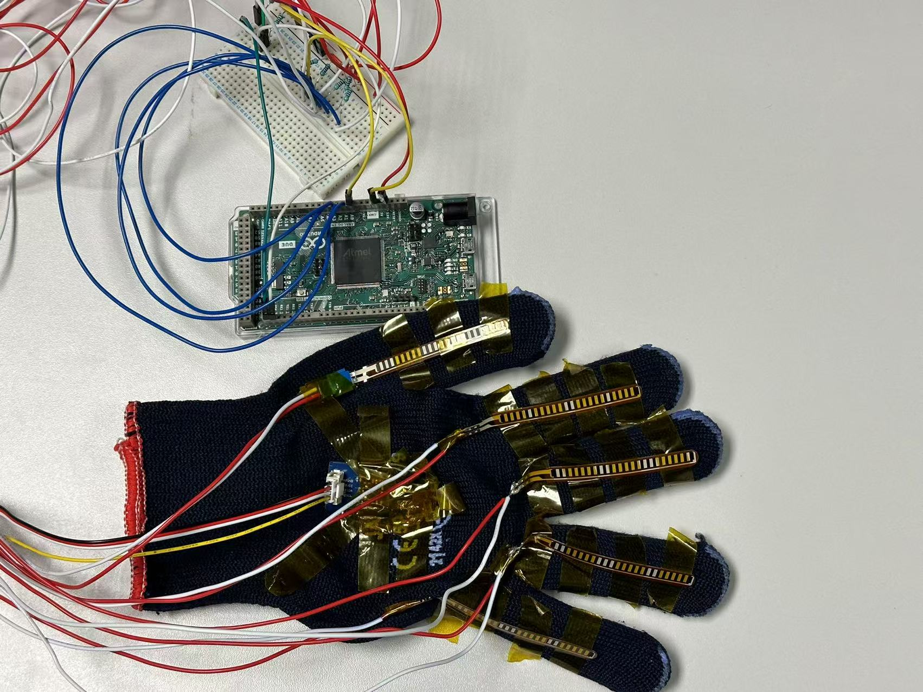
Hardware
Arduino Due
5 Flex Sensors: On each finger Soldered onto wires to measure finger bending.
1 IMU: On the back of the glove Stick to the glove to capture motion and orientation of the hand.
Polyester Knit Glove with Kapton tape

Slide 5
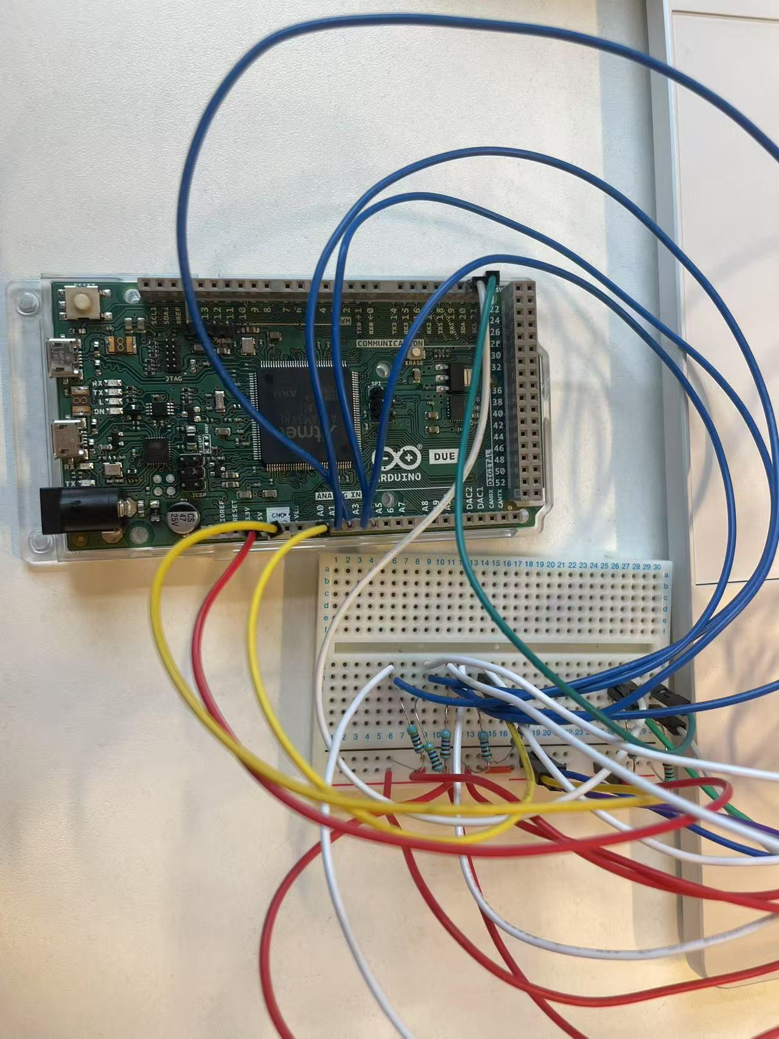
Hardware
Flex
Sticked on the glove
Connected to the Arduino Due using a voltage divider circuit
IMU
Attached to the back of the glove with pull-up resistors

Slide 6
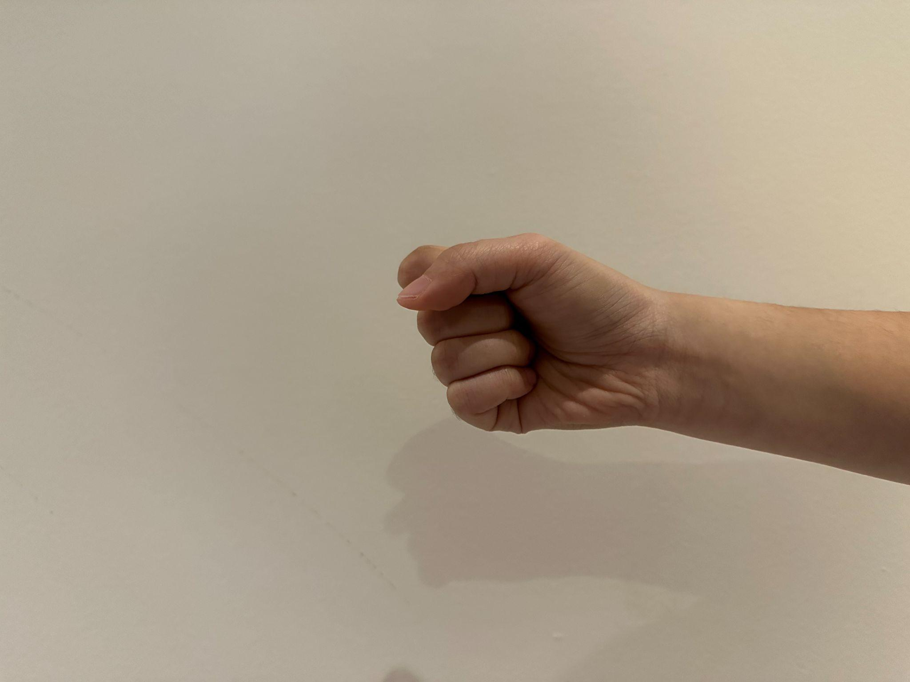
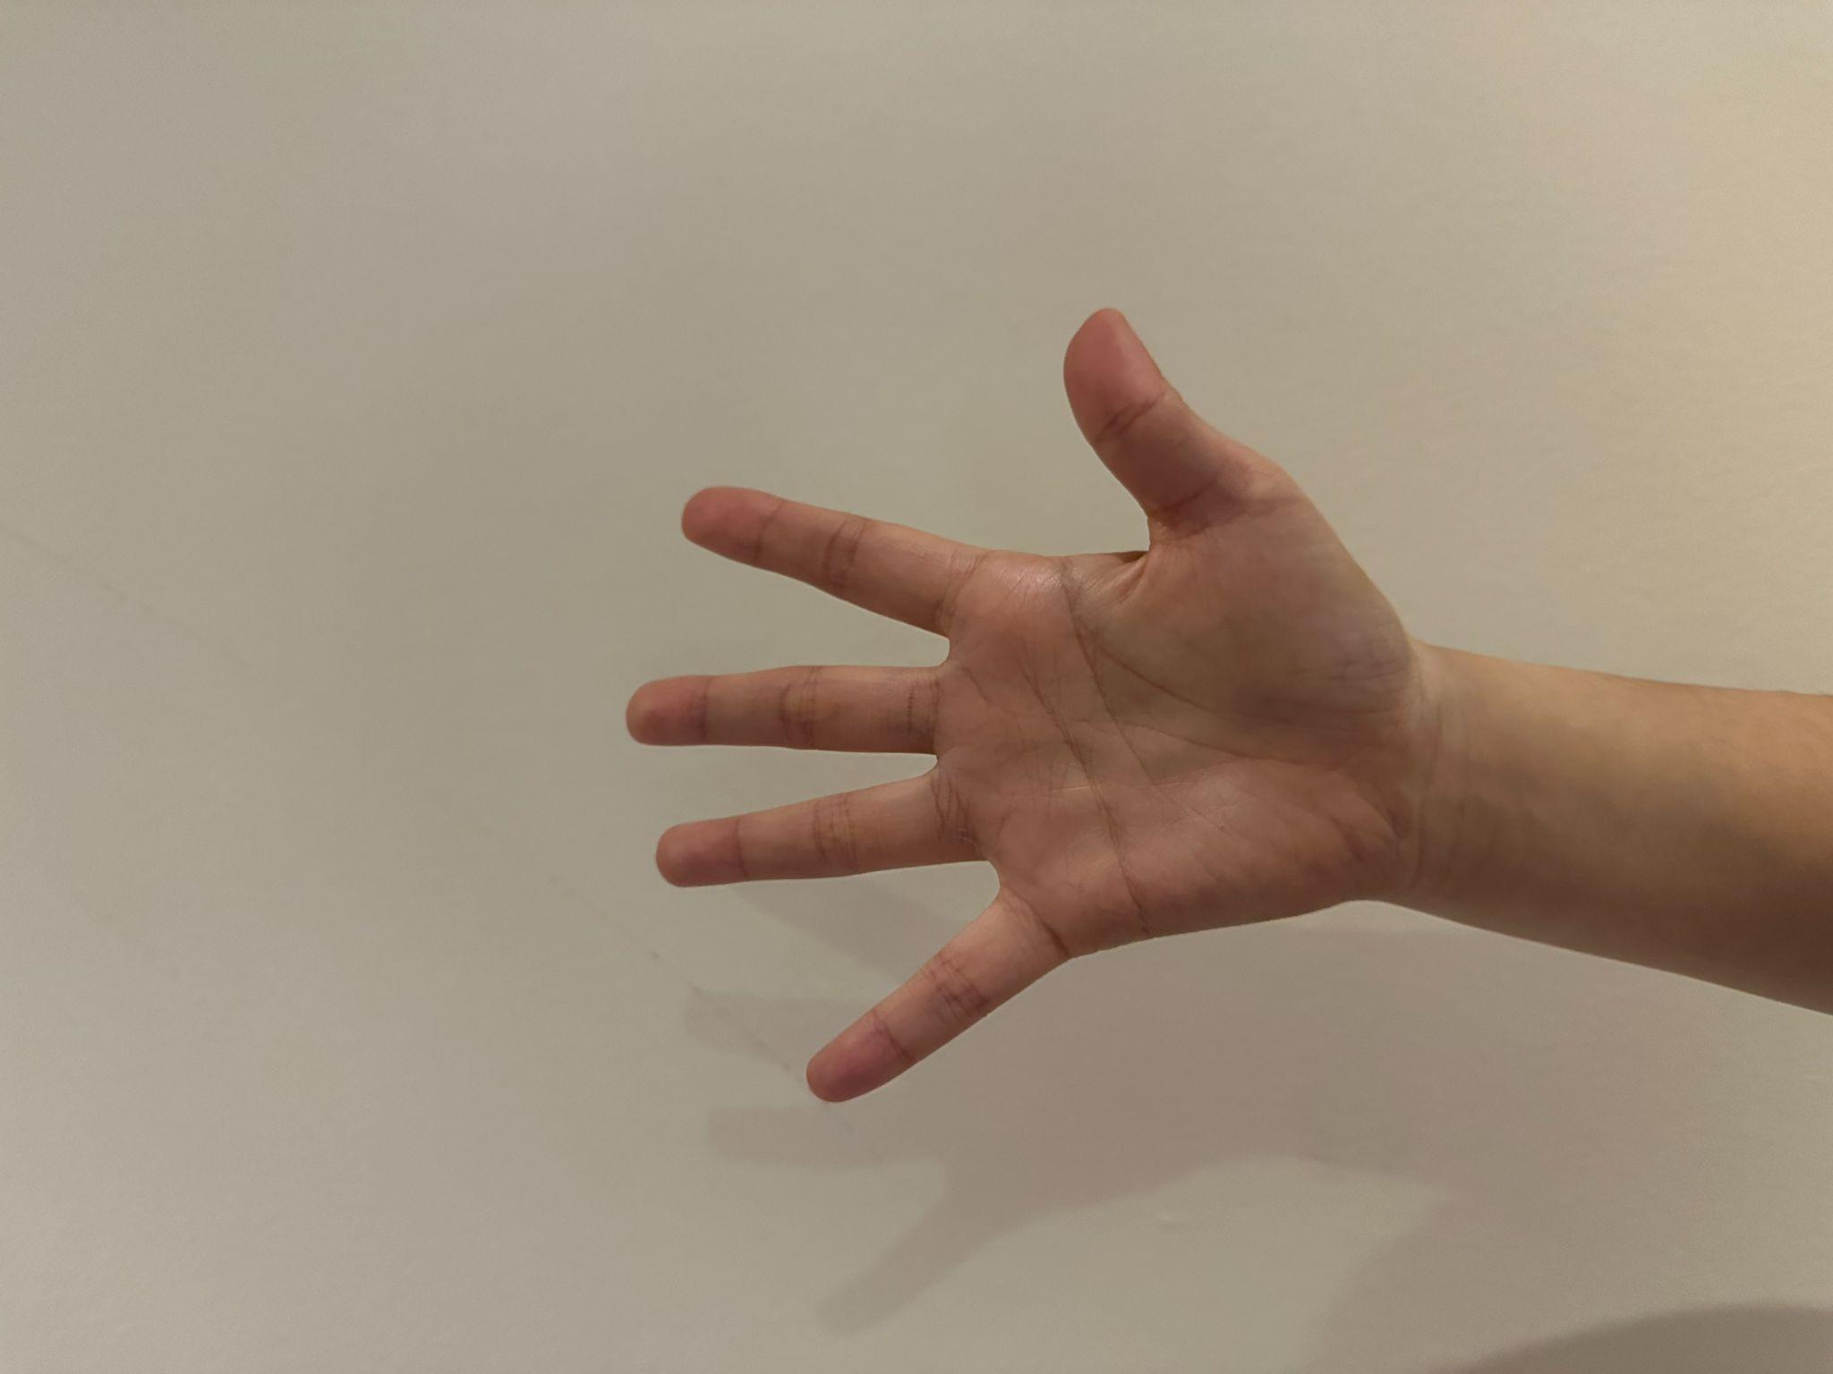
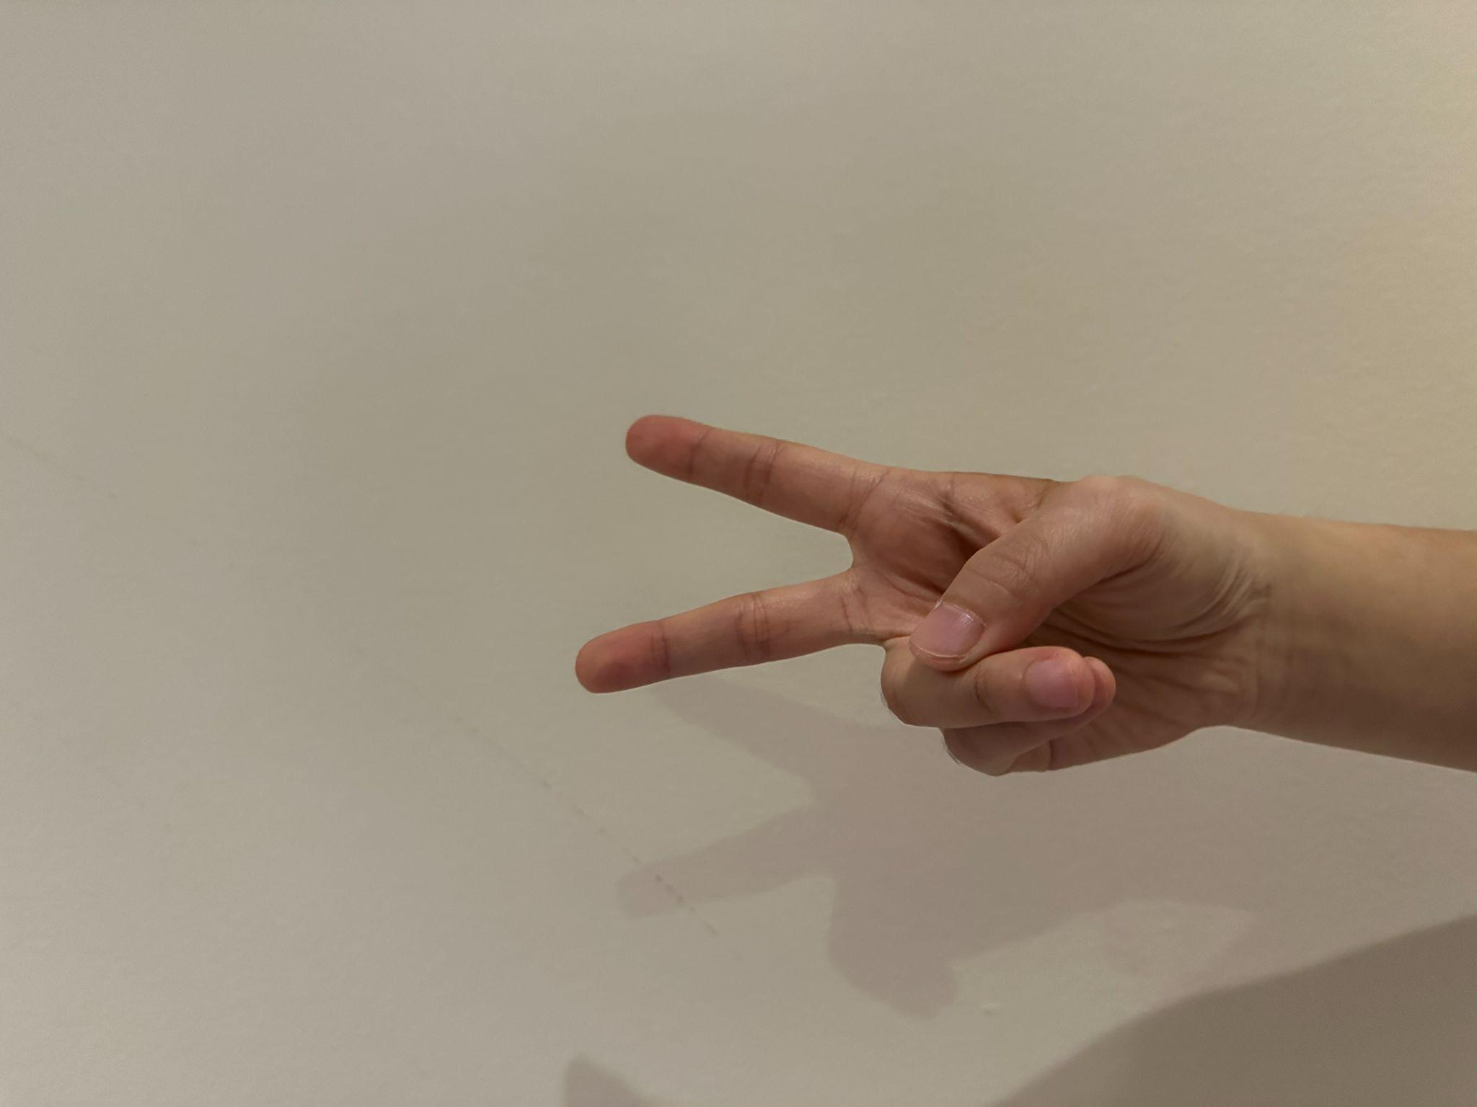
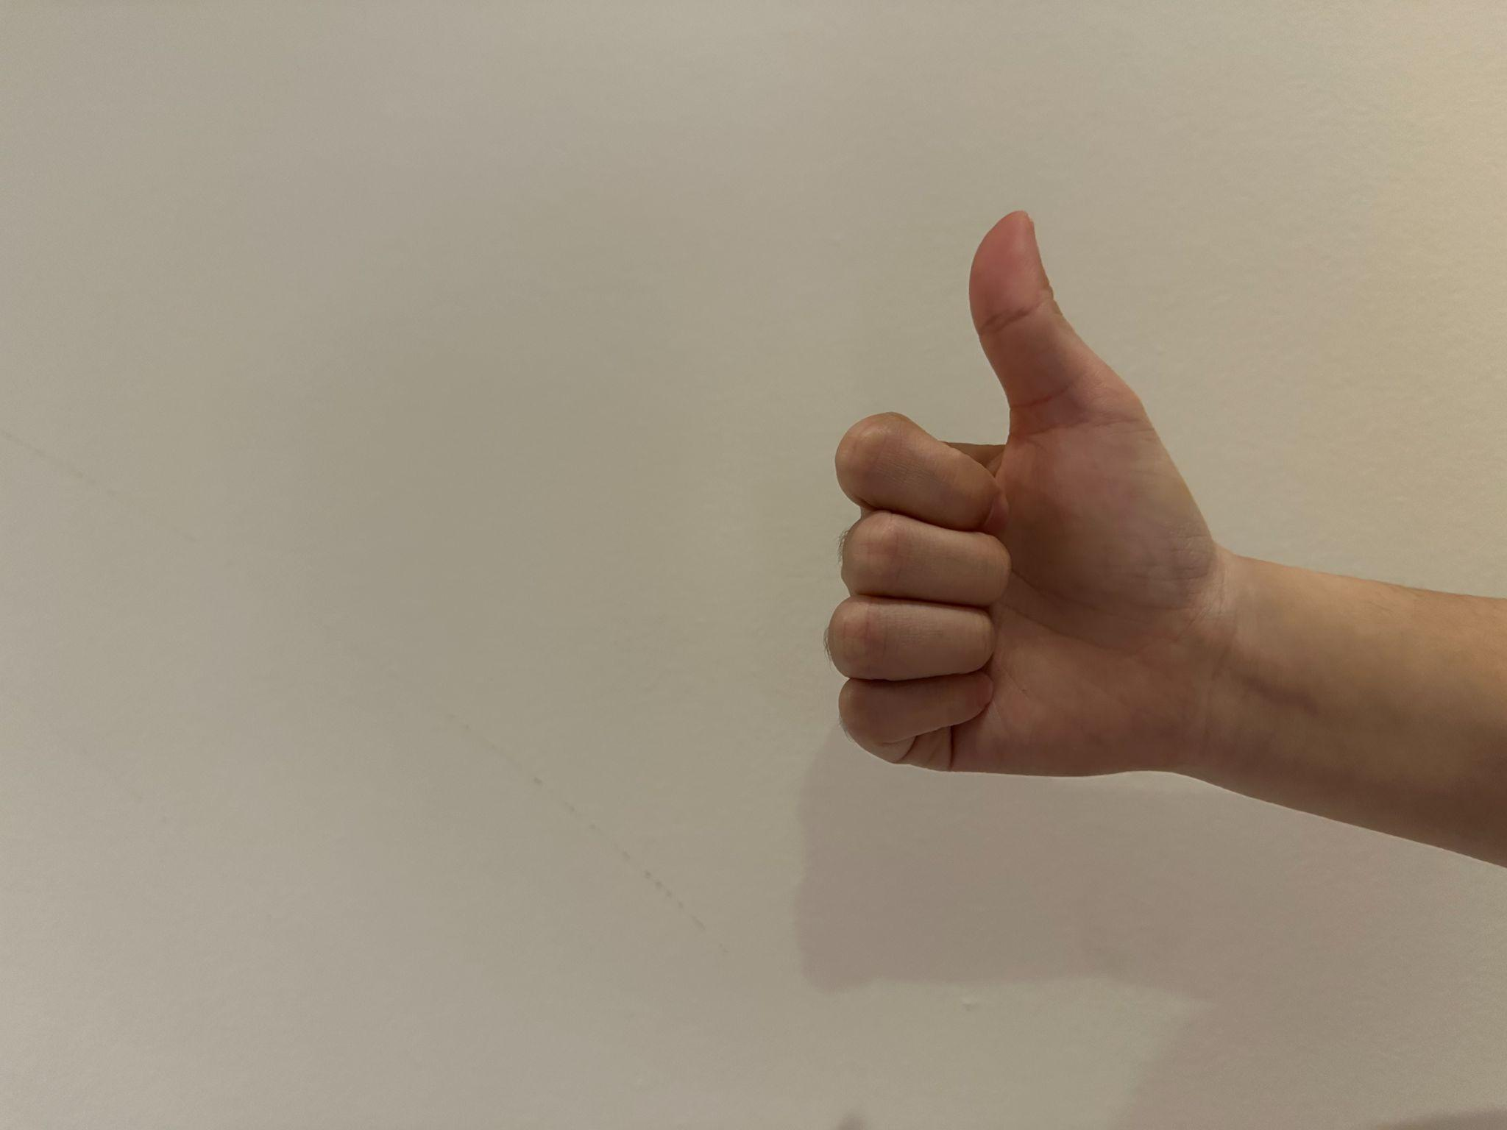
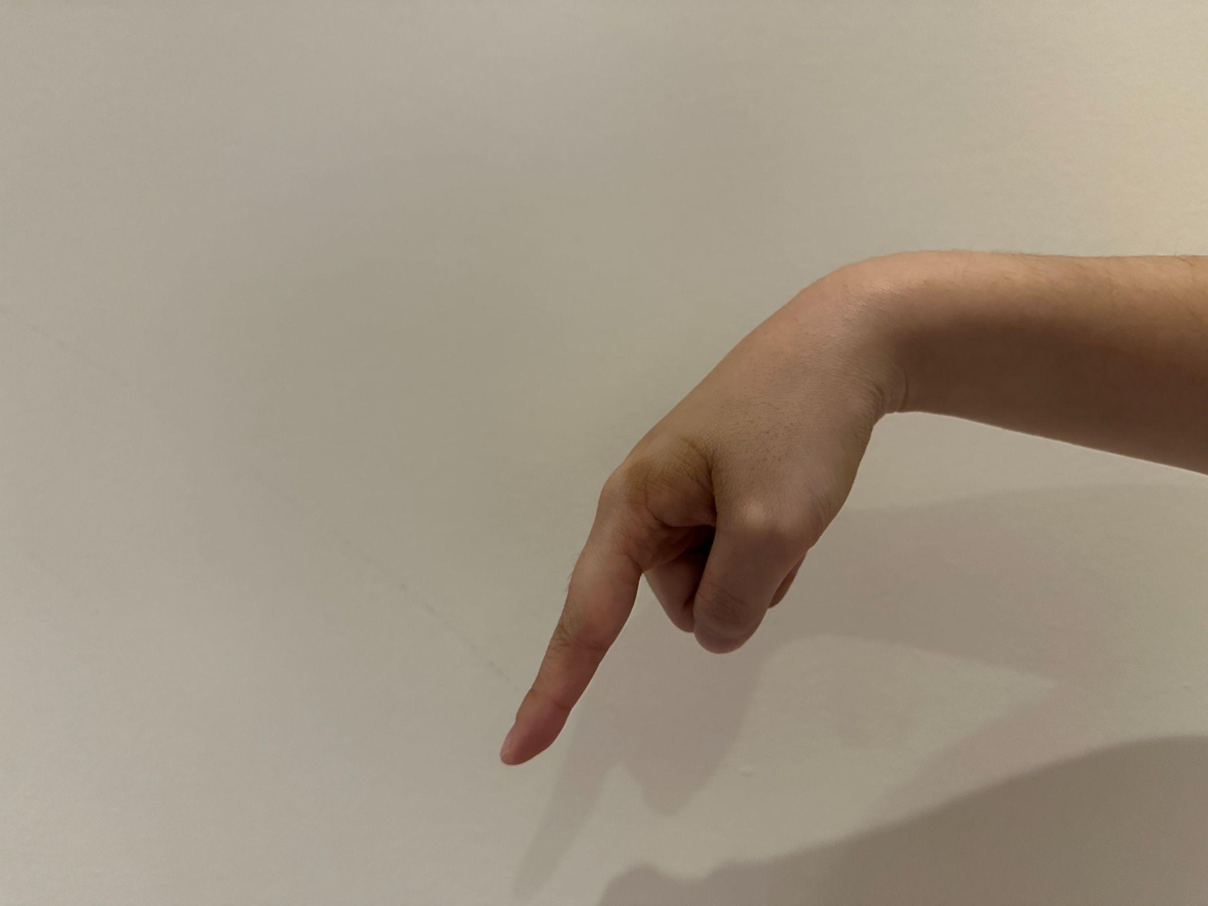
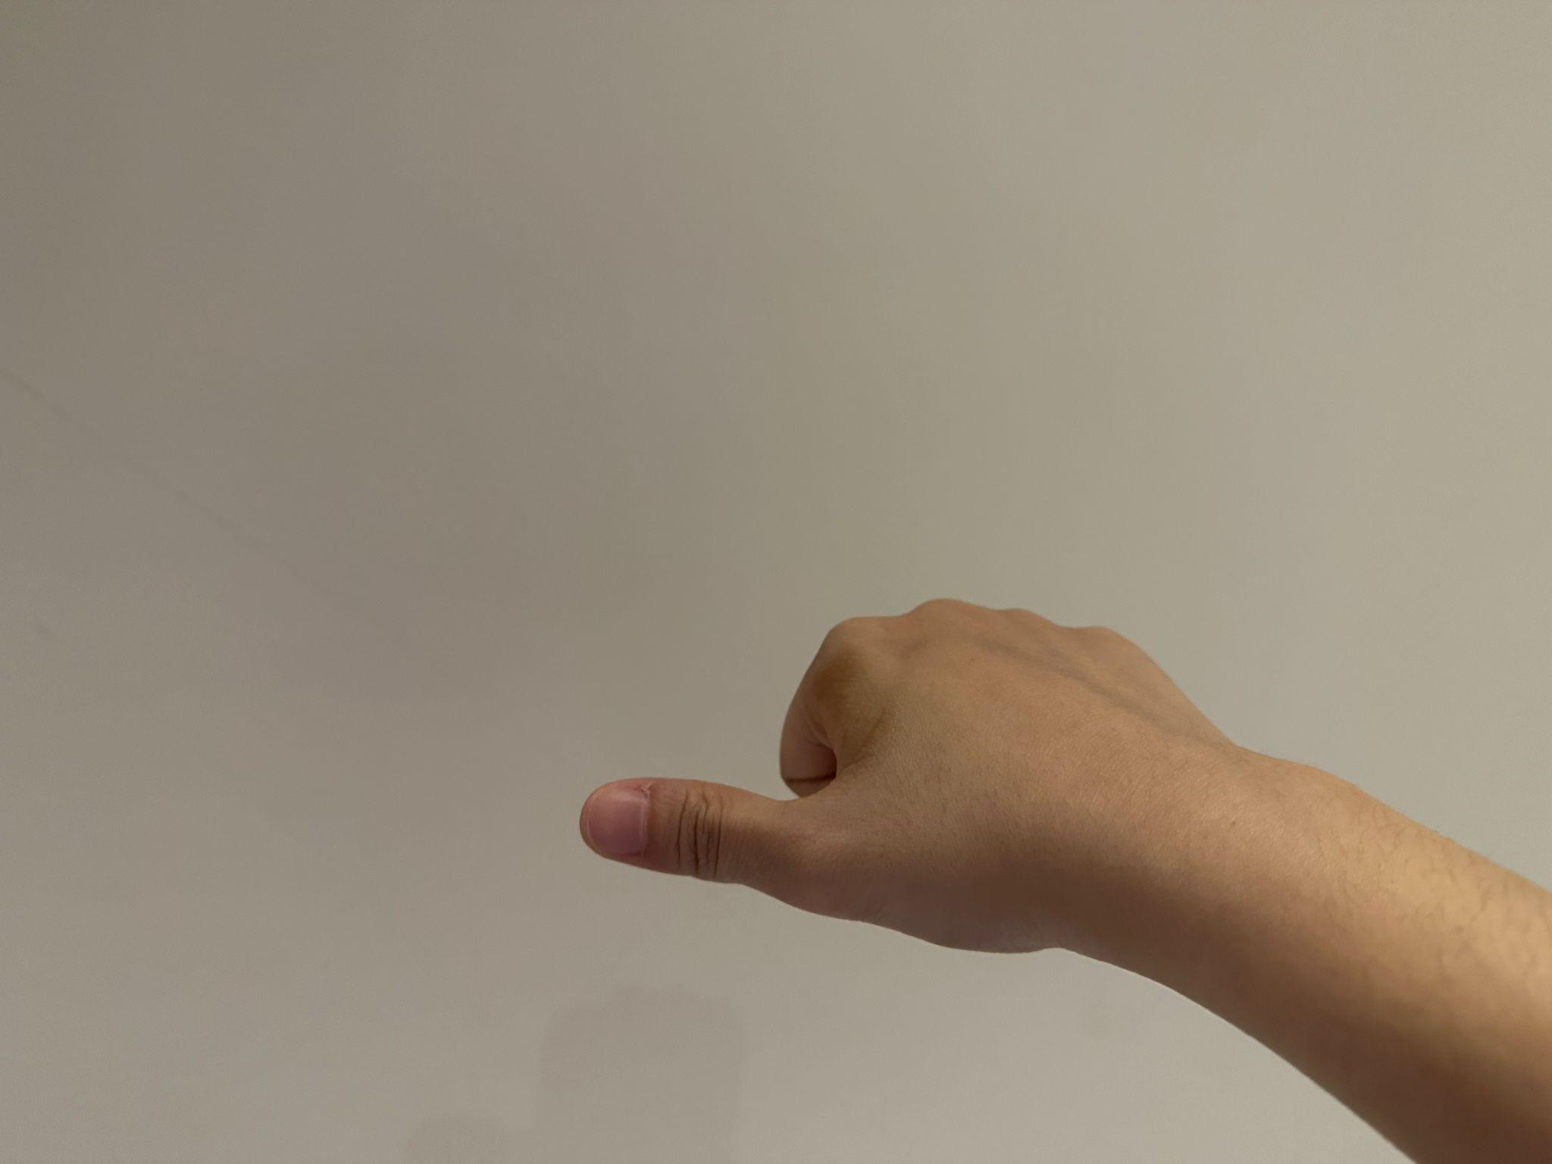
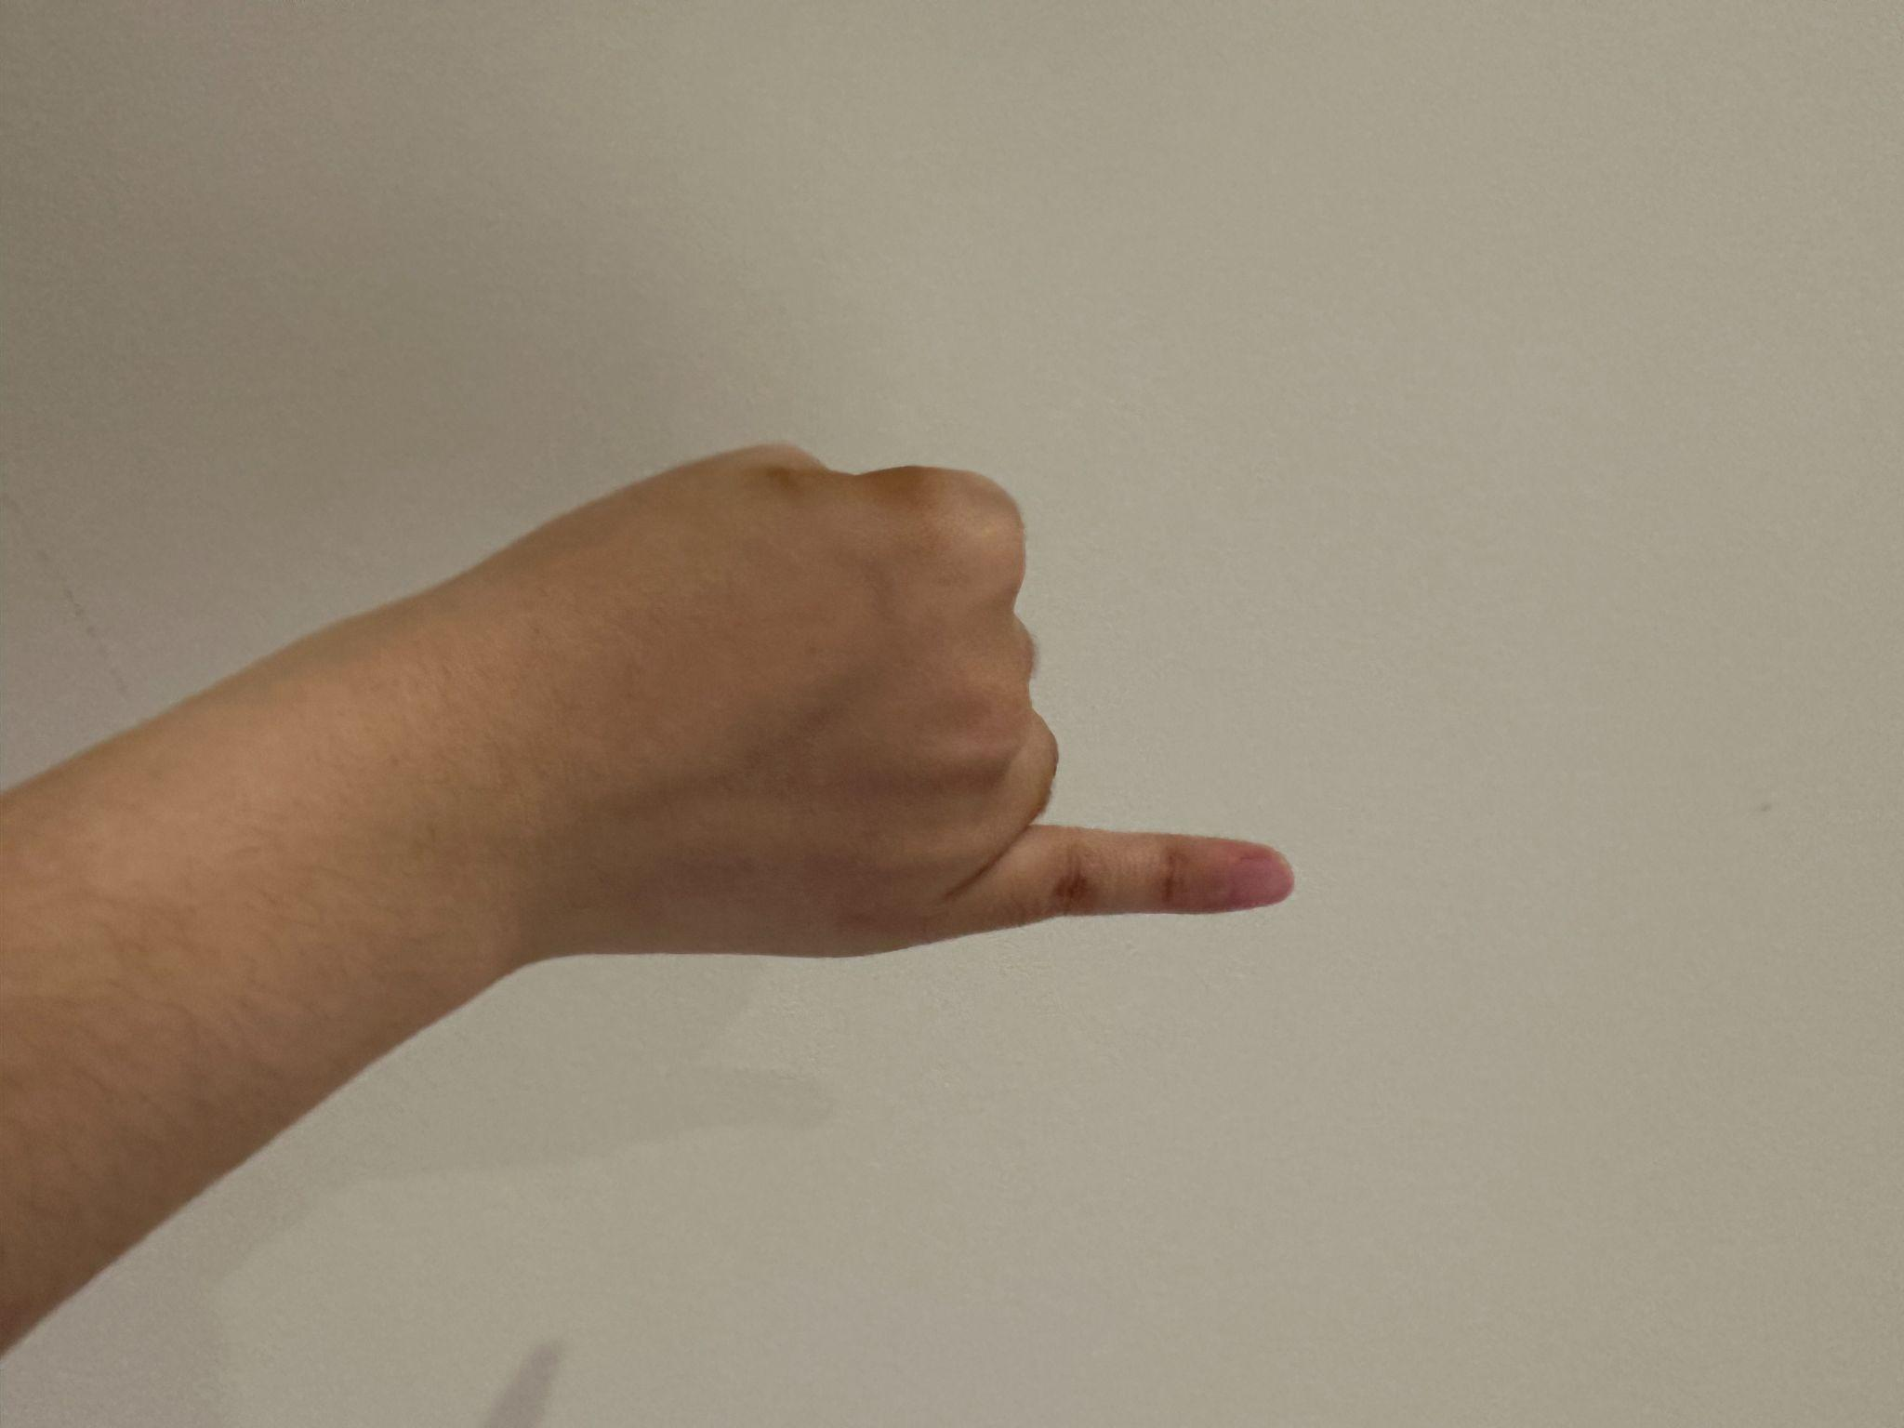
Data collection
7 gestures (Rock, Paper, Scissors and 4 directions)
Rock Paper Scissor
Up Down Left Right

Slide 7
Data collection
Playing sequence in each trial:
Rock, Up, Paper, Up, Scissors, Up, Rock, Down, Paper, Down, Scissors, Down, Rock, Left, Paper, Left, Scissors, Left, Rock, Right, Paper, Right, Scissors, Right, Rock
24 transitions
80 Trials collected
Sampling rate: 50 HZ

Slide 8
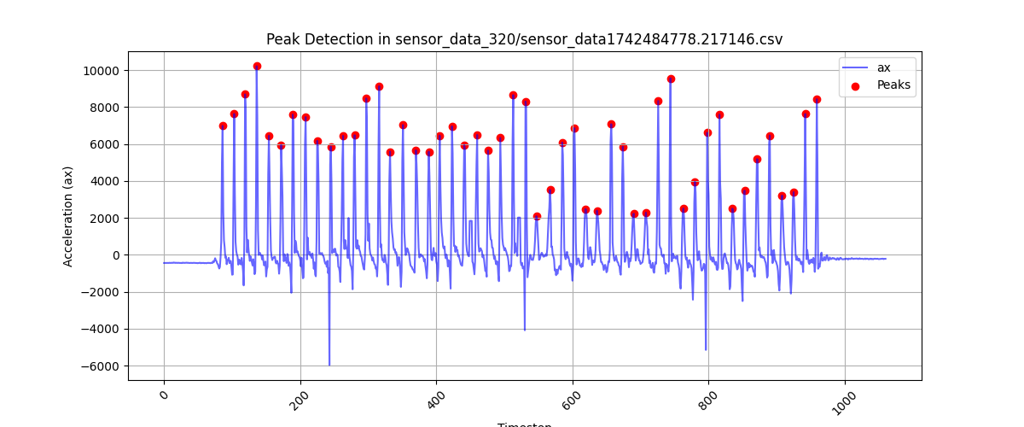
Data labelling
Automatic
Use acceleration data to determine the beats

Slide 9
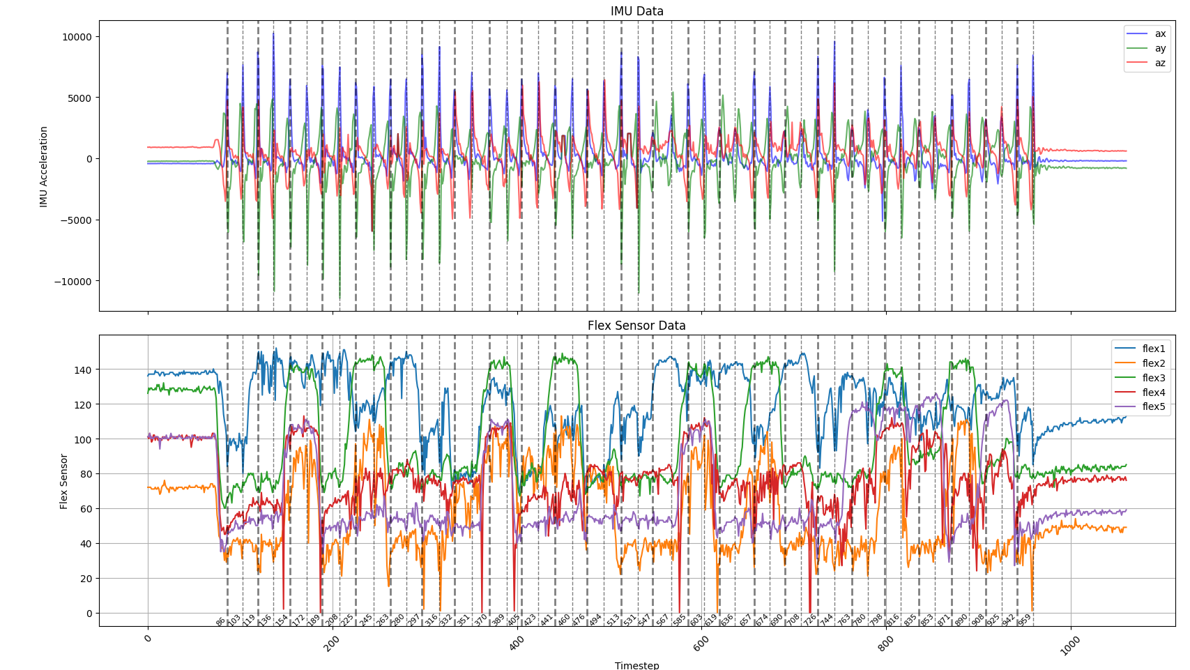
Data labelling

Slide 10
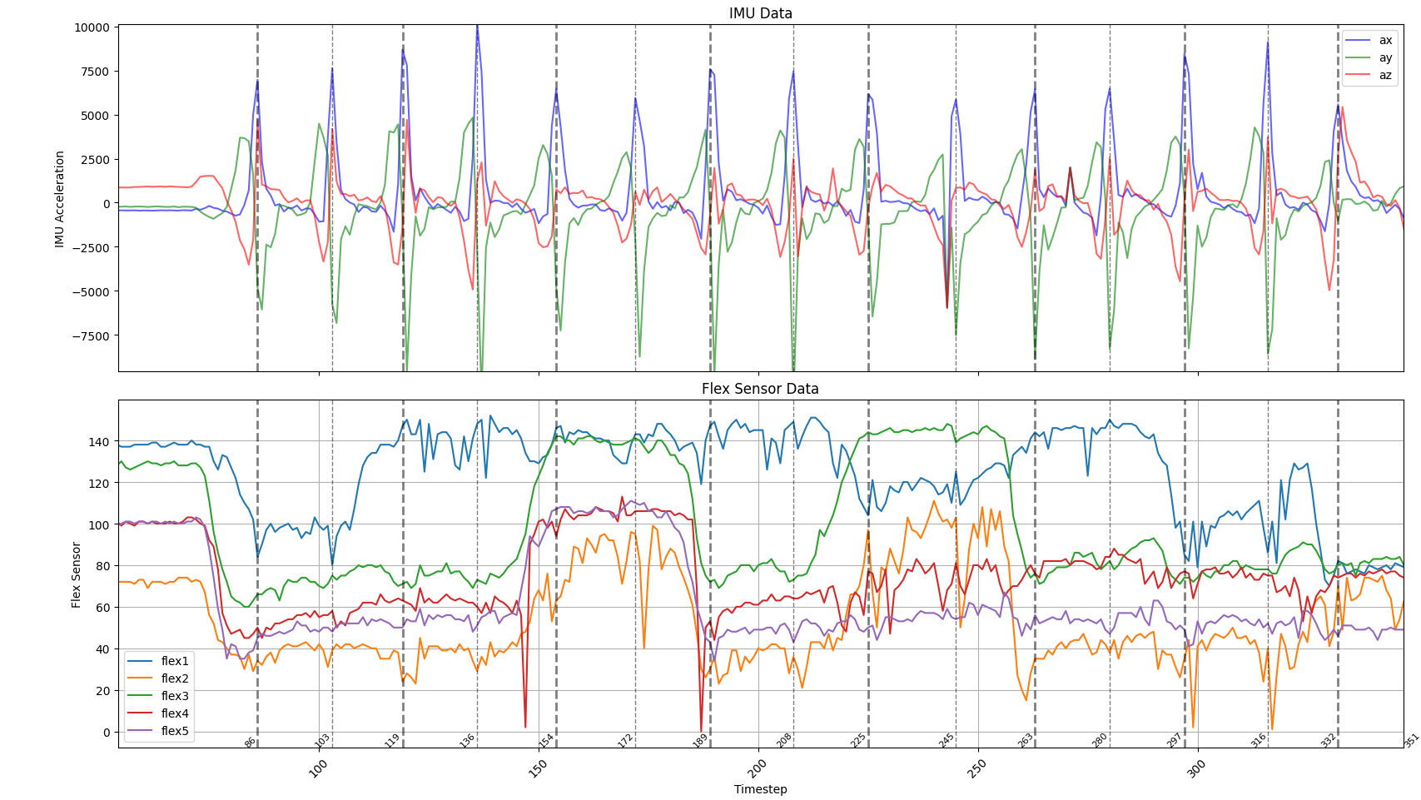
Data labelling
24 transitions
2 beats for each gesture
(24+1) * 2 = 50 beats
✊
✊
⬆️
⬆️
🖐️
🖐️
⬆️
⬆️
✌
✌
⬆️
⬆️

Slide 11
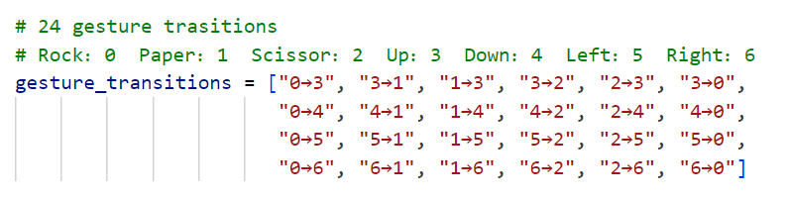
Data labelling
24 classes: 24 transitions

Slide 12
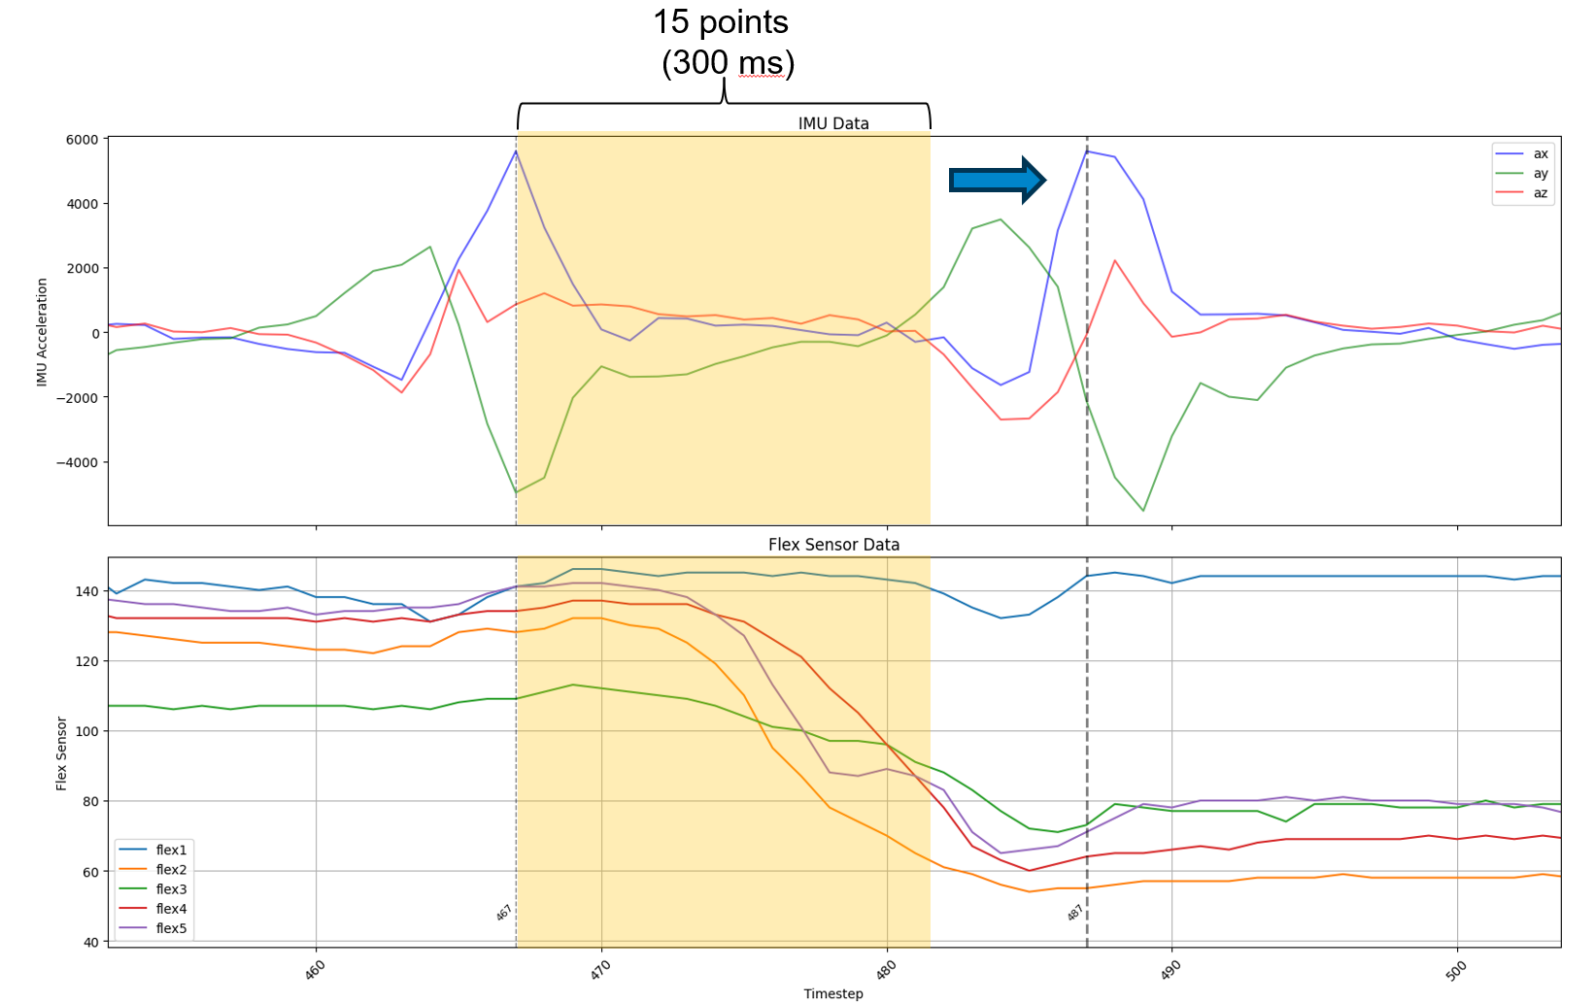
Data labelling
Window size = 15
Step size = 1
Data dimension: (n, 15, 11)
Data pre-processing
IMU data:
Moving average
Window size = 5
Flex data:
Median filtering
Kernal size = 3
Normalization

Slide 13
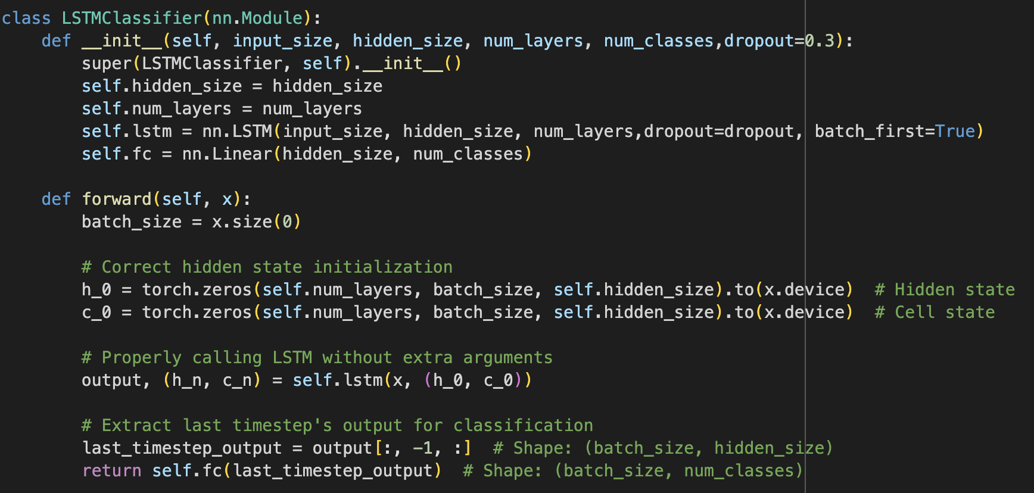
Training
Model: LSTMClassifier(input_size=11, hidden_size=64, num_layers=3, num_classes=24, dropout=0.3)

Slide 14
Training
Model
LSTM: input size 11, hiddden_size 64, num_layer 3, num_class 24
optimizer
Adam: learning rate 2e-3, weight decay 1e-5
loss function
CrossEntropyLoss
Training hyperparameter
batch size 32, 100 epoch with early stopping, patience 10
Training hardware
single A100 from colab

Slide 15
Training pipeline
Stage A
pretrained on massive recorded(80000+) data from more diversed sources
stage B
finetuning on relatve smaller(6000+) dataset from single source
stage C
finetuning on small dataset recorded on new hardware,due to some hardware failures.

Slide 16
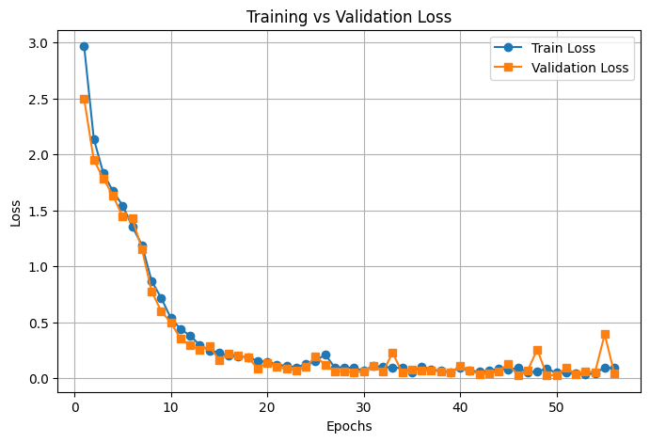
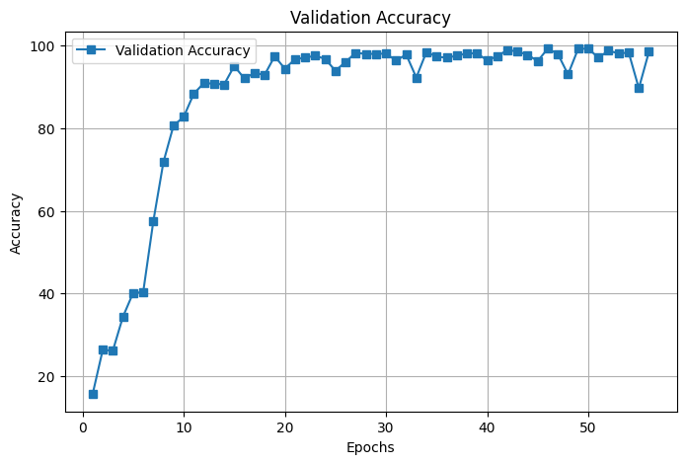
Training & Validation
Training:

Slide 17
Offline Performance
Model performance
Training data
Training data A, hardware A(pretraining):
80% from Yan Zhu and Diao Bohan
20% from various classmates
80000 samples in 200hz, downsampled to 20000 samples in 50hz
Acc ~62%
Training data B, hardware A:
6000 samples in 50hz from Yan Zhu
Acc ~ 81%
Training data C, hardware B(new flex sensors for two fingers due to hardware failures):
3000 samples inn 50hz from Yan Zhu
Acc ~ 93%, Precision 95%+
Test data
Test data : Yan Zhu (some unseen data recorded with hardware B)

Slide 18
Offline Performance
Gesture | Up | Down | Left | Right
Rock | 0.9932 | 0.9952 | 0.0000 | 0.5714
Paper | 0.3333 | 0.1250 | 0.7500 | 0.9832
Scissor | 0.5000 | 0.5714 | 0.3000 | 0.6250
Up | 0.6364 (→Rock) | 0.9943 (→Paper) | 0.5238 (→Scissor)
Down | 0.9983 (→Rock) | 0.6667 (→Paper) | 0.3846 (→Scissor)
Left | 0.9978 (→Rock) | 0.7500 (→Paper) | 0.4286 (→Scissor)
Right Overall Prc 81%+ | 0.3333 (→Rock) | 0.9854 (→Paper) | 0.4286 (→Scissor)

Slide 19
Offline Performance
Bad case analysis:
Problem: Performance of left-related gestures is lower compared to other directions
Analysis: Left gestures confused with other directions (same hand gesture as UP but different orientation).
Solution: Increase High-Quality Left Gesture Data

Slide 20
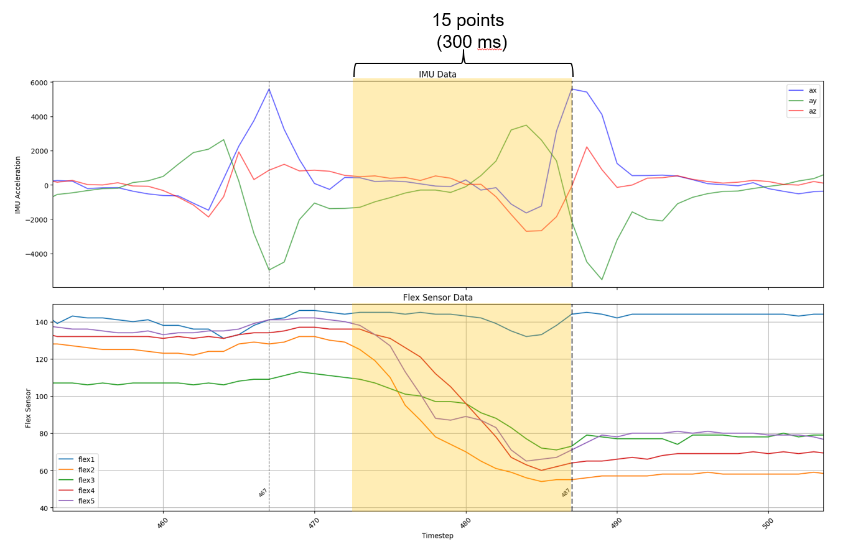
Real time prediction
Beat detection and Gesture prediction run in parallel threads
Beat detection:
Store new data in a sliding window (300 ms)
Find accel_values peak
Put the newest window data to prediction_queue
To avoid double-triggering of beats, set up a BEAT_COOLDOWN
Gesture prediction:
Get the data from prediction_queue

Slide 21
Real time prediction
Also tried a voting mechanism
Use several windows before the beat and choose the most common prediction
Useful when the model is not accurate enough

Slide 22
Offline Performance Final
Gesture | Up | Down | Left | Right
Rock | 0.8750 | 0.9678 | 0.9875 | 0.9894
Paper | 0.9932 | 0.9924 | 0.9985 | 0.9942
Scissor | 0.9954 | 0.9986 | 0.7500 | 0.6667
Up | 0.8871 (→Rock) | 0.8950 (→Paper) | 0.9965 (→Scissor)
Down | 0.9934 (→Rock) | 0.9367 (→Paper) | 0.9954 (→Scissor)
Left | 0.8333 (→Rock) | 0.9915 (→Paper) | 0.9986 (→Scissor)
Right Overall Prc 93%+ | 0.9954 (→Rock) | 0.9875 (→Paper) | 0.8182 (→Scissor)

Slide 23
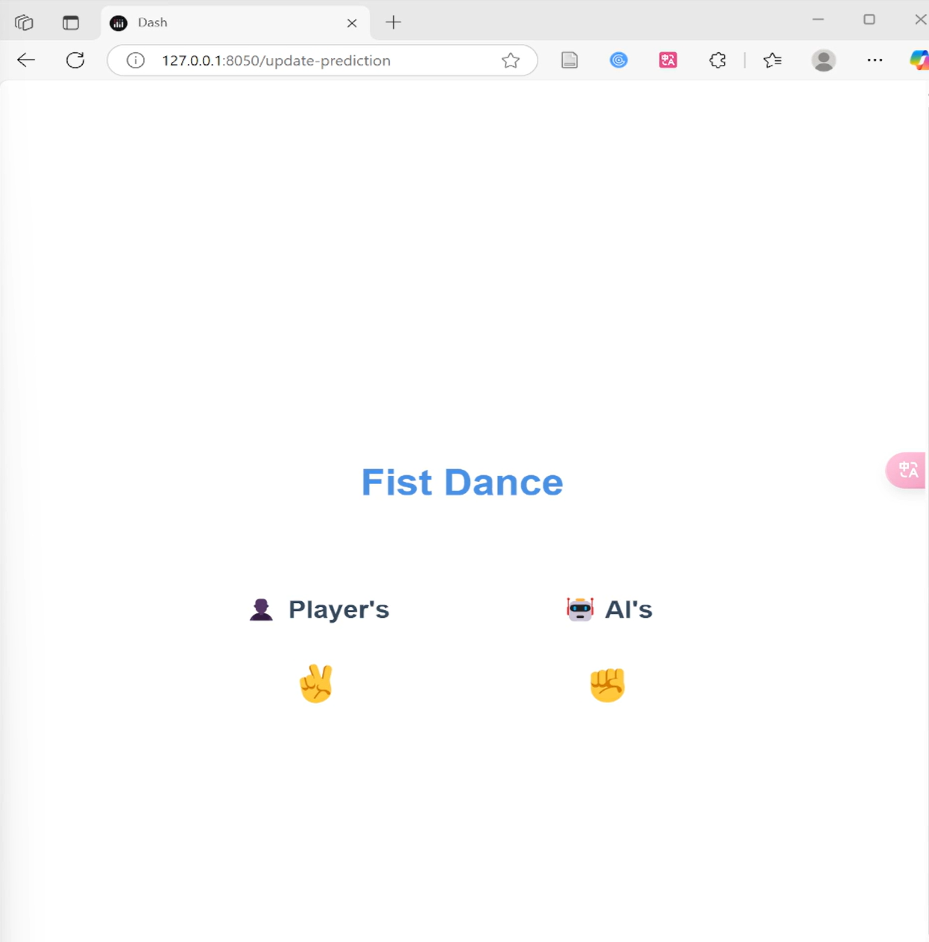
Real time prediction
Designed an user interface
Display gestures in real time

