Slide 1
Thesis Seminar 2023-2024
Research Topic
Jacopo Binati

Slide 2
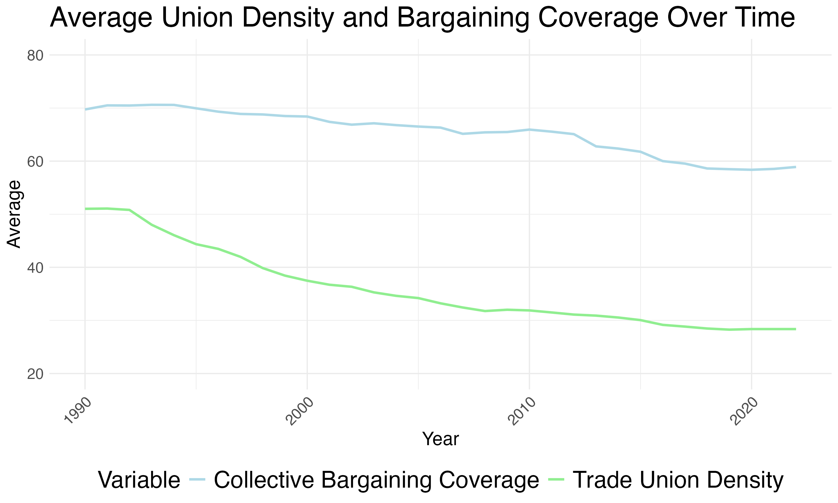
The Impact of Trade Union Dynamics on Income Inequality Trends in European Countries
Trade Union Density shows the percentage of workers with jobs who are members of a union compared to all workers with jobs in the economy.
Collective Bargaining Coverage is about how many workers have their pay and job conditions set through agreements made by groups.

Slide 3
Introduction to the topic
The nexus between labour practices and economic inequality has increasingly come under scrutiny.
Collective bargaining stands out as a critical lever in shaping equitable employment conditions and wage distribution.
By empowering workers to negotiate en masse, it is theorized that collective bargaining can lead to more equitable distributions of income, enhance job security, and improve working conditions.
Empirical evidence and economic theory suggest that collective bargaining plays a pivotal role in reducing income disparities, with increased coverage rates linked to narrower wage gaps.
Countries practicing more centralized bargaining, particularly through multi-employer negotiations, tend to show fewer earnings inequality, highlighting the potential of collective bargaining mechanisms to foster more equitable economic outcomes.
This thesis aims to unpack the complex relationship between collective bargaining coverage and its effectiveness in mitigating inequality.

Slide 4
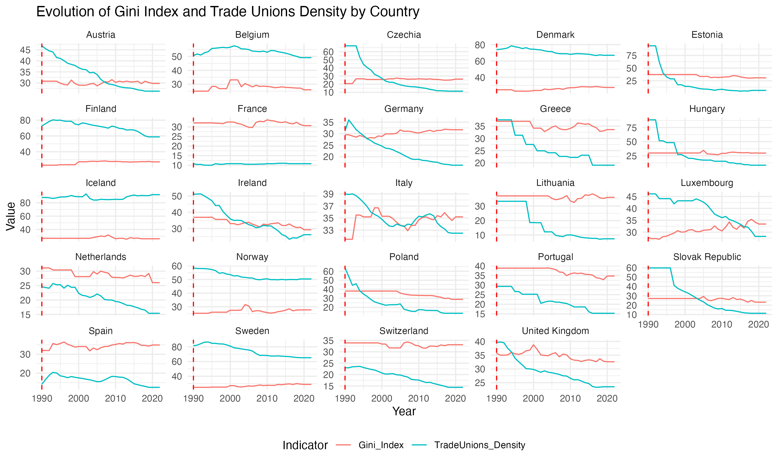
Countries and Time
Austria, Belgium, Czechia, Denmark, Estonia, Finland, France, Germany, Greece, Hungary, Iceland, Ireland, Italy, Latvia, Lithuania, Luxembourg, Netherlands, Norway, Poland, Portugal, Slovak Republic, Slovenia, Spain, Sweden, Switzerland, United Kingdom
Time Horizon: from 1990 until 2022
Data gathering:
OECD database
WorldBank Data
Eurostat

Slide 5
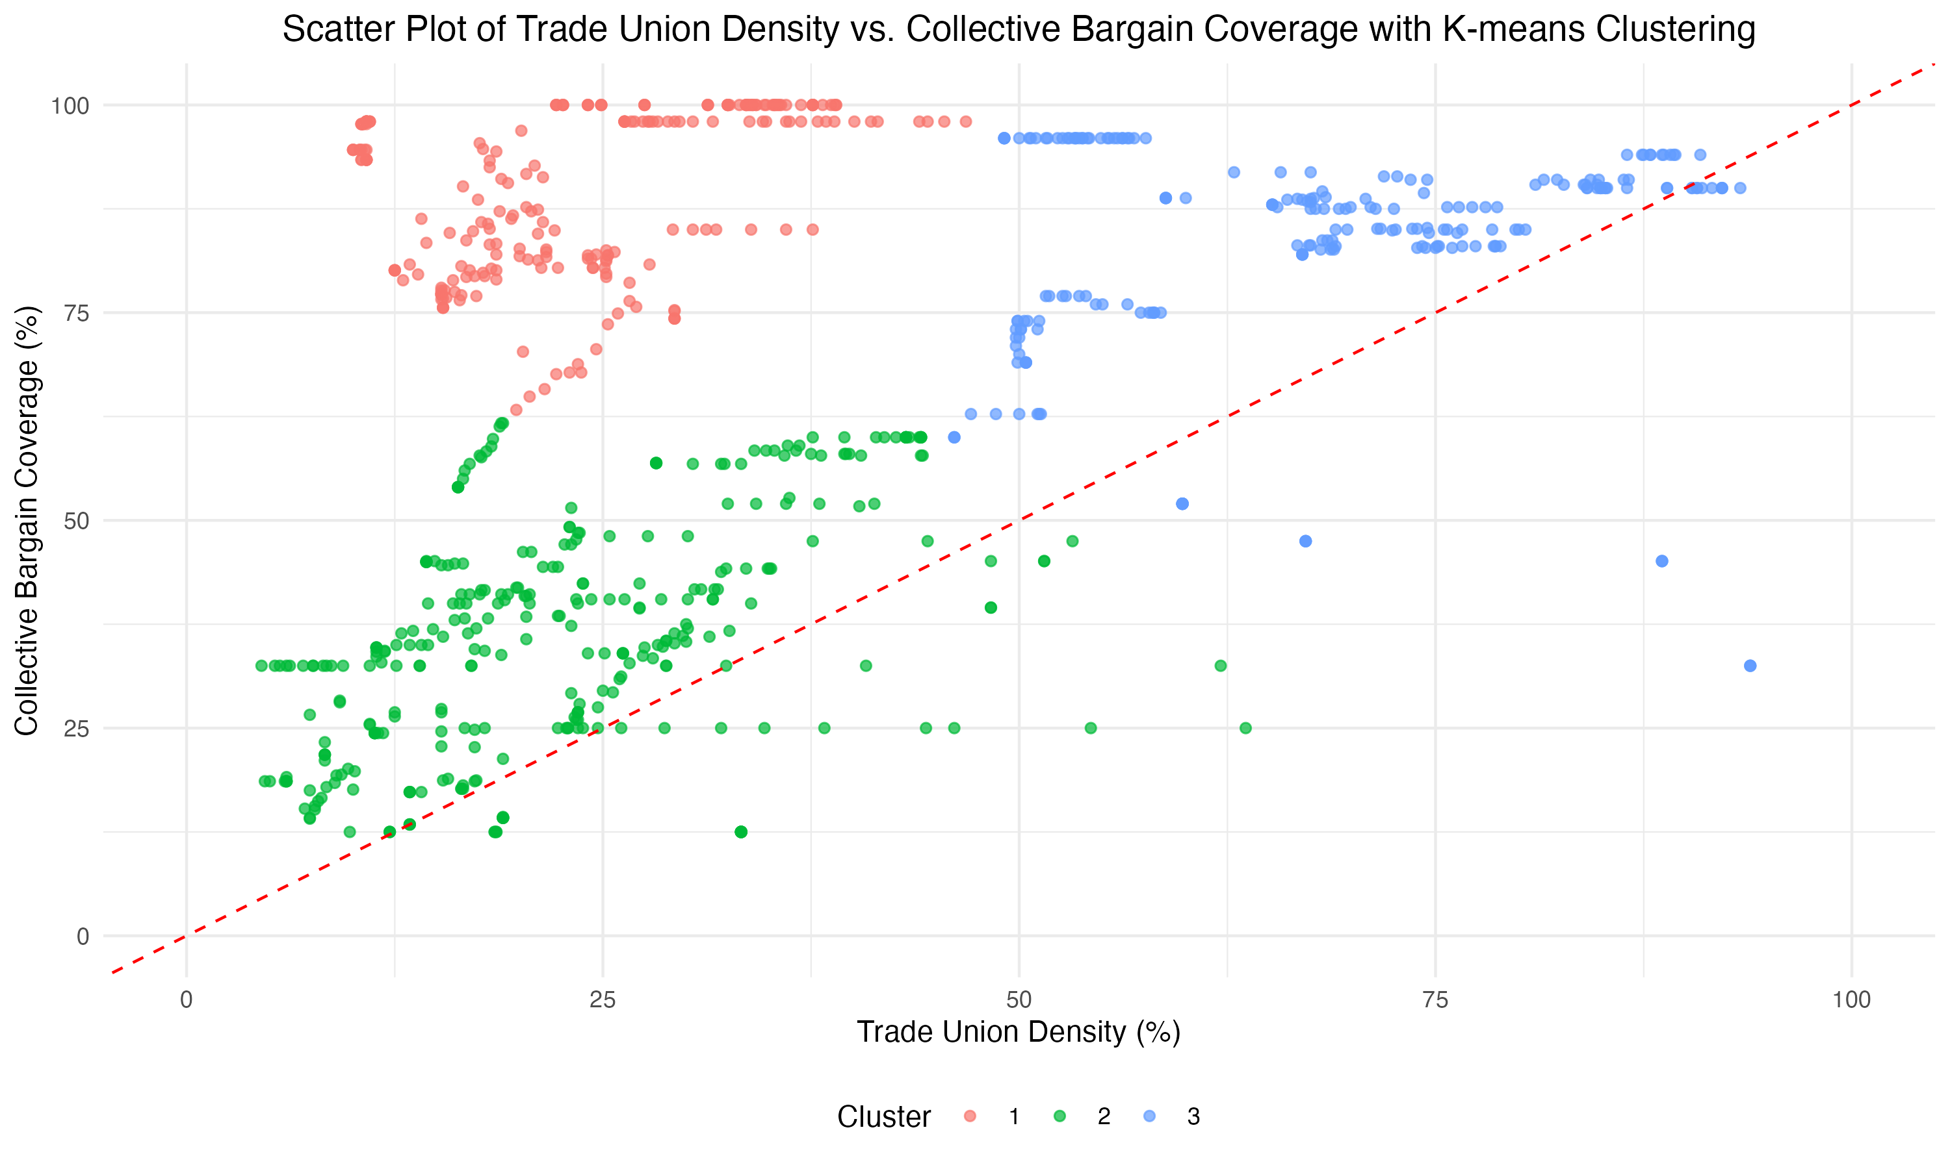
Density and Coverage across different countries

Slide 6
Variables
Collective bargaining:
•Collective Bargain Coverage
•Trade unions density
Labor Market:
•Labour force participation rate (Women age 15 to 64)
•Unemployment rate (Women age 15 to 64)
•Labor force, total
•Minimum Wage
•Labor tax and contributions (% of commercial profits)
•Part time employment, total (% of total employment)
Economic growth:
•Real Average annual wage growth
•Real GDP
•Annual inflation CPI
•Exports of goods and services (annual % growth)
•Imports of goods and services ( % of GDP)
•Foreign direct investment, net inflows (% of GDP)
•Foreign direct investment, net outflows (% of GDP)
•Central government debt, total (% of GDP)

Slide 7
Variables
Gross Domestic Product (GDP) Analysis:
GDP's role in analyzing country size.
Impact of GDP and Foreign Direct Investments (FDIs) on labour unions and income inequality.
Effect of Economic Growth on Labour Unions:
Robust GDP growth strengthens labour market conditions.
Enhances bargaining power of unions, leading to improved wages and working conditions..
Inflation and Wage Growth Relationship:
Inflation's confounding effect on wage growth analysis.
Underestimation of union's positive impact on wage growth if inflation is not accounted for.
Wage Growth as a Confounder:
Potential overestimation of union's role in wage increase.
Need to control for wage growth to understand GDP's impact on income inequality.
Role of Tax Contribution:
Positive correlation with GDP.
Potential confounder affecting income distribution.
Impact of Women Workers' Dynamics:
Employment and unemployment rates as confounders.
Influence of gender-specific labour dynamics on union membership and income inequality.
Significance of Democratic Governance:
Interaction between Civic Participation and Rule of Law Index.
Influence on labour union activities and efficacy.
Labour Unions and Democratic Reforms:
Engagement beyond workplace.
Responsive to quality of Democratic Governance.

Slide 8
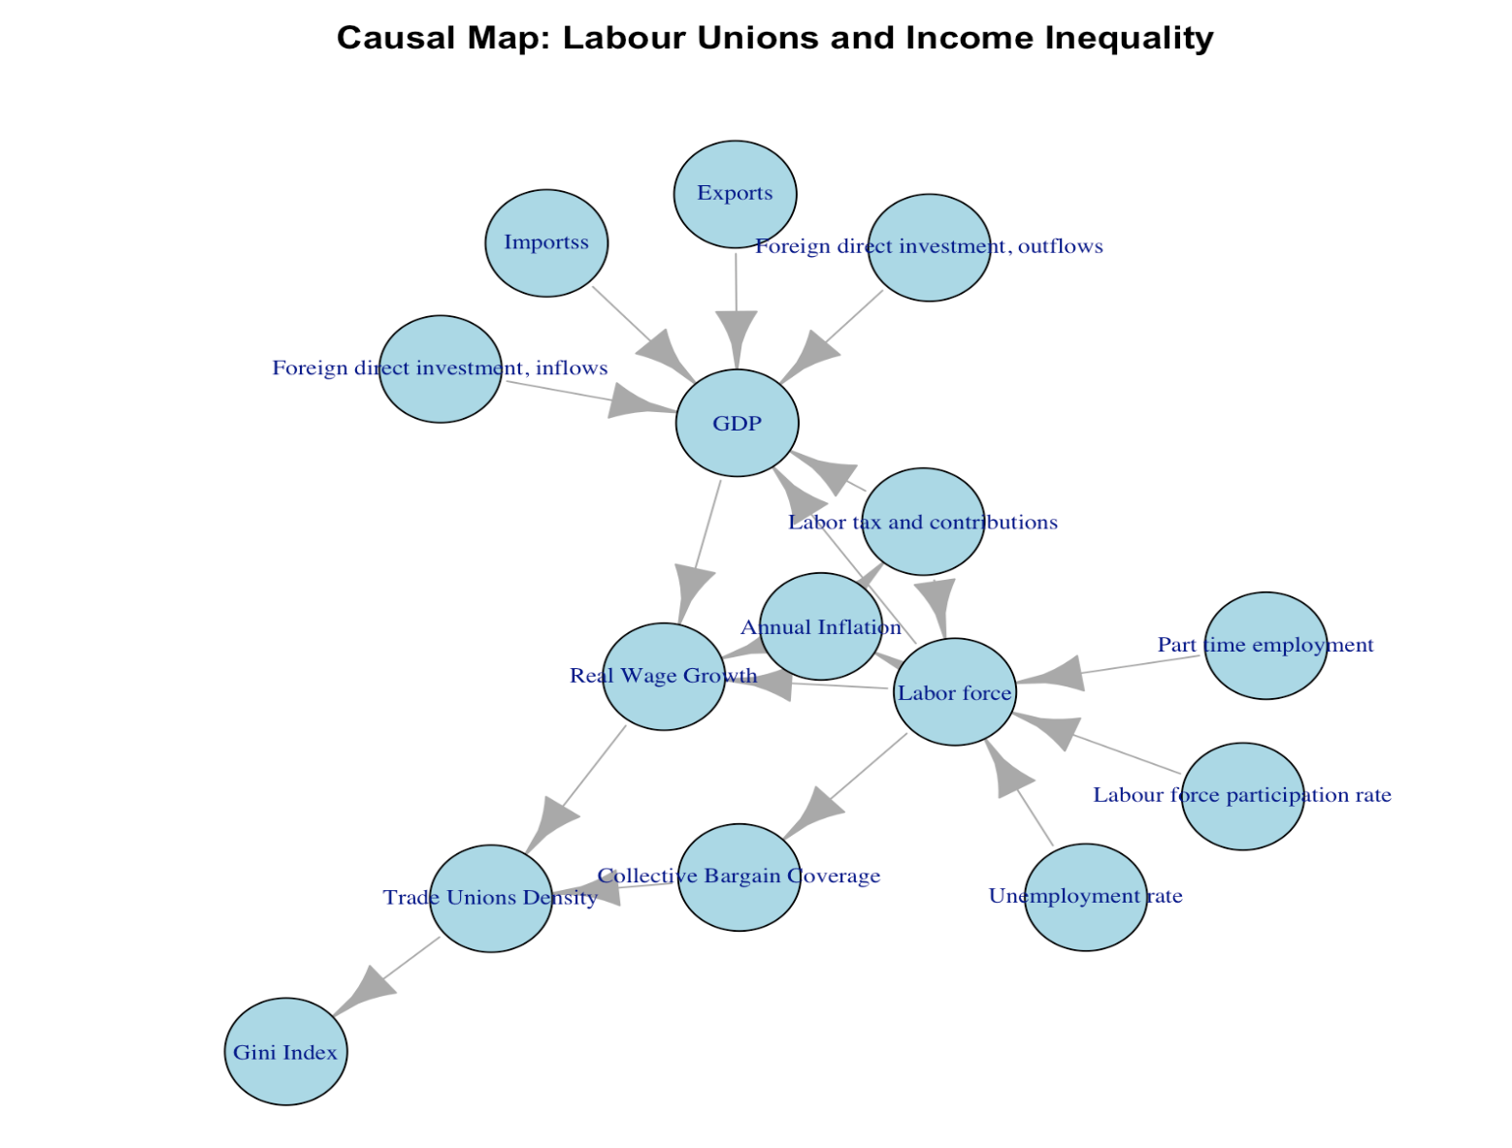
Causal Map

Slide 9
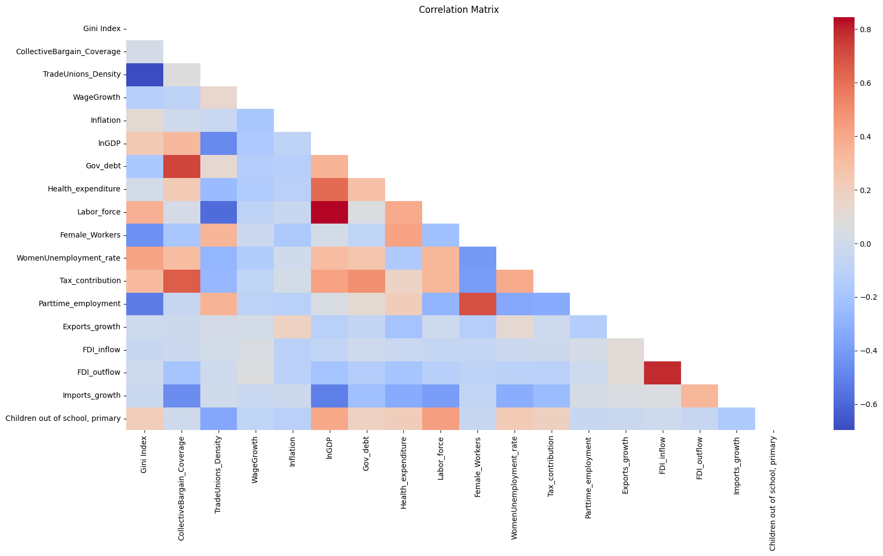
Correlation Matrix with Gini Coefficient
Identification of Endogeneity Issue:
Bargain identified as potentially endogenous concerning the Gini Index.
Need for instrumental variable (IV) analysis for unbiased and consistent estimates.
Selection of Instrument:
Demo chosen as instrument, hypothesized to impact Gini Index only through its effect on bargain.
First Stage Regression:
Regress Bargaining Power on Democratic Governance and control variables.
Validate instrument's relevance.
Validation of Instrument:
Significant coefficients observed, particularly for Democratic Governance.
Estimated coefficient: 23.023832.
High F-statistic (198.8) and low p-value (< 2.2e-16) confirm instrument's strength.
Second Stage Regression:
Regress Gini Index on fitted values of Bargaining Power from first stage and control variables.
Obtain unbiased estimate of Bargaining Power's impact on Gini Index, mitigating endogeneity concerns.

Slide 10
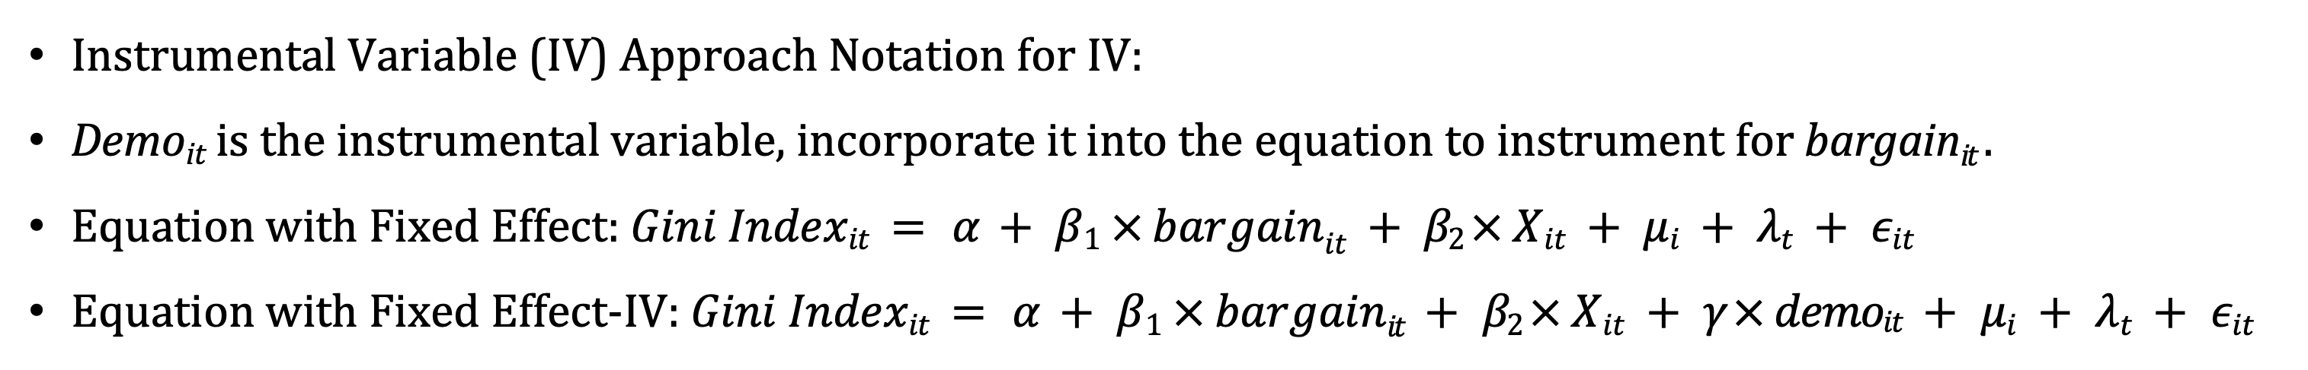
Methods
Two Ways Fixed Effect on Country and Years, using Democratic Governance as Instrumental Variable
Instrumental Variable (IV) Approach Notation for IV:
Demo_{it} is the instrumental variable, incorporate it into the equation to instrument for bargain_{it} .
Equation with Fixed Effect: $Gini Indexit = α + β1 × bargainit + β2 × Xit + μi + λt + εit$
Equation with Fixed Effect-IV: $Gini Indexit = α + β1 × bargainit + β2 × Xit + γ × demoit + μi + λt + εit$

Slide 11
Bibliography
•Barth, E., Bryson, A. & Dale-Olsen, H., 2020. Union Density Eﬀects on Productivity and Wages. The Economic Journal.
•Jaumotte, F. & Buitron, C., 2019. Inequality: traditional drivers and the role of union power. Oxford Economic Papers.
•Jaumotte, F. & Osorio-Buitron, C., 2015. Inequality and Labor Market Institutions. ERN: Poverty & Inequality (Topic).
•Perron, S., 2022. State Union Density Effects on Workers’ Support for Reducing Income Inequality, 1973-2016. Social Currents.
•Meurrens, E.A., 2021. Relating Union Density to Wealth Inequality and Subjective Well-Being Across 13 OECD Countries. UF Journal of Undergraduate Research.
•Alexiou, C. & Trachanas, E., 2022. The impact of trade unions and government party orientation on income inequality: evidence from 17 OECD economies. Journal of Economic Studies.
•Kerr, A. & Wittenberg, M., 2021. Union wage premia and wage inequality in South Africa. Economic Modelling.
•Harris, R.D.F. & Moﬀat, J., 2023. What explains the increase in trade union density and female share of union members in the United Kingdom in 2017–2020? Journal of Industrial Relations.

