Slide 1
Thesis Seminar 2023-2024
Research Topic
Jacopo Binati

Slide 2
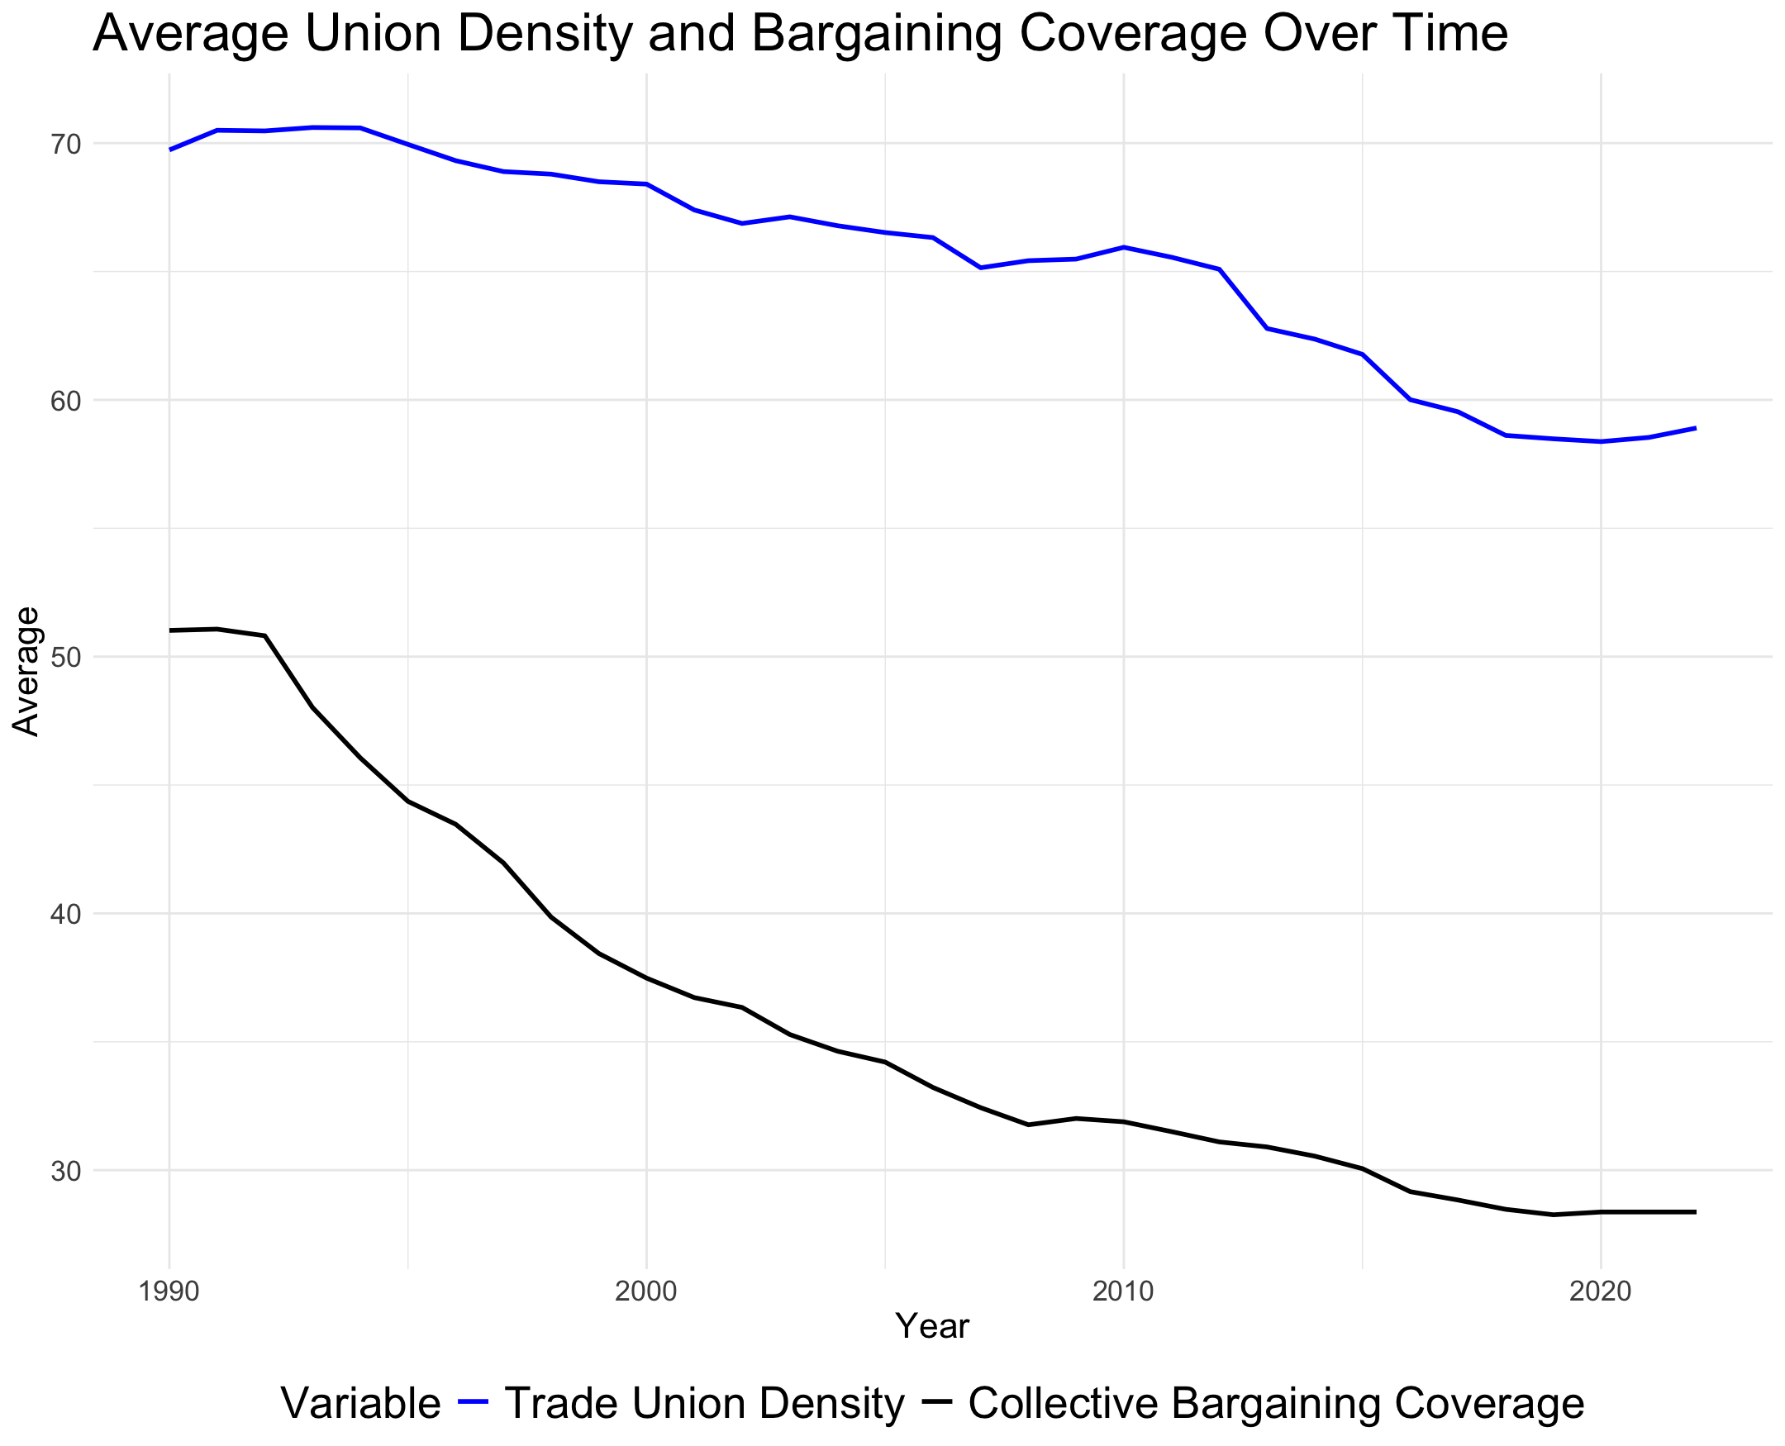
The Impact of Trade Union Dynamics on Income Inequality Trends in European Countries
Trade Union Density shows the percentage of workers with jobs who are members of a union compared to all workers with jobs in the economy.
Collective Bargaining Coverage is about how many workers have their pay and job conditions set through agreements made by groups.
The relationship between collective bargaining coverage and union density exhibit, on average, a positive relationship

Slide 3
Countries and Time
Austria, Belgium, Czechia, Denmark, Estonia, Finland, France, Germany, Greece, Hungary, Iceland, Ireland, Italy, Latvia, Lithuania, Luxembourg, Netherlands, Norway, Poland, Portugal, Slovak Republic, Slovenia, Spain, Sweden, Switzerland, United Kingdom
Time Horizon: from 1990 until 2022
Data gathering:
OECD database
WorldBank Data
Eurostat

Slide 4
Variables
Collective bargaining:
•Collective Bargain Coverage
•Trade unions density
Labor Market:
•Labour force participation rate (Women age 15 to 64)
•Unemployment rate (Women age 15 to 64)
•Labor force, total
•Minimum Wage
•Labor tax and contributions (% of commercial profits)
•Part time employment, total (% of total employment)
Economic growth:
•Real Average annual wage growth
•Real GDP
•Annual inflation CPI
•Exports of goods and services (annual % growth)
•Imports of goods and services ( % of GDP)
•Foreign direct investment, net inflows (% of GDP)
•Foreign direct investment, net outflows (% of GDP)
•Central government debt, total (% of GDP)

Slide 5
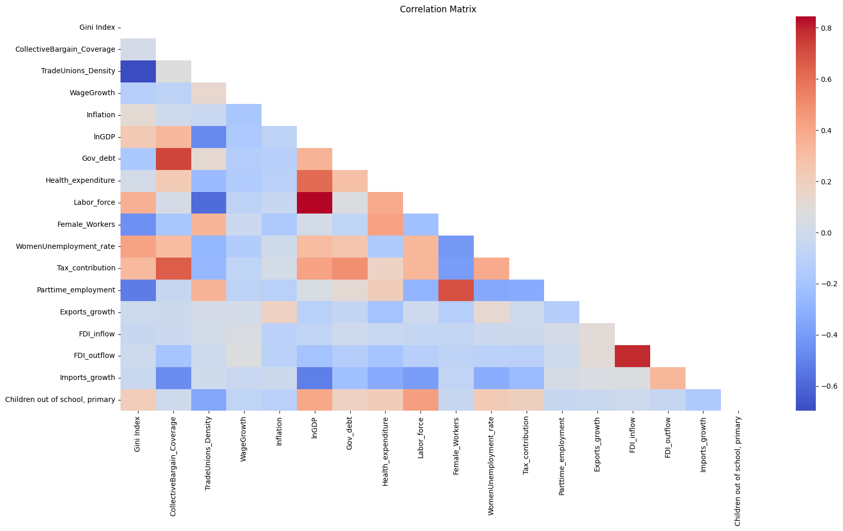
Correlation Matrix
correlation doesn't imply causation, it can provide valuable insights into potential causal relationships. Strong correlations between variables may indicate potential causal links that merit further investigation.

Slide 6
Methods
Two Ways Fixed Effect on Country and Years, using Democratic Governance as Instrumental Variable
Gini Index_{it} = α + β₁ × bargain_{it} + β₂ × X_{it} + μ_{i} + λ_{t} + ϵ_{it}
Gini Index_{it} = α + β₁ × bargain_{it} + β₂ × X_{it} + γ × demo_{it} + μ_{i} + λ_{t} + ϵ_{it}
Instrumental Variable (IV) Approach Notation for IV:
𝑍𝑖𝑡Zit​ is your instrumental variable, incorporate it into your equation to instrument for 𝑏𝑎𝑟𝑔𝑎𝑖𝑛𝑖𝑡bargainit​. Example Equation: 𝑏𝑎𝑟𝑔𝑎𝑖𝑛𝑖𝑡=𝛿0+𝛿1×𝑍𝑖𝑡+𝜂𝑖𝑡bargainit​=δ0​+δ1​×Zit​+ηit​ 𝛿0δ0​ and 𝛿1δ1​ are coefficients, 𝜂𝑖𝑡ηit​ is the error term. Usage: Utilize predicted values of 𝑏𝑎𝑟𝑔𝑎𝑖𝑛𝑖𝑡bargainit​ from this equation in your main equation. Main Equation with IV: 𝐺𝑖𝑛𝑖𝐼𝑛𝑑𝑒𝑥𝑖𝑡=𝛼+𝛽1×𝑏𝑎𝑟𝑔𝑎𝑖𝑛^𝑖𝑡+𝛽2×𝑋𝑖𝑡+𝛾×𝑑𝑒𝑚𝑜𝑖𝑡+𝜇𝑖+𝜆𝑡+𝜖𝑖𝑡GiniIndexit​=α+β1​×bargain​it​+β2​×Xit​+γ×demoit​+μi​+λt​+ϵit​ 𝑏𝑎𝑟𝑔𝑎𝑖𝑛^𝑖𝑡bargain​it​ represents predicted values from the instrumental variable regression.

Slide 7
Bibliography
•Barth, E., Bryson, A. & Dale-Olsen, H., 2020. Union Density Eﬀects on Productivity and Wages. The Economic Journal.
•Jaumotte, F. & Buitron, C., 2019. Inequality: traditional drivers and the role of union power. Oxford Economic Papers.
•Jaumotte, F. & Osorio-Buitron, C., 2015. Inequality and Labor Market Institutions. ERN: Poverty & Inequality (Topic).
•Perron, S., 2022. State Union Density Effects on Workers’ Support for Reducing Income Inequality, 1973-2016. Social Currents.
•Meurrens, E.A., 2021. Relating Union Density to Wealth Inequality and Subjective Well-Being Across 13 OECD Countries. UF Journal of Undergraduate Research.
•Alexiou, C. & Trachanas, E., 2022. The impact of trade unions and government party orientation on income inequality: evidence from 17 OECD economies. Journal of Economic Studies.
•Kerr, A. & Wittenberg, M., 2021. Union wage premia and wage inequality in South Africa. Economic Modelling.
•Harris, R.D.F. & Moﬀat, J., 2023. What explains the increase in trade union density and female share of union members in the United Kingdom in 2017–2020? Journal of Industrial Relations.

