Slide 1
CSEM Building block LNOI
Jacopo Leo
Homa Zarebidaki

Slide 2
Passive components

Slide 3
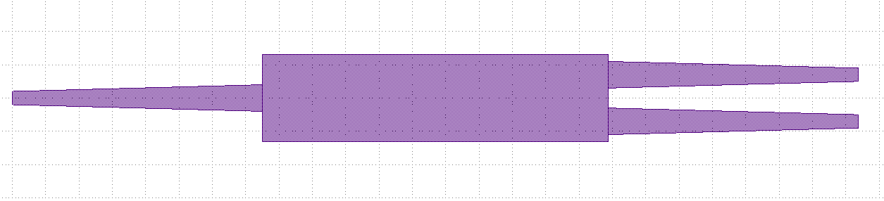
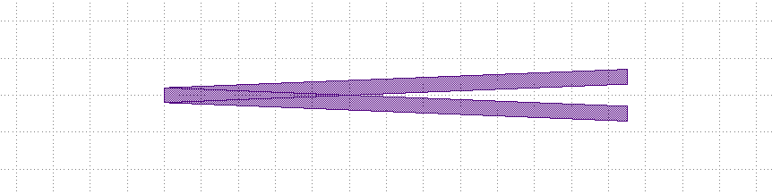
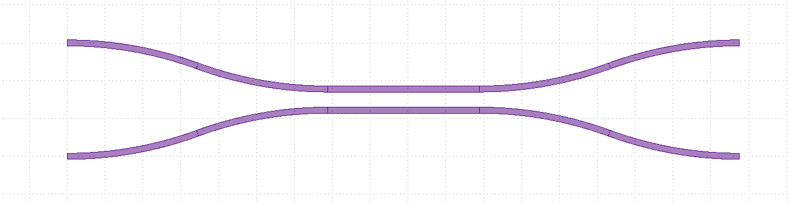
Coupler 1x2 in CouplerPDKCSEM.py
Multi mode interferometer (MMI)
Y-junction
Directional coupler

Slide 4
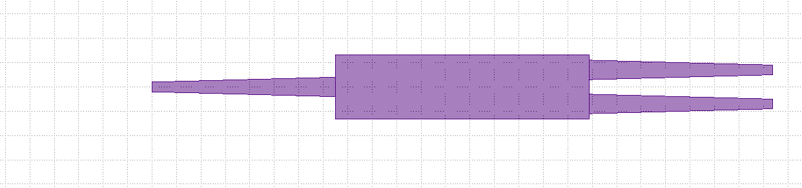
MMI
length_tapper
length
a0
waveguide_width
width_tapper
width
gap
b1
b0

Slide 5
Y-junction
length
b1
waveguide_width
gap
a0
b0

Slide 6
Directional coupler
a1
b1
length
gap
spacing
a0
b0
Waveguide_width
bend_type with radius
Extra_parameters | Default value | Descprition
bend_type | Bend.S_BEND | S_BEND, EULER
radius | Radius of the cross-section | Radius of the bend in um

Slide 7
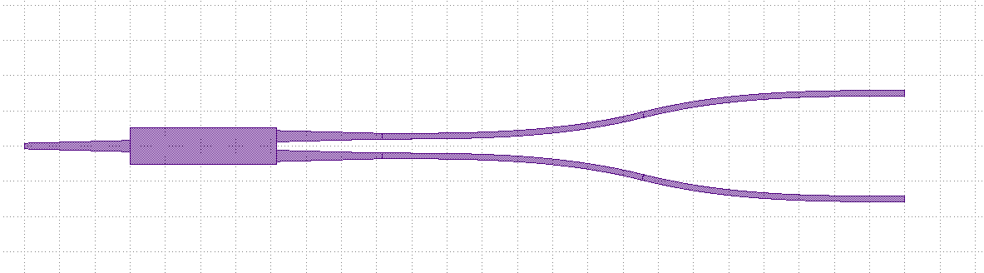
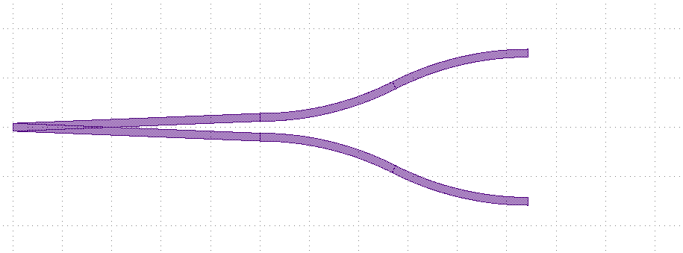
Extra-parameters for Coupler MMI/Y-Junction
bend_type and radius
b1
a0
spacing
Extra_parameters | Default value | Descprition
spacing | 0 | um
bend_type | Bend.S_BEND | S_BEND, EULER
radius | Radius of the cross-section | Radius of the bend in um
b0
MMI extra-parameters
bend_type and radius
b1
a0
spacing
b0
Y-Junction extra-parameters

Slide 8
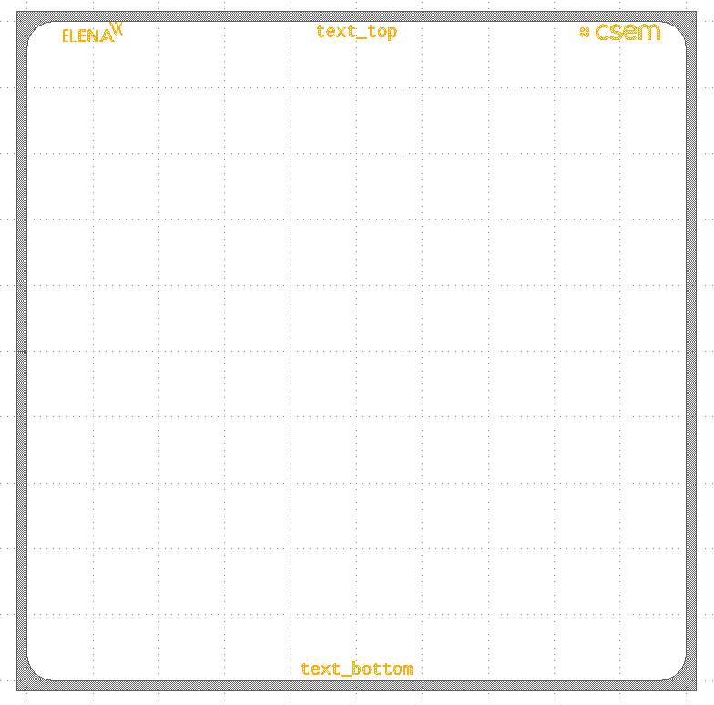
Border chip in BorderPDKCSEM.py
Extra_parameters | Default value | Descprition
chip_size_x | 5000 | um
chip_size_y | 5000 | um
extra_size | 150 | um
text_bottom | “”
text_top | “”
elena_logo_position | Border.Position.NONE | NONE, RIGHT, LEFT
csem_logo_position | Border.Position.NONE | NONE, RIGHT, LEFT
radius
text top
extra_size
chip_size_y
chip_size_x
text bottop

Slide 9
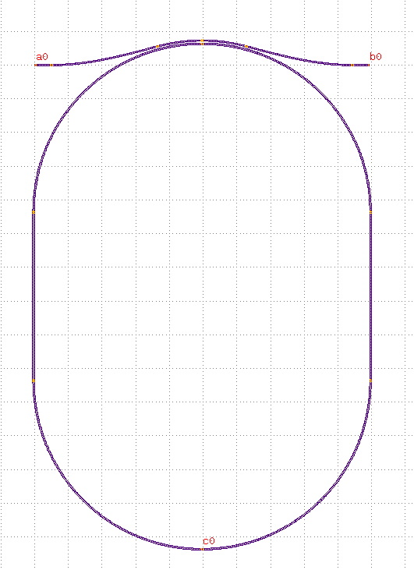
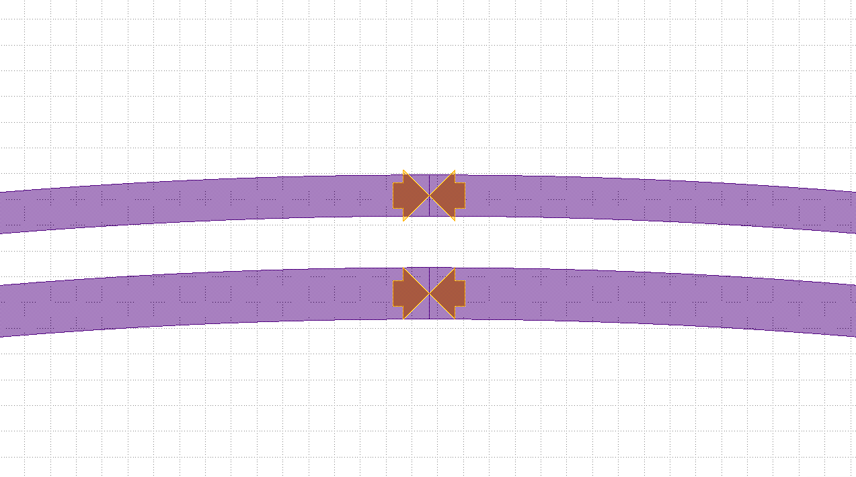
Resonator in ResonatorPDKCSEM.py
bus_wg_width
b0
a0
gap
Extra_parameters | Default value | Descprition
length_straight | 0 | um
angle | 0 | degree
bend | Bend.ARC | ARC, EULER
angle
resonator_wg_width
length_straight
radius

Slide 10
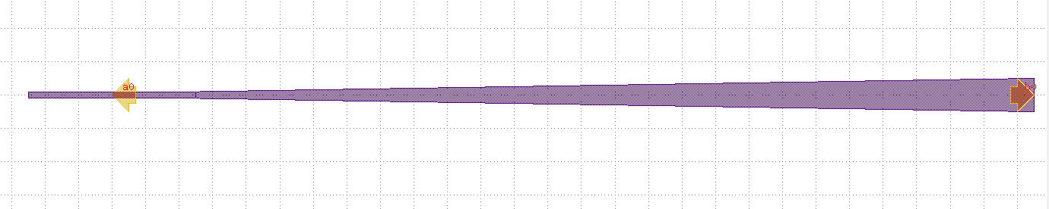
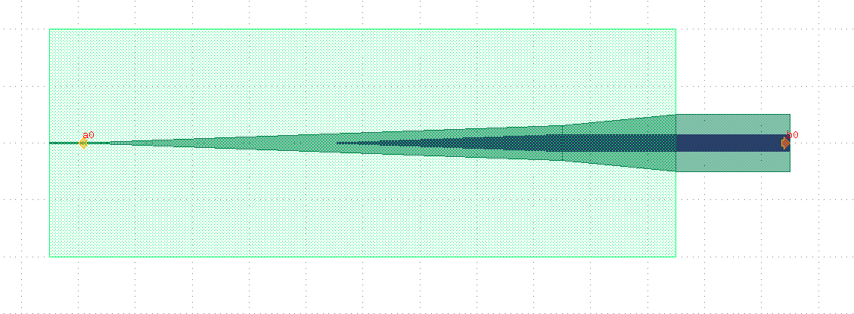
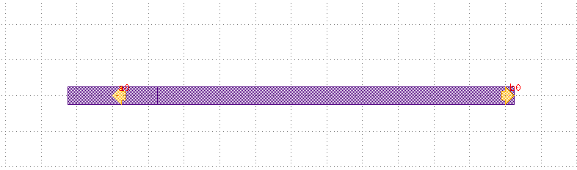
Edge coupler in EdgeCouplerPDKCSEM.py
Single Edge coupler
Double Edge coupler
None Edge coupler

Slide 11
Single Edge coupler
width
waveguide_width
b0
a0
length_front_extend
length
Extra_parameters | Default value | Descprition
length_front_straight | 5 | unit: um, the edge of the chip at the middle of its length

Slide 12
Double Edge coupler
window_open
width3
width2
waveguide_width
width1
  width_top_tapper
a0
b0
length_front_extend
length1
length2
length_back_extend
length3
Extra_parameters | Default value | Descprition
length_front_straight | 5 | unit: um, the edge of the chip at the middle of its length
Length_back_extend | 10 | um
Window_open | 50 | um

Slide 13
None Edge Coupler
waveguide_width
a0
b0
length_front_extend
length
Extra_parameters | Default value | Descprition
length_front_straight | 5 | unit: um, the edge of the chip at the middle of its length

Slide 14
Notes:
Contact slide

